Slide 1
Chapter 4
Energy and Metabolism
Starr, Biology Today and Tomorrow with Physiology, 6th Edition. © 2021 Cengage. All Rights Reserved. May not be scanned, copied or duplicated, or posted to a publicly accessible website, in whole or in part.

Slide 2
Chapter 4 Learning Objectives (1 of 2)
4.1 Application
4.2.1 Describe the concept that energy tends to disperse.
4.2.2 Explain why a chemical bond holds energy.
4.2.3 Use the first and second laws of thermodynamics to explain why the total amount of energy available for doing work in the universe always decreases.
4.3.1 Explain chemical bond energy.
4.3.2 Describe activation energy.
4.3.3 Explain how cells store and retrieve energy in organic molecules.
4.4.1 Explain enzyme specificity and how it arises.
4.4.2 Describe metabolic pathways and mechanisms that regulate them.
4.4.3 Explain how cells use electron transfer chains.
4.4.4 Describe the role of ATP in a cell’s energy economy.

Slide 3
Chapter 4 Learning Objectives (2 of 2)
4.5.1 Name three factors that influence the rate and direction of diffusion.
4.5.2 Explain selective permeability in terms of lipid bilayers.
4.5.3 Describe the relationship between osmosis and turgor pressure in cells.
4.6.1 Explain why a cell requires transport proteins in its plasma membrane.
4.6.2 Use appropriate examples to describe the way transport proteins selectively move molecules across membranes.
4.6.3 Explain why active transport requires energy and passive transport does not.
4.6.4 Describe the mechanisms by which cells take in and expel materials in bulk.

Slide 4
4.1 A Toast to Alcohol Dehydrogenase
Binge drinking is one of the most serious problems on college campuses.
Alcohol dehydrogenase (ADH), helps break down ethanol and other toxic compounds.
Ethanol and its breakdown products damage liver cells, leading to alcoholic hepatitis or cirrhosis of the liver.
Liver unable to keep up with excessive drinking may lead to fatty liver disease.

Slide 5
4.2 Life Runs on Energy
Energy
  The capacity to do work
Work occurs as a result of energy transfers.
  Example: A plant cell powers glucose synthesis by absorbing light energy from the sun.
Some energy is lost during every transfer or conversion.

Slide 6
Laws of Thermodynamics
First law of thermodynamics
  Energy cannot be created or destroyed.
  Energy can be converted from one form to another and transferred between objects or systems.
Second law of thermodynamics
  Energy tends to disperse spontaneously.
  Some energy disperses at each energy transfer, usually in the form of heat.

Slide 7
One-Way Flow of Energy
Living things maintain their organization by harvesting energy from someplace else.
Energy flows in one direction through the biosphere (starting mainly from the sun) then into and out of ecosystems.
Energy in chemical bonds is a type of potential energy.

Slide 8
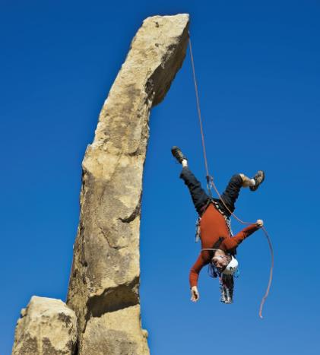
Potential Energy
Notes:
Figure 4.3 Illustration of potential energy.
By opposing gravity’s downward pull, the rope attached to the rock keeps this man from falling. Similarly, a chemical bond that joins two atoms keeps them from flying apart.

Slide 9
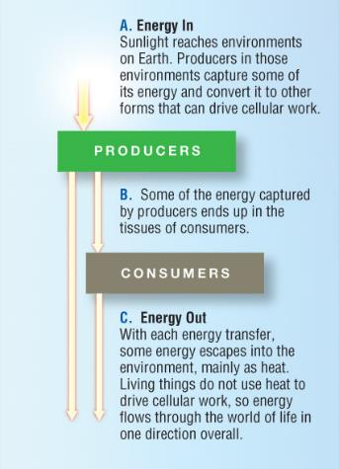
Energy Flow in the World
Notes:
Figure 4.5 The flow of energy through the world of life.
Energy (yellow arrows) flows from the environment into living organisms, then to the environment.

Slide 10
4.3 Energy in the Molecules of Life
Cells store and retrieve energy in metabolic reactions.
Some reactions require a net input of energy—others end with a net release of energy.
Reaction
  Process of chemical change
Reactant
  Molecule that enters a reaction
Product
  A molecule remaining at the end of a reaction

Slide 11
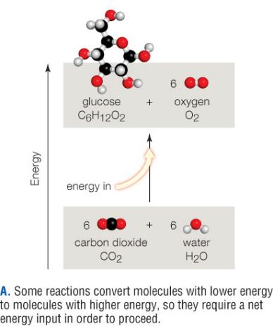
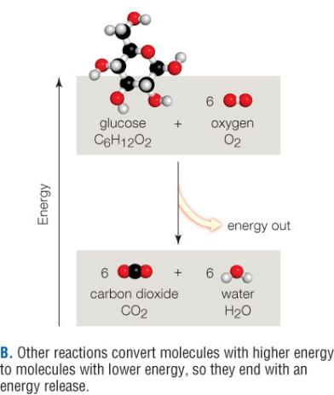
Energy Inputs and Outputs in Chemical Reactions
Notes:
Figure 4.7 The ins and outs of energy in chemical reactions.
A. Some reactions convert molecules with lower energy to molecules with higher energy, so they require a net energy input in order to proceed.
B. Other reactions convert molecules with higher energy to molecules with lower energy, so they end with an energy release.

Slide 12
Why the Earth Doesn’t Go Up in Flames
Molecules of life release energy when combined with oxygen, but not spontaneously—energy is required to start even energy-releasing reactions.
Activation energy
  Minimum amount of energy required to start a reaction

Slide 13
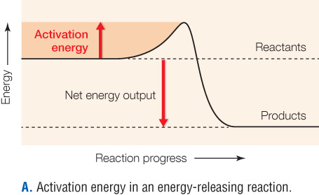
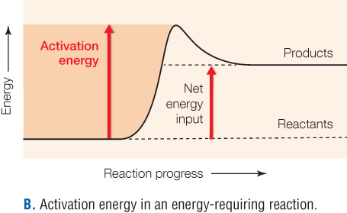
Activation Energy
Notes:
Figure 4.8 Activation energy.
In graphs that show energy changes during a reaction, activation energy is an energy hill. Activation energy prevents a reaction from starting spontaneously.

Slide 14
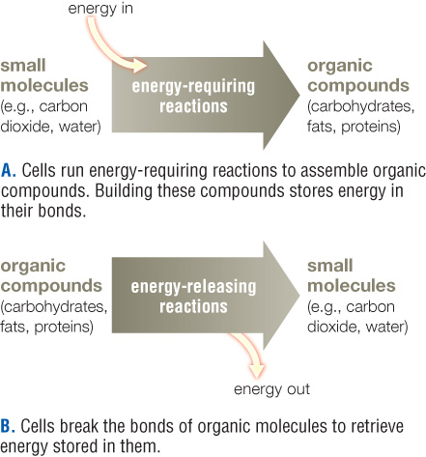
Energy In, Energy Out
Notes:
Figure 4.9 Cells store and retrieve energy in the chemical bonds of organic molecules.
A. Cells run energy-requiring reactions to assemble organic compounds. Building these compounds stores energy in their bonds.
B. Cells break the bonds of organic molecules to retrieve energy stored in them.

Slide 15
4.4 Enzymes and Metabolic Pathways
Enzyme
  Protein or RNA that speeds a reaction without being changed by it
  Makes a reaction run much faster than it would on its own
    Reduces activation energy
Substrate
  Reactant molecule specifically acted upon by an enzyme
  An enzyme’s particular substrates bind at the active site

Slide 16
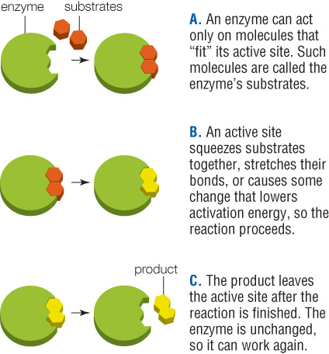
How an Active Site Works
Notes:
Figure 4.11 The active site.
An active site is a pocket in an enzyme where substrates bind and the reaction occurs. For simplicity, enzymes and their active sites are often depicted as blobs or geometric shapes.

Slide 17
Factors That Influence Enzyme Activity
Each enzyme works best within a characteristic range of temperature, pH, and salt concentration.
When conditions break hydrogen bonds, an enzyme changes its characteristic shape (denatures); and stops working.
Regulatory molecules affect an enzyme by binding directly to its active site; or elsewhere on the enzyme.

Slide 18
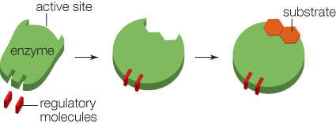
Regulatory Molecule Binding to Enzymes
Notes:
Figure 4.14 Regulatory molecule binding to enzymes.
Specific ions or molecules that bind to an enzyme change its shape in a way that enhances or inhibits its activity.

Slide 19
Cofactors
Metal ions or coenzymes that associate with an enzyme and are necessary for its function
  Example: many dietary vitamins and minerals
Coenzyme
  An organic cofactor
  Unlike enzymes, it may be modified by a reaction
  Example: coenzyme NAD⁺ + electrons + H → NADH

Slide 20
ATP and Phosphorylation
ATP functions as a coenzyme in many reactions.
When a phosphate group is transferred to or from a nucleotide, energy is transferred along with it.
Phosphate-group transfers (phosphorylation) to and from ATP couple energy-releasing reactions with energy-requiring ones.

Slide 21
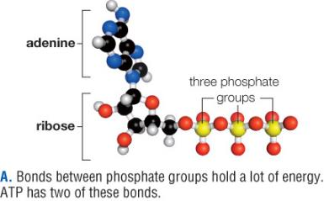
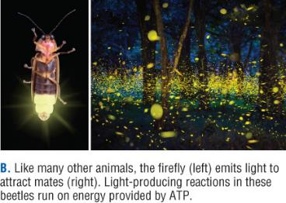
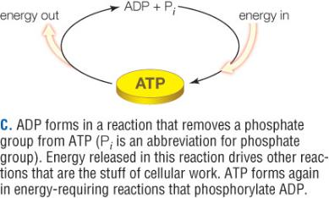
ATP as an Energy Carrier
Notes:
Figure 4.15 The nucleotide ATP, an important energy currency in a cell’s metabolism.
Bonds between phosphate groups hold a lot of energy. ATP has two of these bonds
Like many other animals, the ﬁreﬂy (left) emits light to attract mates (right). Light-producing reactions in these beetles run on energy provided by ATP.
ADP forms in a reaction that removes a phosphate group from ATP (Pi is an abbreviation for phosphate group). Energy released in this reaction drives other reactions that are the stuff of cellular work. ATP forms again in energy-requiring reactions that phosphorylate ADP.

Slide 22
Metabolic Pathways
Cells concentrate, convert, and dispose of most substances in enzyme-mediated reaction sequences.
Metabolic pathway
  Series of enzyme-mediated reactions by which cells build, remodel, or break down an organic molecule

Slide 23
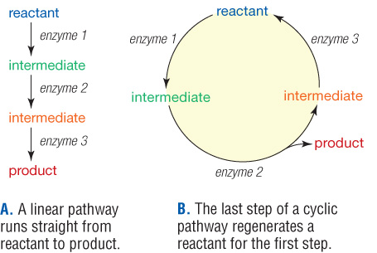
Linear and Cyclic Metabolic Pathways
Notes:
Figure 4.16 Linear and cyclic metabolic pathways
A linear pathway runs straight from reactant to product.
The last step of a cyclic pathway regenerates a reactant for the ﬁrst step.

Slide 24
Controlling Metabolism
Various controls over enzymes allow cells to conserve energy and resources by producing only what they require
  Concentrations of reactants and products
  Feedback inhibition
Feedback inhibition
  Mechanism by which a change that results from some activity decreases or stops the activity

Slide 25

Feedback Inhibition
Notes:
Figure 4.17 Feedback inhibition.
In this example, two enzymes act in sequence to convert a substrate to a product. the product inhibits the activity of the first enzyme.

Slide 26
Electron Transfers
Electron transfer chains allow cells to harvest energy in manageable increments
Electron transfer chain
  An array of membrane-bound enzymes and other molecules that accept and give up electrons in sequence

Slide 27
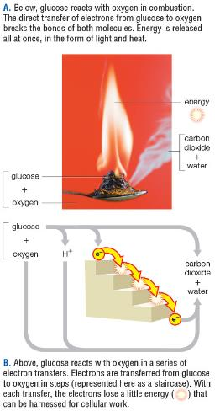
Controlled Energy Release
Notes:
Figure 4.18 Comparing uncontrolled (a) and controlled (B) energy release.
Below, glucose reacts with oxygen in combustion. The direct transfer of electrons from glucose to oxygen breaks the bonds of both molecules. Energy is released all at once, in the form of light and heat.
Above, glucose reacts with oxygen in a series of electron transfers. Electrons are transferred from glucose to oxygen in steps (represented here as a staircase). With each transfer, the electrons lose a little energy that can be harnessed for cellular work.

Slide 28
4.5 Diffusion across Membranes
Diffusion
  Spontaneous spreading of molecules or ions through a liquid or gas

Slide 29
Diffusion Rate
How quickly a particular solute diffuses through a particular solution depends on five factors:
  Concentration
  Temperature
  Size
  Charge
  Pressure

Slide 30
Semipermeable Membranes
When fluids on either side of a selectively permeable membrane differ in solute concentration, water diffuses across the membrane in a direction that depends on tonicity:
  Hypotonic: low solute concentration relative to another fluid
  Hypertonic: high solute concentration relative to another fluid
  Isotonic: same solute concentration relative to another fluid

Slide 31
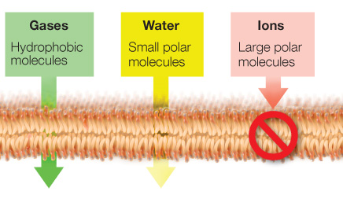
Selective Permeability of Lipid Bilayers
Notes:
Figure 4.20 Selective permeability of lipid bilayers.
Water and other small polar molecules can diffuse through a lipid bilayer, but less freely than hydrophobic molecules and gases. A lipid bilayer is completely impermeable to ions and large polar molecules.

Slide 32
Osmosis (1 of 2)
Osmosis
  Diffusion of water across a selectively permeable membrane between two fluids that are not isotonic
If extracellular fluid is not isotonic, cell volume changes
  Cells in hypertonic fluid shrink
  Cells in hypotonic fluid swell

Slide 33
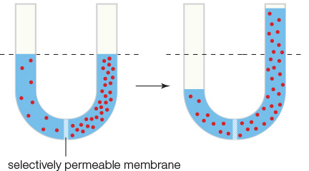
Osmosis (2 of 2)
Notes:
Figure 4.21 Osmosis.
A membrane separates two fluids of differing solute concentration. the membrane is selectively permeable: water can cross it, but the solute (red dots) cannot. the fluid volume changes in the two compartments as water diffuses through the membrane from the hypotonic solution to the hypertonic one.

Slide 34
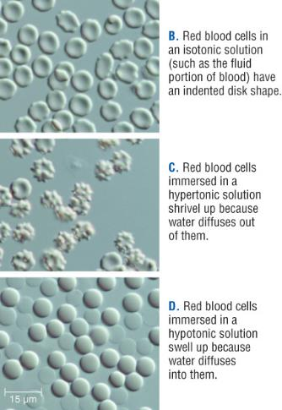
Effects of Tonicity in Human Red Blood Cells
Notes:
Figure 4.22 Effects of tonicity.
Like a selectively permeable bag filled with a solution of sucrose and water (a), red blood cells have no mechanism to compensate for osmosis (B–D).

Slide 35
Osmosis and Turgor
In plant cells, turgor counters osmosis.
Turgor
  Pressure that a fluid exerts against a wall, membrane, or other structure that contains it
Osmosis continues until two fluids are isotonic, or until pressure against the hypertonic fluid counters the movement.

Slide 36
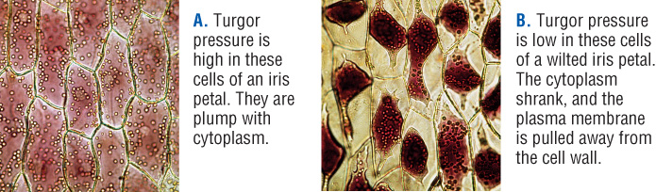
Effects of Tonicity in Plant Cells
Notes:
Figure 4.23 Osmotic pressure keeps plant parts erect.
Turgor pressure is high in these cells of an iris petal. They are plump with cytoplasm.
Turgor pressure is low in these cells of a wilted iris petal. The cytoplasm shrank, and the plasma membrane is pulled away from the cell wall.

Slide 37
4.6 Membrane Transport Mechanisms
Gases, water, and small nonpolar molecules can diffuse across a lipid bilayer.
Most other molecules and ions cross only with the help of transport proteins.
Each type of transport protein moves a specific ion or molecule across a membrane.

Slide 38
Passive and Active Transport
Passive transport
  Concentration gradient drives a solute across a cell membrane through a transport protein.
  It requires no energy input.
  Example: glucose transporters
Active transport
  A transport protein uses energy (ATP) to pump a solute across a cell membrane against its concentration gradient.
  Example: calcium pump

Slide 39
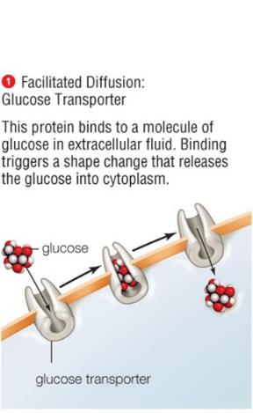
Passive Transport of Glucose
Notes:
Figure 4.24 Examples of membrane-crossing mechanisms.
Facilitated Diffusion: Glucose Transporter

Slide 40
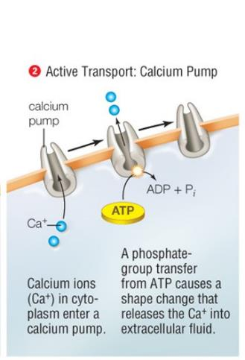
Active Transport of Calcium Ions
Notes:
Figure 4.24 Examples of membrane-crossing mechanisms.
2. Active Transport: Calcium Pump

Slide 41
Membrane Trafficking (1 of 2)
Endocytosis
  Process by which a cell takes in a small amount of extracellular fluid by a ballooning inward of its cellular membrane
Exocytosis
  Process by which a cell expels a vesicle’s contents to extracellular fluid by merging the vesicle with the plasma membrane

Slide 42
Membrane Trafficking (2 of 2)
Phagocytosis (“cell eating”)
  Endocytic pathway by which cells such as macrophages and other white blood cells engulf particles such as microbes or cellular debris

Slide 43
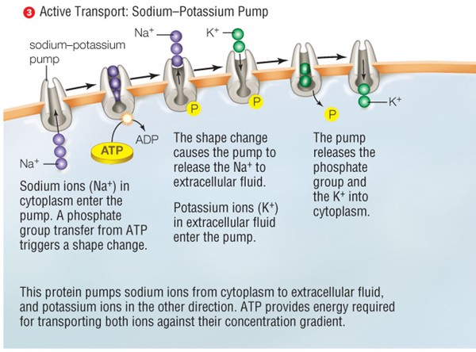
Membrane Crossings
Notes:
Figure 4.24 Examples of membrane-crossing mechanism.

Slide 44
Membrane-Crossing Mechanisms
Simple diffusion: Noncharged molecules pass between phospholipids to enter/exit the cell (high concentration to low concentration)
Osmosis: type of simple diffusion; water molecules move through selectively permeable membrane
Facilitated diffusion: movement through protein channels in the cell membrane
Active transport: movement across membrane against concentration gradient; requires ATP

Slide 45
Points to Ponder
Testosterone supplements have been used by athletes for some time.
  Why do athletes use them?
  Why use testosterone instead of estrogen?
Should the cause of liver failure be used as a factor to prioritize the liver transplant wait list? Why or why not?
What is the alcohol flushing reaction? Why does this occur when drinking alcoholic beverages?

