Slide 1
Chapter 14
Prokaryotes, Protists, and Viruses
Starr, Biology Today and Tomorrow with Physiology, 6th Edition. © 2021 Cengage. All Rights Reserved. May not be scanned, copied or duplicated, or posted to a publicly accessible website, in whole or in part.

Slide 2
Chapter 14 Learning Objectives (1 of 2)
14.1 Application
14.2.1 Describe conditions on the early Earth.
14.2.2 List three possible sources for the organic building blocks of Earth’s first life.
14.2.3 Describe the proposed steps that led to the first cellular life.
14.3.1 Describe the likely characteristics of the last common ancestor of all life.
14.3.2 Explain how scientists discovered that there are two prokaryotic domains.
14.3.3 Describe some fossils of early life and the habitats in which they formed.
14.3.4 Explain the role of prokaryotic cells in the oxygenation of Earth’s atmosphere and the biological consequences of the increase in oxygen.
14.4.1 List some structural and functional traits shared by bacteria and archaea.
14.4.2 Describe how prokaryotic cells reproduce, and the mechanisms by which they can share genes.
14.4.3 Explain the roles bacteria play in ecosystems.
14.4.4 Using appropriate examples, explain how bacteria affect human health.
14.4.5 Describe two extreme habitats in which archaea are found.

Slide 3
Chapter 14 Learning Objectives (2 of 2)
14.5.1 Describe the process by which nucleus likely evolved.
14.5.2 Explain why some components of eukaryotes are similar to archaea and others are similar to bacteria.
14.6.1 Give examples of single-celled, colonial, and multicellular protists.
14.6.2 Describe the ecological roles played by protists.
14.6.3 List some human diseases caused by protists and describe the protists that cause them.
14.6.4 Describe the protist group that is most closely related to plants and the group that is most closely related to animals.
14.7.1 Explain how viruses replicate.
14.7.2 Compare the structure of a bacteriophage and the human immunodeficiency virus (HIV).
14.7.3 Explain how new combinations of viral genes can arise.

Slide 4
14.1 The Human Microbiota
Microbiome
  These are the types of microorganisms supported by humans.
  Most are harmless or beneficial to humans.
  A small minority are human pathogens.
The current mix of species in and on you depends on a variety of factors, such as diet, and that in turn affects your health.
  Example: A diet rich in grains selects for species such as Prevotella copri, which is associated with rheumatoid arthritis.

Slide 5
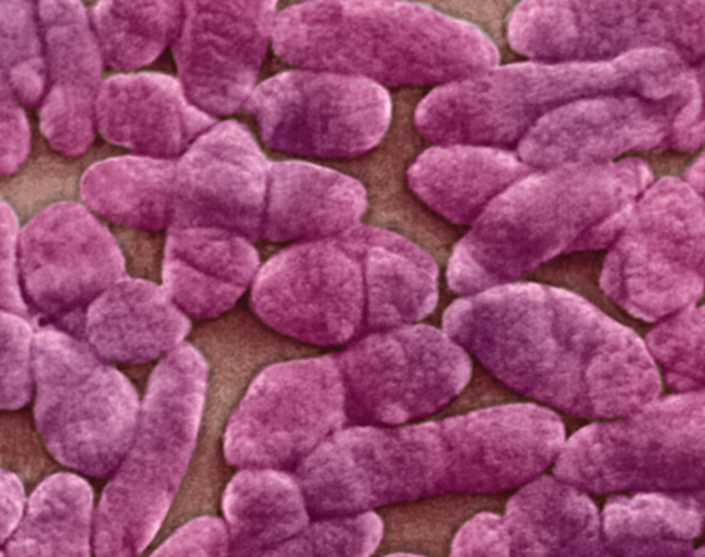
Human Intestinal Bacteria
Notes:
Figure 14.1 Human intestinal bacteria.
Bilophila wadsworthia is a species most abundant in people who eat a lot of animal fat.

Slide 6
14.2 Origin of Cellular Life
Earth’s early atmosphere likely contained water vapor, carbon dioxide, hydrogen, and nitrogen—but no oxygen gas.
Oxygen gas is reactive—if it had been present, complex compounds could not have formed and persisted.

Slide 7
Origin of the Building Blocks of Life
Lightning-fueled atmospheric reactions
  1950s: Stanley Miller produced organic compounds from a mixture of gases in a spark chamber.
Delivery from space via meteorites
  Amino acids, sugars, and nucleotide bases have been found in meteorites that fell to Earth.
Reactions at deep-sea hydrothermal vents
  Amino acids form spontaneously in a simulated vent environment.

Slide 8
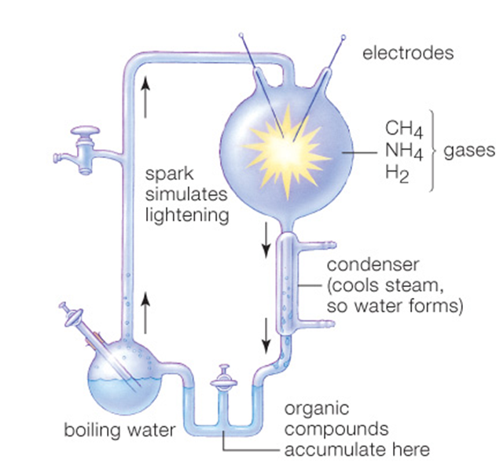
Lightning-Fueled Reactions
Notes:
Figure 14.2 Stanley Miller’s experimental apparatus.
It was used to test whether lightning-fueled reactions could have formed organic monomers in Earth’s early atmosphere. Water vapor, hydrogen gas (H₂), methane (CH₄), and ammonia (NH₄) circulated in a glass chamber to simulate the atmosphere. Sparks provided by an electrode simulated lightning.

Slide 9
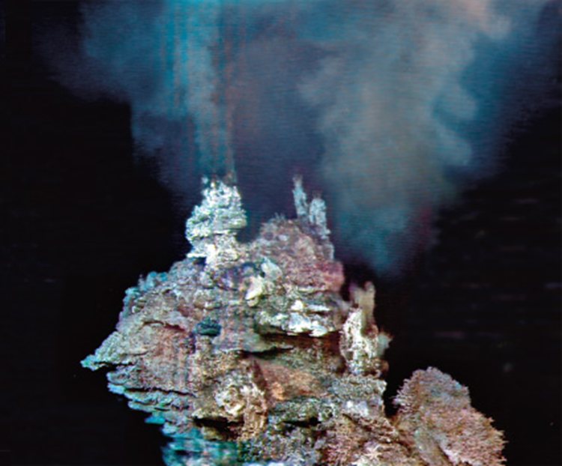
Reactions at Hydrothermal Vents
Notes:
Figure 14.3 A hydrothermal vent on the seafloor.
At such vents, mineral-rich water heated by geothermal energy streams out into cold ocean water.

Slide 10
Origin of Metabolism
Organic polymers may have formed on clay-rich tidal flats.
  Positively charged organic molecules stick to negatively charged clay particles on tidal flats, and become concentrated by evaporation.
Iron–sulfur world hypothesis
  Early metabolic reactions may have taken place on the surface of rocks rich in iron sulfide near deep-sea hydrothermal vents.

Slide 11
Origin of Genetic Material
DNA is the genetic material in modern cells, but self-replicating ribozymes (RNA) may have stored the first genetic material.
RNA world hypothesis
  RNA may have served as the first material of inheritance.
  RNA served a dual role, as a genome and as a catalyst.

Slide 12
Origin of Cell Membranes
Laboratory simulations show how fatty acid membranes enclosing RNA might have formed on early Earth.
Protocell
  A membrane-enclosed collection of interacting molecules that can take up material and replicate
  Possible ancestors of cellular life

Slide 13
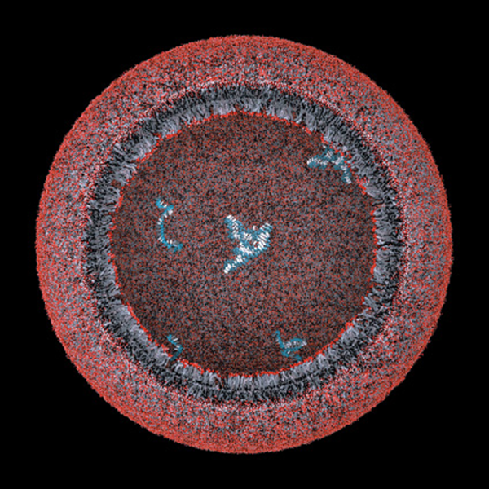
Laboratory-Produced Protocell
Notes:
Figure 14.4 Illustration of a laboratory-produced protocell.
A bilayer membrane of fatty acids encloses strands of RNA.

Slide 14
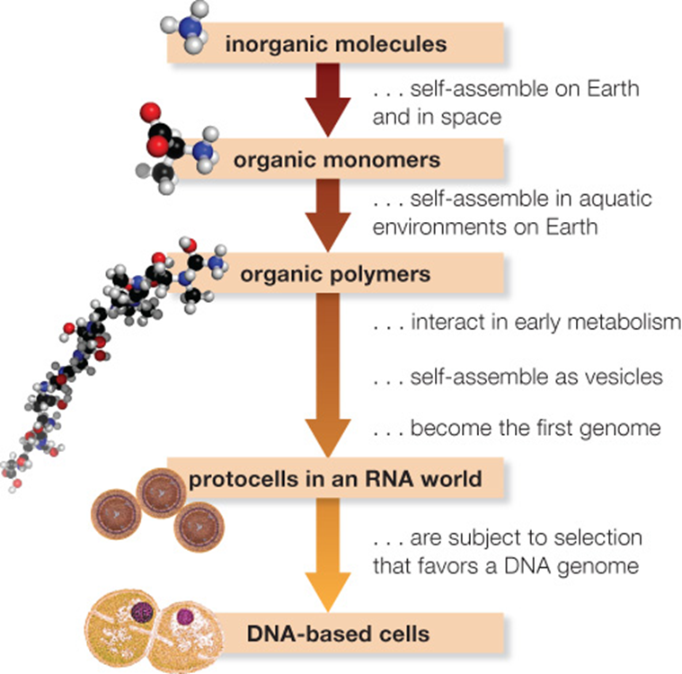
Proposed Sequence for Evolution of Cells
Notes:
Figure 14.5 Proposed sequence for the evolution of cells.
Scientists carry out experiments and simulations that test the feasibility of each step.

Slide 15
14.3 Early Life
Evidence of early life:
  Comparing genes of living organisms indicates that the common ancestor of all organisms lived about 4 billion years ago.
Stromatolites
  Earliest fossil cells are found in rocks that date to about 3.5 billion years ago.
Notes:
Figure 14.8 Modern stromatolites in Australia’s Shark Bay.

Slide 16
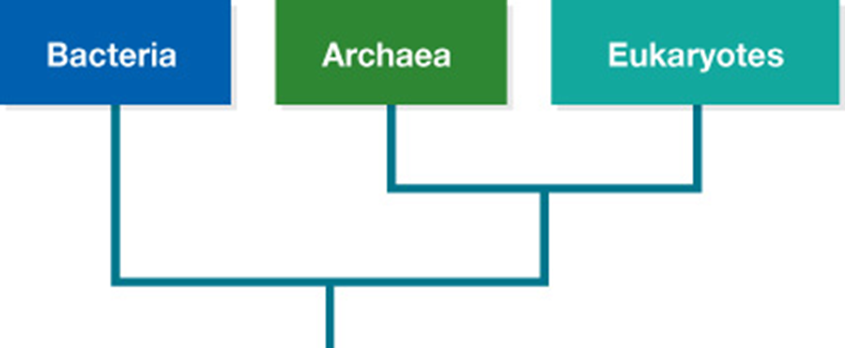
The Three Domains
Notes:
Figure 14.6 The three-domain classification system.

Slide 17
14.4 Modern Bacteria and Archaea
Prokaryotes constitute two distinct lineages.
Bacteria
  Well-known and widespread group of cells that do not have a nucleus
Archaea
  More closely related to eukaryotes than to bacteria
  Many types live in extreme habitats
  No nucleus

Slide 18
Origin of Bacteria and Archaea
Bacteria and Archaea diverged about 3.5 billion years ago.
  About 2.7 billion years ago, one lineage of bacteria (cyanobacteria) began to carry out photosynthesis by the oxygen-releasing pathway.
Oxygen then accumulated in the air and water.
  It provided a selective pressure for oxygen-thriving organisms to spread.
  Ozone gas then formed and accumulated as the ozone layer.

Slide 19
Structure and Function
Typical bacterial cell
  No nucleus or other organelles
  Cytoplasm contains ribosomes and a single, circular prokaryotic chromosome (DNA).
  Cell wall gives the cell a characteristic shape (coccus, spirillum, bacillus).
  Cell wall may be covered with a secreted capsule.
  Bacterial flagella or pili allow cells to move.

Slide 20
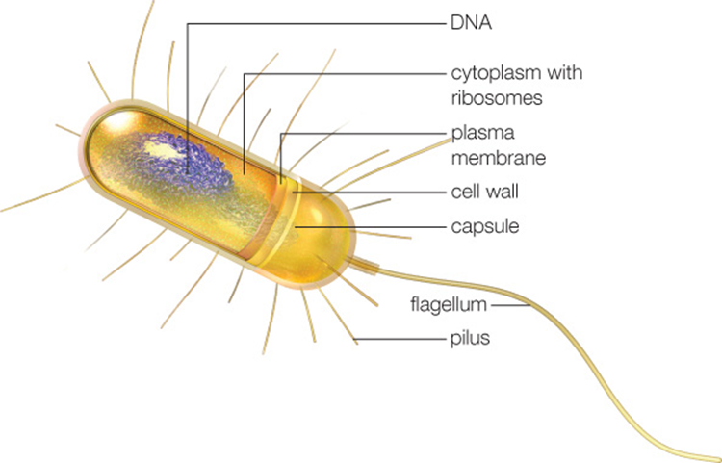
Generalized Prokaryotic Body Plan
Notes:
Figure 14.9 Generalized structure of a prokaryotic cell.

Slide 21
Reproduction and Gene Transfers
Binary fission
  Asexual reproduction that forms two identical descendant cells
Conjugation
  Transfers a small ring of nonchromosomal DNA (plasmid) to another individual through a sex pilus
Transformation
  Takes up DNA from its environment
Transduction
  Viruses move genes from one host cell to another

Slide 22
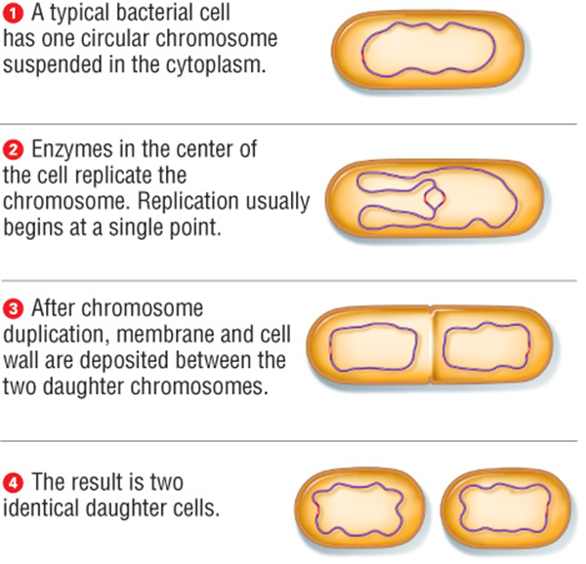
Process of Binary Fission
Notes:
Figure 14.10 Asexual reproduction by binary fission.
A typical bacterial cell has one circular chromosome suspended in the cytoplasm.
Enzymes in the center of the cell replicate the chromosome. Replication usually begins at a single point.
After chromosome duplication, membrane and cell wall are deposited between the two daughter chromosomes.
The result is two identical daughter cells.

Slide 23
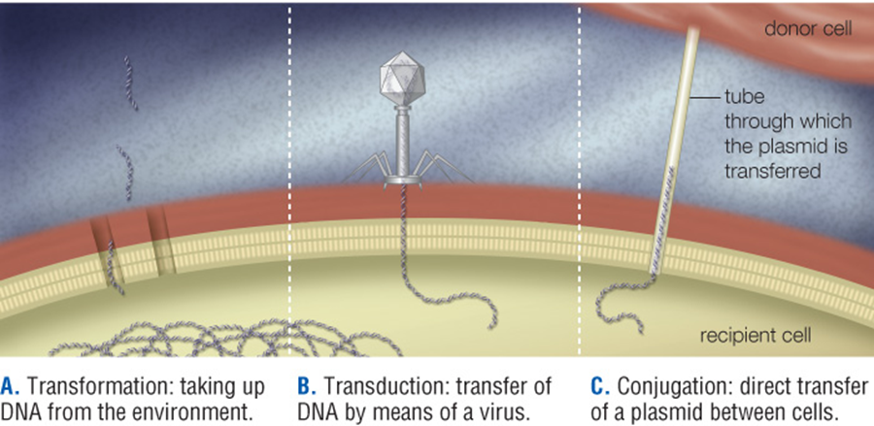
Binary Fission and Gene Exchange
Notes:
Figure 14.11 Mechanisms of gene exchange between prokaryotic cells.
Transformation: taking up DNA from the environment.
Transduction: transfer of DNA by means of a virus.
Conjugation: direct transfer of a plasmid between cells.

Slide 24
Metabolic Diversity (1 of 2)
Autotrophs obtain carbon from carbon dioxide (CO₂).
  Photoautotrophs use light energy.
  Chemoautotrophs remove electrons from inorganic molecules such as hydrogen sulfide or methane.

Slide 25
Metabolic Diversity (2 of 2)
Heterotrophs obtain carbon from organic molecules.
  Photoheterotrophs get energy from light, and carbon from small organic molecules.
  Chemoheterotrophs obtain both energy and carbon by breaking down carbohydrates, lipids, and proteins.
  Decomposers break down organic molecules into inorganic ones.

Slide 26
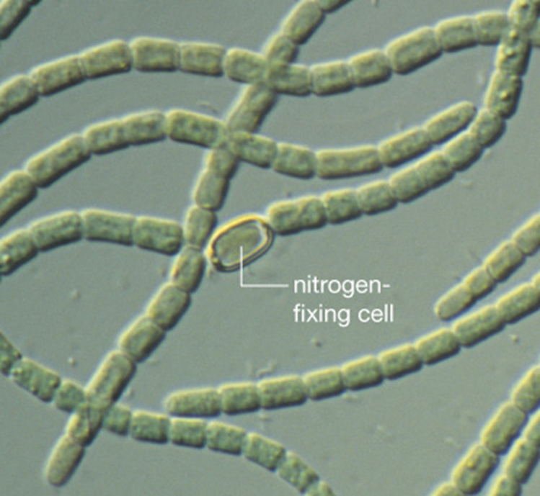
Aquatic Cyanobacteria
Notes:
Figure 14.12 Aquatic cyanobacteria.
This species grows as long chains of cells connected by a secreted mucous sheath. Some cells in the chain are specialized for nitrogen fixation.

Slide 27
Domain Bacteria
Photosynthetic bacteria (cyanobacteria)
  Release oxygen into the atmosphere
  Nitrogen-fixing bacteria make nitrogen available to photosynthesizers by nitrogen fixation.
    Nitrogen and hydrogen combine to form ammonia.
Decomposers break organic material into inorganic subunits.
  Recycles nutrients in wastes and remains
  Includes lactate fermenters
Bacteria also cause many common diseases.

Slide 28
Examples of Bacterial Diseases
Disease | Description
Whooping cough | Childhood respiratory disease
Tuberculosis | Respiratory
Impetigo, boils | Blisters, sores on skin
Strep throat | Sore throat, can damage heart
Cholera | Diarrheal illness
Syphilis | Sexually transmitted disease
Gonorrhea | Sexually transmitted disease
Chlamydia | Sexually transmitted disease
Lyme disease | Rash, ﬂulike symptoms, spread by ticks
Botulism, tetanus | Muscle paralysis by bacterial toxin
Notes:
Table 14.1 Examples of Bacterial Diseases

Slide 29
Domain Archaea
Extreme thermophiles
  Organisms that live in very high-temperature environments such as hydrothermal vents
Extreme halophiles
  Organisms that live in high salt concentrations, such as in a California lake
Methanogens
  Anaerobic organisms that produce methane gas
  Live in swamps, sediments, and animal guts

Slide 30
14.5 Origin of Eukaryotes
Eukaryotes first appeared in the fossil record about 1.8 billion years ago.
The nucleus and endomembrane system probably evolved from infoldings of the plasma membrane.
Some eukaryotic organelles (mitochondria and chloroplasts) may have evolved from bacteria by endosymbiosis.

Slide 31
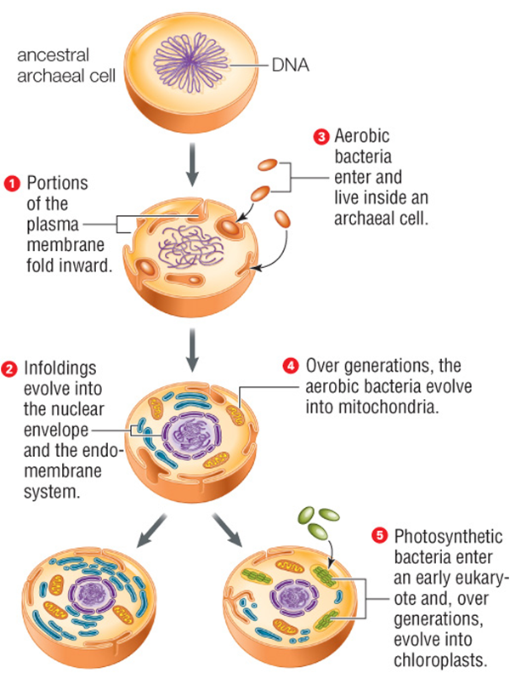
Evolution of Eukaryotic Organelles
Notes:
Figure 14.15 Evolution of eukaryotic organelles.
The nuclear envelope and endomembrane components are derived from infoldings of the plasma membrane. Mitochondria and chloroplasts evolved from bacteria that lived inside a host cell.

Slide 32
14.6 Protists
A eukaryote that is not a fungus, plant, or animal
Now being assigned to groups that reflect evolutionary relationships
  Most are single-celled, but some are multicelled species.
  Nearly all live in water or moist habitats, including host tissues.

Slide 33
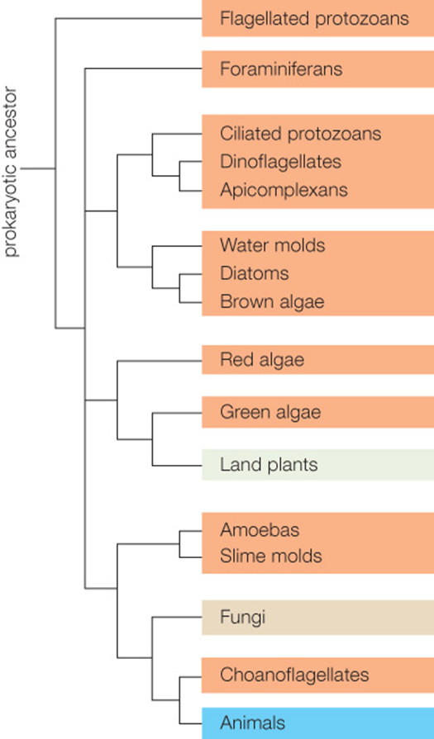
Evolutionary Tree for the Eukaryotes
Notes:
Figure 14.16 Evolutionary tree for the eukaryotes.
Orange boxes indicate the protist lineages.

Slide 34
Flagellated Protozoans (1 of 2)
Heterotrophic lineage of unwalled, single-celled protists that have one or more flagella
  A layer of proteins (pellicle) below the cell membrane provides shape.
Both free-living and parasitic species

Slide 35
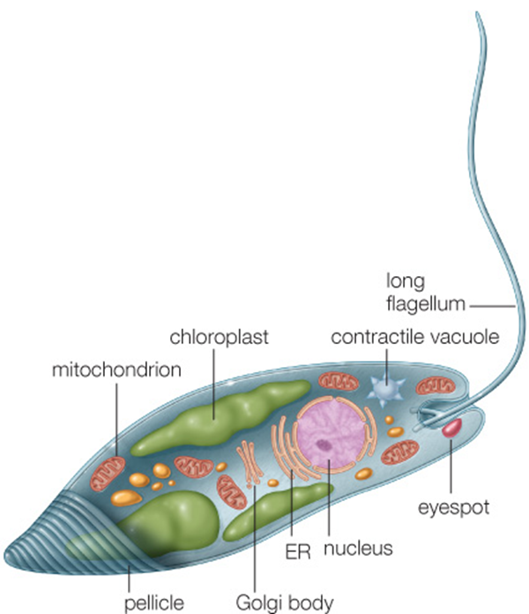
Flagellated Protozoans (2 of 2)
Notes:
Figure 14.17 Euglena, a freshwater flagellated protozoan.
The species depicted here has chloroplasts that evolved from a green alga.

Slide 36
Foraminiferans
Single-celled predators that secrete calcium carbonate shells
  Remains contribute to limestone and chalk
  Planktonic forams may have photosynthetic protists living in their cytoplasm.
Plankton
  Community of tiny drifting or swimming organisms
Notes:
Figure 14.18 A planktonic foraminiferan.
The yellow dots are algae that live in its cytoplasm.

Slide 37
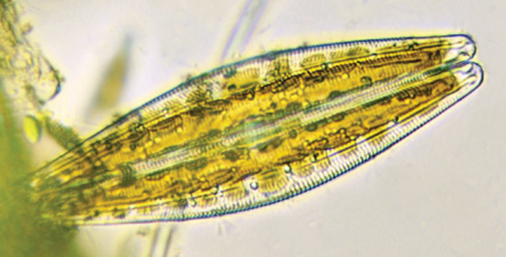
Diatoms
Nonmotile
Single-celled
Photosynthetic protist
Secretes two-part silica shell
Notes:
Figure 14.19 Diatom.
Chloroplasts are visible through the cell’s silica shell.

Slide 38
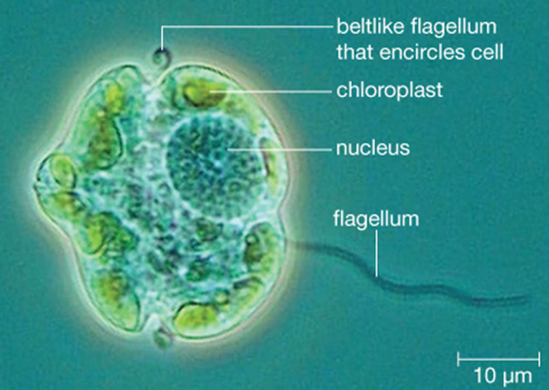
Dinoflagellates
Aquatic single cells that move with a whirling motion
  Typically have cellulose plates and two flagella
  May be heterotrophic or photosynthetic
  Some are bioluminescent: light-producing
Notes:
Figure 14.20 Photosynthetic dinoflagellate.

Slide 39
Dinoflagellates and Algal Blooms
Algal bloom
  Population explosion of single-celled aquatic organisms such as dinoflagellates
  Caused by nutrient-enriched water
  Depletes oxygen and suffocates aquatic animals
  Some dinoflagellates produce toxins that sicken people and directly kill aquatic organisms.

Slide 40
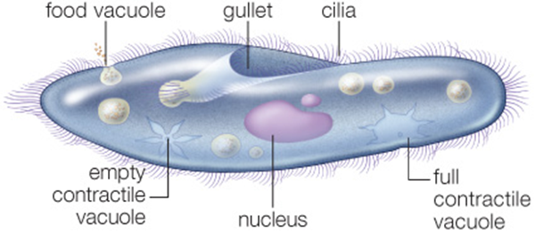
The Ciliates
Single-celled heterotrophs that use cilia to move and feed
  Most ciliates are predators in seawater or fresh water.
  Some live in guts of mammalian grazers and help their host digest plant material.
Notes:
Figure 14.21 The freshwater ciliate Paramecium.

Slide 41
Amoebas
Single-celled heterotrophic amoebozoans that move and feed by extending pseudopods
  Live in aquatic habitats and animal bodies
  Some cause human disease.
Example: Entamoeba histolytica

Slide 42
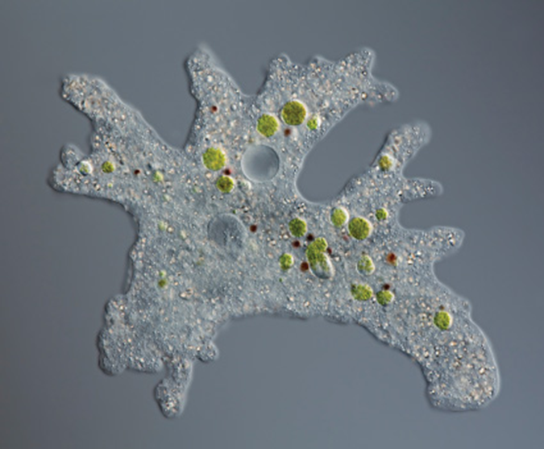
Freshwater Amoeba
Notes:
Figure 14.22 Amoeba proteus, a freshwater amoeba.

Slide 43
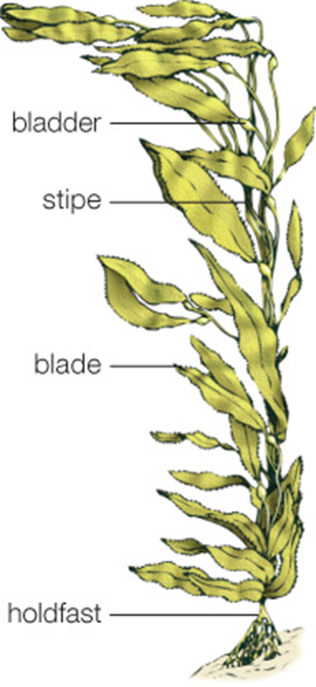
Brown Algae
Multicellular photosynthetic protists
Live mainly in temperate and cool seas
Close relative of diatoms
Example: giant kelp
Notes:
Figure 14.23 Structure of a giant kelp.

Slide 44
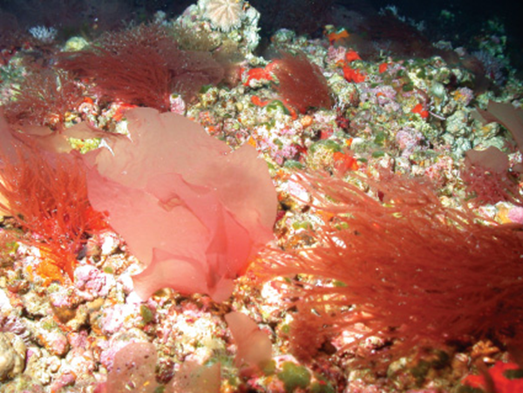
Red Algae
Single-celled or multicelled photosynthetic protists with red accessory pigments (phycobilins) that allow them to live at great depths
Red algae have many commercial uses.
  Nori, agar, carrageenan
Notes:
Figure 14.24 Red algae.

Slide 45
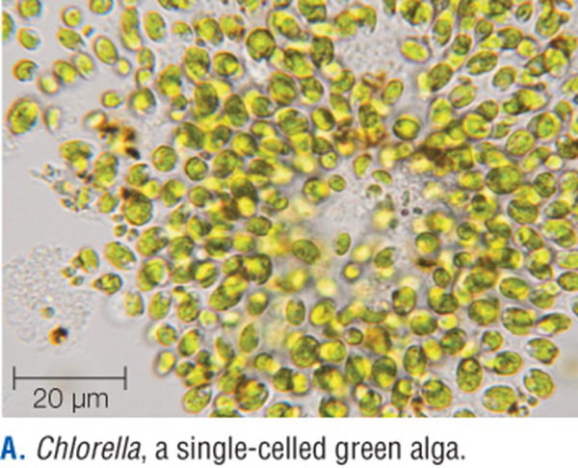
Green Algae
Single-celled, colonial, or multicelled photosynthetic protist
  Most closely related to land plants
  Include fresh water and marine species
  Some grow on soil, trees, or other damp surfaces; some partner with fungi to form lichens.
Notes:
Figure 14.25 Green algae.
A. Chlorella, a single-celled green alga.

Slide 46
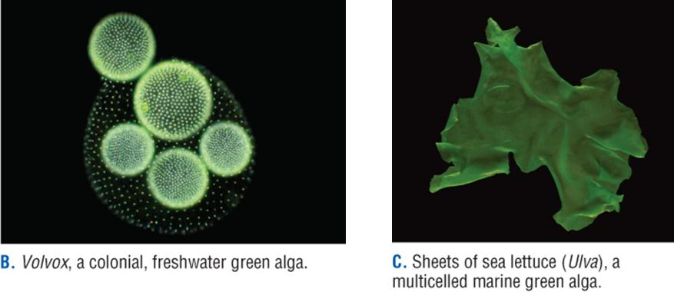
Examples of Green Algae
Notes:
Figure 14.25 Green algae.
B. Volvox, a colonial, freshwater green alga.
C. Sheets of sea lettuce (Ulva), a multicelled marine green alga.

Slide 47
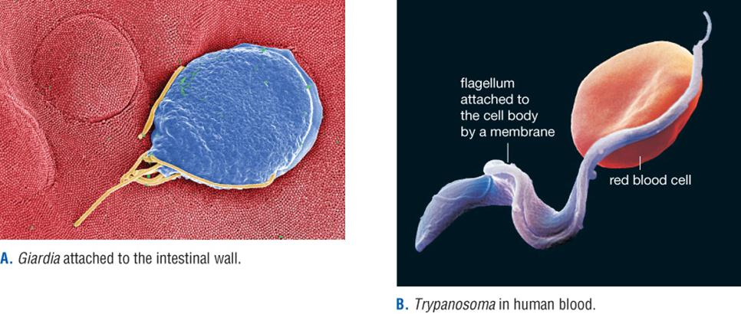
Protists in the Human Body
Notes:
Figure 14.26 Flagellated protozoans that parasitize humans.
Giardia attached to the intestinal wall.
Trypanosoma in human blood.

Slide 48
Apicomplexans (1 of 2)
Parasitic protist that enters and lives inside the cells of its host
Example: Plasmodium
  Apicomplexan species that causes malaria

Slide 49
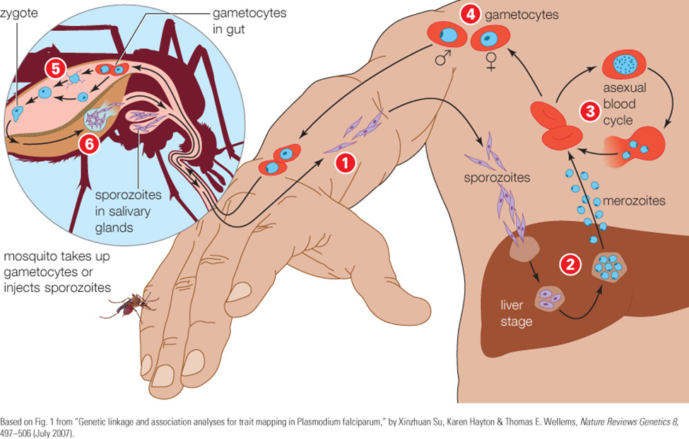
Apicomplexans (2 of 2)
Notes:
Figure 14.27 Life cycle of Plasmodium, the protist that causes malaria.
1. Infected mosquito bites a human. Sporozoites enter the blood, which carries them to the liver.
2. Sporozoites reproduce asexually in liver cells, then mature into merozoites. Merozoites leave the liver and enter the bloodstream, where they infect red blood cells.
3. Inside some red blood cells, merozoites reproduce asexually. These cells burst and release more merozoites into the bloodstream.
4. Inside other red blood cells, merozoites develop into male and female gametocytes.
5. A female mosquito bites and sucks blood from the infected person. Gametocytes in red blood cells enter her gut and mature into gametes, which fuse to form zygotes.
6. Zygotes develop into sporozoites that migrate to the mosquito’s salivary glands.

Slide 50
Plasmodial and Cellular Slime Molds
Plasmodial slime mold
  Heterotrophic protist that moves and feeds as a multinucleated mass
  Forms a fruiting body in unfavorable conditions
Cellular slime mold
  Heterotrophic protist that usually lives as a single-celled predator, but cells aggregate and form a fruiting body in unfavorable conditions

Slide 51
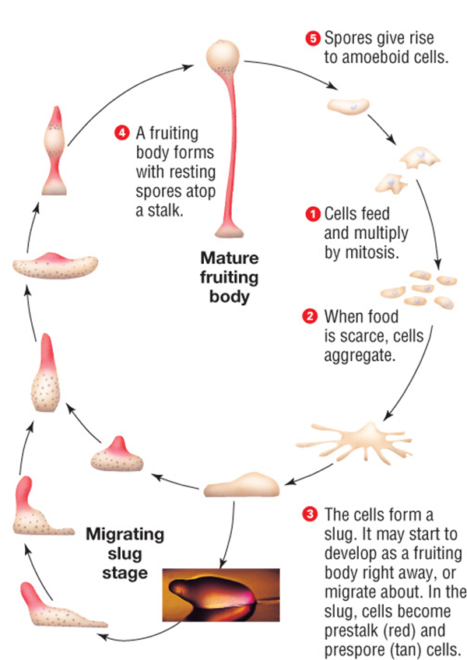
Life Cycle of a Cellular Slime Mold
Notes:
Figure 14.29 Life cycle of the cellular slime mold Dictyostelium discoideum.

Slide 52
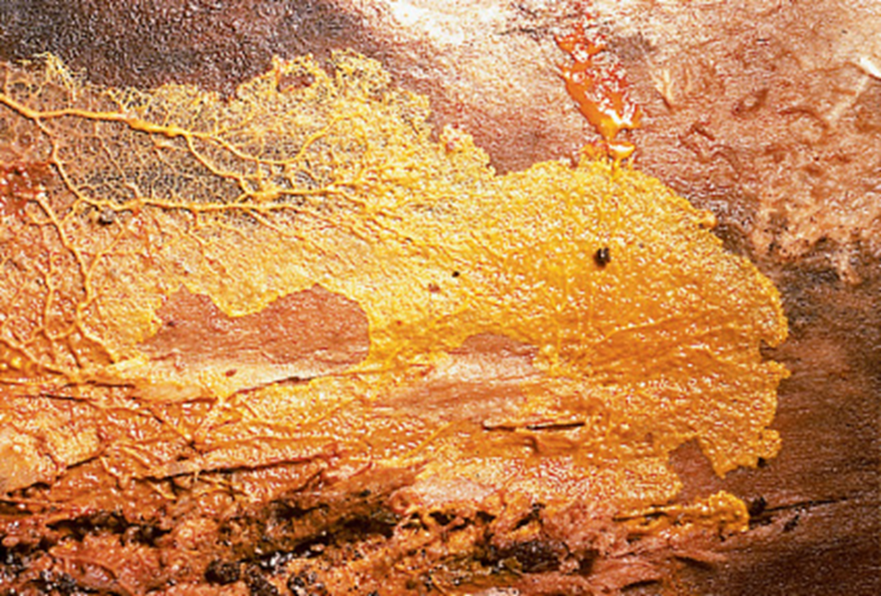
Plasmodial Slime Mold Streaming Across a Log
Notes:
Figure 14.30 Plasmodial slime mold on a log.
This multinucleated mass (the plasmodium) streams along at a rate of about a millimeter an hour, engulfing any food it encounters. As the plasmodium travels, it lays down a trail of slime. If it later happens across its own trail, it will move off in a different direction. In this way, the slime mold “remembers” where it has been and avoids revisiting areas where it has already depleted its food supply.

Slide 53
Choanoflagellates
“Collared flagellate”
  Each cell has a long flagellum surrounded by a ring of filaments reinforced with actin.
  Cell extends pseudopods to capture food, which is digested within the cell body.
  Most live as single cells; some form colonies.
Thought to be the closest living relatives of animals

Slide 54
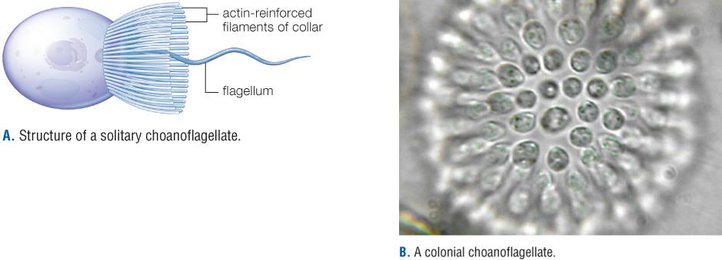
Examples of Choanoflagellates
Notes:
Figure 14.31 Choanoflagellates, the modern protist group most closely related to animals.
Structure of a solitary choanoflagellate.
A colonial choanoflagellate.

Slide 55
14.7 Viruses
A virus’s structure is adapted for infection and replication within a specific type of host.
Nearly all viral replication cycles include the same key steps:
  Virus attaches to protein on host cell membrane.
  Viral genome enters cell.
  Viral genes direct cell to replicate viral DNA or RNA and proteins; components self-assemble.
  New viruses bud or burst from host cell.

Slide 56
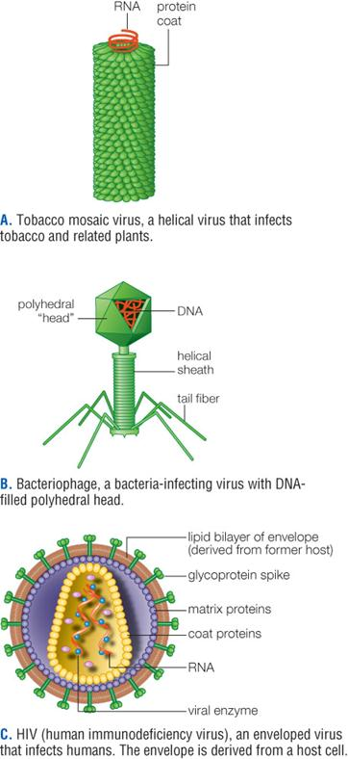
Virus Structure
Notes:
Figure 14.32 Examples of virus structure.
Tobacco mosaic virus, a helical virus that infects tobacco and related plants.
Bacteriophage, a bacteria-infecting virus with DNA-filled polyhedral head.
HIV (human immunodeficiency virus), an enveloped virus that infects humans. The envelope is derived from a host cell.

Slide 57
HIV—The AIDS Virus
HIV (human immunodeficiency virus)
  An enveloped RNA virus that replicates inside human white blood cells
  Viral RNA and enzymes enter host cell.
  Reverse transcriptase converts viral RNA into DNA, which is integrated into host chromosome and transcribed along with host genes.
  Host cells make new viral RNA and proteins, and assemble new viral particles, which bud from cell.

Slide 58
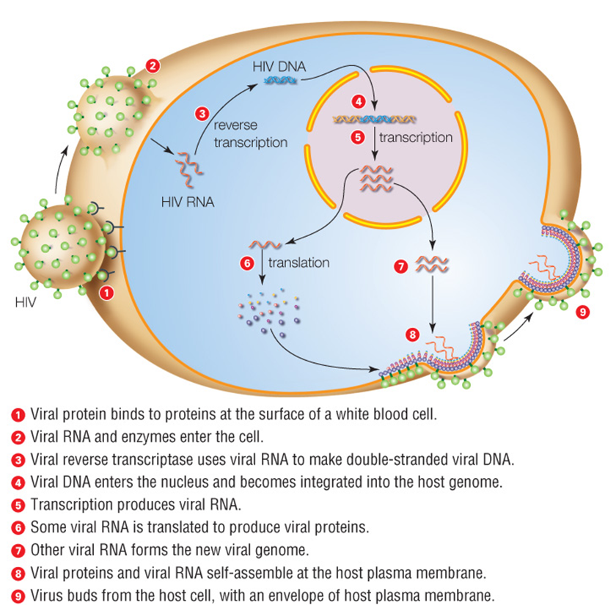
HIV, an Enveloped RNA Virus
Notes:
Figure 14.33 Replication of HIV, an enveloped RNA virus.
HIV enters human white blood cells and replicates inside them. The process requires a viral enzyme, as well as the host's transcription and translation machinery.

Slide 59
Bacteriophages
Nonenveloped virus that infects bacteria
  Replicate in bacteria by two pathways: lytic and lysogenic
Lytic pathway
  Virus replicates in its host and quickly kills it by breaking off plasma membrane (lysis).
Lysogenic pathway
  Virus becomes integrated into the host’s chromosome and is passed on to the next generation.

Slide 60
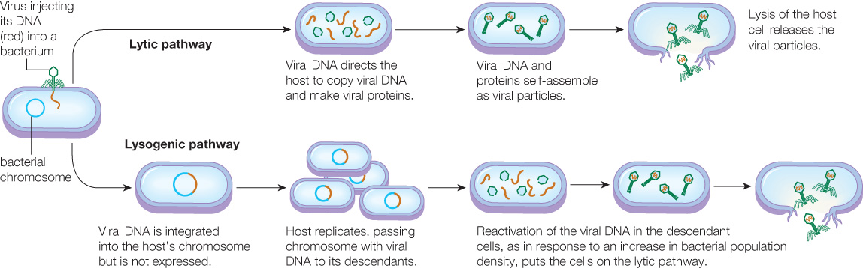
Viral Replication Pathways
Notes:
Figure 14.34 The two bacteriophage replication pathways.

Slide 61
Viruses and Human Health
Some viruses are beneficial to human health.
Others are human pathogens.
  Most produce mild symptoms and only brief effects.
  Others remain in the body in a latent state, and can reawaken later on.
    Example: herpesviruses
  Some may cause cancer.
    Example: human papillomavirus (HPV)

Slide 62
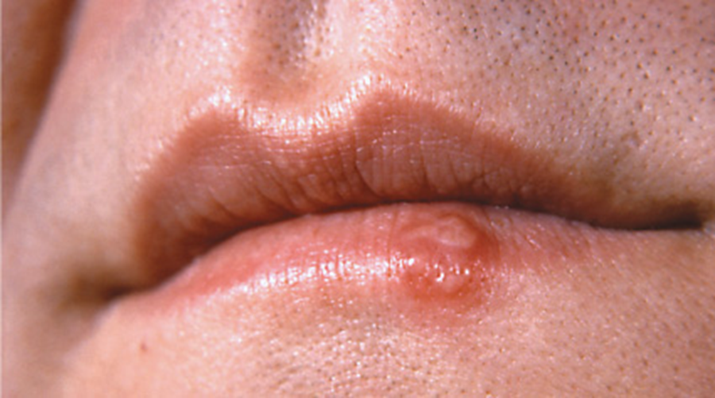
Cold Sore
Notes:
Figure 14.35 Cold sore.
Evidence of an active herpes simplex virus 1 infection. Fluid rich in viral particles leaks from the open sore.

Slide 63
New Flus
Influenza viruses that cause flus:
  Enveloped RNA viruses
  Mutate quickly; reverse transcriptase makes frequent replication errors
  Repair enzymes and proofreading activity do not operate during reverse transcription.
New strains also arise by viral reassortment.
  Swapping of genes between related viruses that infect a host at the same time
A new flu vaccine is produced every year because of mutations.

Slide 64
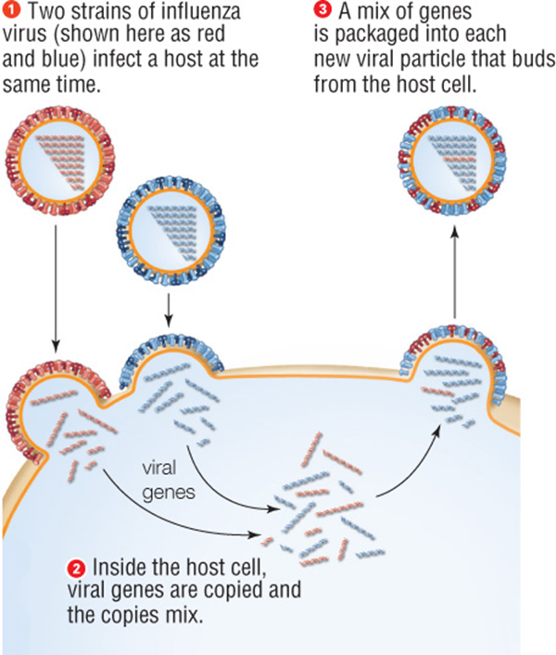
Viral Reassortment
Notes:
Figure 14.36 Viral reassortment.
When a host cell is infected by two viruses of the same type, such as two influenza viruses, viral genes recombine to form viruses with new gene combinations.

Slide 65
Points to Ponder
Discuss recent E. coli outbreaks that have caused recalls on food stuffs such as beef and lettuce.
  How can these be prevented?
Discuss the ongoing Ebola outbreak.
  What do the new treatment/preventative measures attempt to address?
  What is the status of an Ebola vaccination?

