Slide 1
Chapter 22
Circulation and Respiration
Starr, Biology Today and Tomorrow with Physiology, 6th Edition. © 2021 Cengage. All Rights Reserved. May not be scanned, copied or duplicated, or posted to a publicly accessible website, in whole or in part.

Slide 2
Chapter 22 Learning Objectives (1 of 3)
22.1 Application
22.2.1 Explain the difference between an open circulatory system and a closed circulatory system.
22.2.2 Compare the path of blood flow in a fish and a mammal.
22.2.3 Discuss the advantages of a four-chambered heart.
22.3.1 Describe the path a blood cell takes through the human circulatory system.
22.3.2 Compare the function of arteries and veins.
22.4.1 Compare the thickness of the wall of the atria and the ventricles, and explain how this difference in their structure reflects differences in their function.
22.4.2 Explain what causes heart sounds.
22.4.3 Describe the events of one cardiac cycle.
22.4.4 Explain the function of the SA and AV nodes.

Slide 3
Chapter 22 Learning Objectives (2 of 3)
22.5.1 Provide examples of plasma proteins and explain their functions.
22.5.2 List the cellular components of blood and their sources.
22.5.3 Describe how blood clots.
22.6.1 Describe how differences in the structure of arteries, veins, and capillaries reflect their different functions.
22.6.2 Explain the role of arterioles in adjusting the distribution of blood flow.
22.6.3 Using appropriate examples, explain how substances enter and leave capillaries.
22.6.4 Describe how the circulatory system and lymphatic system are connected.
22.7.1 Explain how atherosclerosis arises and why it is harmful.
22.7.2 Describe the causes and symptoms of a stroke.
22.7.3 Describe two methods of treating a blocked cardiac artery.

Slide 4
Chapter 22 Learning Objectives (3 of 3)
22.8.1 Explain why animal cells need oxygen and describe how they obtain it.
22.8.2 Give examples of invertebrate respiratory organs.
22.8.3 Describe the structure of a respiratory surface.
22.9.1 Trace the flow of air during one human respiratory cycle.
22.9.2 Explain the role of muscles in inhalation and exhalation.
22.9.3 Compare the mechanisms by which oxygen and carbon dioxide are transported in the blood.
22.9.4 Describe common respiratory disorders and their causes.

Slide 5
22.1 A Shocking Save
A natural pacemaker in the heart wall generates electrical signals that stimulate contraction of heart muscle.
When the pacemaker malfunctions, electrical signaling becomes disrupted, the heart stops beating, and blood flow halts (sudden cardiac arrest).
CPR can supply the brain with oxygen, but it can’t restart the heart—that requires a defibrillator.

Slide 6
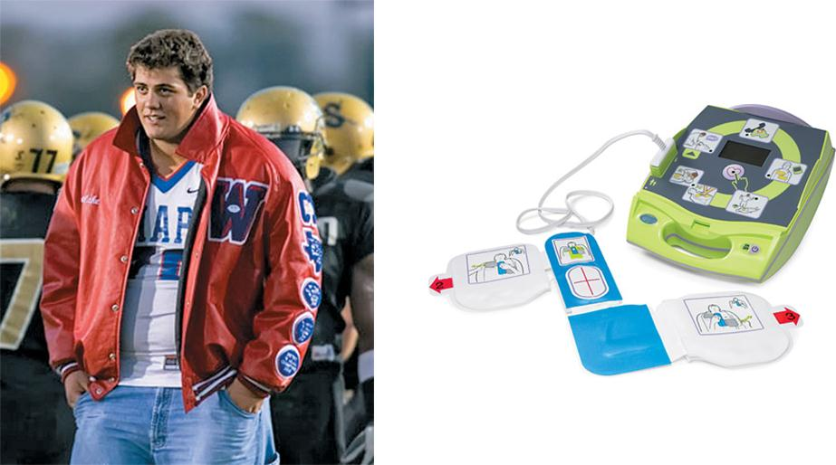
Survivor of Sudden Cardiac Arrest
Notes:
Figure 22.1 Surviving sudden cardiac arrest.
Matt Nader (top) suffered a sudden cardiac arrest while in high school. CPR and quick defibrillation may have saved his life. Automated external defibrillators (AEDs) such as the one shown at bottom can restart a heart and are designed to be simple enough to be used by a trained layperson.

Slide 7
22.2 Circulatory Systems
All animals must supply their cells with nutrients and oxygen, and remove wastes.
In some small invertebrates, materials simply diffuse through interstitial fluid.
  Fluid between cells
Complex animals distribute materials through a circulatory system, in which a heart pumps blood through blood vessels.

Slide 8
Open and Closed Circulatory Systems
Open circulatory system
  Circulatory system in which hemolymph leaves vessels and flows among tissues
Closed circulatory system
  Circulatory system in which blood stays inside a continuous network of vessels
  Flow is faster than in open systems
  Found in all vertebrates and some invertebrates

Slide 9
Closed Circulatory System
In a closed circulatory system, materials are transferred between blood and cells of other tissues by diffusion through capillaries.
Capillaries
  Smallest-diameter blood vessels
  Exchanges of gases and other materials with tissues
  A capillary bed supplies an organ.

Slide 10
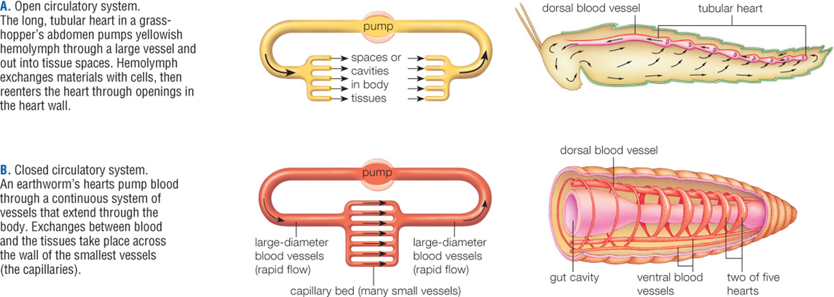
Open and Closed Circulatory System
Notes:
Figure 22.2 Open versus closed circulatory systems.
Open circulatory system.
The long, tubular heart in a grasshopper’s abdomen pumps yellowish hemolymph through a large vessel and out into tissue spaces. Hemolymph exchanges materials with cells, then reenters the heart through openings in the heart wall.
B. Closed circulatory system.
An earthworm’s hearts pump blood through a continuous system of vessels that extend through the body. Exchanges between blood and the tissues take place across the wall of the smallest vessels (the capillaries).

Slide 11
Evolution of Vertebrate Cardiovascular Systems
Fishes have a two-chambered heart (atrium and ventricle); blood flows in one circuit.
Atrium
  Heart chamber that receives blood from a vein and pumps it into a ventricle
Ventricle
  Heart chamber that pumps blood out of the heart and into an artery

Slide 12
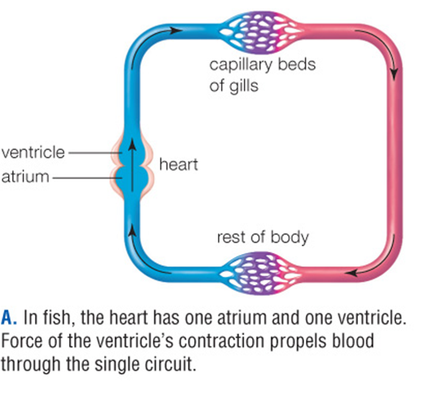
Fish Circulatory System
Notes:
Figure 22.3 Variation among vertebrate circulatory systems.
A. In fish, the heart has one atrium and one ventricle. Force of the ventricle’s contraction propels blood through the single circuit.

Slide 13
Evolution of Vertebrate Cardiovascular Systems; Another Method
In most vertebrates, blood flows in two circuits.
Amphibians and most reptiles have a three-chambered heart with two atria and one ventricle.
Crocodilians, birds, and mammals have a four-chambered heart that separates oxygen-rich blood from oxygen-poor blood.

Slide 14
Two Cardiovascular Circuits
Pulmonary circuit
  Circuit through which blood flows from the heart to the lungs and back
Systemic circuit
  Circuit through which blood flows from the heart to the body tissues and back

Slide 15
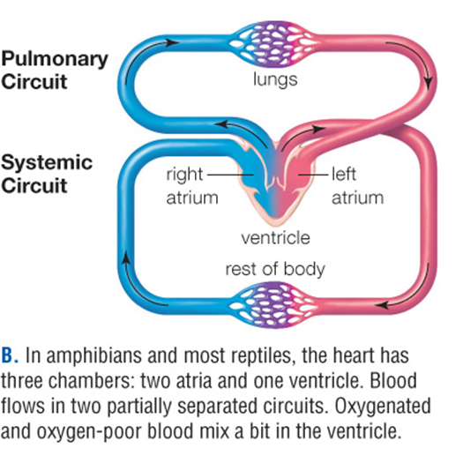
Amphibian and Reptile Circulatory System
Notes:
Figure 22.3 Variation among vertebrate circulatory systems.
B. In amphibians and most reptiles, the heart has three chambers: two atria and one ventricle. Blood flows in two partially separated circuits. Oxygenated and oxygen-poor blood mix a bit in the ventricle.

Slide 16
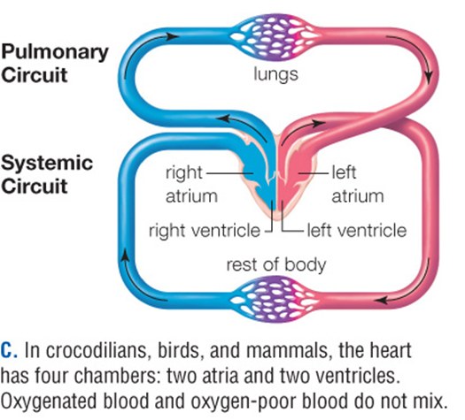
Circulatory System of Crocodilians, Birds, and Mammals
Notes:
Figure 22.3 Variation among vertebrate circulatory systems.
B. In amphibians and most reptiles, the heart has three chambers: two atria and one ventricle. Blood flows in two partially separated circuits. Oxygenated and oxygen-poor blood mix a bit in the ventricle.

Slide 17
22.3 Human Cardiovascular System
The two separate circuits: Pulmonary and systemic has a network of different types of blood vessels that carry blood between the heart and capillary beds.
  Artery
    Carries blood from the heart to an organ
  Arteriole
    Carries blood from an artery to a capillary bed
  Venule
    Carries blood from capillaries to a vein
  Vein
    Returns blood to the heart

Slide 18
The Pulmonary Circuit
Oxygen-poor blood collected by the right atrium is pumped from the right ventricle, through pulmonary arteries, to the lungs.
In capillaries of the lungs, blood gives off CO₂ and picks up O₂.
Oxygen-rich blood returns through pulmonary veins to the left atrium.

Slide 19
The Systemic Circuit
Oxygen-rich blood collected by the left atrium is pumped from the left ventricle, through the aorta, to capillary beds of the body.
At capillary beds in the body, blood gives up O₂ and picks up CO₂.
The superior vena cava and inferior vena cava return oxygen-poor blood to the right atrium.

Slide 20
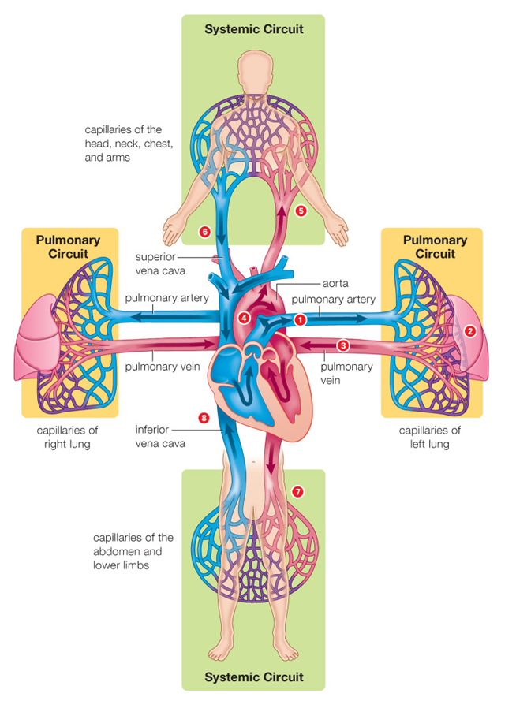
The Two Circuits of the Human Cardiovascular System
Notes:
Figure 22.4 The two circuits of the human cardiovascular system.
Pulmonary circulation is shown in the gold boxes, and systemic circulation in the green boxes.

Slide 21
22.4 The Human Heart
Structures of the human heart:
  Pericardium protects the heart.
  Each half of the heart has two chambers: an upper atrium and a lower ventricle.
  Superior and inferior vena cava deliver blood to the right atrium.
  Pulmonary veins deliver blood to the left atrium.
  Atrioventricular (AV), aortic, and pulmonary valves prevent blood from moving backward.

Slide 22
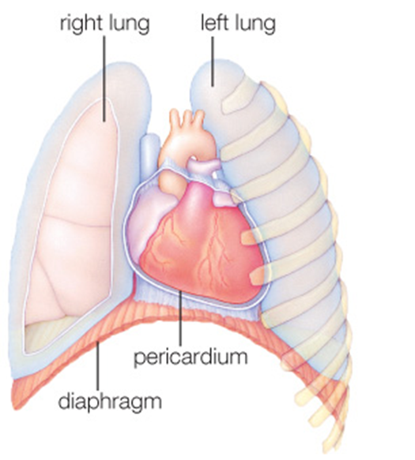
Location and Structure of the Human Heart
Notes:
Figure 22.5 Location and structure of the human heart.
The heart is located inside the rib cage and between the lungs.

Slide 23
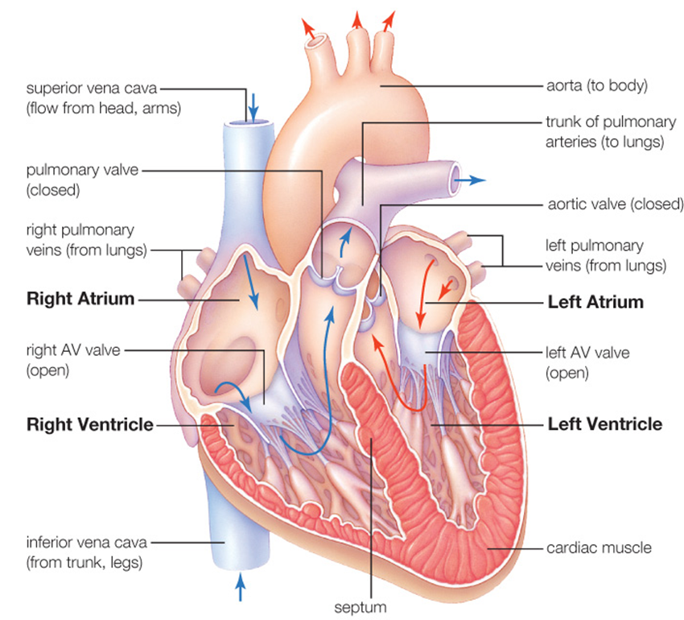
Location and Structure of the Human Heart
Notes:
Figure 22.5 Location and structure of the human heart.
B. Cutaway view of the heart. Arrows indicate the path of oxygenated blood (red) and oxygen-poor blood (blue).

Slide 24
The Cardiac Cycle (1 of 2)
Sequence of contraction and relaxation of heart chambers that occurs with each heartbeat
Signals from the cardiac pacemaker trigger contraction of the atria, then the ventricles.
  Atria fill ventricles.
  Ventricles drive blood flow away from the heart.
  Closing heart valves cause heartbeat sounds.

Slide 25
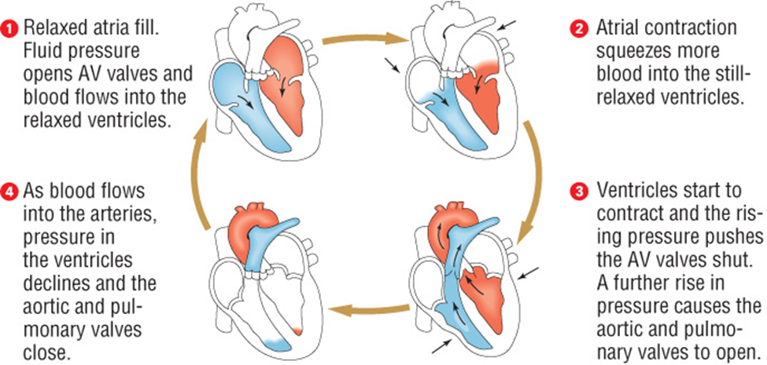
The Cardiac Cycle (2 of 2)
Notes:
Figure 22.6 The cardiac cycle.

Slide 26
Setting the Pace of Contractions
Spontaneous signals from the cardiac pacemaker cause cardiac muscle fibers to contract in a coordinated rhythm.
Gap junctions connect cardiac muscle cells.

Slide 27
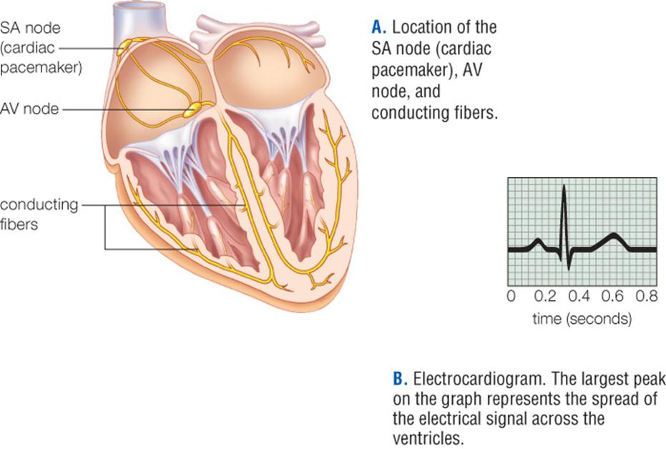
Electrical Activity in the Heart
Notes:
Figure 22.7 Electrical activity in the heart
Location of the SA node (cardiac pacemaker), AV node, and conducting fibers.
Electrocardiogram. The largest peak on the graph represents the spread of the electrical signal across the ventricles.

Slide 28
22.5 Blood
An average adult has about 4.5 liters of blood, consisting of plasma, red blood cells, white blood cells, and platelets.
Plasma
  Fluid portion of blood, composed of water with dissolved ions and molecules
  Transports gases, nutrients, wastes, signaling molecules, and plasma proteins

Slide 29
Blood Cells and Platelets
Blood cells and platelets arise from stem cells in bone marrow.
Red blood cells (erythrocytes)
  Transport O₂ and, to a lesser extent, CO₂
  Lack nucleus/organelles; lives about four months
White blood cells (leukocytes)
  Housekeeping (digest debris); defense against viruses, bacteria, and other pathogens
Platelets
  Patch tears in blood vessels and initiates blood clotting

Slide 30
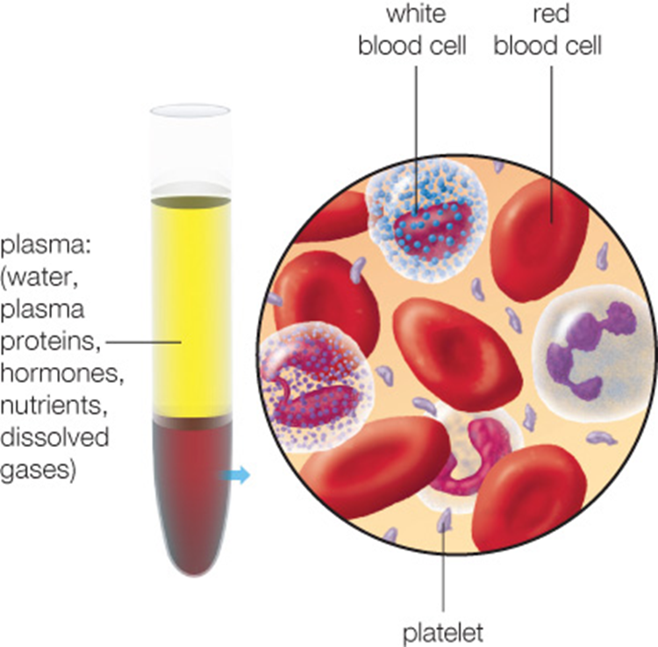
Components of Blood
Notes:
Figure 22.8 Components of blood.

Slide 31
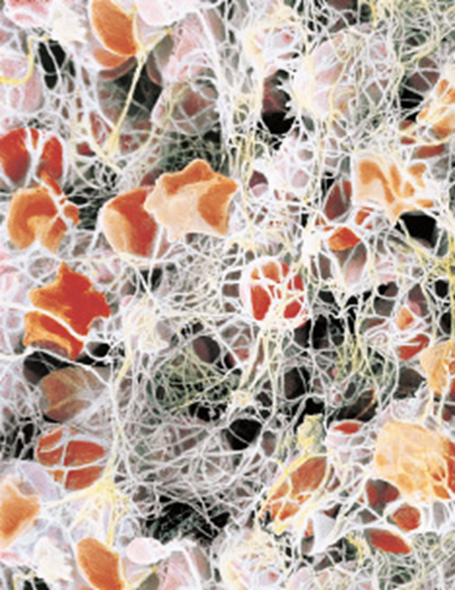
Blood Clotting
Notes:
Figure 22.9 Blood clotting.
Cells and platelets become trapped by threads of the protein fibrin.

Slide 32
High-Pressure Flow in Arteries
Blood is pumped from ventricles into arteries under high pressure.
Muscular, elastic walls propel blood forward when ventricles are relaxed.
A pulse is the bulging of an artery with each ventricular contraction.

Slide 33
22.6 Blood Vessel Form and Function
Pressure exerted by blood against walls of vessels
  Highest in arteries; lowest in veins
  Higher in systemic circuit than pulmonary circuit
  Normal blood pressure is about 120/80 mm Hg (systolic/diastolic)
Systolic pressure
  Blood pressure when ventricles are contracting
Diastolic pressure
  Blood pressure when ventricles are relaxed

Slide 34
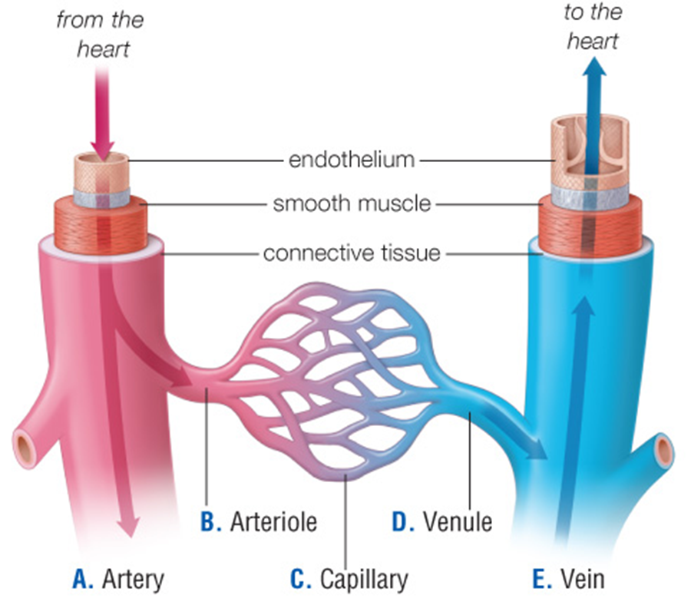
Blood Vessels
Notes:
Figure 22.10 Blood vessels.

Slide 35
Adjusting Resistance at Arterioles
Depending on need, the body alters distribution of blood flow through the body by adjusting the diameter of arterioles.
  Vessels that receive blood from an artery and deliver it to capillaries
  Example: More blood sent to gut when eating.

Slide 36
Capillary Exchange and Function of the Lymph Vessels
Capillary beds exchange materials between blood and interstitial fluid around cells.
  Gases diffuse across the plasma membrane.
  Blood pressure at arterial ends of capillary beds causes plasma to leak out, carrying oxygen, ions, and nutrients.
  Osmosis at venous ends of capillary beds causes water from interstitial fluid to enter blood, carrying wastes (excess fluid becomes lymph).

Slide 37
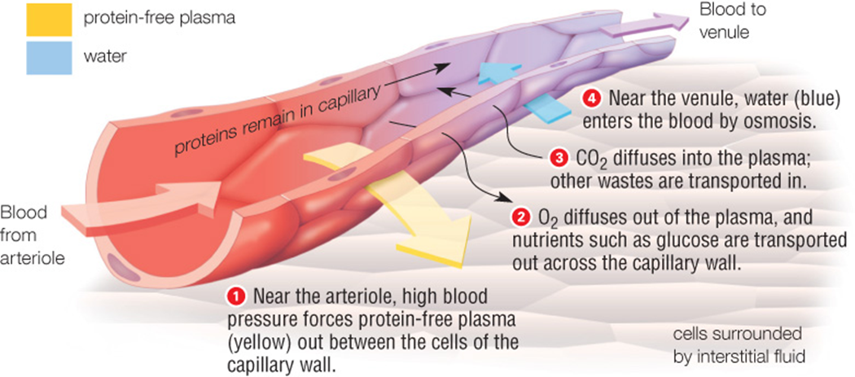
Capillary Exchange
Notes:
Figure 22.11 Capillary exchange.

Slide 38
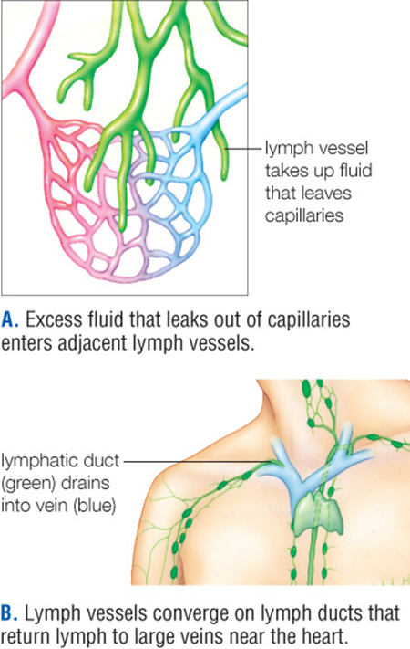
Circulatory and Lymphatic Interactions
Notes:
Figure 22.12 Interactions between the circulatory and lymphatic systems.
Excess fluid that leaks out of capillaries enters adjacent lymph vessels.
Lymph vessels converge on lymph ducts that return lymph to large veins near the heart.

Slide 39
Back to the Heart (1 of 2)
Venules converge into veins, which return blood to the heart.
  Veins are a blood volume reservoir (hold up to 70% of blood).
  Skeletal muscles help blood move; valves in veins keep blood from moving backward.

Slide 40
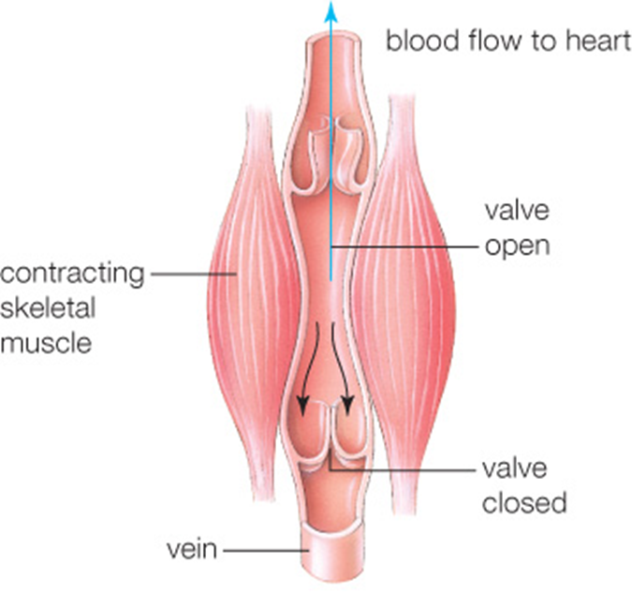
Back to the Heart (2 of 2)
Notes:
Figure 22.13 Skeletal muscle’s effect on a vein.
Contraction of a skeletal muscle compresses an adjacent vein, forcing blood inside the vein through a one-way valve and in the direction of the heart.

Slide 41
22.6 Cardiovascular Disorders
Anemia
  Occurs when red blood cells are impaired or fewer than normal
  Decreases oxygen delivery to cells
  Most common blood disorder
  Many causes: sickle cell anemia; lack of iron; bleeding
Blood may have an impaired or excessive tendency to clot.
  Spontaneous clot formation
  Causes: hemophilia; bursting of a blood vessel

Slide 42
Cardiovascular Disease
Atherosclerosis
  Artery interior narrows because of lipid deposition and inflammation.
  LDLs deposit cholesterol; HDLs remove it.
Hypertension (a silent killer)
  Chronically high blood pressure (above 140/90)

Slide 43
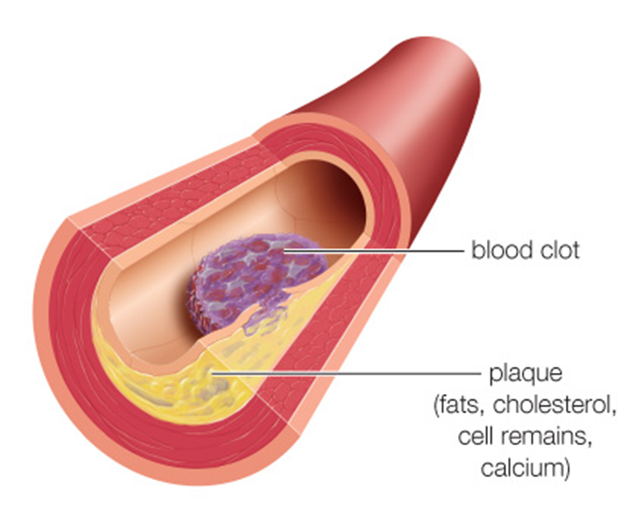
Atherosclerosis
Notes:
Figure 22.14 Atherosclerosis.
Plaque accumulates in an artery making it more likely to rupture. If it does, a clot that forms at the rupture site further narrows the vessel.

Slide 44
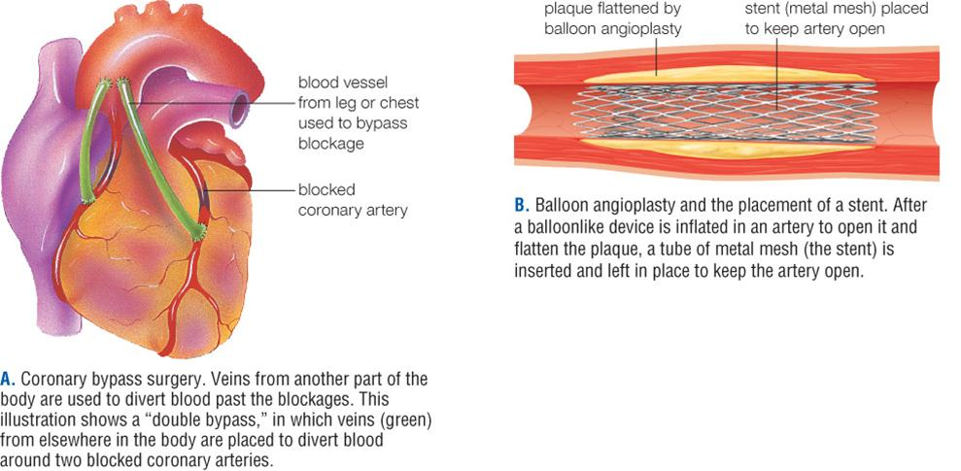
Treating a Blocked Artery
Notes:
Figure 22.15 Treating a blocked coronary (heart) artery.
Such blockages are the main cause of heart attacks in older adults.
Coronary bypass surgery. Veins from another part of the body are used to divert blood past the blockages. This illustration shows a “double bypass,” in which veins (green) from elsewhere in the body are placed to divert blood around two blocked coronary arteries.
Balloon angioplasty and the placement of a stent. After a balloonlike device is inflated in an artery to open it and flatten the plaque, a tube of metal mesh (the stent) is inserted and left in place to keep the artery open.

Slide 45
Stroke (1 of 2)
Interruption of blood flow in the brain
Most stroked occur when a blood vessel in the brain has been blocked.
Atherosclerosis raises risk that a clot will form.
Remember how to help someone using FAST:
F stands for face; a stroke causes one side of the face to droop.
A stands for arms; a stroke makes it difficult to hold one’s arms out at the same level.

Slide 46
Stroke (2 of 2)
S stands for speech; a stroke often causes slurred speech.
T stands for time; if any signs of stroke are detected, minimizing the time to treatment increases the odds of survival and, in survivors, of avoiding brain damage.
Stroke symptoms vary.

Slide 47
22.8 Animal Respiratory Systems
The respiratory system, working with the circulatory system, uses the process of respiration to exchange gases across a respiratory surface.
Respiration
  Physiological process by which animals obtain oxygen and get rid of waste CO₂

Slide 48
Two Sites of Gas Exchange (1 of 2)
Gases enter and leave an animal body across a respiratory surface.
  A moist surface across which gases are exchanged between animal cells and air
  A second exchange of gases takes place internally, where oxygen diffuses from interstitial fluid into a cell, and carbon dioxide diffuses in the opposite direction.
A circulatory system enhances the movement of gases between these two sites of gas exchange.

Slide 49
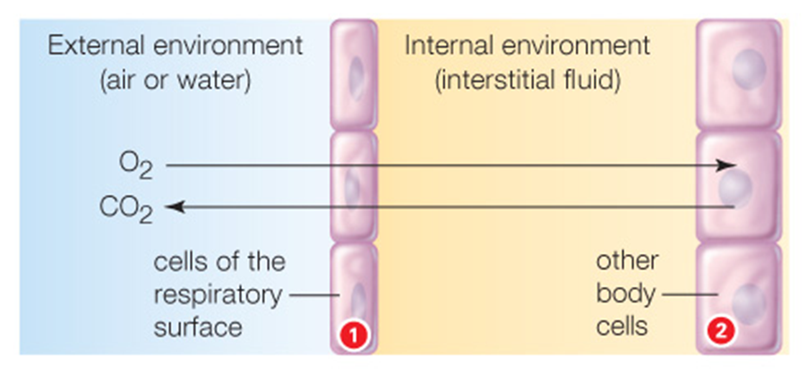
Two Sites of Gas Exchange (2 of 2)
Notes:
Figure 22.16 Two sites of gas exchange.
Cells of a respiratory surface exchange gases with the external environment and with fluid inside the body.
Other body cells exchange gases with the internal environment (interstitial fluid). In some invertebrates, gases simply diffuse between the two sites. In animals with a circulatory system, blood transports gases rapidly between the two exchange sites.

Slide 50
Respiratory Organs
In some aquatic animals, the respiratory surface may be the body surface or external gills.
  Most fishes have internal gills that extend from the back of the mouth to the body surface.
    Filamentous respiratory organs increase the surface area available for gas exchange.
  Water flows into the mouth and over gill filaments containing blood vessels.
    Water and blood flow in opposite directions, maximizing the amount of oxygen that diffuses into the blood.

Slide 51
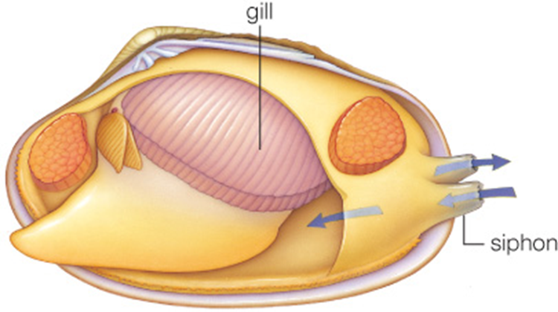
Internal Gills
Notes:
Figure 22.17 Clam with internal gills.
(Drawn with upper half of shell removed.) Water (blue arrow) enters through one siphon, flows over the gills, and exits through another siphon.

Slide 52
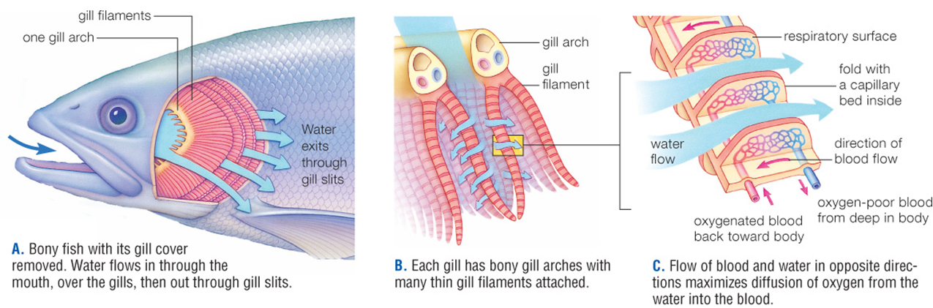
Fish Respiration
Notes:
Figure 22.18 Fish respiration.
Bony fish with its gill cover removed. Water flows in through the mouth, over the gills, then out through gill slits.
Each gill has bony gill arches with many thin gill filaments attached.
Flow of blood and water in opposite directions maximizes diffusion of oxygen from the water into the blood.

Slide 53
Respiratory Systems in Insects
Insects, the most successful air-breathing land invertebrates, have a hard surface and a tracheal respiratory system.
  Tracheal system: branching tubes deliver air from the body surface to tissues

Slide 54
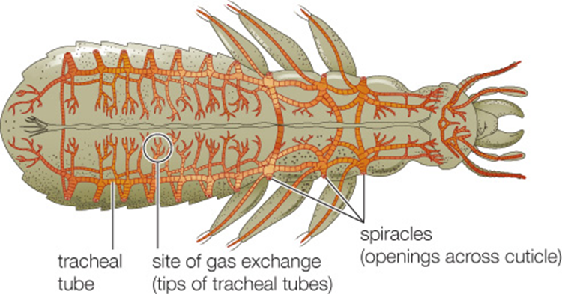
Tracheal Tube System of Insects
Notes:
Figure 22.19 Tracheal tube system of an insect.
Spiracles at the body surface are the entrance to chitin-reinforced tracheal tubes that convey air deep inside the body.

Slide 55
Respiratory System Organ: The Lungs
All mammals and birds, most amphibians, and some fishes have lungs, which provide a large surface area for gas exchange.
Lungs
  Internal saclike organs
  Serve as the respiratory surface in most land vertebrates and some fish

Slide 56
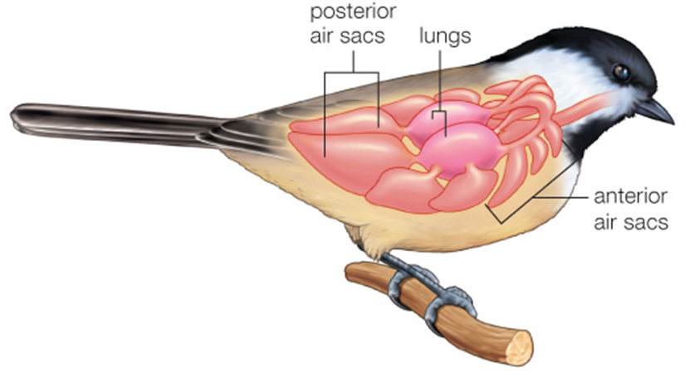
Bird Respiratory System
Notes:
Figure 22.20 Bird respiratory system.
Inflatable air sacs keep air moving through the lungs in one direction.

Slide 57
22.9 Human Respiratory Function
Pharynx
  Throat; opens to airways and digestive tract
Larynx
  Short airway containing vocal cords (voice box)
  Contraction of vocal cords changes the size of the glottis
Glottis
  Opening formed when the vocal cords relax

Slide 58
Structures of the Human Respiratory System
Epiglottis
  Flap at the entrance to larynx
  Flops down when you swallow
Trachea
  Major airway leading to the lungs; windpipe
  Branches into two bronchi, each leading to a lung
Bronchus (bronchi)
  Airway connecting the trachea to a lung
Bronchiole
  Small airway leading from bronchus to alveoli
Alveoli (alveolus)
  Tiny, thin-walled air sacs
  Site of gas exchange in the lung

Slide 59
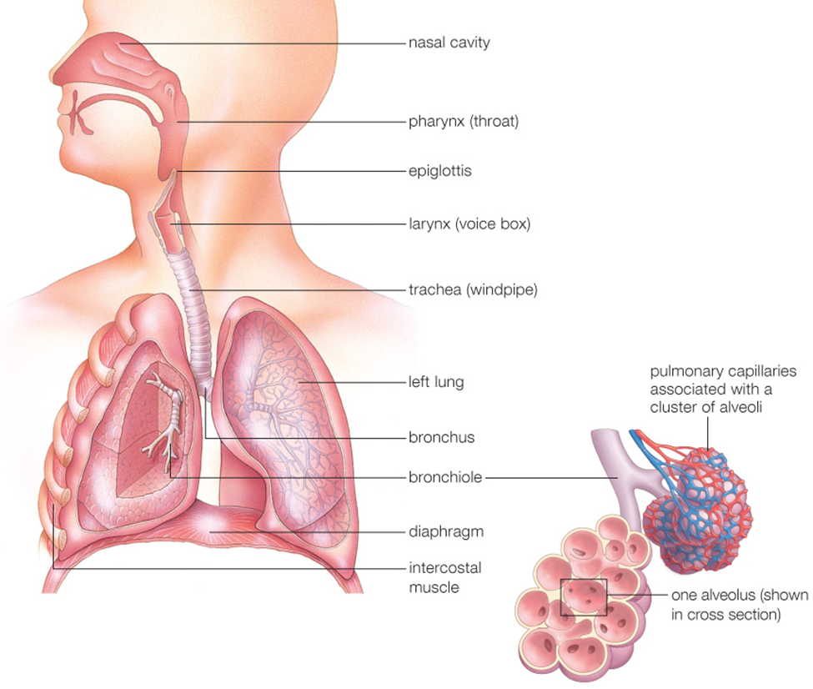
Human Respiratory Organs and Associated Structures
Notes:
Figure 22.21 Human respiratory organs and associated structures.
The diaphragm and intercostal muscles (muscles between the ribs) are muscles of respiration. The epiglottis is a flap of tissue that folds over the trachea and prevents food from entering it when you swallow.

Slide 60
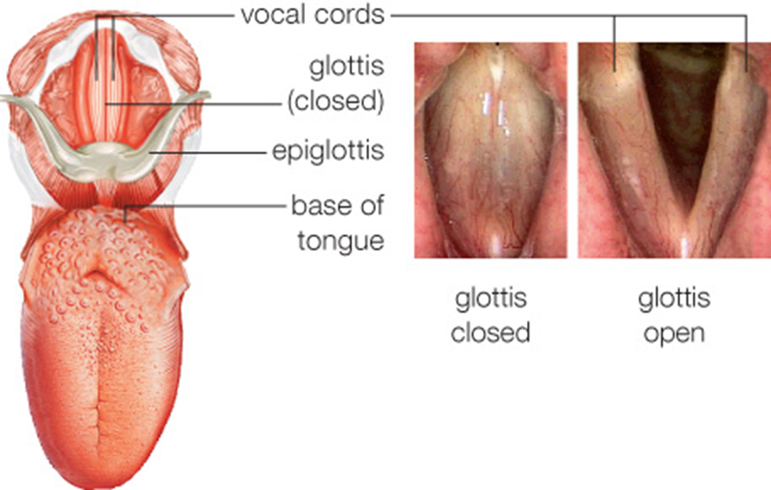
The Larynx
Notes:
Figure 22.22 The glottis and vocal cords from above.

Slide 61
How You Breathe
Actions of the diaphragm and intercostal muscles allow you to breathe.
Diaphragm
  Dome-shaped muscle at base of thoracic cavity that alters thoracic cavity size during breathing.
Intercostal muscles
  Muscles between the ribs; help alter the size of the thoracic cavity during breathing.

Slide 62
The Respiratory Cycle
One inhalation and one exhalation
Inhalation is always active (requires energy).
  Muscle contractions expand the chest cavity.
  Lung pressure decreases below atmospheric pressure, and air flows in.
Exhalation is usually passive.
  Muscles of respiration relax; volume of thoracic cavity decreases, pushing air out of lungs.

Slide 63
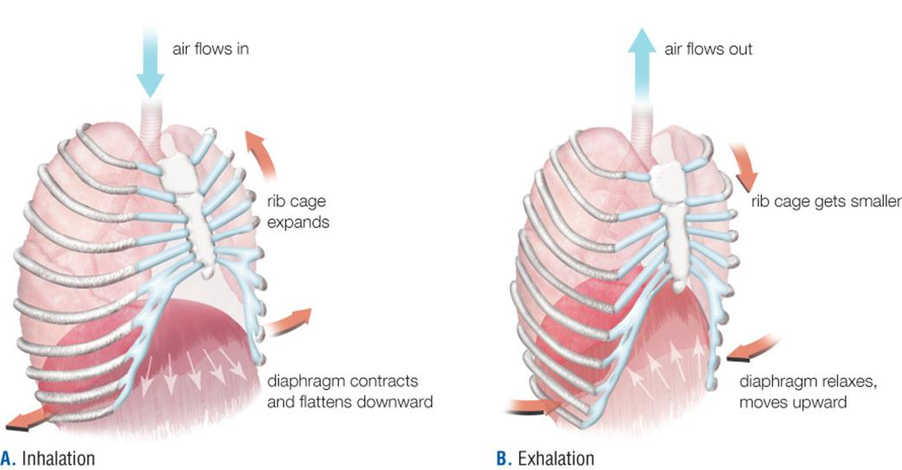
Inhalation and Exhalation
Notes:
Figure 22.23 How muscle actions alter the size of the thoracic cavity during one respiratory cycle.
Inhalation
Exhalation

Slide 64
Control of Breathing
A respiratory center in the brain stem controls depth and rate of normal breathing.
Neurons signal diaphragm and intercostal muscles to begin inhalation, 10 to 14 times per minute.
When activity increases CO₂ production, receptors in arteries and the brain signal for an increase in rate and depth of breathing.

Slide 65
Exchanges at Alveoli
Blood carries gases between lungs and body tissues.
  Fused basement membranes of alveolar and pulmonary capillary cells form the respiratory membrane.

Slide 66
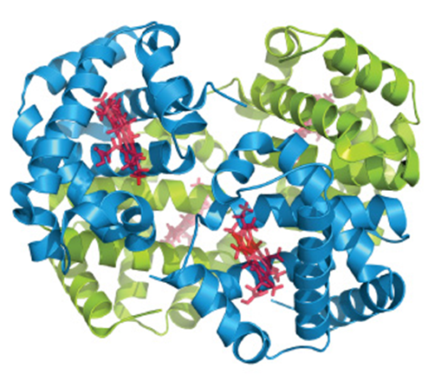
Transport of Gases (1 of 2)
Nearly all O₂ inhaled binds to hemoglobin.
  Protein of four globin chains with an iron-containing heme cofactor.
  In capillary beds, hemoglobin releases O₂, which diffuses across interstitial fluid into cells.
Notes:
Figure 22.24 Hemoglobin.
This protein consists of four globin molecules (blue and green). Each polypeptide associates with an iron-containing heme group (red) that can reversibly bind a molecule of O₂.

Slide 67
Transport of Gases (2 of 2)
CO₂ diffuses from cells into interstitial fluid, then into blood.
Enzymes in red blood cells converts most CO₂ into bicarbonate (HCO₃–), which dissolves in plasma.
  Converted back to CO₂ in pulmonary capillaries
CO₂ diffuses from pulmonary capillaries into air in alveoli, then is expelled.

Slide 68
Respiratory Disorders
Ciliated and mucus-secreting epithelial cells lining bronchioles help protect us from respiratory infections such as bronchitis.
With asthma, an inhaled irritant triggers inflammation and constriction of airways, making breathing difficult.
Cigarette smoke damages the epithelial lining, and is the main cause of emphysema—irreversible loss of lung function.

Slide 69
Sleep Apnea
Disorder in which breathing repeatedly stops and restarts spontaneously
Commonly seen during sleep
Generally tongue or other soft tissue blocks the airway
Raises risk of heart attack and stroke

Slide 70
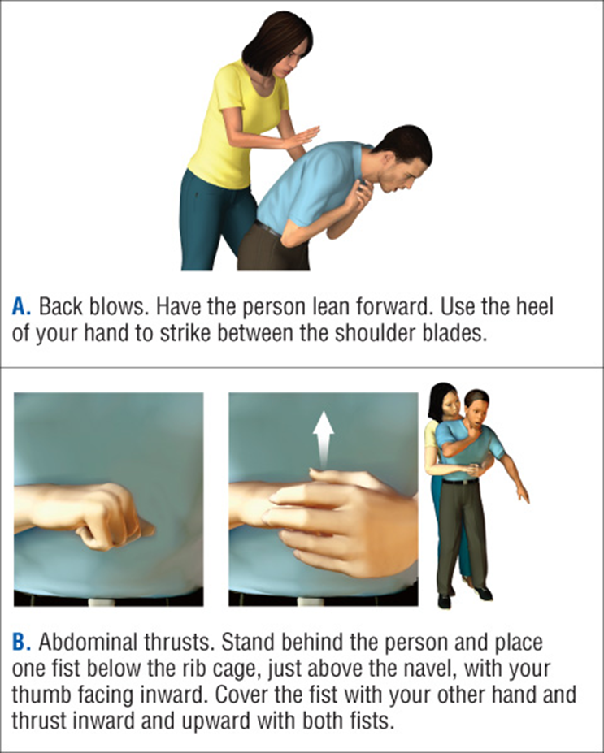
Choking
An object blocks the larynx
Notes:
Figure 22.25 First aid for choking in a conscious adult.
The Red Cross recommends that rescuers ask if a victim is choking and wants help. If the person nods, the rescuer should alternate between a series of five back blows and five abdominal thrusts.
Back blows. Have the person lean forward. Use the heel of your hand to strike between the shoulder blades.
Abdominal thrusts. Stand behind the person and place one fist below the rib cage, just above the navel, with your thumb facing inward. Cover the fist with your other hand and thrust inward and upward with both fists.

Slide 71
Points to Ponder
How have AEDs affected the survival rates of individuals who experience heart attacks?
What are the different effects of the different forms of smoking (cigar, pipe, or marijuana) on health?

