Slide 1
Chapter 23
Immunity
Starr, Biology Today and Tomorrow with Physiology, 6th Edition. © 2021 Cengage. All Rights Reserved. May not be scanned, copied or duplicated, or posted to a publicly accessible website, in whole or in part.

Slide 2
Chapter 23 Learning Objectives (1 of 2)
23.1 Application
23.2.1 Explain immunity in terms of antigens and receptors.
23.2.2 Describe the three lines of defense in vertebrate immunity.
23.2.3 Use examples to describe some functions of white blood cells.
23.3.1 Use examples to explain some benefits and risks associated with normal microbiota.
23.3.2 Describe the body’s natural barriers and how they prevent microorganisms from entering the internal environment.
23.4.1 Describe the role of complement in innate immunity.
23.4.2 Describe the process of inflammation.
23.4.3 Explain how fever occurs and its advantages.
23.5.1 Describe antibodies and their function.
23.5.2 Explain how antigen receptor diversity arises.
23.5.3 Describe the way T cell receptors recognize antigen.

Slide 3
Chapter 23 Learning Objectives (2 of 2)
23.6.1 Explain the advantages of having two types of adaptive immune responses.
23.6.2 Describe the four defining characteristics of adaptive immunity.
23.6.3 Explain the role of helper T cells in adaptive immune responses.
23.7.1 Describe the symptoms of allergies and how they arise.
23.7.2 Using an appropriate example, explain autoimmunity.
23.7.3 Describe immune deficiency in terms of AIDS.
23.8.1 Explain why a vaccine elicits immunity.

Slide 4
23.1 Frankie’s Last Wish
Healthy cervical cells can be transformed into cancerous ones by human papillomavirus (HPV).
  Gardasil vaccine protects against infection by types of genital HPV commonly associated with cervical cancer.
Frankie McCullough was 31 when she died of cervical cancer.
  Her last wish was that young women should get annual exams and Pap smears to detect cervical cancer early.

Slide 5
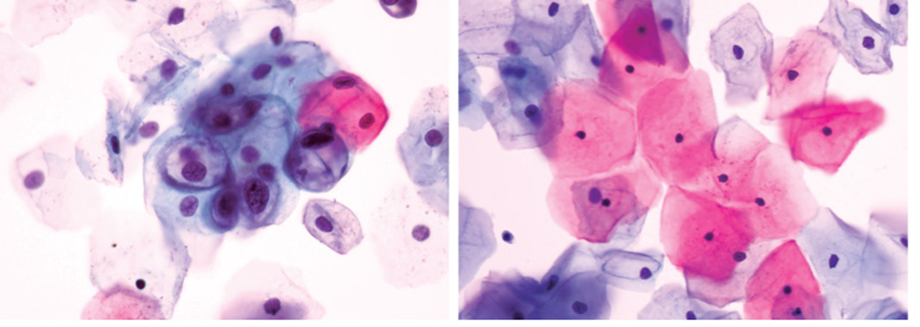
HPV and Cervical Cancer
Notes:
Figure 23.1 HPV and cervical cancer.
HPV-induced changes in cervical cells sometimes lead to cancer. Cervical cancer is treatable if detected early, which is why routine Pap smears are recommended for women over 21.

Slide 6
23.2 Integrated Responses to Threats
Humans have coevolved with many pathogens for which we have immunity.
  The capacity to resist and combat infection
Unique patterns in membrane proteins help the body identify cells that belong (self) and cells that do not belong (nonself).
Cells of modern multicelled eukaryotes have receptors that recognize pathogen-associated molecular patterns (PAMPs).

Slide 7
Evolution of the Body’s Defenses
A PAMP is an antigen.
  A molecule or particle recognized by the body as nonself
PAMP receptors are parts of innate immunity.
  A set of immediate, general defenses that help protect multicelled organisms from infection
Vertebrates also have adaptive immunity.
  A set of immune defenses that can be tailored to specific pathogens encountered by an organism during its lifetime

Slide 8
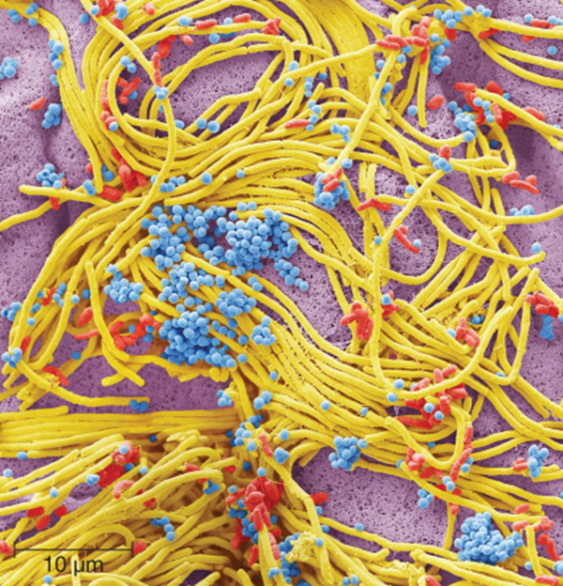
Bacteria Found on a Mobile Phone
Notes:
Figure 23.3 Bacteria found on a mobile phone.
The average mobile phone has about 18 times more bacteria on it than the average toilet handle in a men’s public bathroom

Slide 9
Comparing Innate and Adaptive Immunity
 | Innate Immunity | Adaptive Immunity
Response time | Immediate | About a week
Triggers | Thousands of PAMPs; tissue injury | Billions of antigens
Specificity | General | Specific to triggering antigen
Notes:
Table 23.1 Comparing Innate and Adaptive Immunity

Slide 10
The Defenders
White blood cells participate in all immune responses.
Many kinds circulate in blood and lymph or reside in organs of the lymphatic system.
All are secretory; immune system cells use cytokines to communicate with one another.
Different types are specialized for different tasks.

Slide 11
White Blood Cells (1 of 3)
Neutrophil
  Circulating phagocytic white blood cell
  Most abundant type of phagocytic WBC
Macrophage
  Phagocytic WBC that migrate through tissue and interstitial fluids
Dendritic cell
  Phagocytic WBC that alert adaptive immune system to the presence of antigen in solid issue
Eosinophil
  Targets large internal parasites

Slide 12
White Blood Cells (2 of 3)
Basophil
  Degranulates in response to injury and antigen
Mast cell
  Degranulates in response to injury and antigen
B lymphocyte (B cell)
  Makes antibodies that recognize antigens
T lymphocyte (T cell)
  Cytotoxic T cells kill infected or cancerous cells.
Natural killer cell (NK cell)
  Kills infected or cancerous cells undetected by cytotoxic T cells

Slide 13
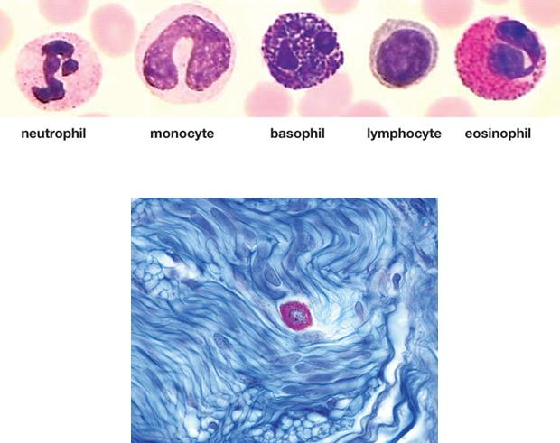
White Blood Cells (3 of 3)
Notes:
Figure 23.4 Some white blood cells.
Staining reveals details such as lobed nuclei and cytoplasmic granules. Above, circulating types (red blood cells are pink). Below, a mast cell (pink) stays anchored in tissue.

Slide 14
23.3 Surface Barriers (1 of 2)
Skin and linings of the body’s tubes and cavities are barriers to infection by microorganisms.
Normal flora
  Microorganisms that typically colonize human surfaces including tubes and cavities of digestive tract
  Can be beneficial but only on body surfaces
  Can cause serious illnesses when they invade tissues, such as pneumonia, ulcers, colitis, whooping cough, meningitis, cancers, tetanus, diphtheria, and staph infections

Slide 15
23.3 Surface Barriers (2 of 2)
Skin’s outer layer is a barrier that keeps normal flora out of blood and tissue fluids.
Epithelial tissues lining body tubes and cavities also have surface barriers.
  Mucus and saliva contain antibacterial lysozyme (enzyme that kills bacteria).
  Gastric fluid kills microorganisms in stomach.
  Salts kills microorganisms in the small intestine.
  Resident bacteria kill invaders in large intestine.
  Lactic acid protects the vagina.
  Flushing protects the urinary tract.

Slide 16
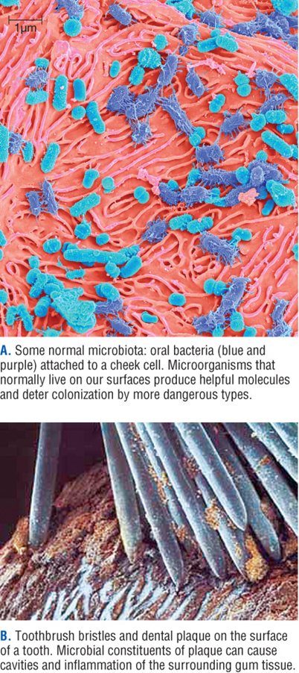
Oral Microbiota
Notes:
Figure 23.5 Oral microbiota: a delicate balance between friend and foe.
Some normal microbiota: oral bacteria (blue and purple) attached to a cheek cell. Microorganisms that normally live on our surfaces produce helpful molecules and deter colonization by more dangerous types.
Toothbrush bristles and dental plaque on the surface of a tooth. Microbial constituents of plaque can cause cavities and inflammation of the surrounding gum tissue.

Slide 17
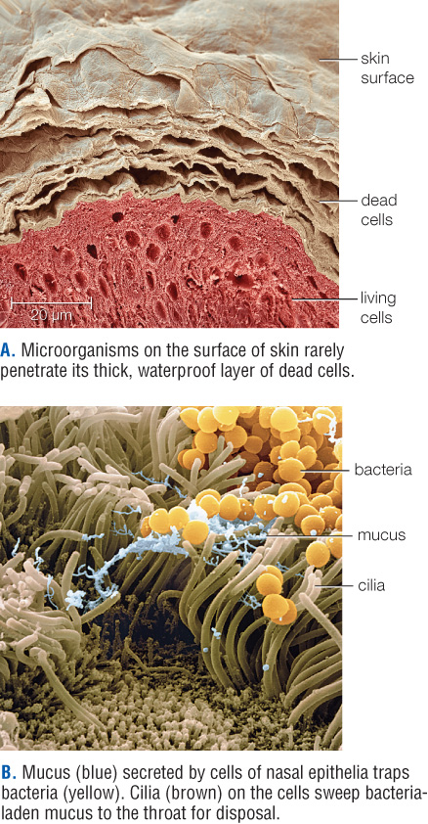
Physical Barriers to Infection
Notes:
Figure 23.6 Examples of physical barriers to infection.
Microorganisms on the surface of skin rarely penetrate its thick, waterproof layer of dead cells.
Mucus (blue) secreted by cells of nasal epithelia traps bacteria (yellow). Cilia (brown) on the cells sweep bacteria-laden mucus to the throat for disposal

Slide 18
23.4 Mechanisms of Innate Immunity
What happens when the surface defenses are down or not working properly?
Innate immunity can stop or slow pathogens.

Slide 19
Complement
Contact with antigen triggers complement activation.
  Set of 30 different kinds of proteins that circulate in inactive form throughout the body
These proteins act in a variety of ways.
  Bind directly to microorganisms
  Bind to antibodies on the surface of cells
  Activate when encounter materials leaking out of damaged cells
  Trigger a cascading reaction that enhances uptake of materials by phagocytic WBCs

Slide 20
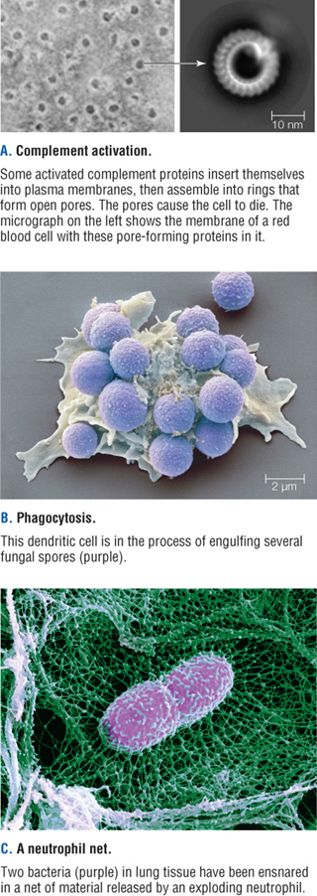
Pathogen-Busting Mechanisms
Notes:
Figure 23.7 Some pathogen-busting mechanisms of innate immunity.
Complement activation. Some activated complement proteins insert themselves into plasma membranes, then assemble into rings that form open pores. The pores cause the cell to die. The micrograph on the left shows the membrane of a red blood cell with these pore-forming proteins in it.
Phagocytosis. This dendritic cell is in the process of engulfing several fungal spores (purple).
A neutrophil net. Two bacteria (purple) in lung tissue have been ensnared in a net of material released by an exploding neutrophil.

Slide 21
Inflammation and Fever
Inflammation
  A fast, local response that simultaneously destroys affected tissue and jump-starts the healing process
  Symptoms include redness and warmth that indicate an area’s increased blood flow
Fever
  A temporary rise in body temperature above the normal 37°C that often occurs in response to infection or serious injury
  Enhances immune defenses by increasing the rate of enzyme activity

Slide 22
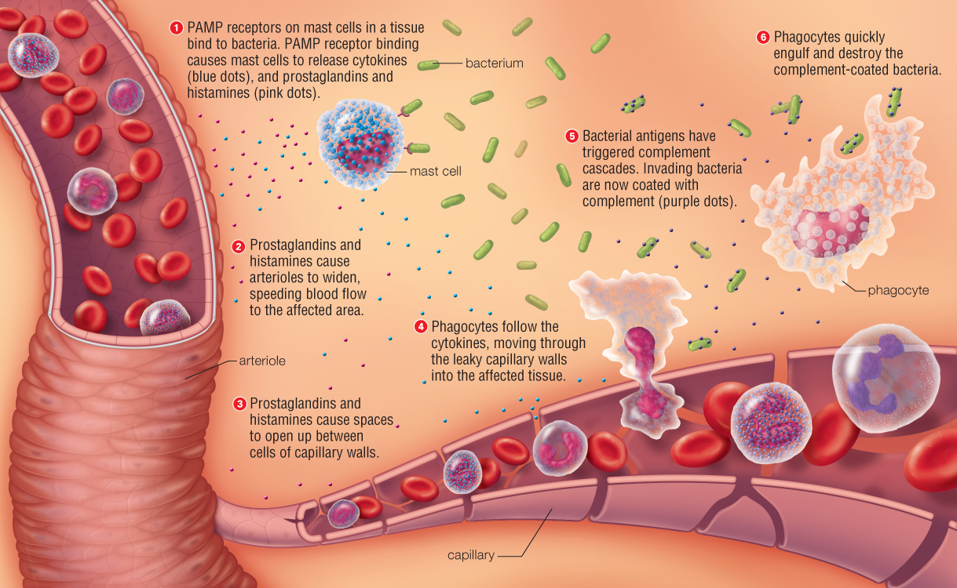
The Inflammatory Response
Notes:
Figure 23.8 Example of inflammation as a response to bacterial infection.
1. PAMP receptors on mast cells in the tissue recognize and bind to bacterial antigen.
2. The mast cells release signaling molecules (blue dots) that cause arterioles to widen. The resulting increase in blood flow, which reddens and warms the tissue, hastens the arrival of phagocytes.
3. The signaling molecules also increase capillary permeability, which allows phagocytes arriving in the bloodstream to move quickly through the vessel walls into the tissue. The tissue swells with fluid as plasma proteins seep out of the leaky capillaries.
4. Meanwhile, bacterial antigens have triggered complement cascades, and invading bacteria have become coated with complement (purple dots).
5. Phagocytes in the tissue recognize and engulf the complement-coated bacteria.

Slide 23
23.5 Antigen Receptors
Recognize specific antigens
  PAMPs
  Antibodies
Antibody
  Y-shaped antigen receptor protein made only by B cells
  Binds only to antigen with complementary shape and charge
  Activates complement and facilitates phagocytosis

Slide 24
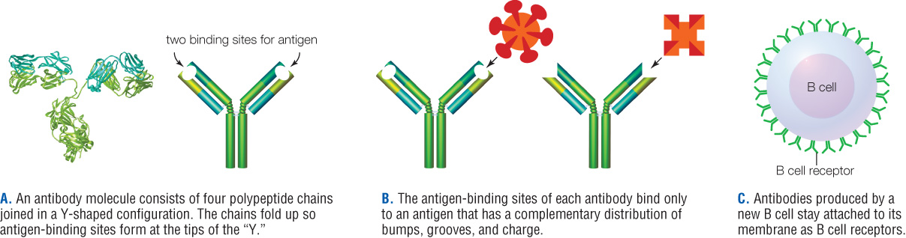
Antibody Structure
Notes:
Figure 23.9 Antibody structure.
An antibody molecule consists of four polypeptide chains joined in a Y-shaped configuration. The chains fold up so antigen-binding sites form at the tips of the “Y.”
The antigen-binding sites of each antibody bind only to an antigen that has a complementary distribution of bumps, grooves, and charge.
Antibodies produced by a new B cell stay attached to its membrane as B cell receptors.

Slide 25
Receptors and Self Markers
B cell receptors
  Antibodies that are not secreted
  Remain attached to the B cell’s plasma membrane
T cell receptor (TCR)
  Antigen-binding receptor on surface of T cells
  Recognizes MHC markers
MHC markers
  Self-recognition proteins on the surface of body cells
  Trigger an adaptive immune response when bound to antigen fragments

Slide 26
Antigen Receptor Diversity
Humans can make billions of unique B and T cell receptors.
Genes that encode receptors occur in several segments that become spliced together during B and T cell differentiation.
Like all blood cells, B and T lymphocytes form in bone marrow.

Slide 27
Antigen Processing (1 of 2)
T cell receptors only recognize antigen presented by an antigen-presenting cell.
  Macrophage, B cells, or dendritic cells
T cell with matching receptors binds antigen–MHC complex on antigen-presenting cell.
  Secretes cytokines that signal all B and T cells with matching receptors to divide, producing many effector cells and memory cells

Slide 28
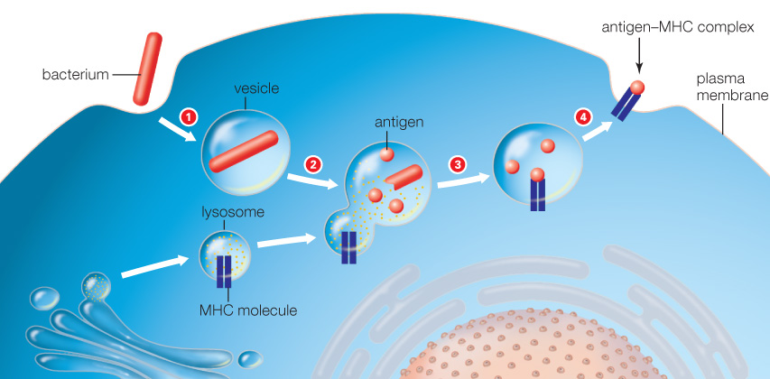
Antigen Processing (2 of 2)
Notes:
Figure 23.11 Antigen processing.
The drawing shows what happens inside a phagocyte after it engulfs an antigen-bearing particle.
An endocytic vesicle forms around a bacterium as it is engulfed.
The vesicle fuses with a lysosome, which contains enzymes and MHC molecules.
Lysosomal enzymes break down the bacterium to molecules. Fragments of bacterial proteins and polysaccharides (antigens) bind to the MHC molecules.
The vesicle fuses with the cell’s plasma membrane by exocytosis. When it does, the antigen–MHC complexes becomes displayed on the cell’s surface.

Slide 29
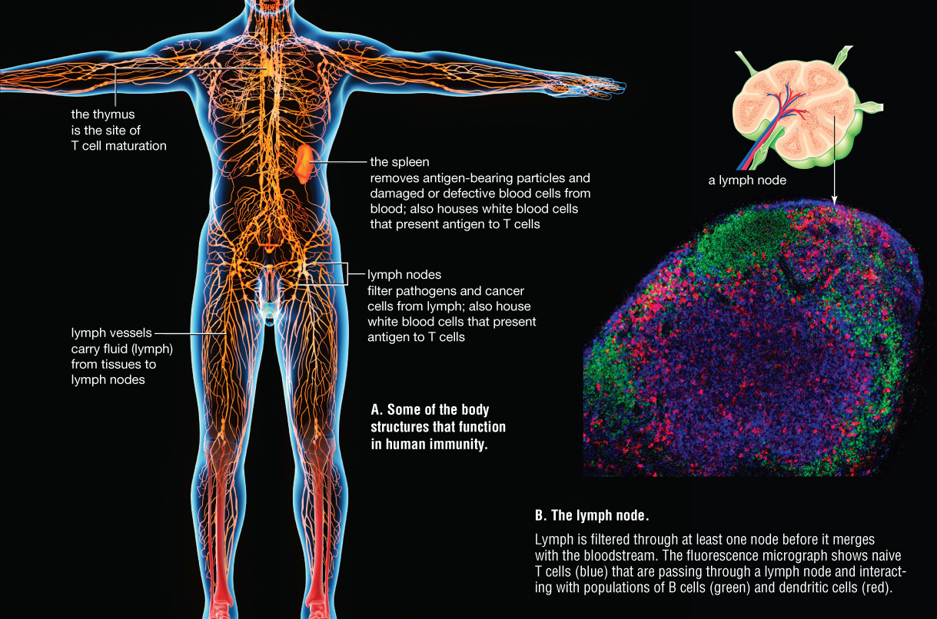
Human Inflammatory Response
Notes:
Figure 23.12 The human lymphatic system.
Some of the body structures that function in human immunity.
The lymph node. Lymph is filtered through at least one node before it merges with the bloodstream. The fluorescence micrograph shows naïve T cells (blue) that are passing through a lymph node and interacting with populations of B cells (green) and dendritic cells (red).

Slide 30
23.6 Adaptive Immune Responses
Two responses work together to eliminate diverse threats.
Antibody-mediated immune response
  Immune response in which antibodies are produced in response to an antigen
Cell-mediated immune response
  Immune response in which cytotoxic T cells and NK cells destroy infected or cancerous body cells

Slide 31
Short- and Long-Term Responses
Effector cells
  Act at once in a primary immune response
Memory cells
  Long-lived lymphocytes reserved for possible future encounters with the same threat
  Can persist for decades after a primary response

Slide 32
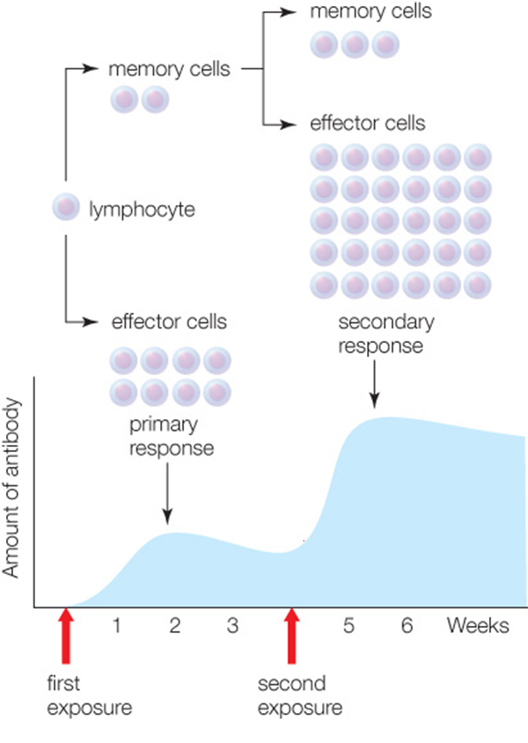
Primary and Secondary Immune Response
Notes:
Figure 23.13 Comparing the primary and secondary immune response.
A first exposure to an antigen triggers a primary immune response, in which effector cells fight the infection. Memory cells that also form act in a faster, stronger secondary response if the antigen returns at a later time.

Slide 33
Four Characteristics of Adaptive Immunity
Self/Nonself recognition
  T cell receptors recognize MHC molecules and antigens.
Specificity
  Adaptive immune responses combat specific antigens.
Diversity
  Lymphocytes have many kinds of antigen receptors.
Memory
  It is the capacity to “remember” an antigen (via memory cells)

Slide 34
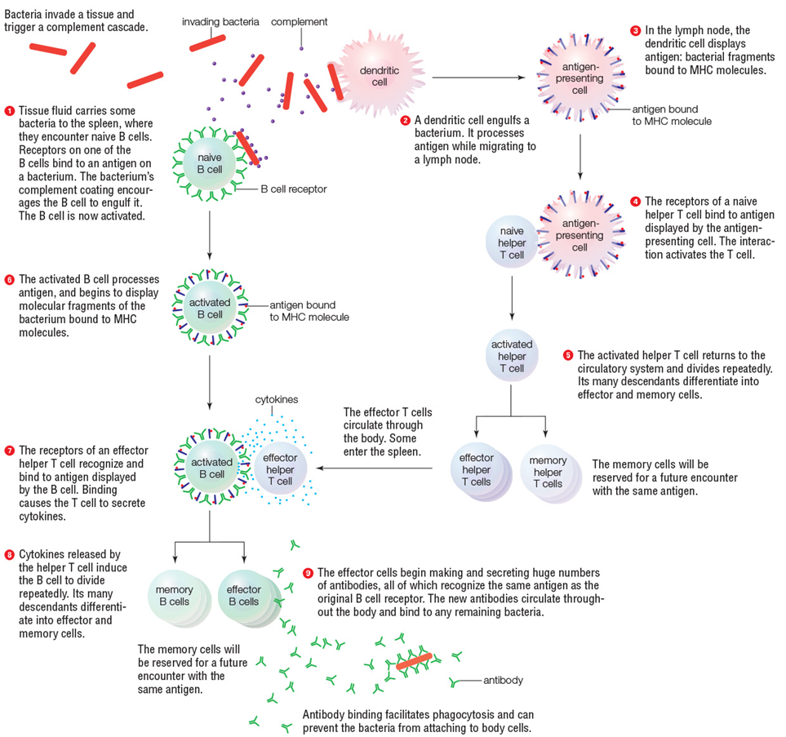
Antibody Immune Response
Notes:
Figure 23.14 An example of an antibody-mediated immune response.
A phagocyte engulfs a bacterium and presents antigen to naive helper T cells, which then divide and differentiate. A new effector helper T cell interacts with a B cell that has engulfed a bacterium. The B cell divides and differentiates, and its effector descendants produce antibodies that target the bacteria.

Slide 35
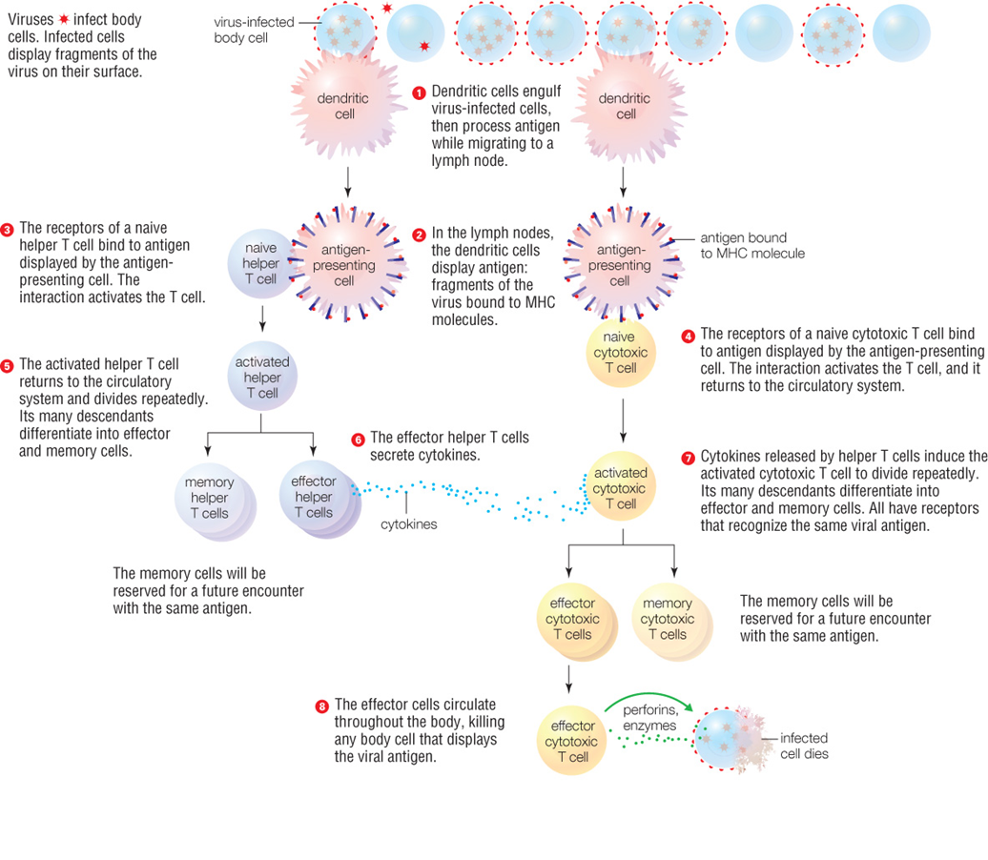
Cell-Mediated Immune Response
Notes:
Figure 23.17 An example of a cell-mediated immune response.
Phagocytes engulf virus-infected body cells and present antigen to naive T cells. Activated helper T cells divide and differentiate, producing effector helper T cells that secrete cytokines. The cytokines signal activated cytotoxic T cells to divide and differentiate, producing effector cytotoxic T cells that can kill infected body cells.

Slide 36
23.7 Immune Malfunction
Even a small failure in immune function can have a major effect on health.
  Allergies
  Overly vigorous responses
  Autoimmune disorders
  Immunodeficiency and AIDS

Slide 37
Overly Vigorous Responses (1 of 2)
Allergen
  A normally harmless substance that causes an immune response
Allergy
  Respiratory allergies: antibody-mediated response
  Contact allergies: cell-mediated response
Anaphylactic shock
  Life-threatening, whole-body reaction to allergens
  Too much fluid leaks from into tissues, blood pressure drops and tissues swell

Slide 38
Overly Vigorous Responses (2 of 2)
Asthma or septic shock
  Too many neutrophils degranulate at once
  Cytokine overdose triggers widespread inflammation that can cause organ failure.
Autoimmune response
  Immune response that targets one’s own tissues
  Example: In multiple sclerosis, T cells attack nerves.

Slide 39
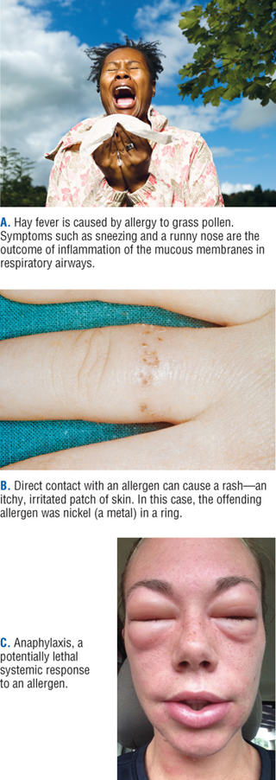
Response to Allergies
Notes:
Figure 23.19 Allergies
Hay fever is caused by allergy to grass pollen. Symptoms such as sneezing and a runny nose are the outcome of inflammation of the mucous membranes in respiratory airways.
Direct contact with an allergen can cause a rash—an itchy, irritated patch of skin. In this case, the offending allergen was nickel (a metal) in a ring.
Anaphylaxis, a potentially lethal systemic response to an allergen.

Slide 40
Immune Deficiency and AIDS
Immunodeficiency
  Insufficient immune function
  Makes people vulnerable to infections by opportunistic agents that are typically harmless to healthy people
Primary immune deficiencies such as SCIDs are present at birth.
Secondary immune deficiency results from exposure to agents such as the HIV virus.

Slide 41
AIDS
The HIV virus destroys the immune system by infecting macrophages, dendritic cells, and helper T cells.
AIDS (acquired immune deficiency syndrome)
  A collection of diseases that develops after the HIV virus weakens the immune system.
Drugs that slow the disease’s progress target processes unique to viral replication.

Slide 42
Global HIV and AIDS Cases
Region | People Living with HIV | AIDS-Related Deaths
Eastern and Southern Africa | 19,600,000 | 380,000
Asia and the Pacific | 5,200,000 | 170,000
Western/Central Africa | 6,100,000 | 280,000
Western/Central Europe and North America | 2,200,000 | 13,000
Latin America | 1,800,000 | 37,000
Eastern Europe and Central Asia | 1,400,000 | 34,000
Caribbean | 310,000 | 10,000
Middle East and North Africa | 220,000 | 9,800
Worldwide total (approximate) | 36,900,000 | 940,000
Source: Joint United Nations Programme HIV/AIDS, 2017 report
Notes:
Table 23.4 Global HIV Cases

Slide 43
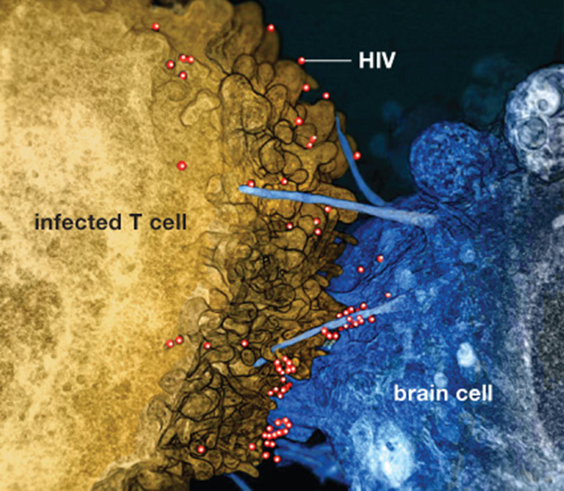
Transmission of HIV
Notes:
Figure 23.20 Cell-to-cell transmission of HIV.
This SEM shows HIV particles passing from an infected T cell to an uninfected brain cell. The immune system can eliminate HIV-infected T cells from the body, but the virus can “hide” for decades by remaining in an inactive state inside brain cells, macrophages, and other long-lived cells. These cells provide a reservoir for the virus, which can reemerge at any time to infect more T cells.

Slide 44
23.8 Vaccines
Immunization
  Procedure used to induce immunity
Active immunization
  A vaccine containing antigens elicits a primary immune response and provides lasting protection.
Passive immunization
  Antibodies purified from blood of other individuals provides immediate but temporary protection.

Slide 45
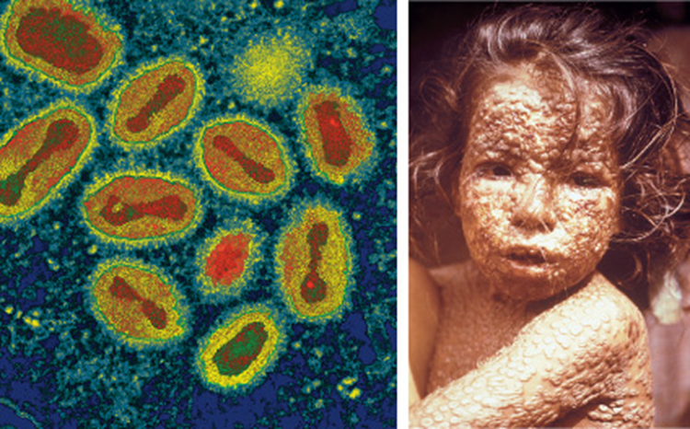
Vaccination: Cause and Effect
Notes:
Figure 23.21 Smallpox: viral cause and effect.
Worldwide use of the smallpox vaccine eradicated naturally occurring cases of smallpox; vaccinations for it ended in 1972.

Slide 46
Recommended Immunizations
Vaccine | Age of Vaccination
Hepatitis B (HepB) | Birth, 1–2 months, and 6–18 months
Rotavirus (RV) | 2, 4, and 6 months
Diphtheria, tetanus, pertussis (DTaP) | 2, 4, 6, and 15 months, and 4–6 years
Haemophilus influenzae type b (HiB) | 2, 4, 6, and 12–15 months
Pneumococcal conjugate (PCV13) | 2, 4, 6, and 12–15 months
Inactivated poliovirus (IPV) | 2, 4, and 6–18 months, and 4–6 years
Influenza (IIV) | Yearly, 6 months and older
Measles, mumps, rubella (MMR) | 12–15 months, and 4–6 years
Varicella (chicken pox, VAR) | 12–15 months, and 4–6 years
Hepatitis A (HepA) | 12 and 18 months
Human papillomavirus (HPV) | 11–12 years
Meningococcal B (MenB) | 11–12 years, 16 years
Notes:
Table 23.5 Recommended Immunization Schedule for Children

Slide 47
Points to Ponder
What is MRSA, how is it treated, and how can you protect against it?
Consider the recent outbreak of communicable diseases that can be prevented by vaccinations.
  How are unvaccinated individuals impacting the occurrence of these outbreaks?

