Slide 1
Image PowerPoint slides to accompany
The Chemical Basis
of Life
Chapter 2

Slide 2
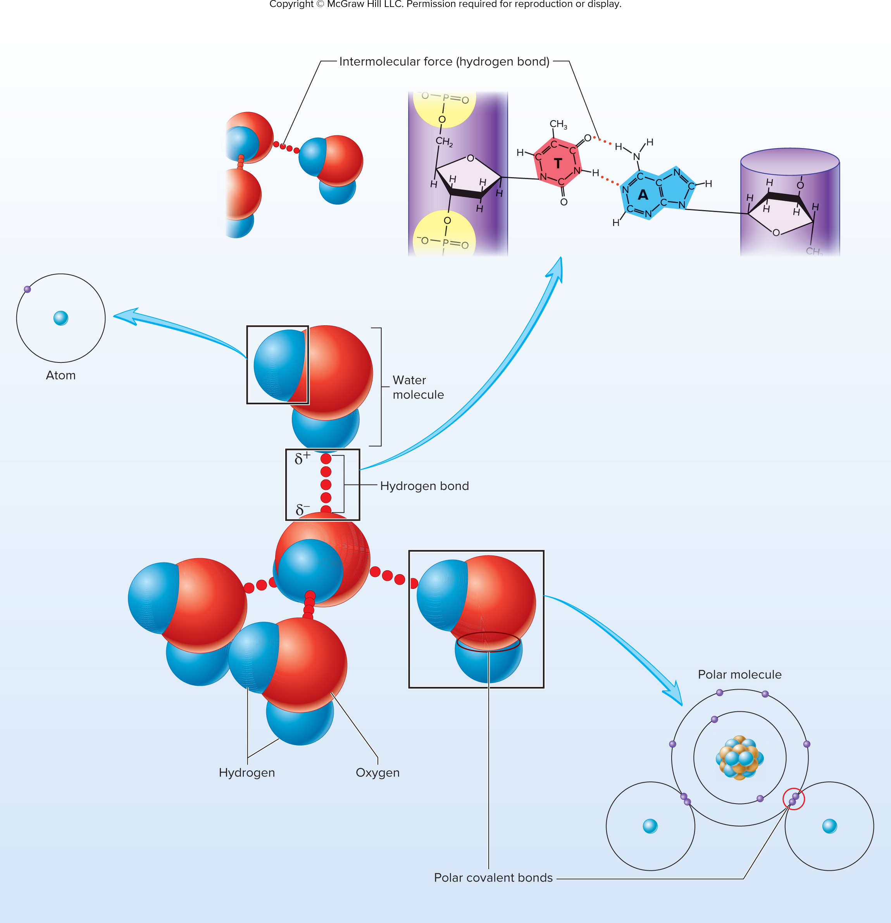
Chapter Opener

Slide 3
Table 2.1
TABLE 2.1
Common Elements in the Human Body
Atomic
Number
Mass
Number
Atomic
Mass
Percent by
Weight
Percent by
Number of Atoms
Element
Symbol
Hydrogen
H
1
1
1.008
9.5
63.0
Carbon
C
6
12
12.01
18.5
9.5
Nitrogen
N
7
14
14.01
3.3
1.4
Oxygen
O
8
16
16.00
65.0
25.5
Fluorine
F
9
19
19.00
Trace
Trace
Sodium
Na
11
23
22.99
0.2
0.3
Magnesium
Mg
12
24
24.31
0.1
0.1
Phosphorus
P
15
31
30.97
1.0
0.22
Sulfur
S
16
32
32.07
0.3
0.05
Chlorine
CI
17
35
35.45
0.2
0.03
Potassium
K
19
39
39.10
0.4
0.06
Calcium
Ca
20
40
40.08
1.5
0.31
Iron
Fe
26
56
55.85
Trace
Trace
Iodine
I
53
127
126.9
Trace
Trace

Slide 4
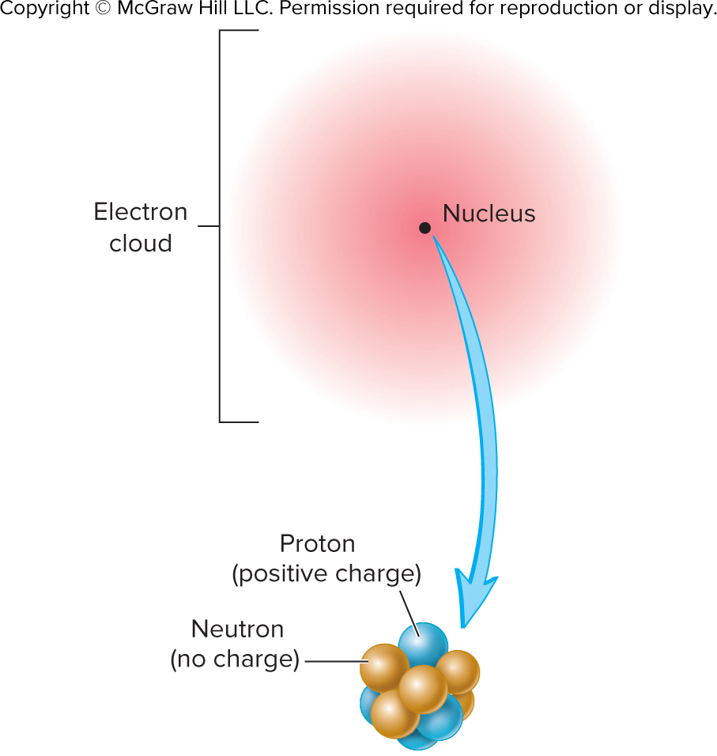
Figure 2.1

Slide 5
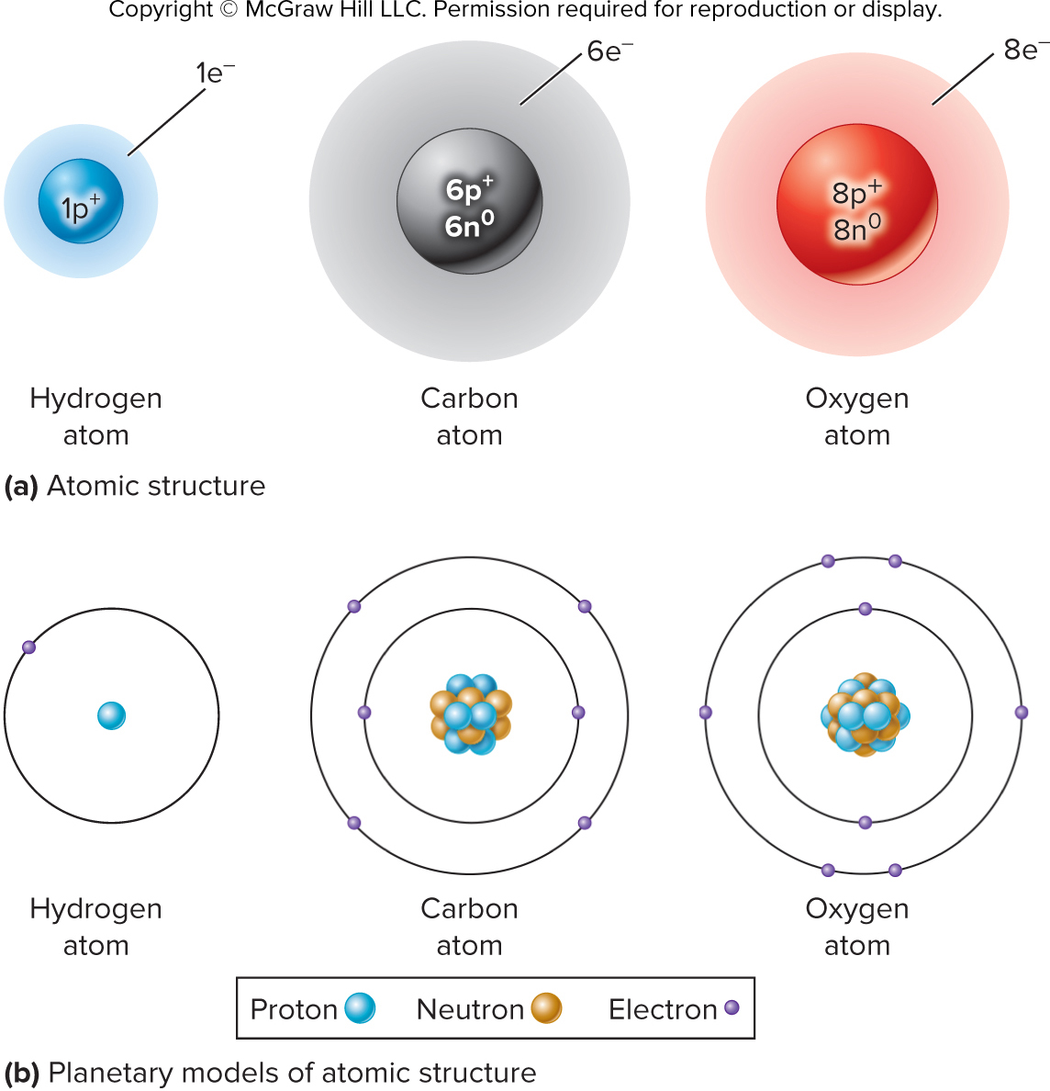
Figure 2.2

Slide 6
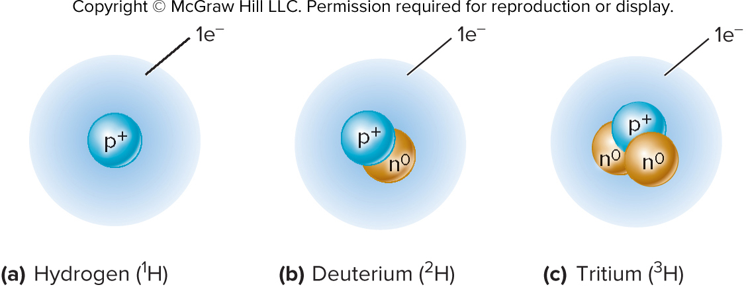
Figure 2.3

Slide 7
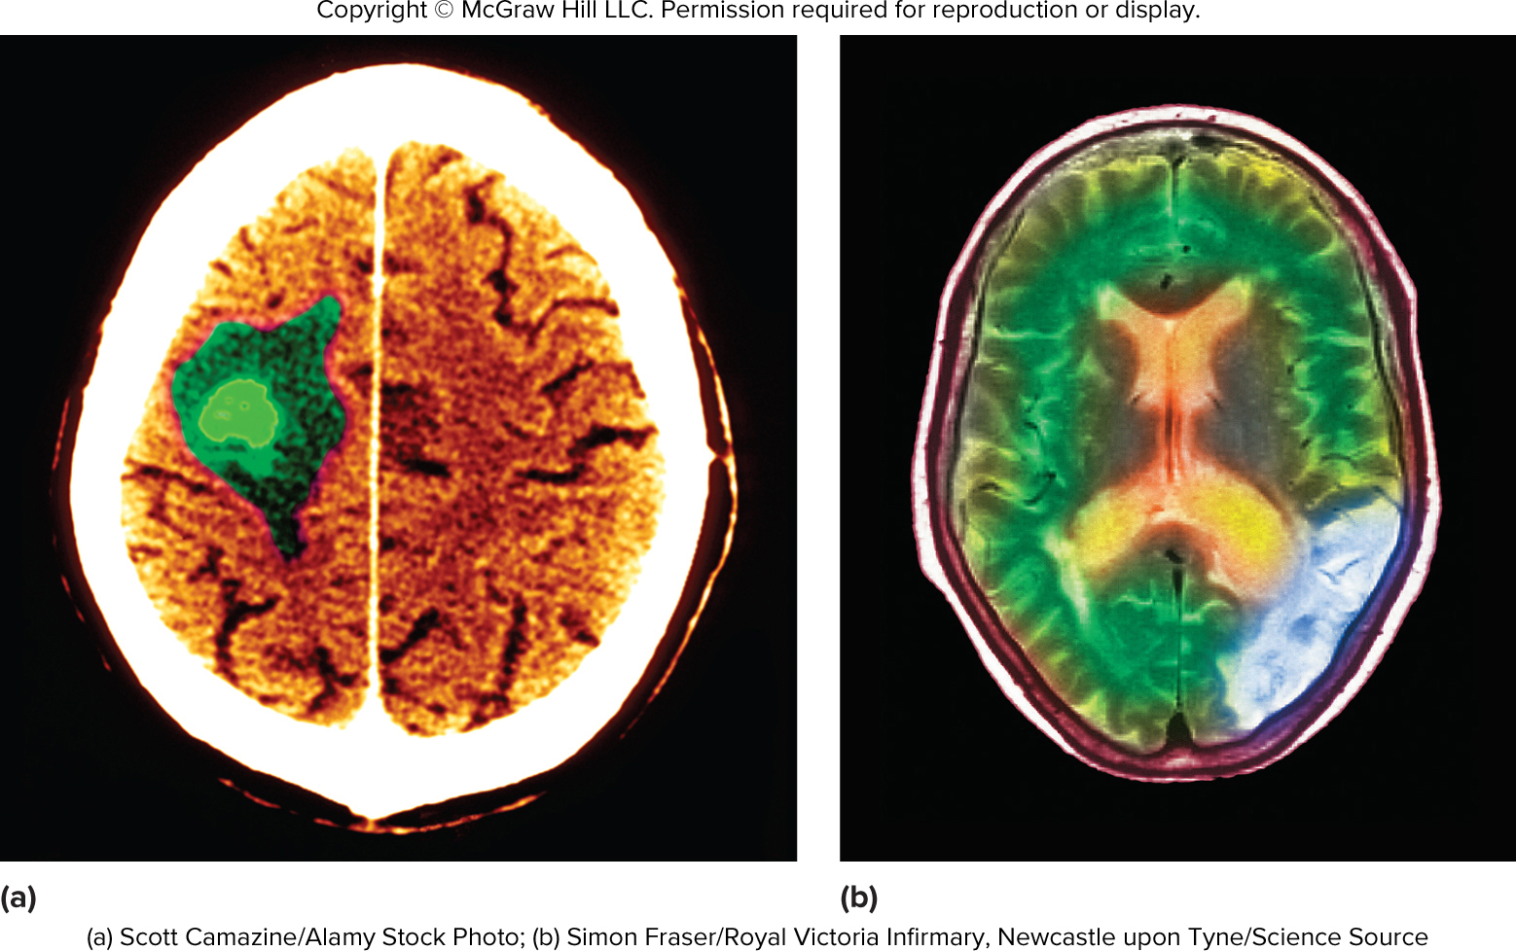
Figure 2.4

Slide 8
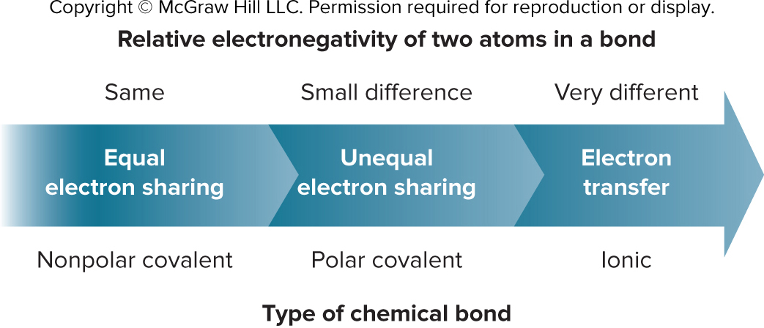
Figure 2.5

Slide 9
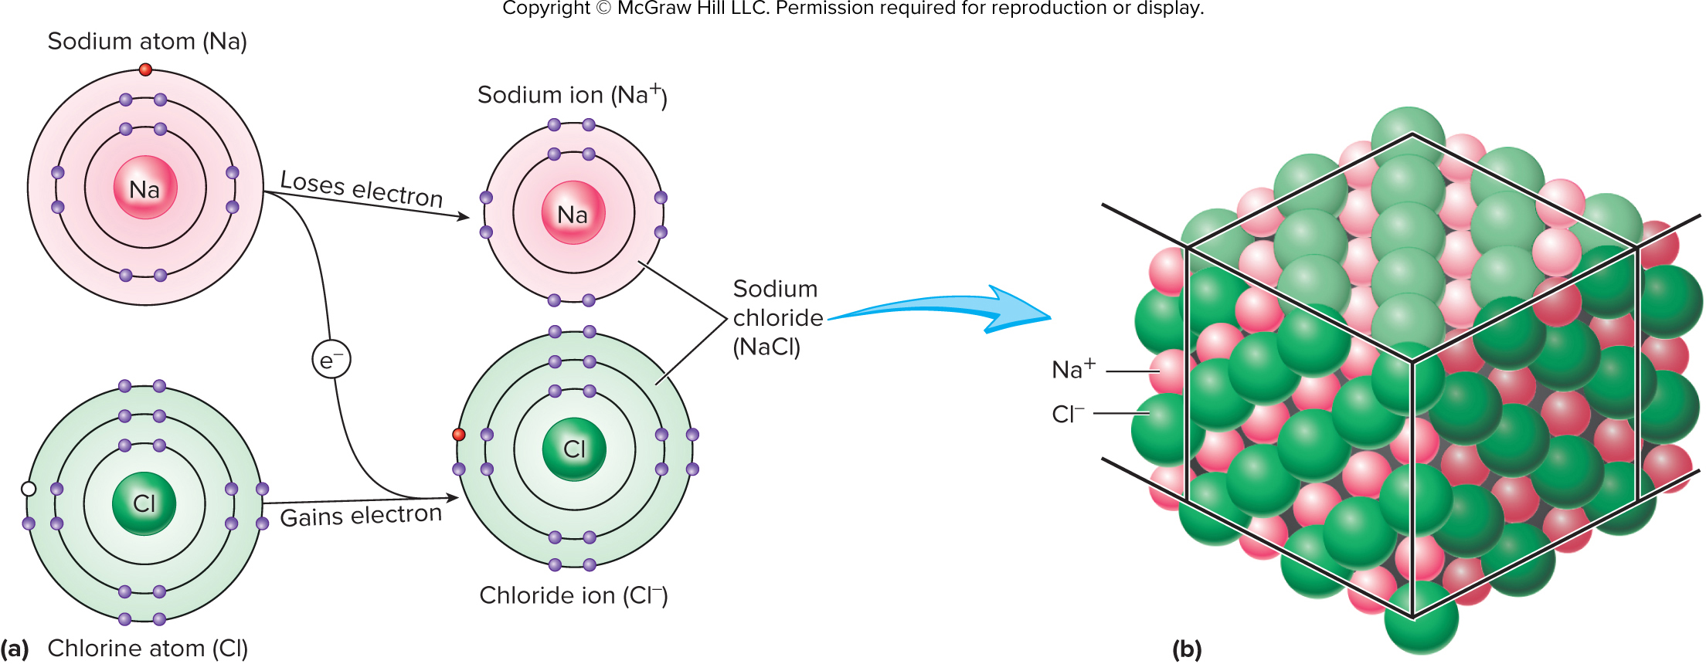
Figure 2.6ab

Slide 10
Table 2.2
TABLE 2.2
Important Ions in the Human Body
Ion
Symbol
Significance*
Calcium
Ca²⁺
Part of bones and teeth; functions in
blood clotting, muscle contraction,
release of neurotransmitters
Sodium
Na⁺
Membrane potentials, water balance
Potassium
K⁺
Membrane potentials
Hydrogen
H⁺
Acid-base balance
Hydroxide
OH⁻
Acid-base balance
Chloride
Cl⁻
Water balance
Bicarbonate
HCO₃⁻
Acid-base balance
Ammonium
NH₄⁺
Acid-base balance
Phosphate
PO₄³⁻
Part of bones and teeth;
functions in energy exchange, acid-
base balance
Iron
Fe²⁺
Red blood cell formation
Magnesium
Mg²⁺
Necessary for enzymes
Iodide
I⁻
Present in thyroid hormones
*The ions are part of the structures or play important roles in the processes listed.

Slide 11
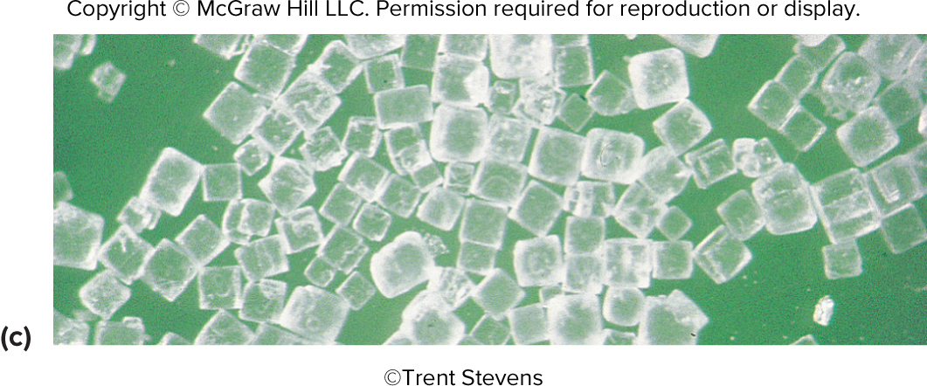
Figure 2.6c

Slide 12
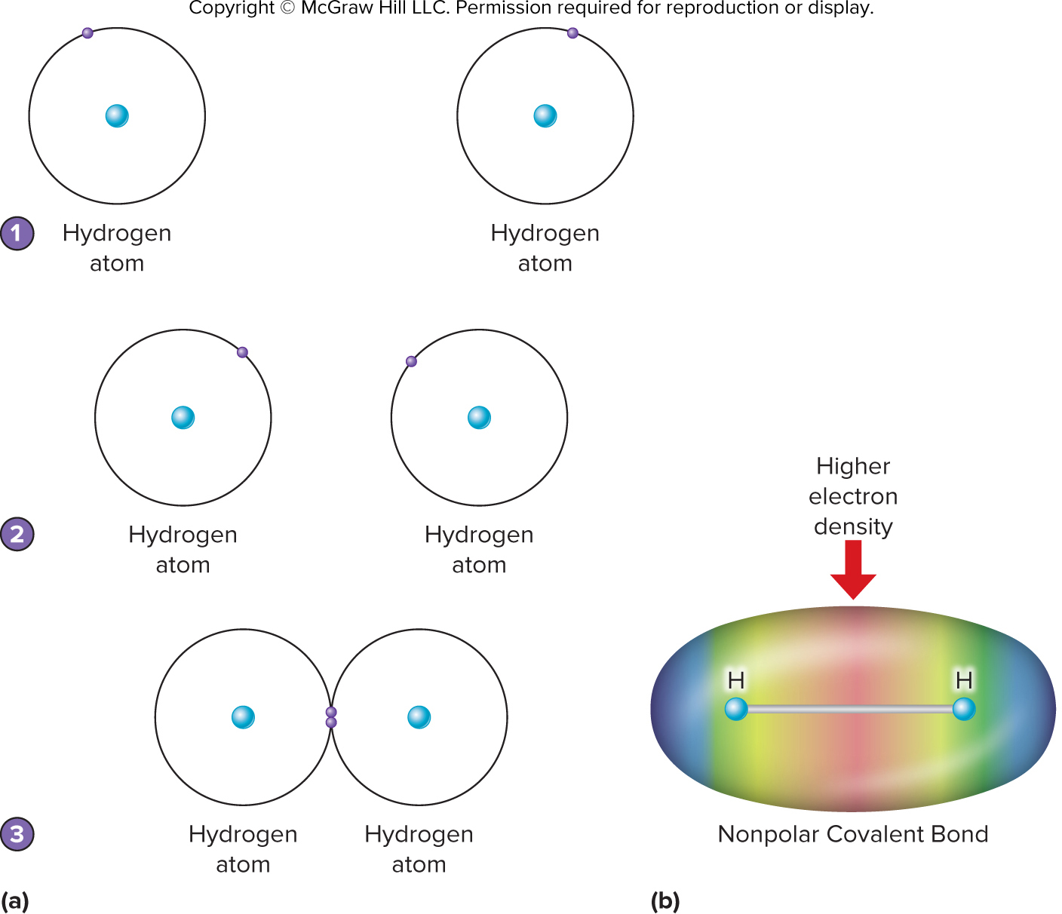
Figure 2.7

Slide 13
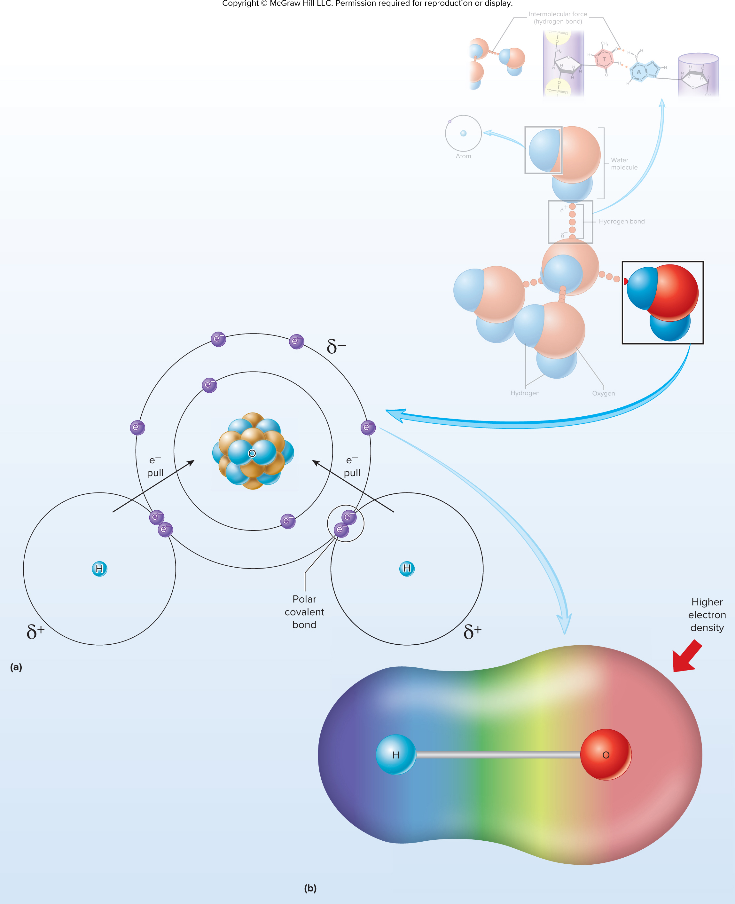
Figure 2.8

Slide 14
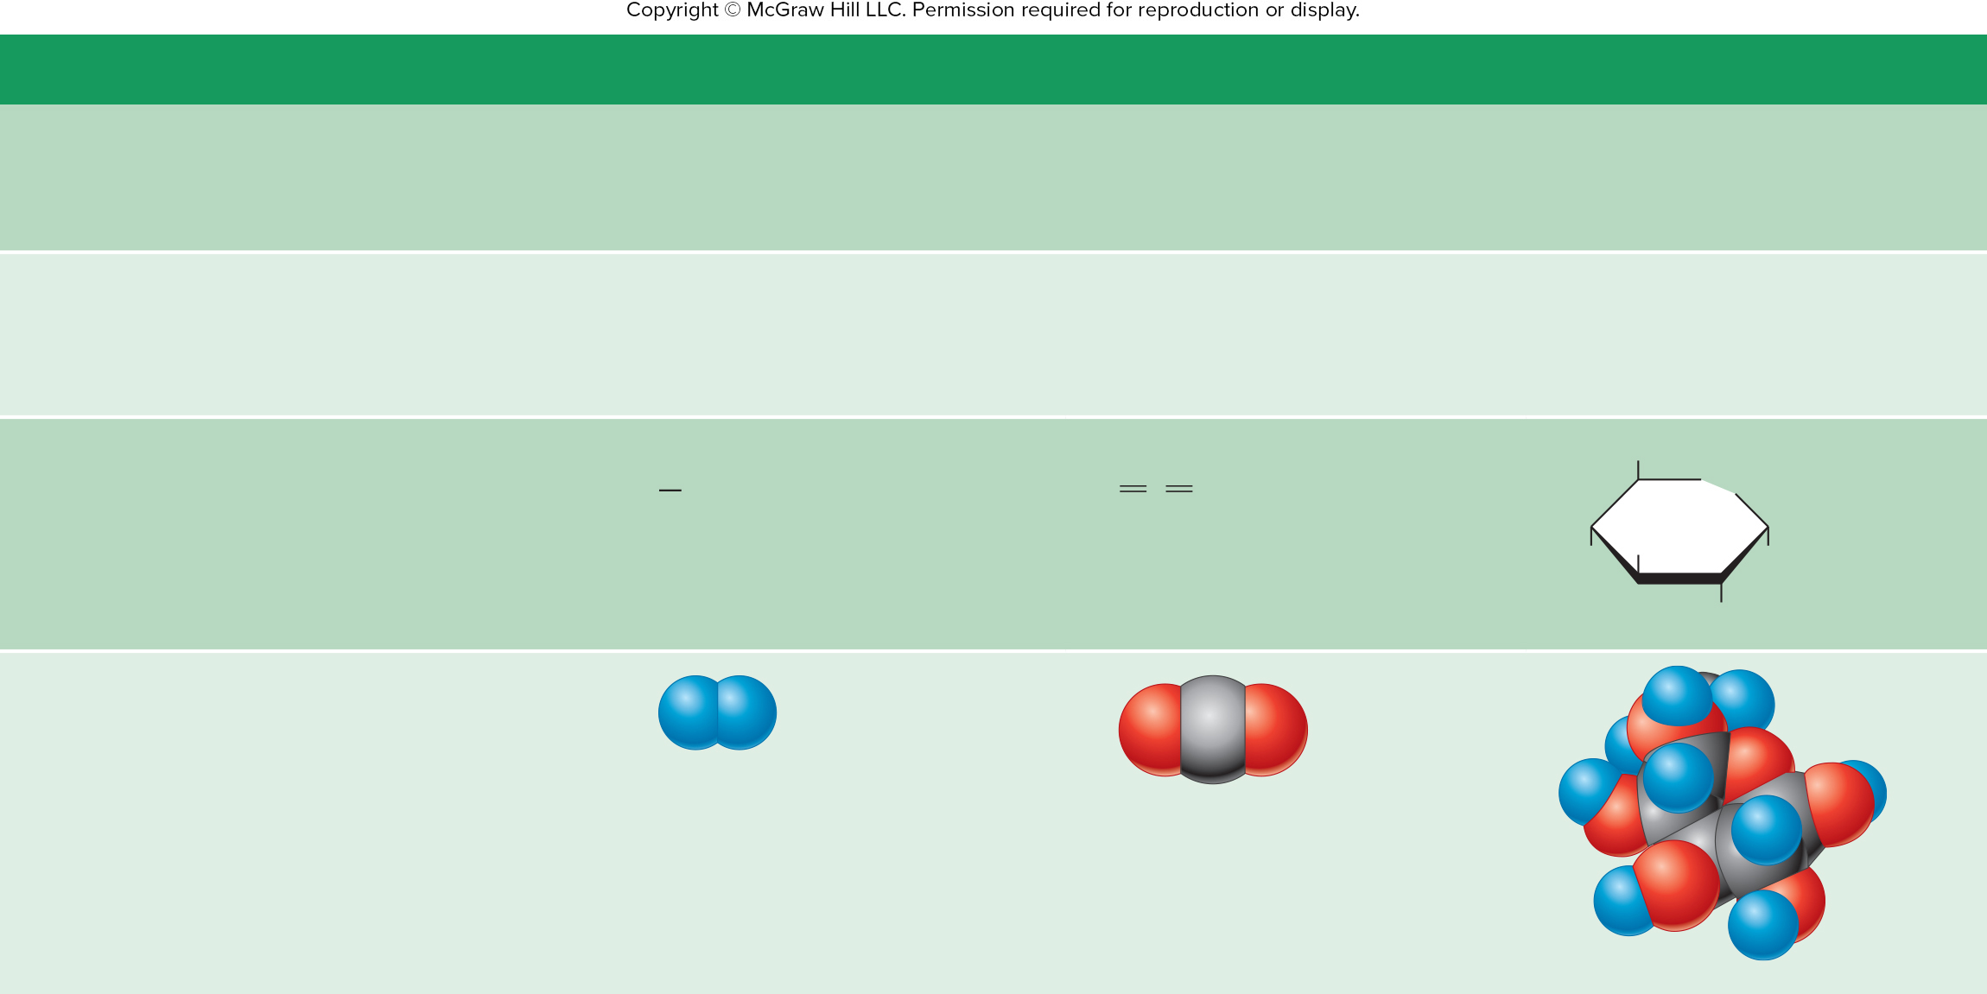
Table 2.3
TABLE 2.3
Picturing Molecules
Representation
Hydrogen
Carbon Dioxide
Glucose
Chemical Formula
The formula shows the kind and number of atoms present.
H₂
CO₂
C₆H₁₂O₆
Electron-Dot Formula
The bonding electrons are shown as dots between the symbols of the atoms.
H:H
O::C::O
Not used for complex molecules
Single covalent bond
Double covalent bond
Bond-Line Formula
CH₂OH
The bonding electrons are shown as lines between the symbols of the atoms.
H
H
O
C
O
O
Single covalent bond
Double covalent bond
HO
OH
OH
OH
Models
Atoms are shown as different-sized and different-colored spheres.
Hydrogen
atom
Oxygen
atom
Carbon
atom

Slide 15
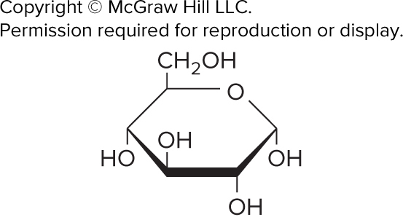
ta 2.01

Slide 16
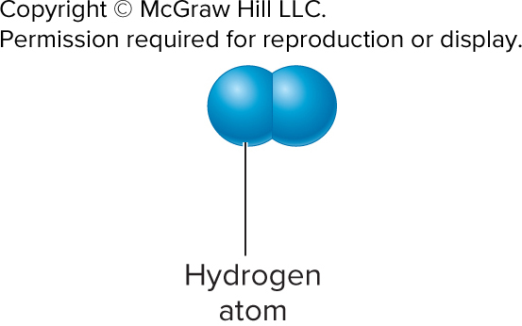
ta 2.02

Slide 17
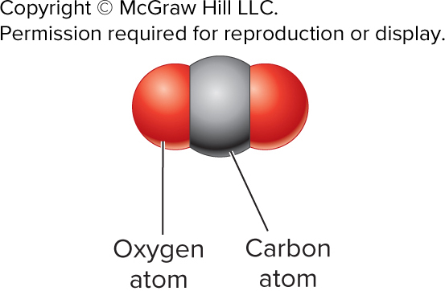
ta 2.03

Slide 18
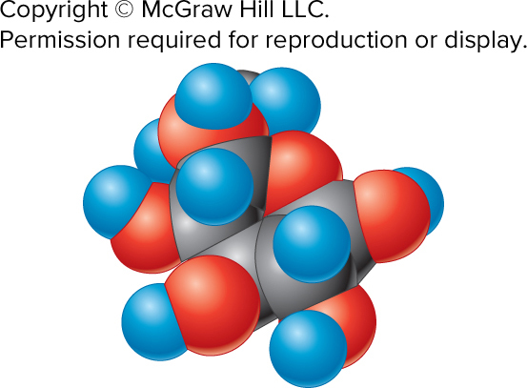
ta 2.04

Slide 19
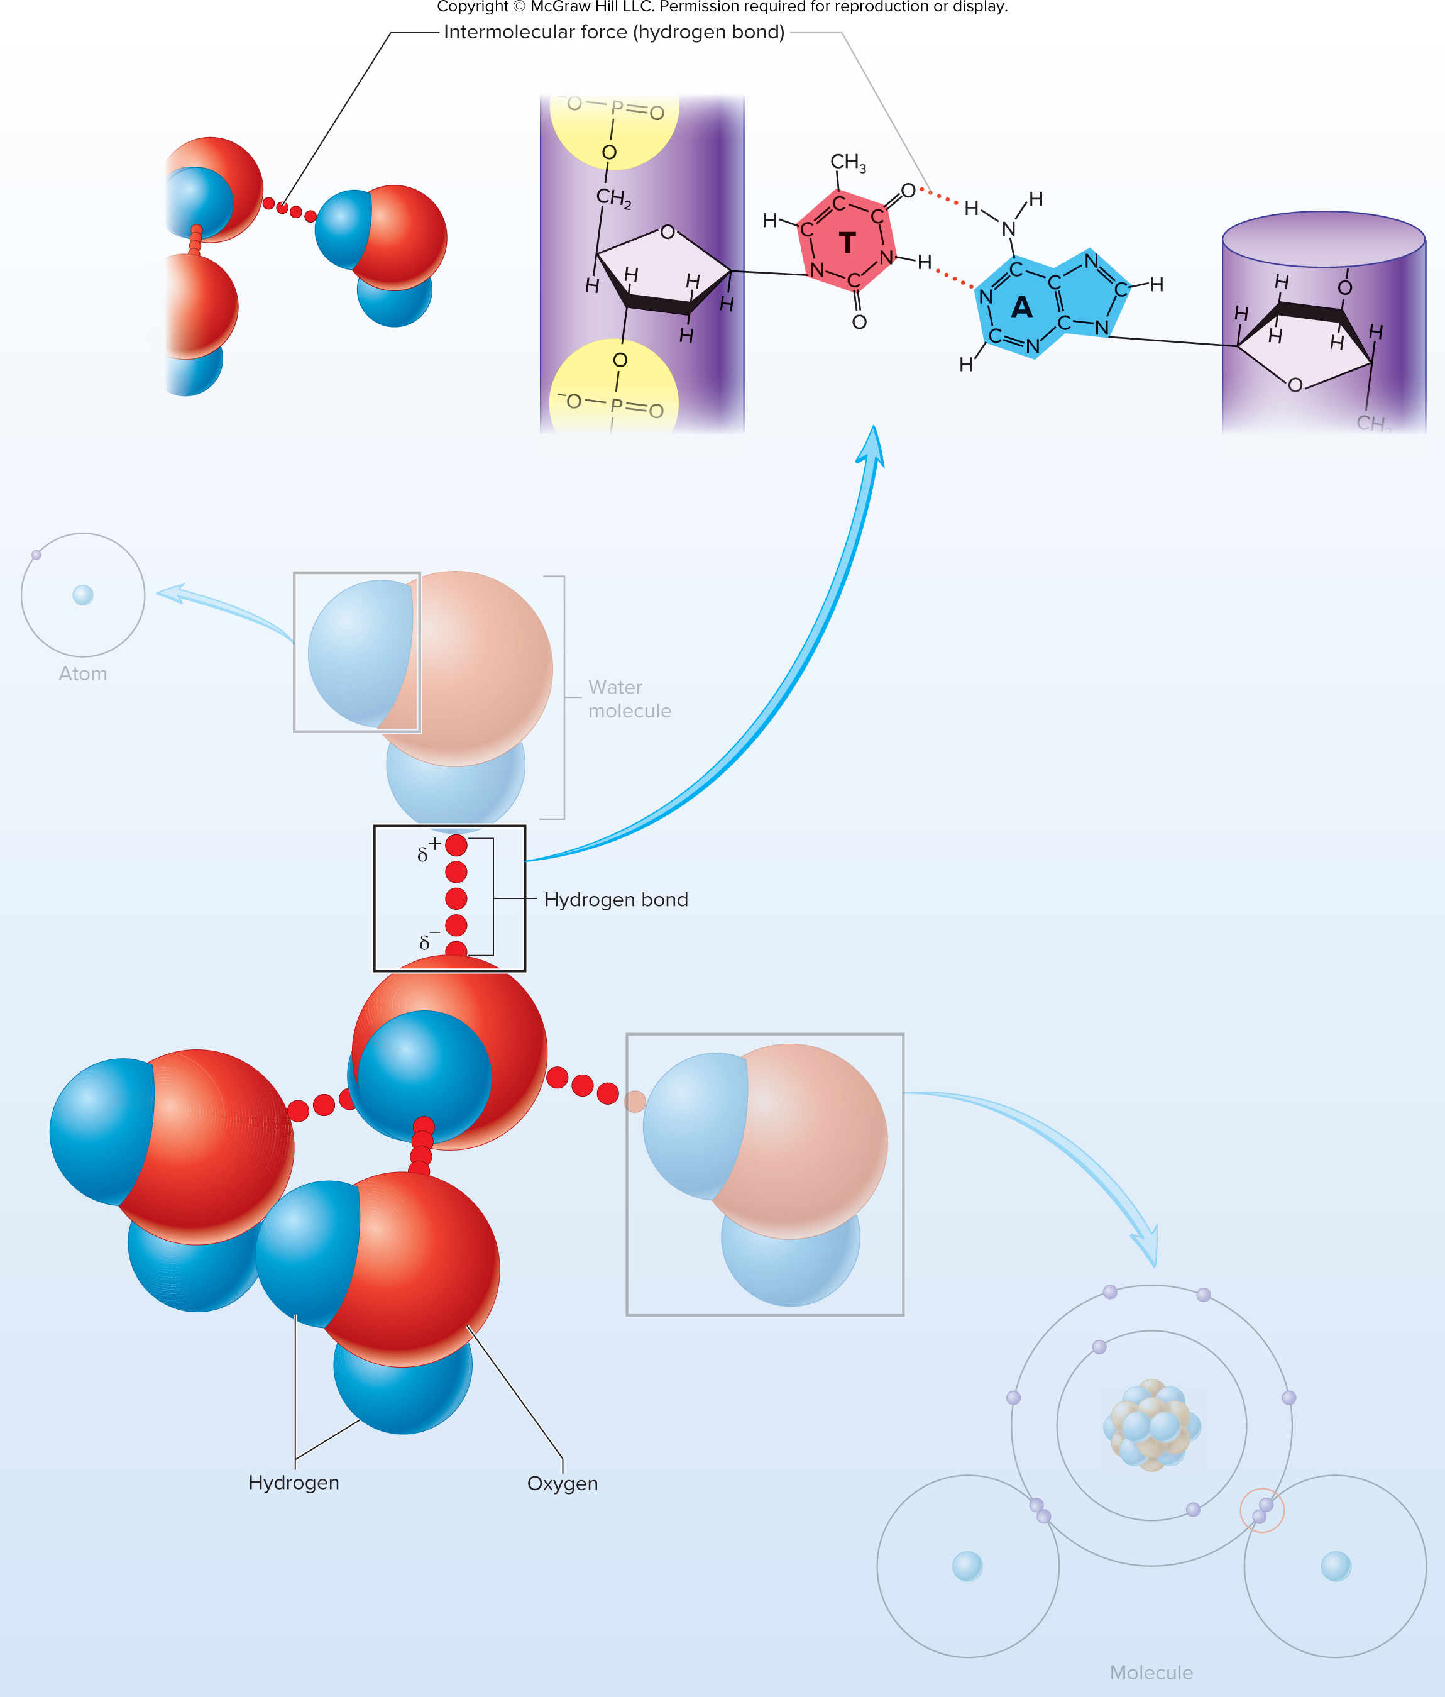
Figure 2.9

Slide 20
Table 2.4
TABLE 2.4
Comparison of Bonds
Chemical Bond
Example
Ionic Bond
A complete transfer of electrons between
two atoms results in separate positively
charged and negatively charged ions.
Na⁺Cl⁻
Sodium chloride
Polar Covalent Bond
H
δ⁺
An unequal sharing of electrons
between two atoms results in a slightly
positive charge (δ+) on one side of the
molecule and a slightly negative charge
(δ⁻) on the other side of the molecule.
O
δ⁻
H
δ⁺
Water
Nonpolar Covalent Bond
An equal sharing of electrons between
two atoms results in an even charge distri-
bution among the atoms of the molecule.
H
H
Hydrogen
Intermolecular Bond
Hydrogen Bond
H
The attraction of oppositely charged ends
of one polar molecule to another polar
molecule holds molecules or parts of mol-
ecules together.
O
H
O
H
H
Water molecules

Slide 21
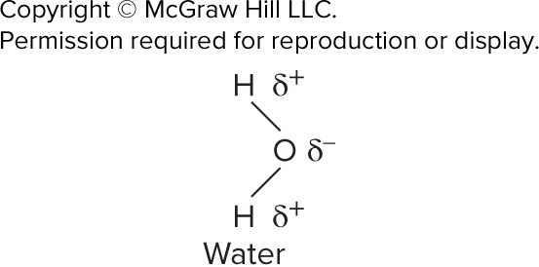
ta 2.05

Slide 22
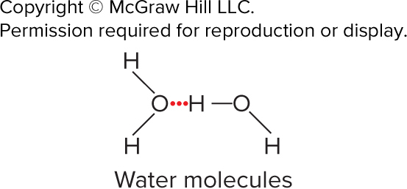
ta 2.06

Slide 23
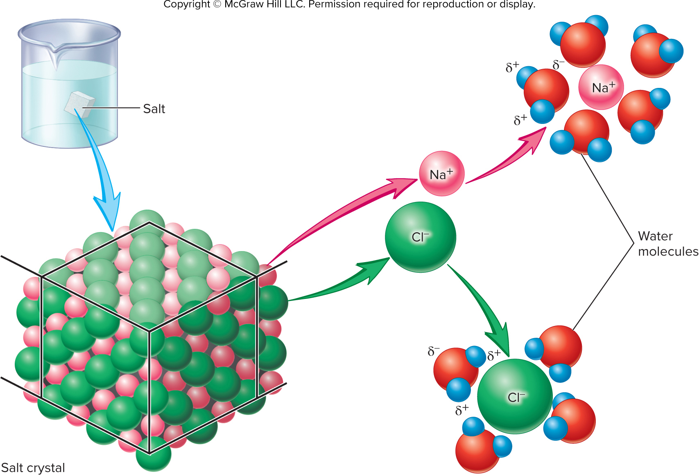
Figure 2.10

Slide 24
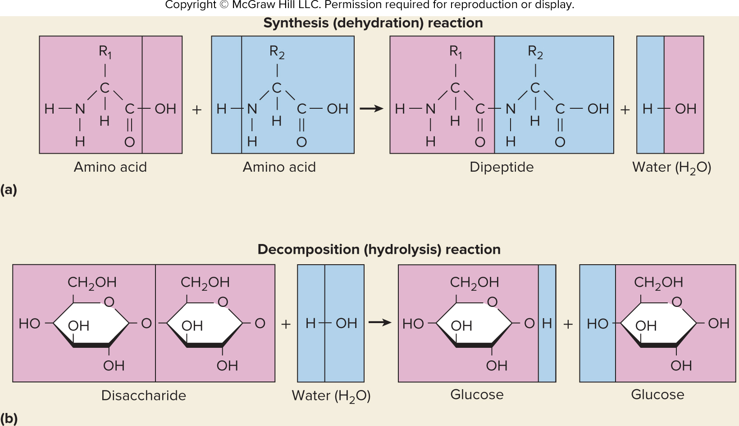
Figure 2.11

Slide 25
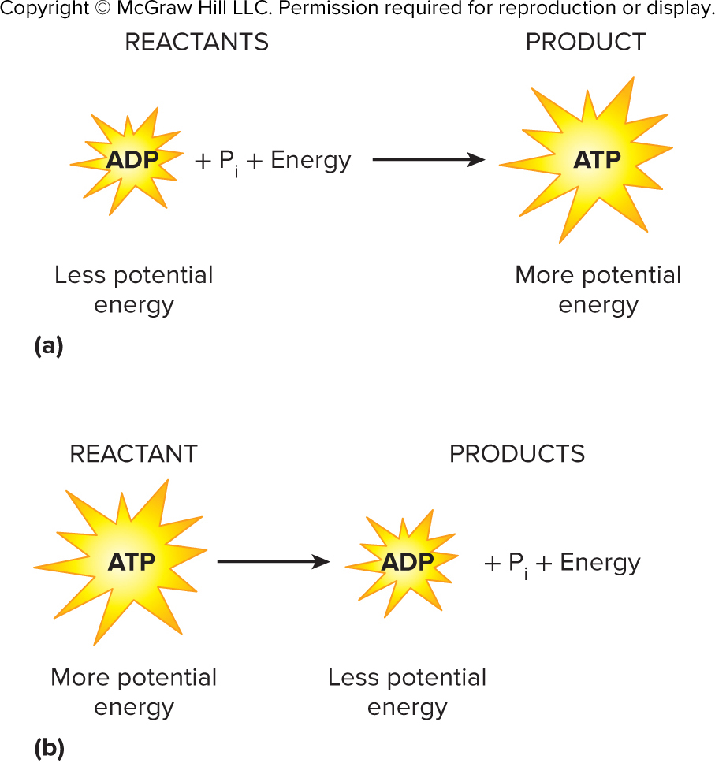
Figure 2.12

Slide 26
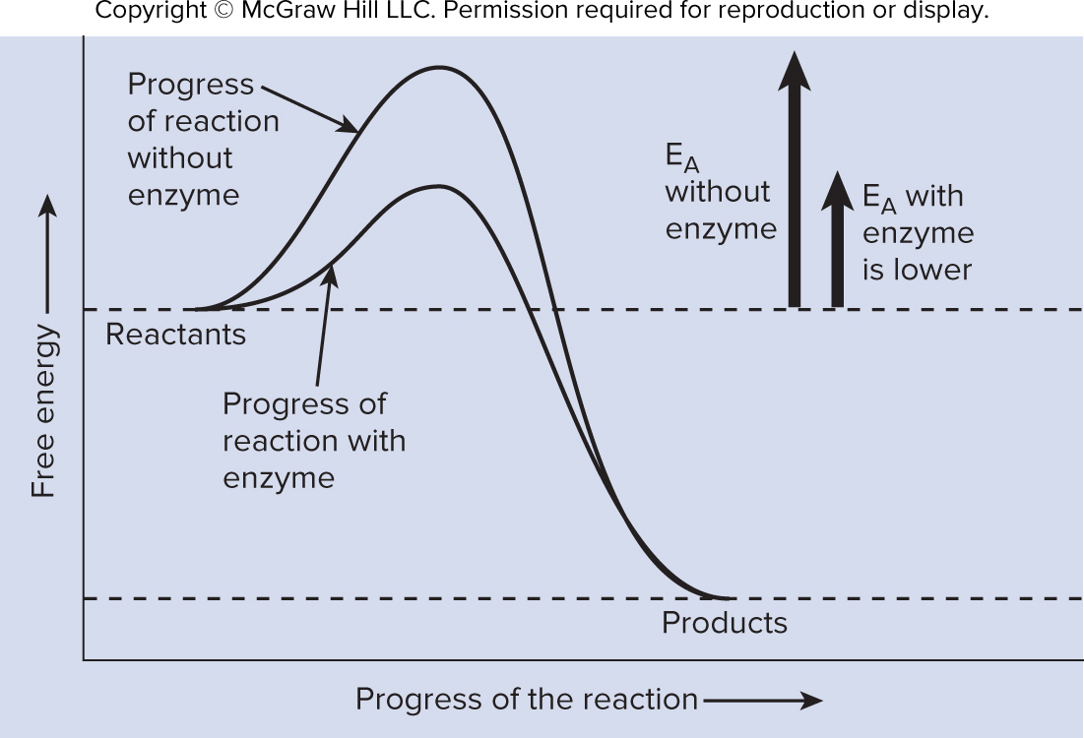
Figure 2.13

Slide 27
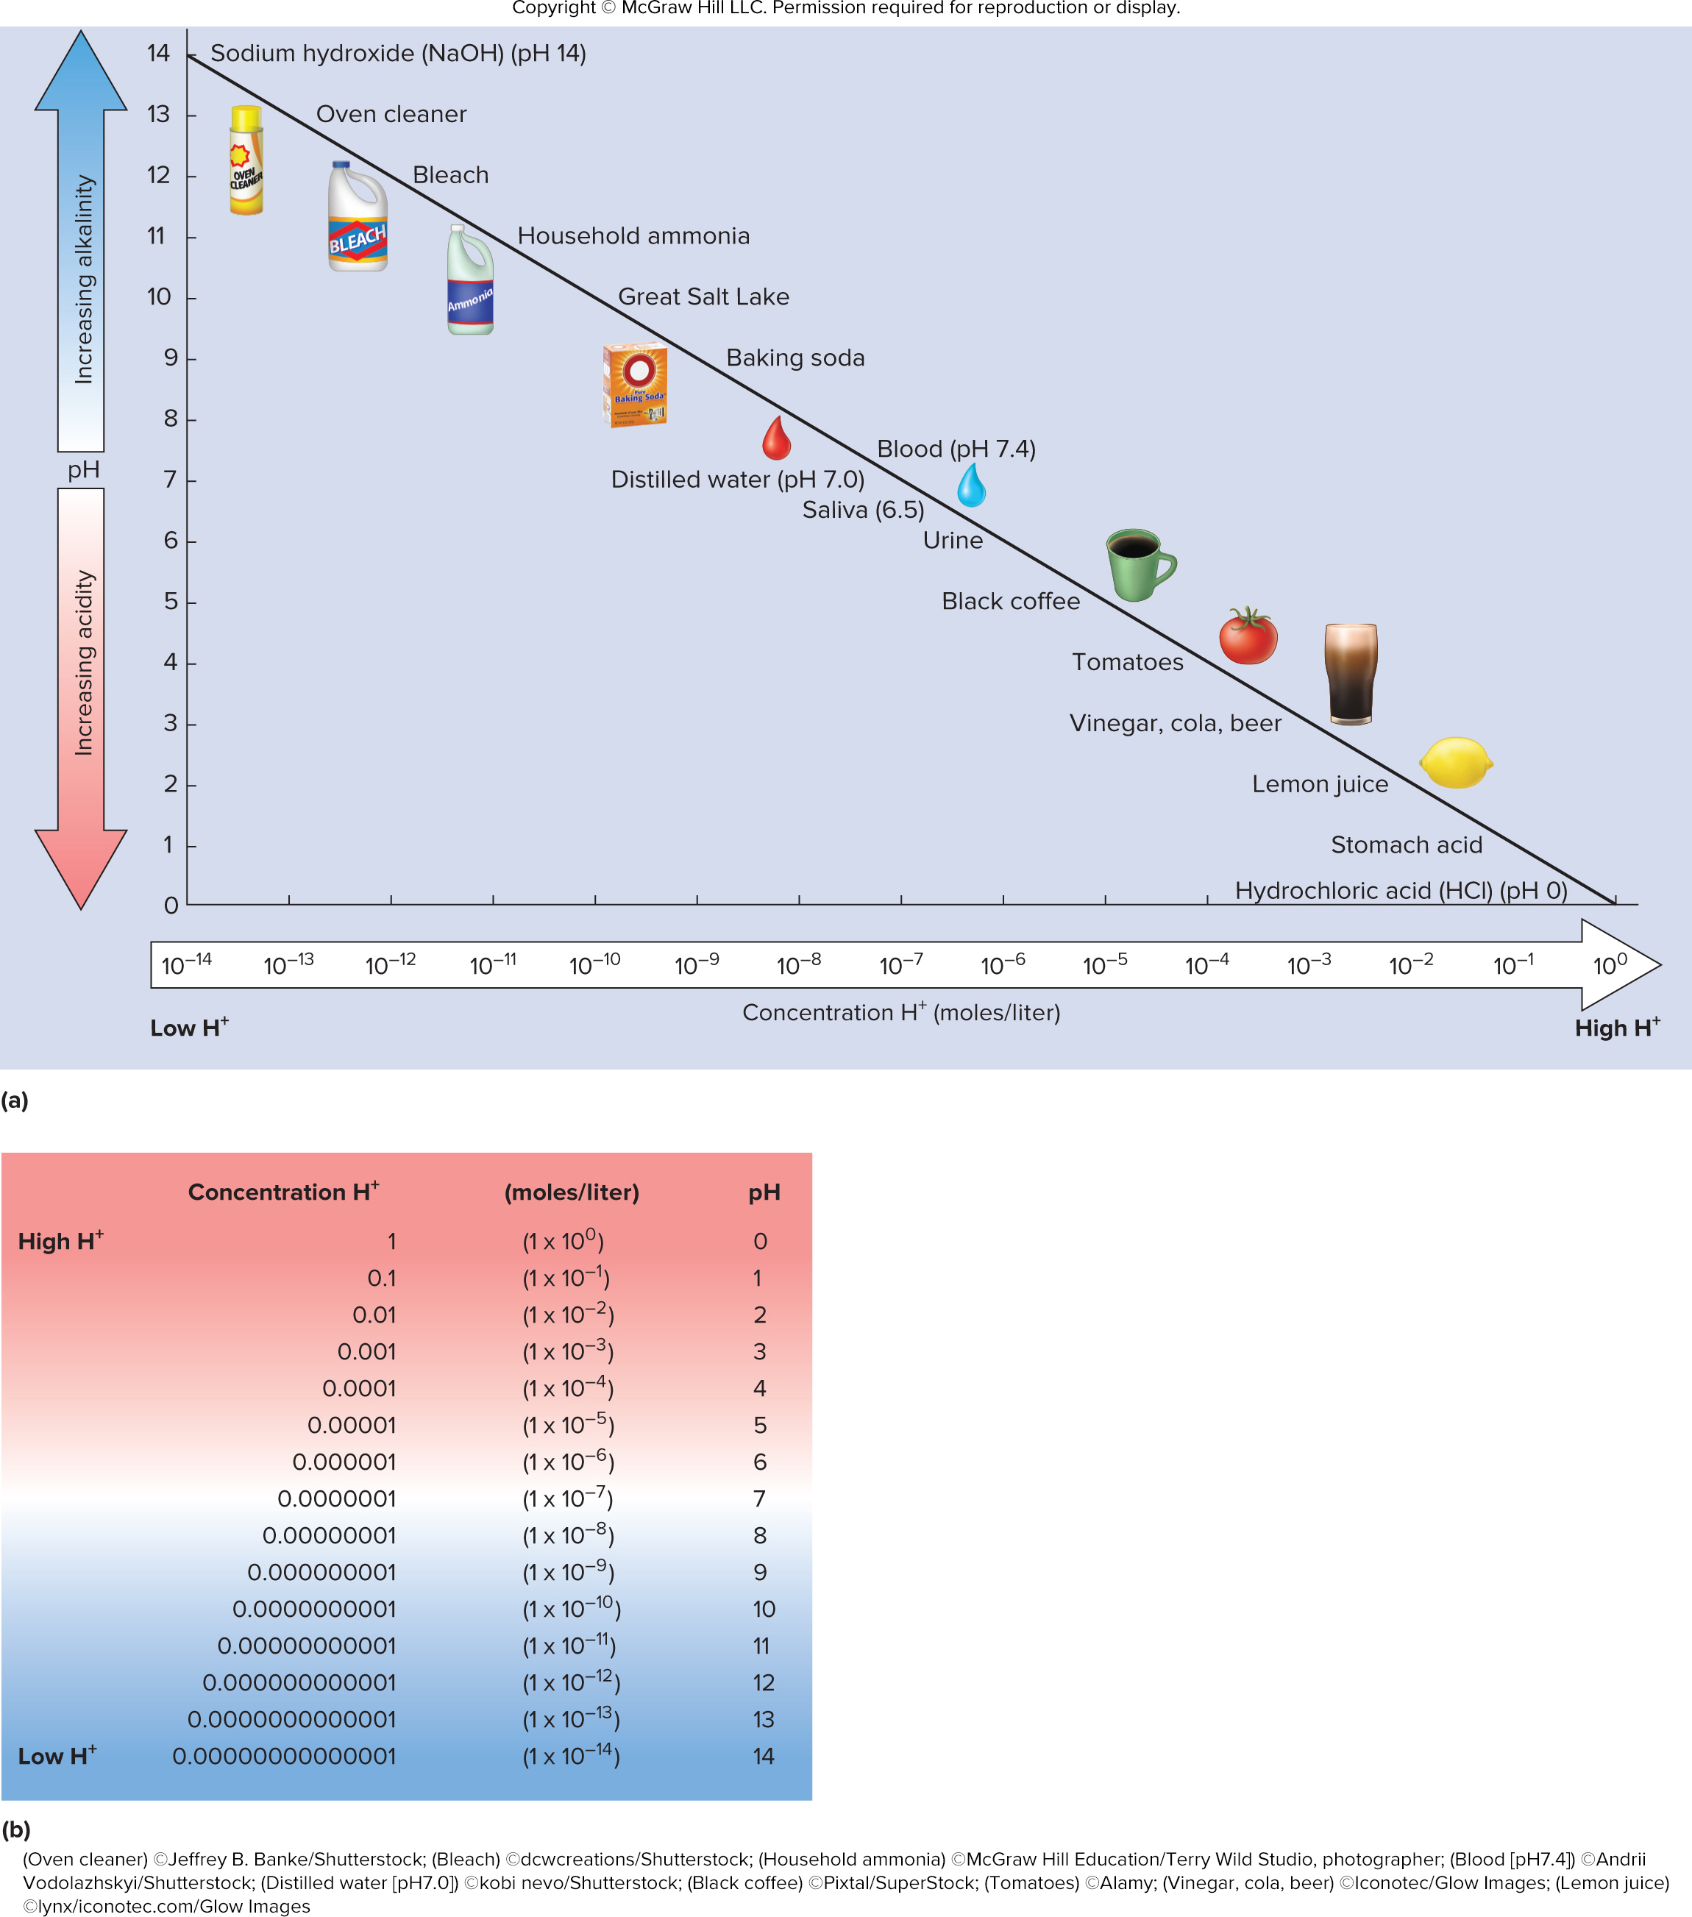
Figure 2.14

Slide 28
Figure 2.15

Slide 29
Table 2.5
TABLE 2.5
Major Functional Groups of Organic Compounds
Name and Structural Formula*
Functional Significance
Hydroxyl
Alcohols contain a hydroxyl group, which is polar and hydrophilic. Hydroxyl groups greatly increase the solubility of molecules in water.
R
O
H
Sulfhydryl
Thiols have a sulfhydryl group, which is polar and hydrophilic. The amino acid cysteine contains a sulfhy-
dryl group that can form a disulfide bond with another cysteine to help stabilize protein structure.
R
S
H
Carbonyl
Ketones and aldehydes have a carbonyl group, which is polar and hydrophilic. Ketones contain a car-
bonyl group within the carbon chain. Ketones are formed during normal metabolism, but they can be elevated in the blood during starvation or certain diabetic states. Aldehydes are similar to ketones, but
they have the carbonyl group at the end of the carbon chain.
O
R
C
R
Carboxyl
Carboxylic acids have a carboxyl group, which is hydrophilic and can act as an acid by donating a hydro-
gen ion. All amino acids have a carboxyl group at one end. At physiological pH, the amino acid carboxyl group is predominantly negatively charged.
O
R
C
OH
Ester
Esters are structures with an ester group, which is less hydrophilic than hydroxyl or carboxyl groups. Triglycerides and dietary fats are esters. Other types of esters include the volatile compounds in perfumes.
O
R
C
O
R
Amino
H
Amines have an amino group, which is less hydrophilic than carboxyl groups. Amines can act as a base by accepting a hydrogen ion. All amino acids have an amine group at one end. At physiological pH, the amino acid amine group is predominantly positively charged.
R
N
H
Phosphate
Phosphates have a phosphate group, which is very hydrophilic due to the double negative charge. Phos-
phates are used as an energy source (adenosine triphosphate) in biological membranes (phospholipids)
and as intracellular signaling molecules (protein phosphorylation).
O
R
O
P
O–
O–
*R = variable group.

Slide 30
ta 2.07a

Slide 31
ta 2.07b

Slide 32
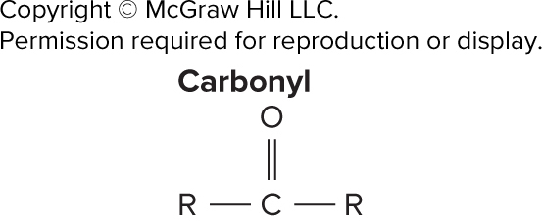
ta 2.07c

Slide 33
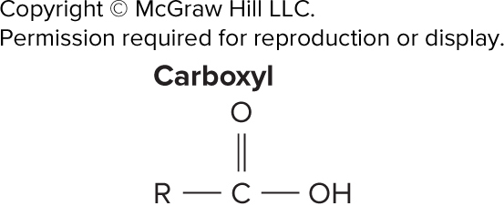
ta 2.07d

Slide 34
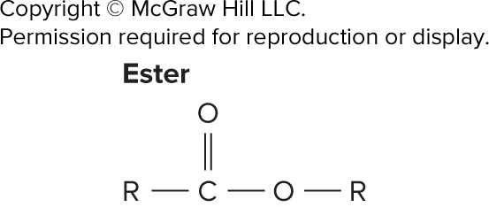
ta 2.07e

Slide 35
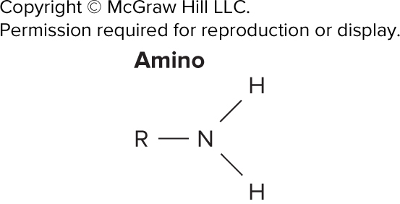
ta 2.07f

Slide 36
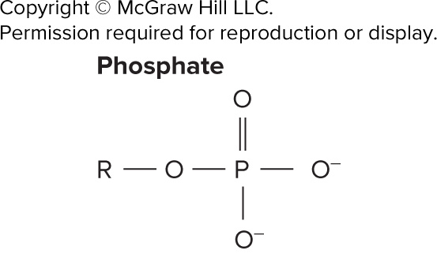
ta 2.07g

Slide 37
Table 2.6
TABLE 2.6
Roles of Carbohydrates in the Body
Role
Example
Structure
Ribose forms part of RNA and ATP molecules.
Deoxyribose forms part of DNA.
Energy
Monosaccharides (glucose, fructose, galactose) can be used as energy sources.
Disaccharides (sucrose, lactose, maltose) and polysaccha-
rides (starch, glycogen) must be broken down to monosac-
charides before they can be used for energy. Glycogen is
an important energy-storage molecule in muscles and in
the liver.
Bulk
Cellulose forms bulk in the feces.

Slide 38
Figure 2.16

Slide 39
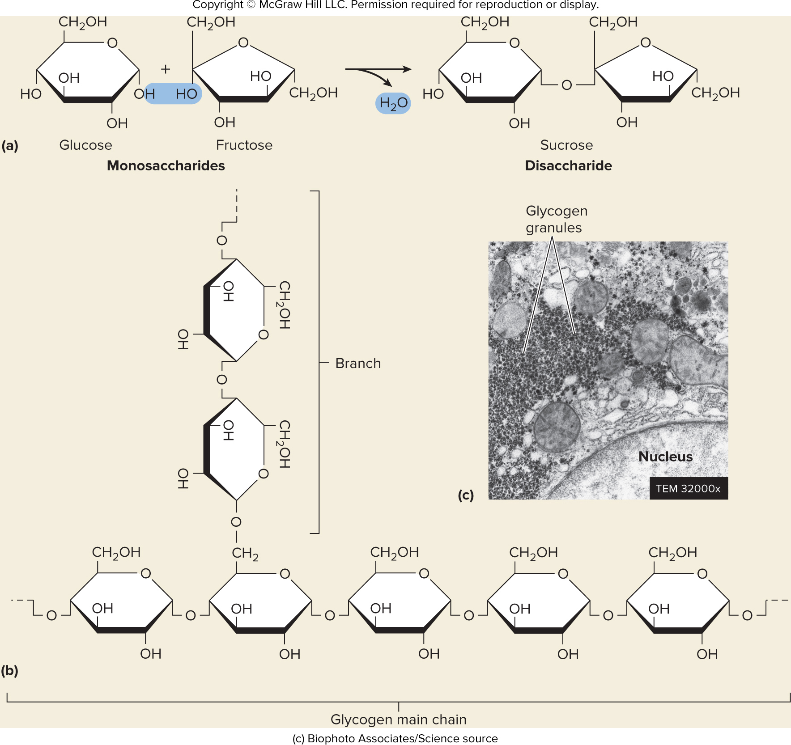
Figure 2.17

Slide 40
Table 2.7
TABLE 2.7
Roles of Lipids in the Body
Role
Example
Protection
Adipose tissue surrounds and pads organs.
Insulation
Adipose tissue under the skin prevents heat loss.
Myelin surrounds nerve cells and electrically insulates
the cells from one another.
Regulation
Steroid hormones regulate many physiological pro-
cesses. For example, estrogen and testosterone are
the reproductive hormones responsible for many of
the differences between males and females. Prosta-
glandins help regulate tissue inflammation and repair.
Vitamins
Fat-soluble vitamins perform a variety of functions.
Vitamin A forms retinol, which is necessary for seeing
in the dark; active vitamin D promotes calcium uptake
by the small intestine; vitamin E promotes wound
healing; and vitamin K is necessary for the synthesis
of proteins responsible for blood clotting.
Structure
Phospholipids and cholesterol are important compo-
nents of the membranes of cells.
Energy
Lipids can be stored and broken down later for
energy; per unit of weight, they yield more energy
than carbohydrates or proteins.

Slide 41
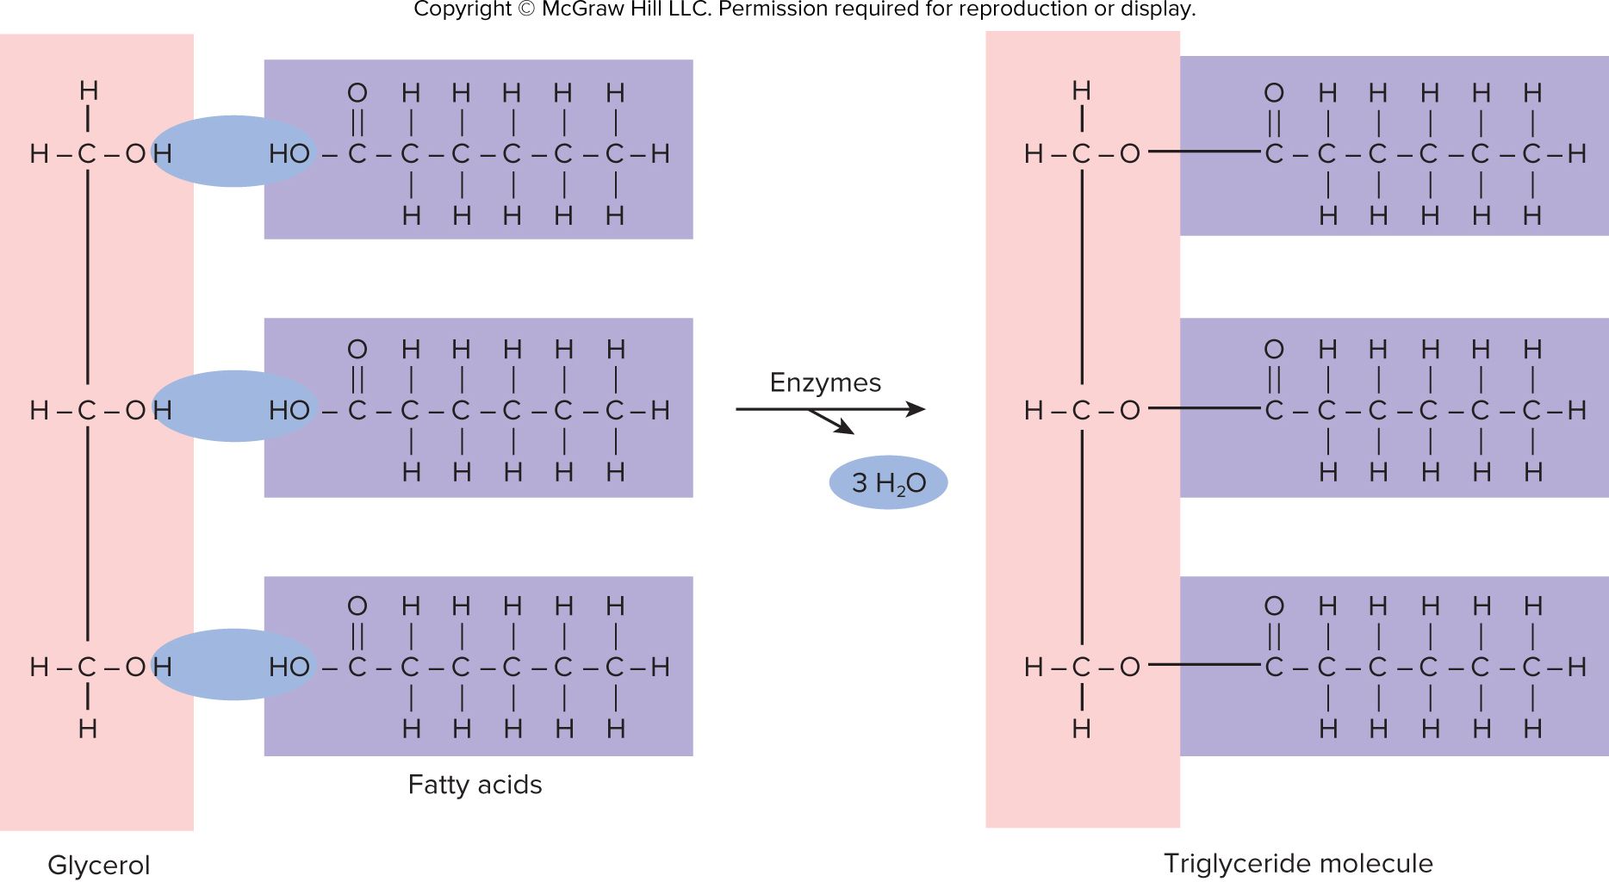
Figure 2.18

Slide 42
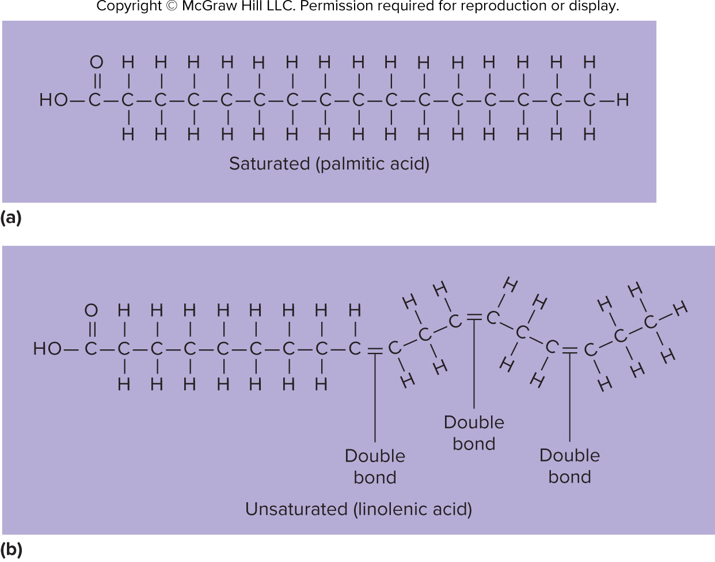
Figure 2.19

Slide 43
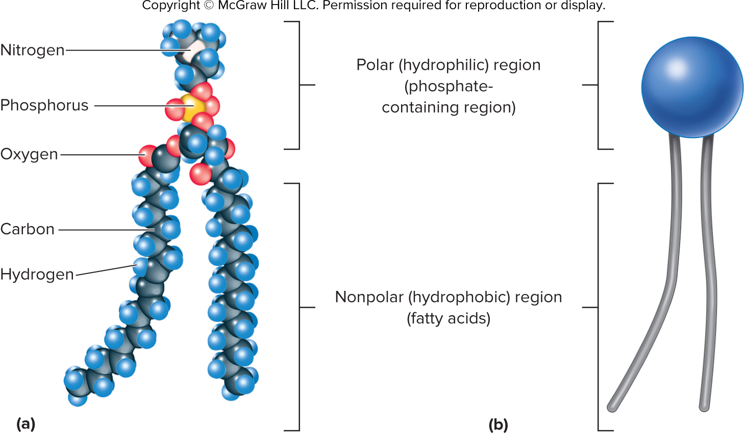
Figure 2.20

Slide 44
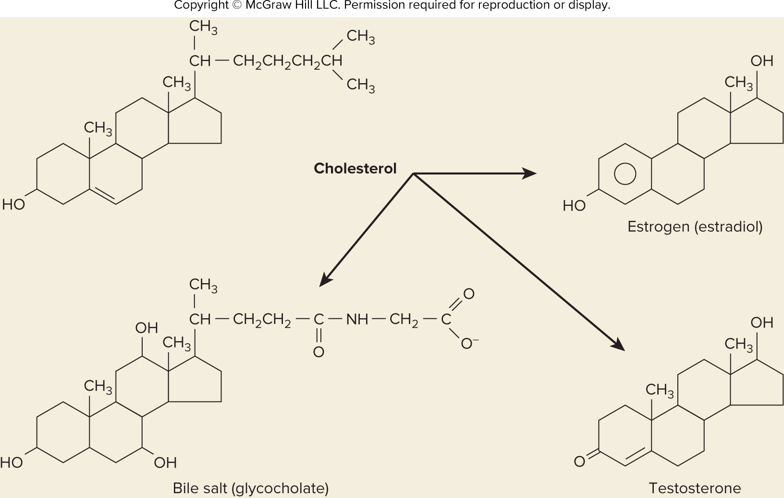
Figure 2.21

Slide 45
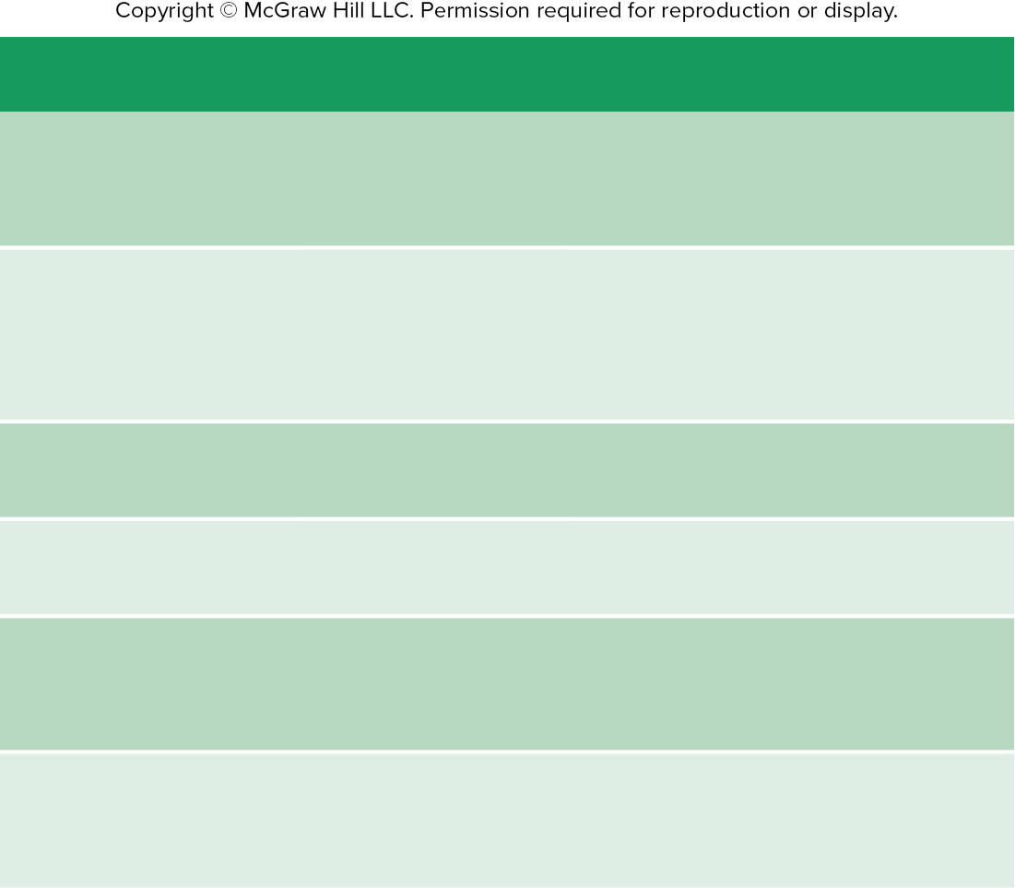
Table 2.8
TABLE 2.8
Roles of Proteins in the Body
Role
Example
Regulation
Enzymes control chemical reactions. Hormones
regulate many physiological processes; for
example, insulin affects glucose transport into cells.
Transport
Hemoglobin transports O₂ and CO₂ in the blood.
Plasma proteins transport many substances in the
blood. Proteins in plasma membranes control the
movement of materials into and out of the cell.
Protection
Antibodies protect against microorganisms and
other foreign substances.
Contraction
Actin and myosin in muscle are responsible for
muscle contraction.
Structure
Collagen fibers form a structural framework in
many parts of the body. Keratin adds strength to
skin, hair, and nails.
Energy
Proteins can be broken down for energy; per
unit of weight, they yield as much energy as
carbohydrates do.

Slide 46
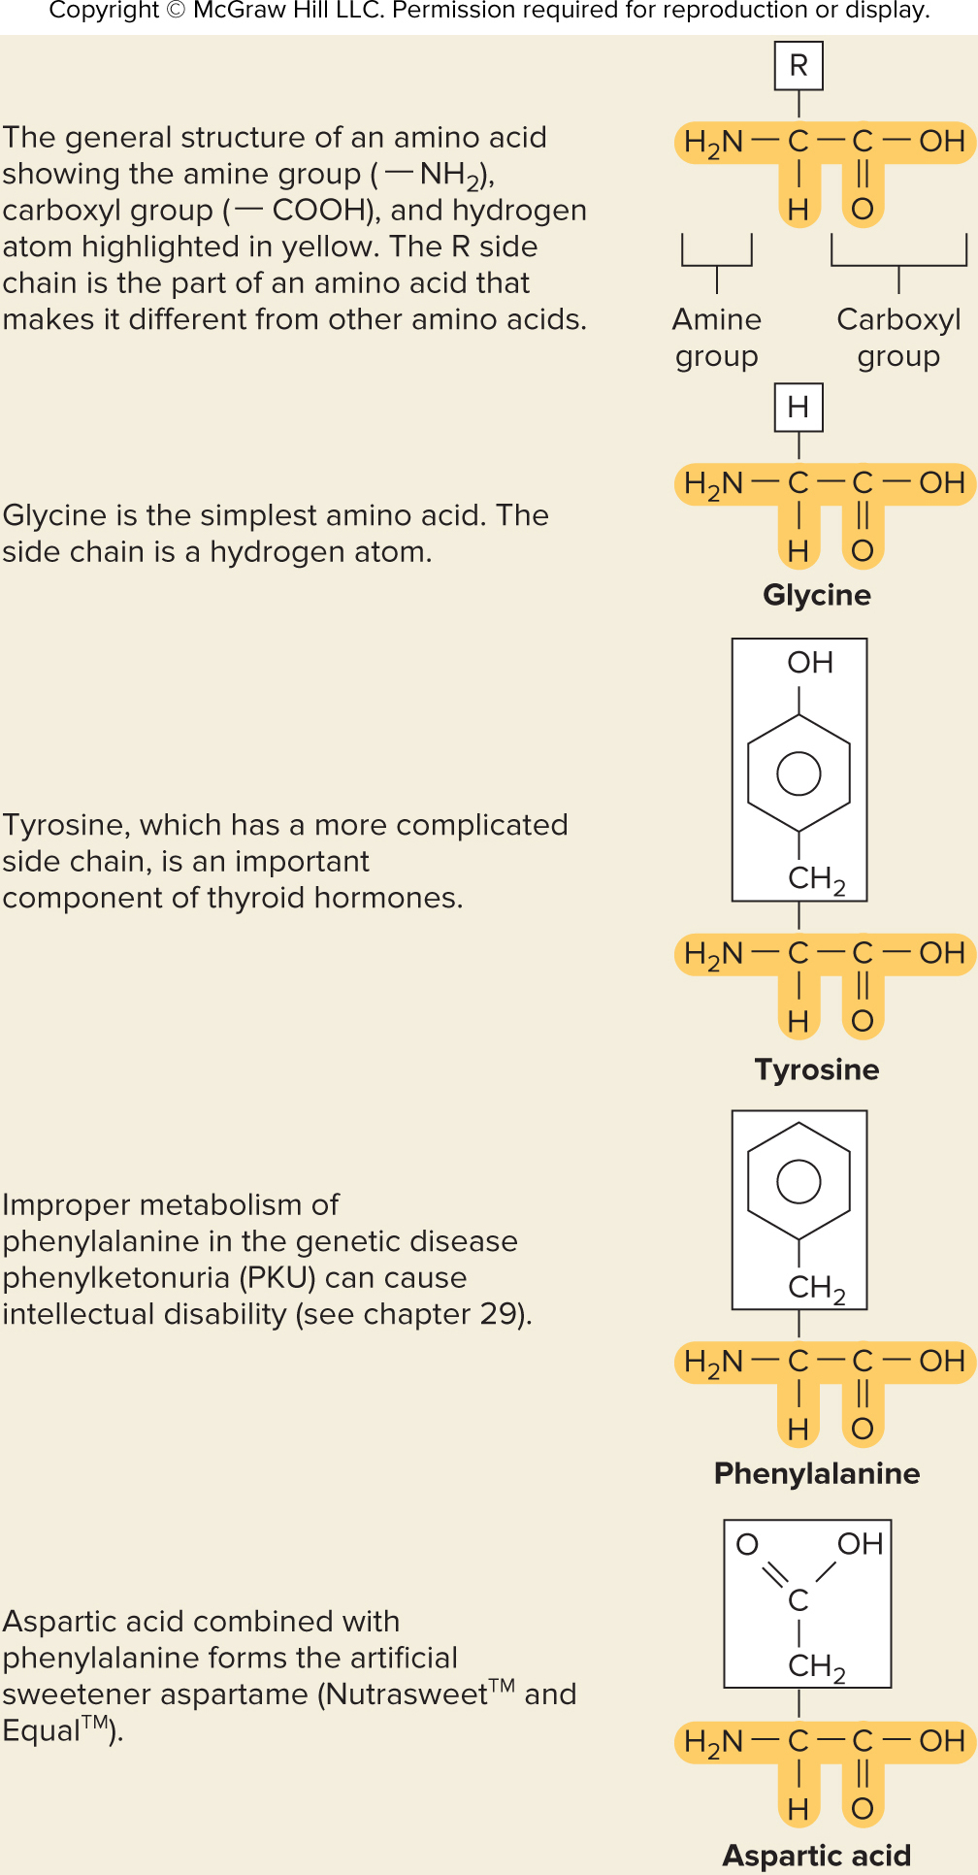
Figure 2.22

Slide 47
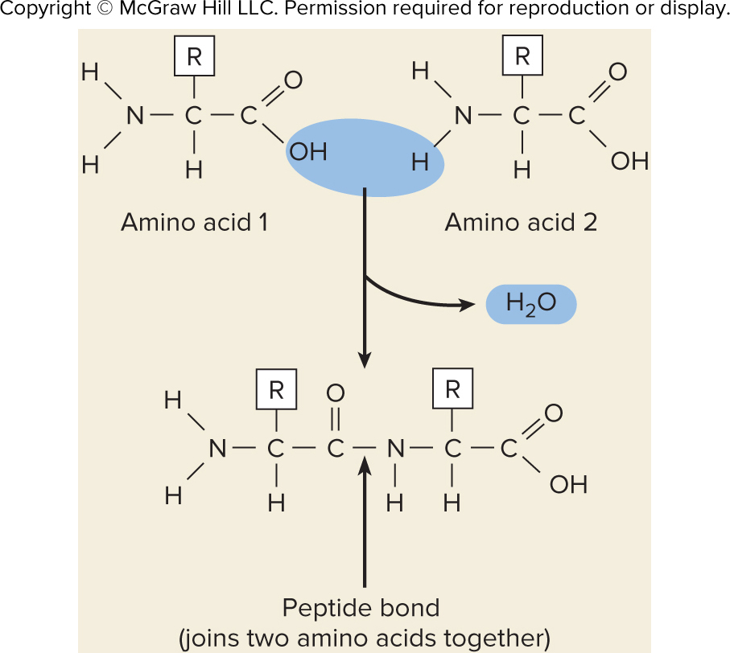
Figure 2.23

Slide 48
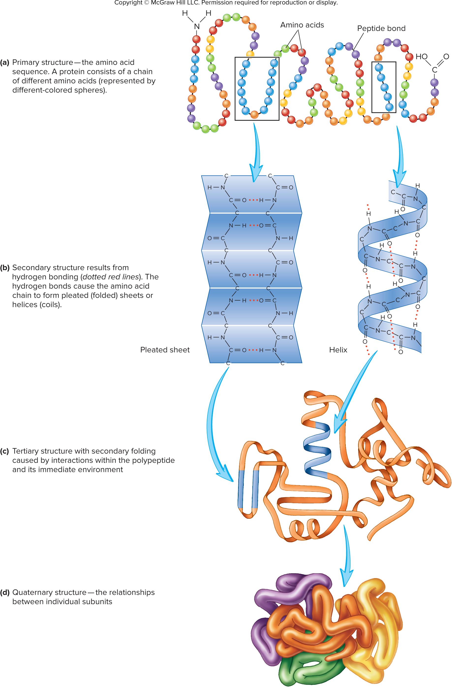
Figure 2.24

Slide 49
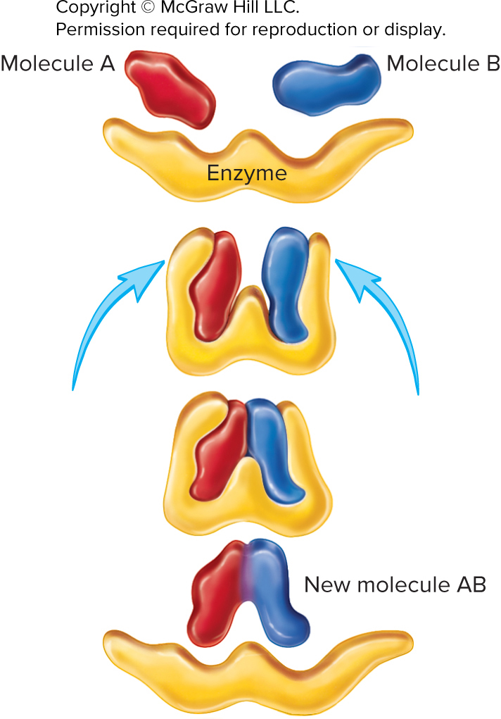
Figure 2.25

Slide 50
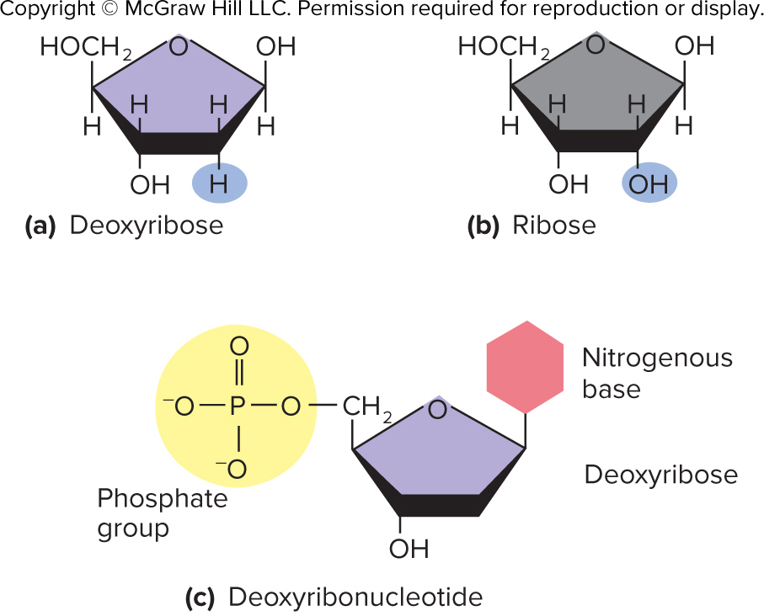
Figure 2.26

Slide 51
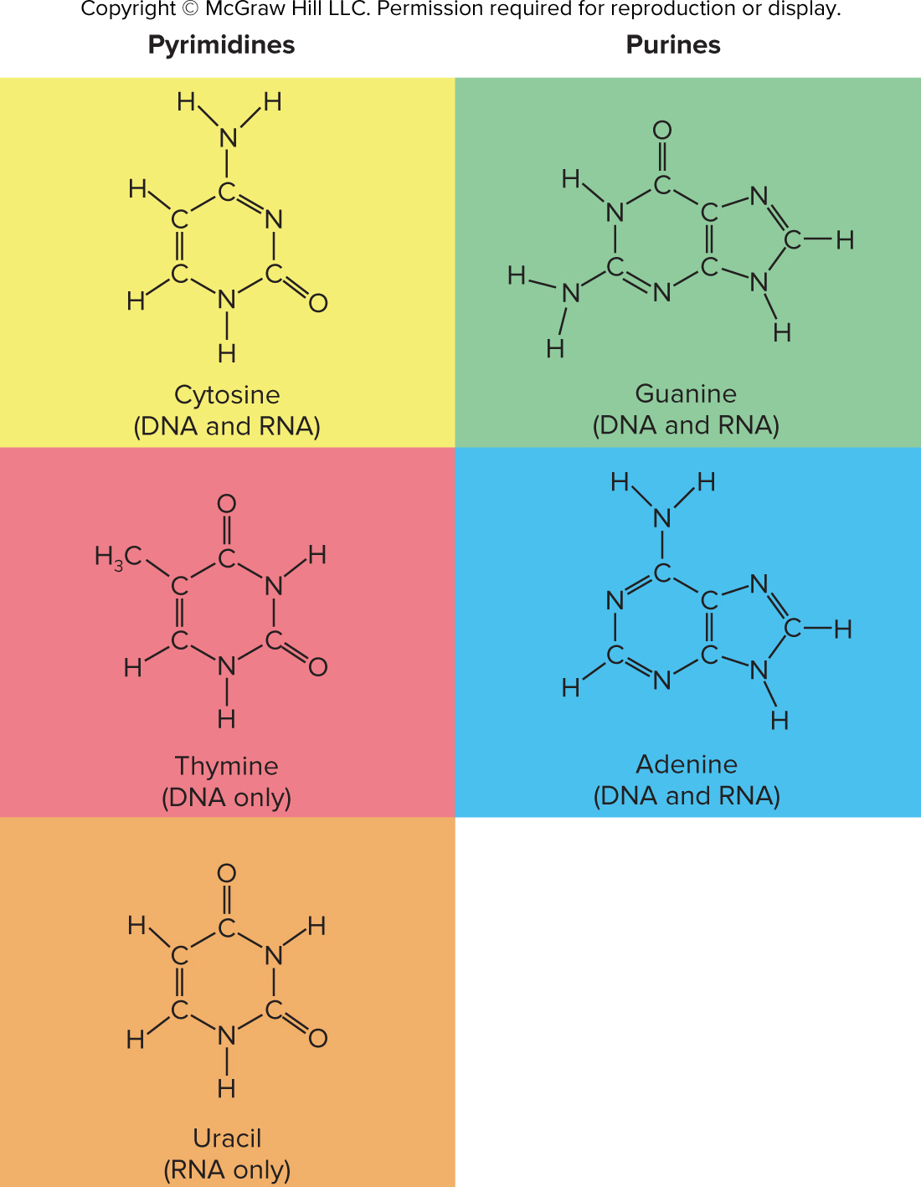
Figure 2.27

Slide 52
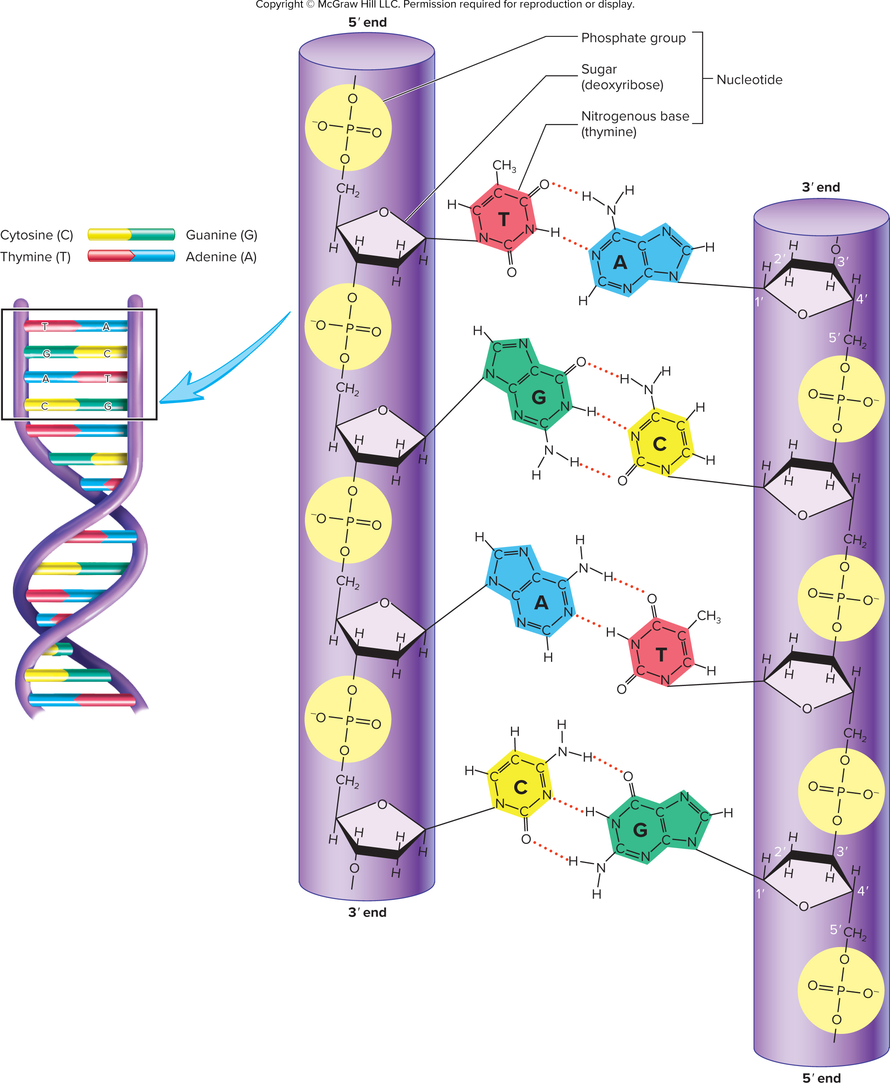
Figure 2.28

Slide 53
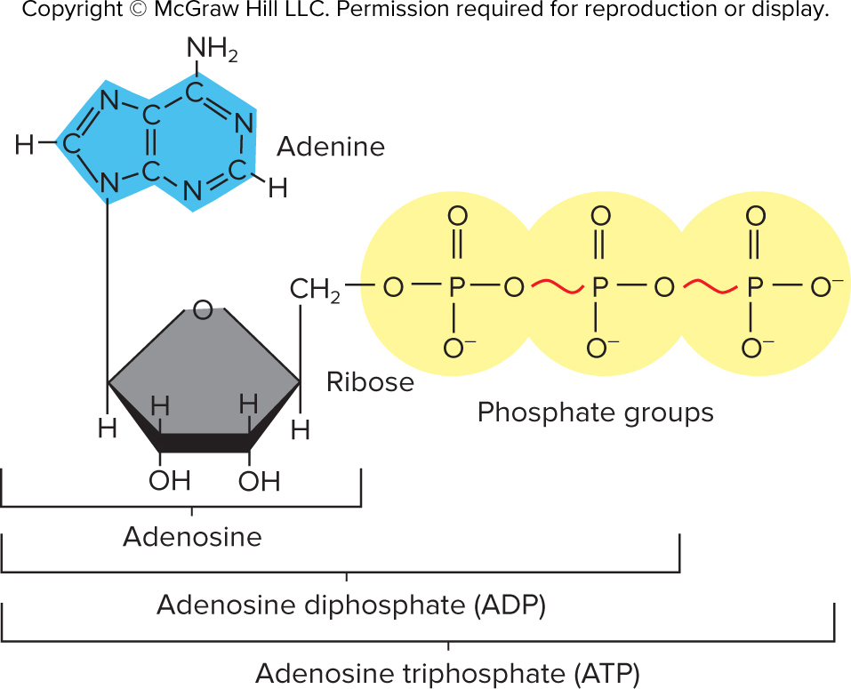
Figure 2.29

