Slide 1
Image PowerPoint slides to accompany
Skeletal System
GROSS ANATOMY
Chapter 7

Slide 2
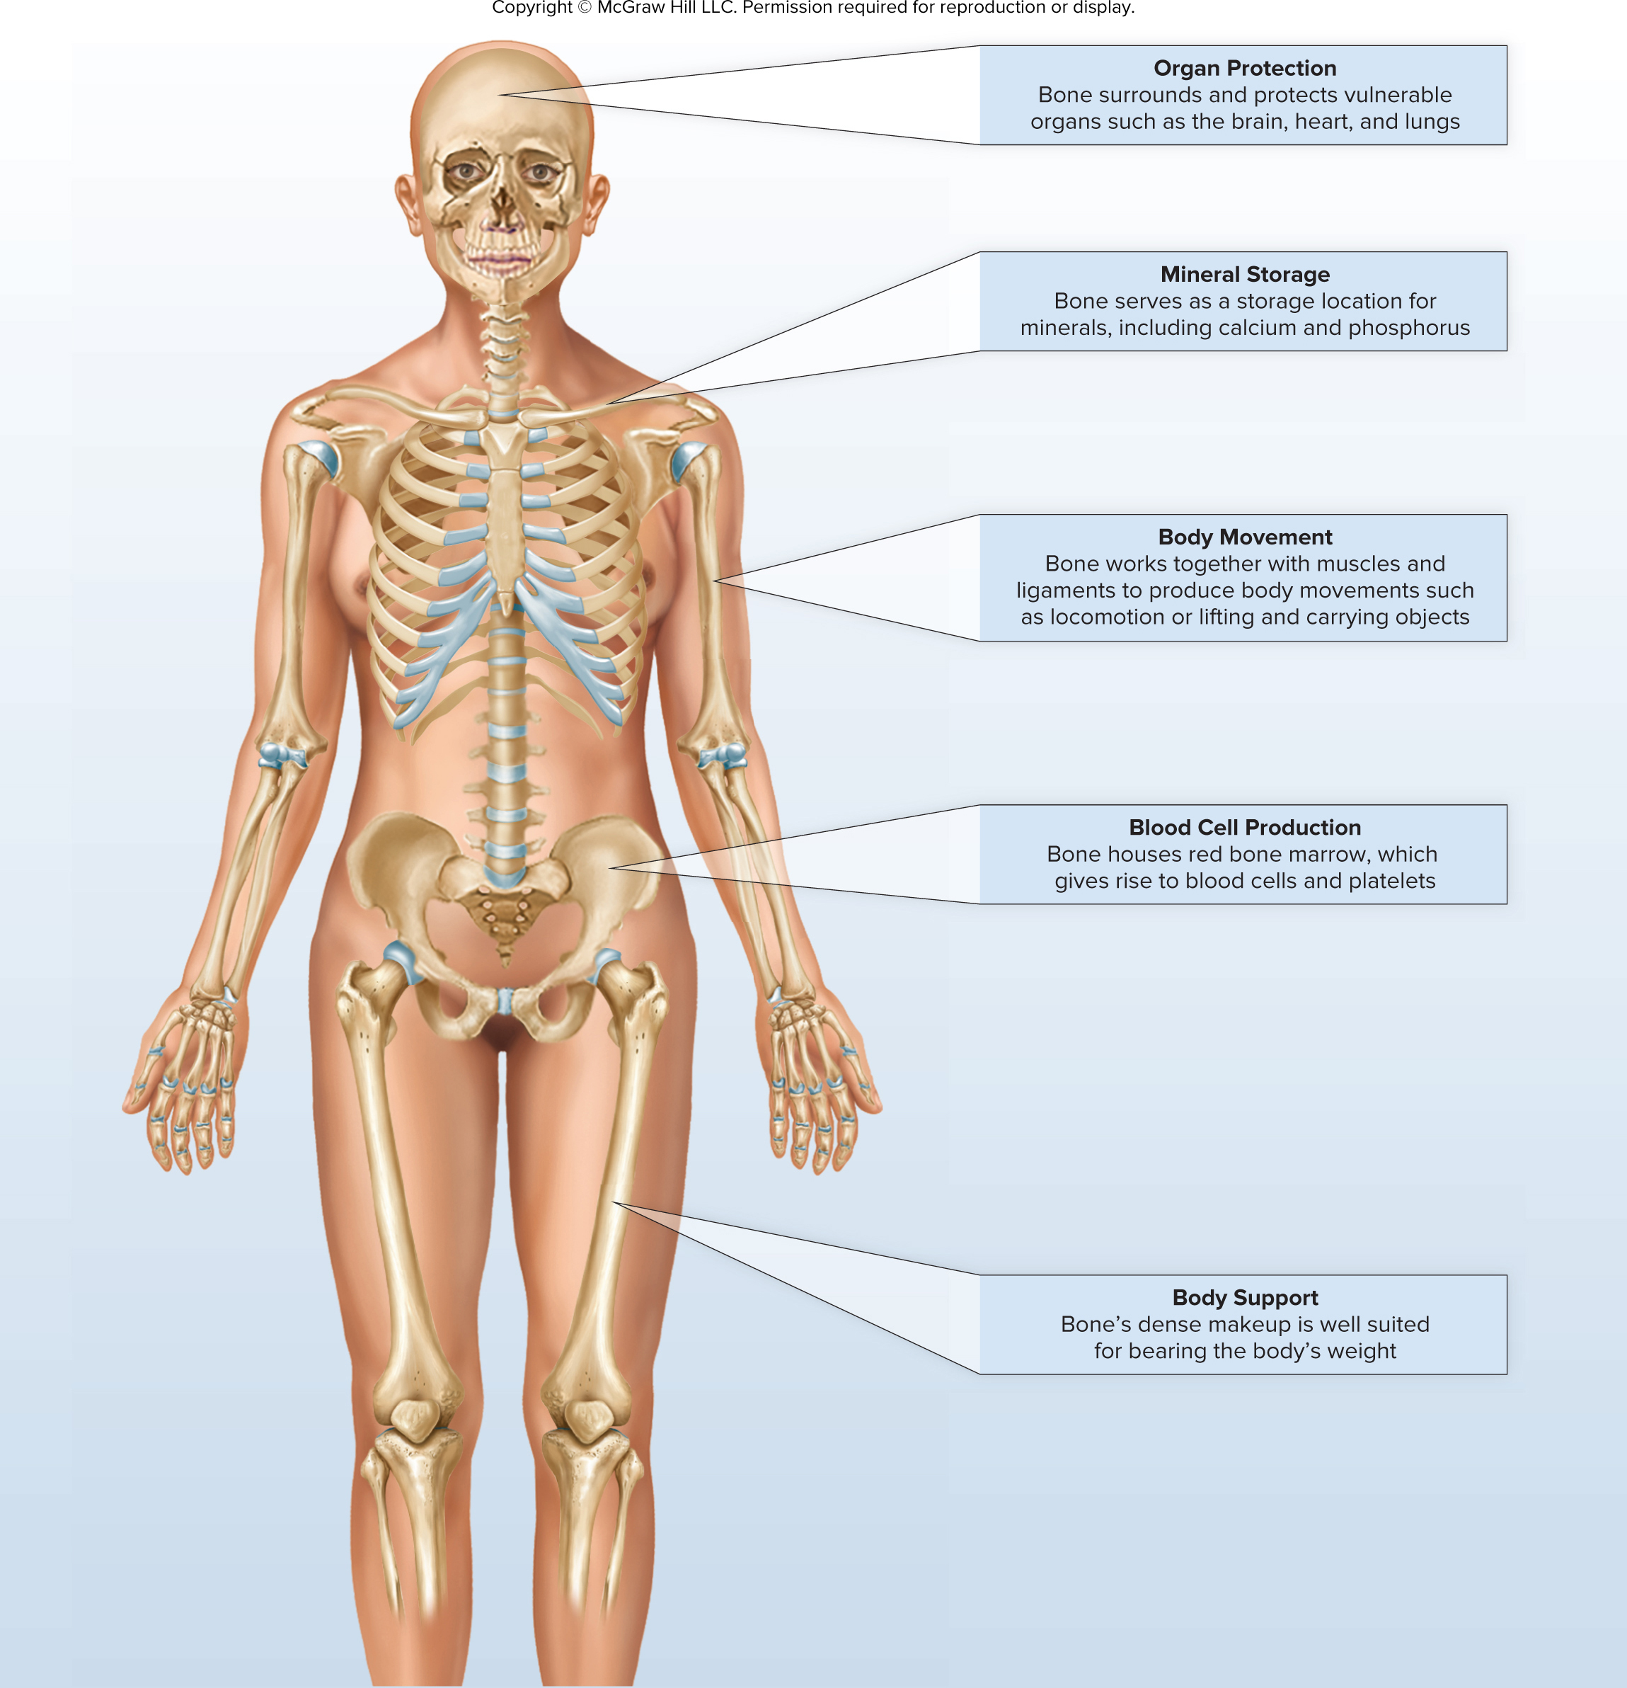
Chapter Opener

Slide 3
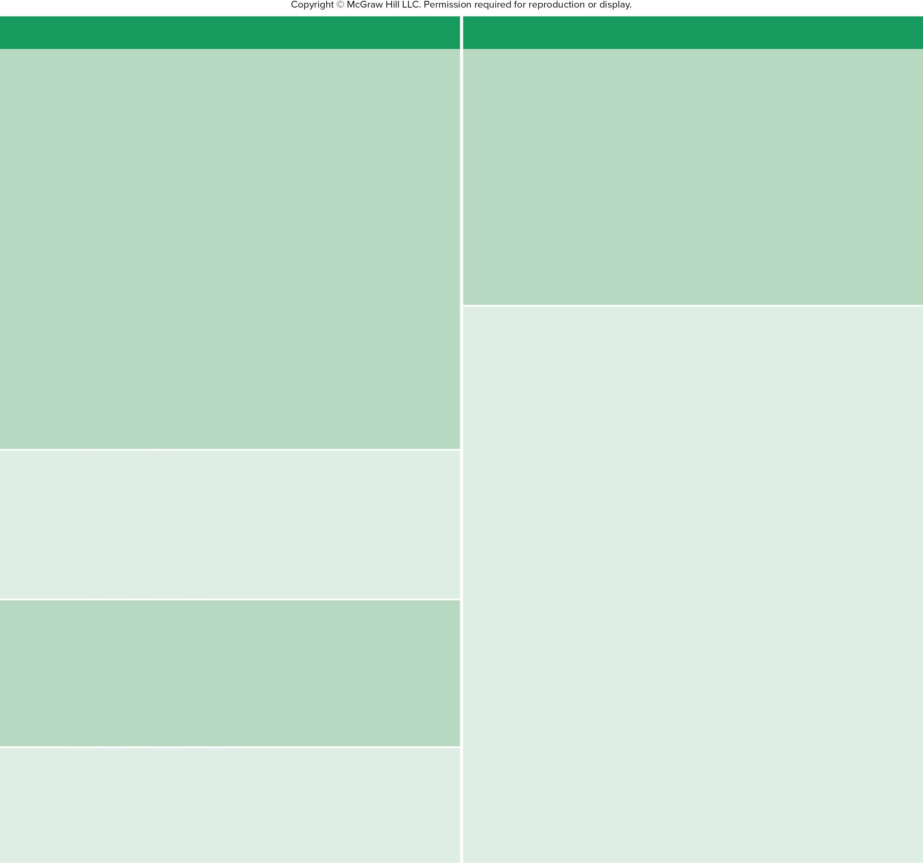
Table 7.1
TABLE 7.1
Number of Named Bones Listed by Category
Bones
Number
Bones
Number
Axial Skeleton
Appendicular Skeleton
Skull (Cranium)
Pectoral Girdle
Cranial bones
Scapula
2
Paired (left and right)
Parietal
2
Clavicle
2
Temporal
2
Upper Limb
Unpaired (single)
Frontal
1
Humerus
2
Sphenoid
1
Ulna
2
Occipital
1
Radius
2
Ethmoid
1
Carpal bones
16
Facial bones
Metacarpal bones
10
Paired
Maxilla
2
Phalanges
28
Zygomatic
2
Total girdle and upper limb bones
64
Palatine
2
Pelvic Girdle
Lacrimal
2
Hip bone
2
Nasal
2
Lower Limb
Inferior nasal concha
2
Femur
2
Unpaired
Mandible
1
Tibia
2
Vomer
1
Fibula
2
Total skull bones
22
Patella
2
Bones Associated with the Skull
Tarsal bones
14
Auditory ossicles
Metatarsal bones
10
Malleus
2
Phalanges
28
Incus
2
Total girdle and lower limb bones
62
Stapes
2
Total appendicular skeleton bones
126
Hyoid
1
Total associated bones
7
Total axial skeleton bones
80
Vertebral Column
Total appendicular skeleton bones
126
Cervical vertebrae
7
Total bones
206
Thoracic vertebrae
12
Lumbar vertebrae
5
Sacrum
1
Coccyx
1
Total vertebral column bones
26
Thoracic Cage
Ribs
24
Sternum
1
Total thoracic cage bones
25
Total axial skeleton bones
80

Slide 4
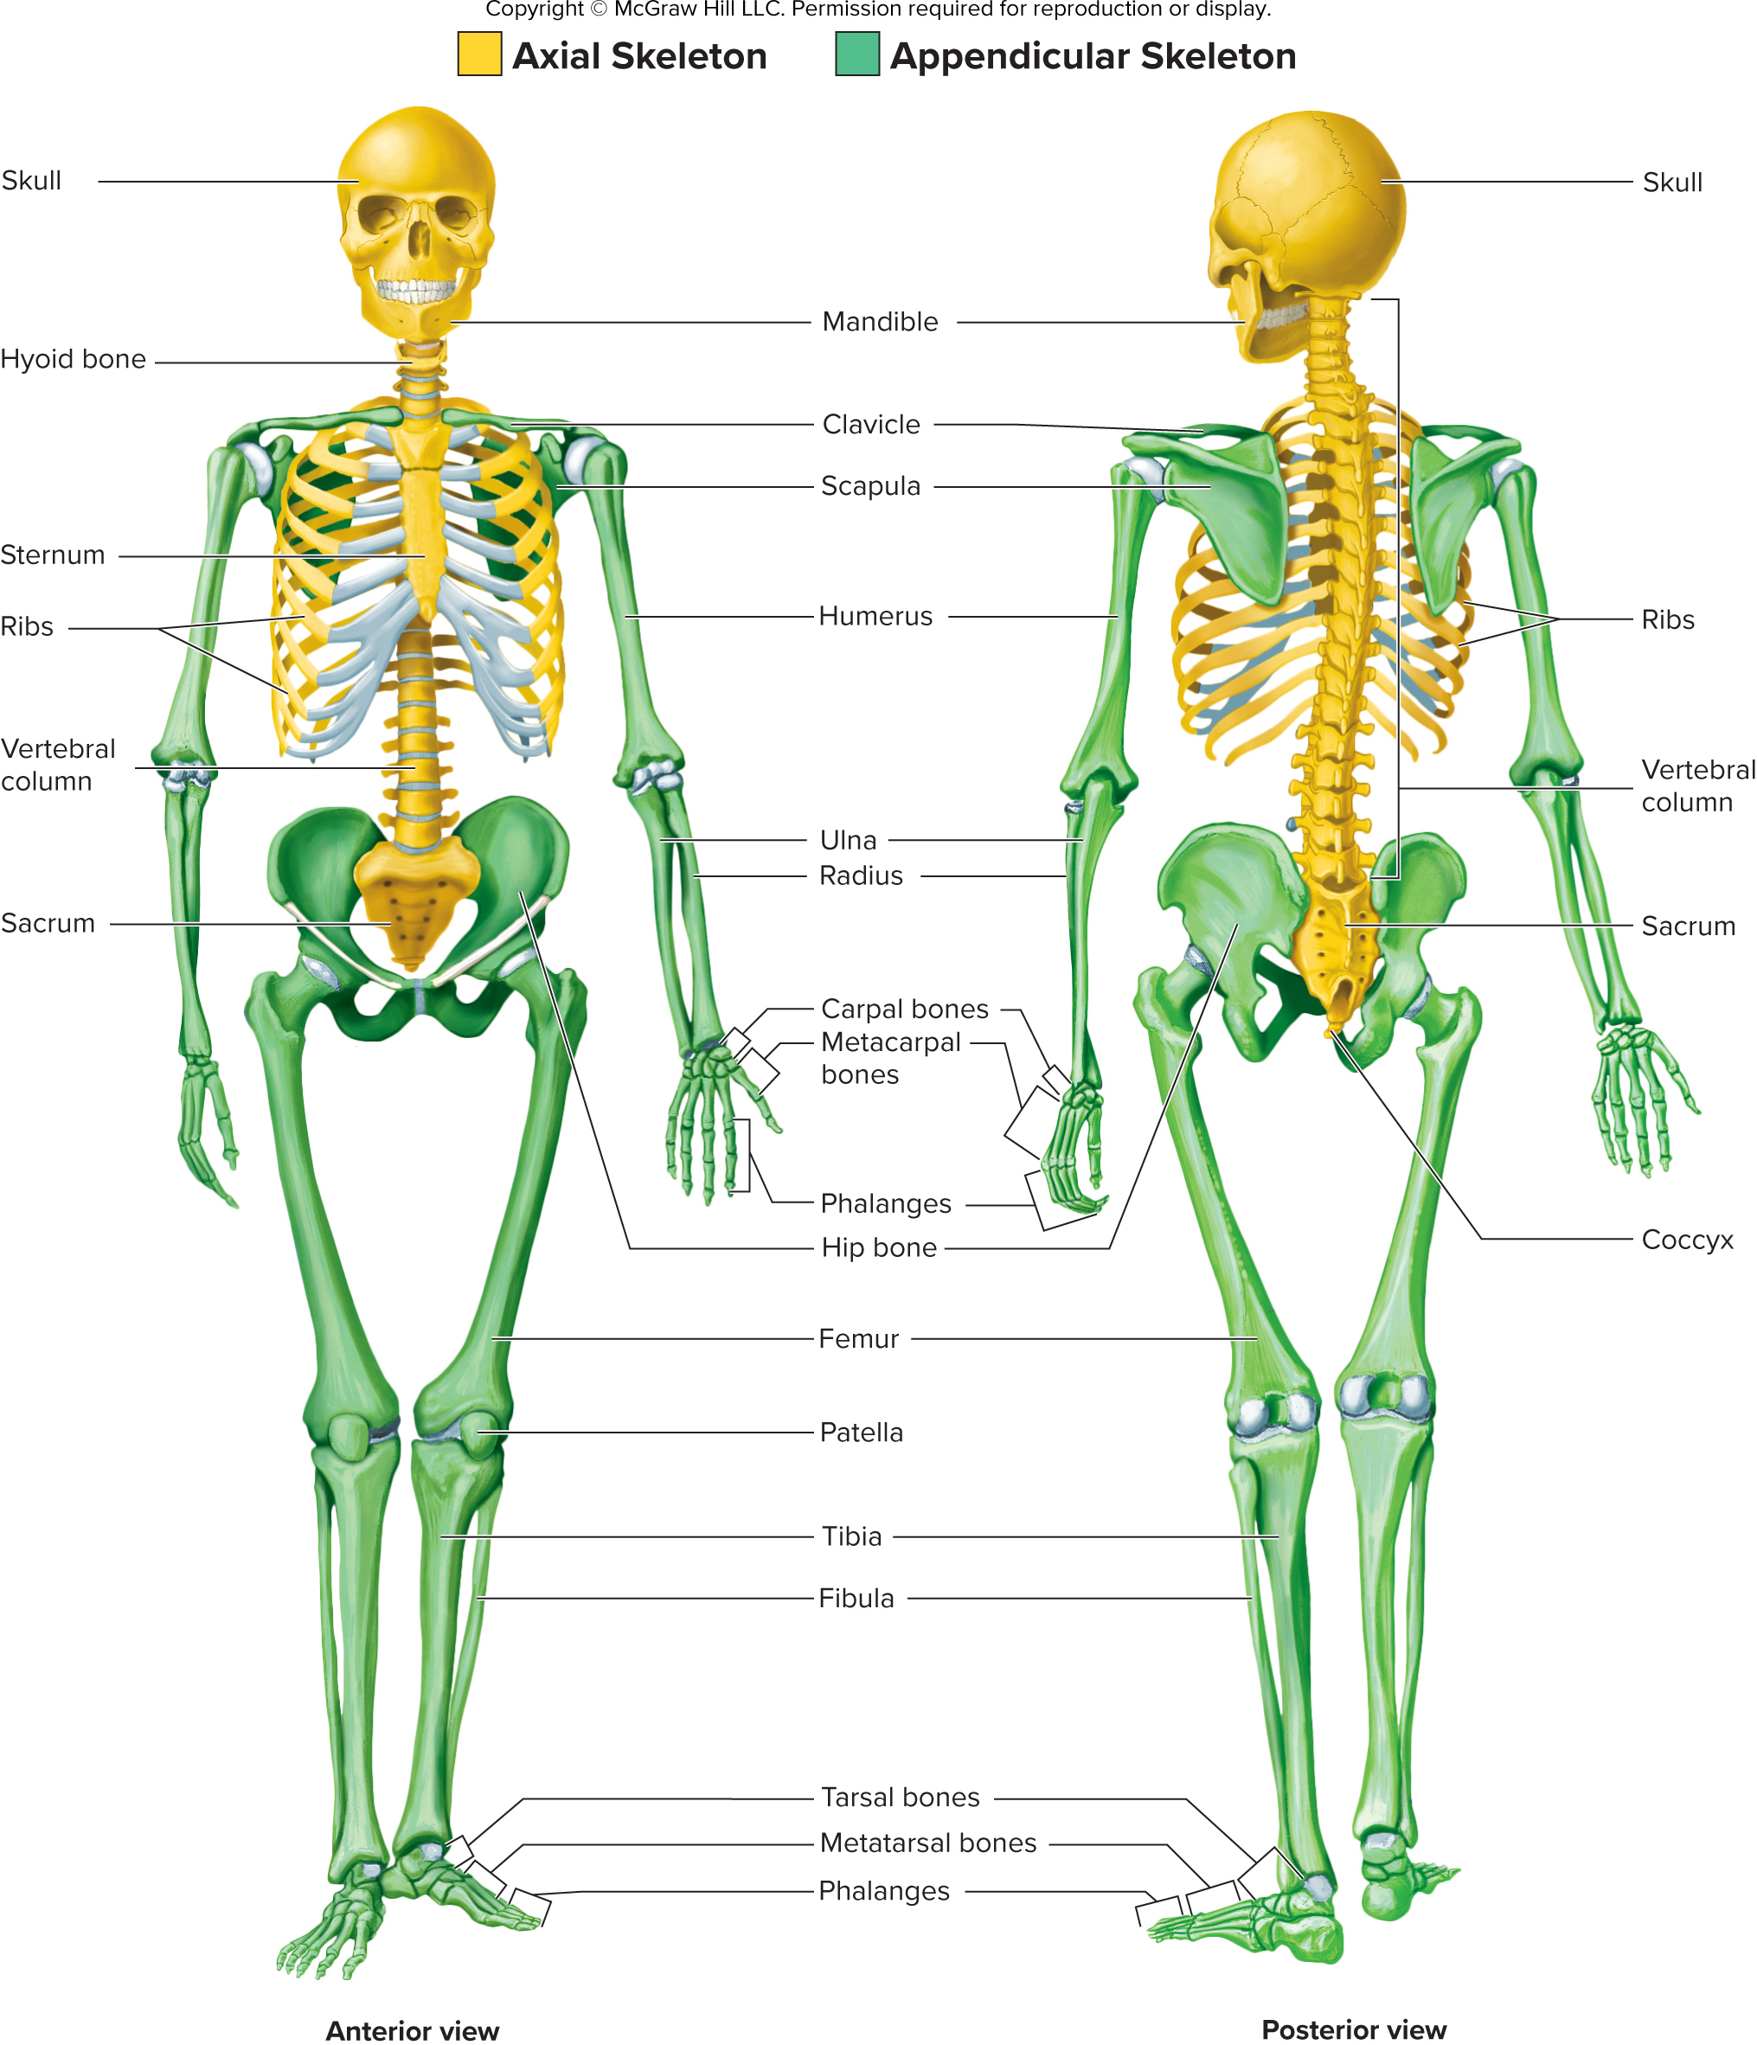
Figure 7.1

Slide 5
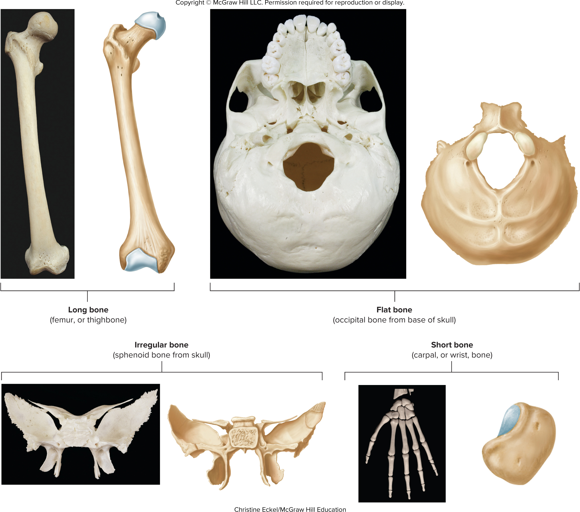
Figure 7.2

Slide 6
Table 7.2
TABLE 7.2
Anatomical Terms for Bone Features
(Surface Markings)
Term
Description
Example
Body
Main part
Body of femur
Head
Enlarged, often
rounded end
Head of femur
Neck
Constriction between
head and body
Neck of femur
Margin, border
Edge
Lateral border of scapula
Angle
Bend
Mandibular angle
Ramus
Branch off the body
beyond the angle
Mandibular ramus
Condyle
Smooth, rounded
articular surface
Lateral condyle of tibia
Facet
Small, flattened articu-
lar surface
Superior articular facet
of atlas
Ridges
Line, linea
Low ridge
Intertrochanteric line
of femur
Crest, crista
Prominent ridge
Iliac crest
Spine
Very high ridge
Scapular spine
Projections
Process
Prominent projection
Acromion process of
scapula
Tubercle
Small, rounded
projection
Greater tubercle of
humerus
Tuberosity,
tuber
Rounded projection;
larger than a tubercle
Deltoid tuberosity of
humerus
Trochanter
Tuberosity on the proxi-
mal femur
Greater trochanter of
femur
Epicondyle
Upon a condyle
Lateral epicondyle of
femur
Lingula
Flat, tongue-shaped
process
Lingula of mandible
Hamulus
Hook-shaped process
Pterygoid hamulus of
sphenoid bone
Horn
Horn-shaped process
Greater horn of hyoid
bone
Openings
Foramen
Hole
Foramen magnum of
occipital bone
Canal, meatus
Tunnel
Hypoglossal canal of
occipital bone
Fissure
Cleft
Superior orbital fissure
of sphenoid bone
Sinus, labyrinth
Cavity
Ethmoid labyrinth
Depressions
Fossa
General term for a
depression
Coronoid fossa of
humerus
Notch
Depression in the
margin of a bone
Mandibular notch
Fovea
Little pit
Fovea capitis of femur
Groove,
sulcus
Deep, narrow
depression
Intertubercular groove
of humerus

Slide 7
Table 7.3
TABLE 7.3
Processes and Other Features of the Skull
Bone on Which
Feature Is Found
Feature
Description
External Features
Temporal lines
Parietal
Attachment site for the temporalis muscle, which closes the jaw (shown in figure 7.5)
Mandibular fossa
Temporal
Depression where the mandible articulates with the skull (shown in figure 7.10)
Mastoid process
Temporal
Enlargement posterior to the ear; attachment site for several muscles that move the head
(shown in figures 7.4, 7.5, and 7.10)
Styloid process
Temporal
Attachment site for three muscles (to the tongue, pharynx, and hyoid bone) and some liga-
ments (shown in figure 7.5)
Nuchal lines
Occipital
Attachment points for several posterior neck muscles (shown in figures 7.4 and 7.10)
Occipital condyle
Occipital
Point of articulation between the skull and the vertebral column (shown in figures 7.4 and 7.10)
Pterygoid hamulus
Sphenoid
Hooked process on the inferior end of the medial pterygoid plate, around which the tendon of
one palatine muscle passes; an important dental landmark (shown in table 7.7e)
Pterygoid plates
(medial and lateral)
Sphenoid
Bony plates on the inferior aspect of the sphenoid bone; the lateral pterygoid plate is the site
of attachment for two muscles of mastication (chewing; shown in figures 7.10 and 7.12)
Palatine process
Maxilla
Anterior two-thirds of the hard palate (shown in figures 7.10 and 7.12)
Alveolar process
Mandible, maxilla
Ridges on the mandible and maxilla containing the teeth (shown in figure 7.7)
Horizontal plate
Palatine
Posterior third of the hard palate (shown in figure 7.12)
Angle
Mandible
Posterior, inferior corner of the mandible (shown in figure 7.5)
Coronoid process
Mandible
Attachment point for the temporalis muscle (shown in figure 7.5)
Mental protuberance
Mandible
Chin (resembles a bent knee; shown in figures 7.5 and 7.7)
Mandibular condyle
Mandible
Region where the mandible articulates with the skull (shown in figure 7.5)
Ramus
Mandible
Portion of the mandible superior to the angle (shown in figure 7.5)
Internal Features
Crista galli
Ethmoid
Process in the anterior part of the cranium to which one of the connective tissue coverings of
the brain (dura mater) connects (shown in figures 7.9 and 7.12)
Petrous part
Temporal
Thick, interior part of temporal bone containing the middle and inner ears and the auditory
ossicles (shown in figure 7.9)
Sella turcica
Sphenoid
Bony structure, resembling a saddle, in which the pituitary gland is located (shown in figure 7.9)

Slide 8
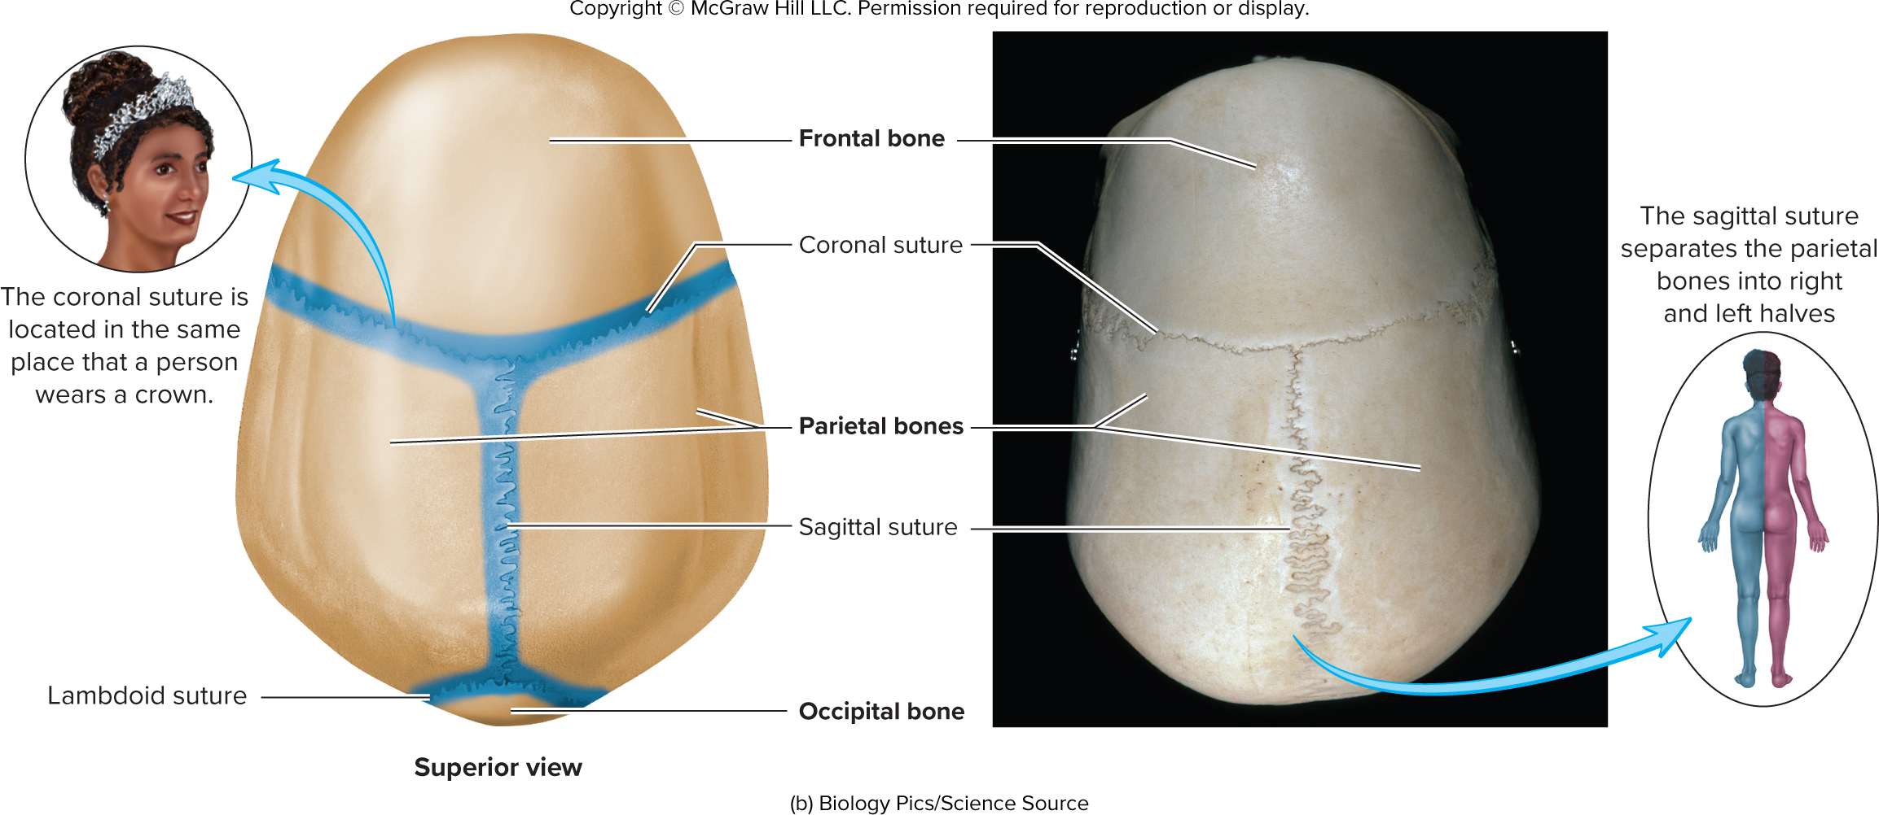
Figure 7.3

Slide 9
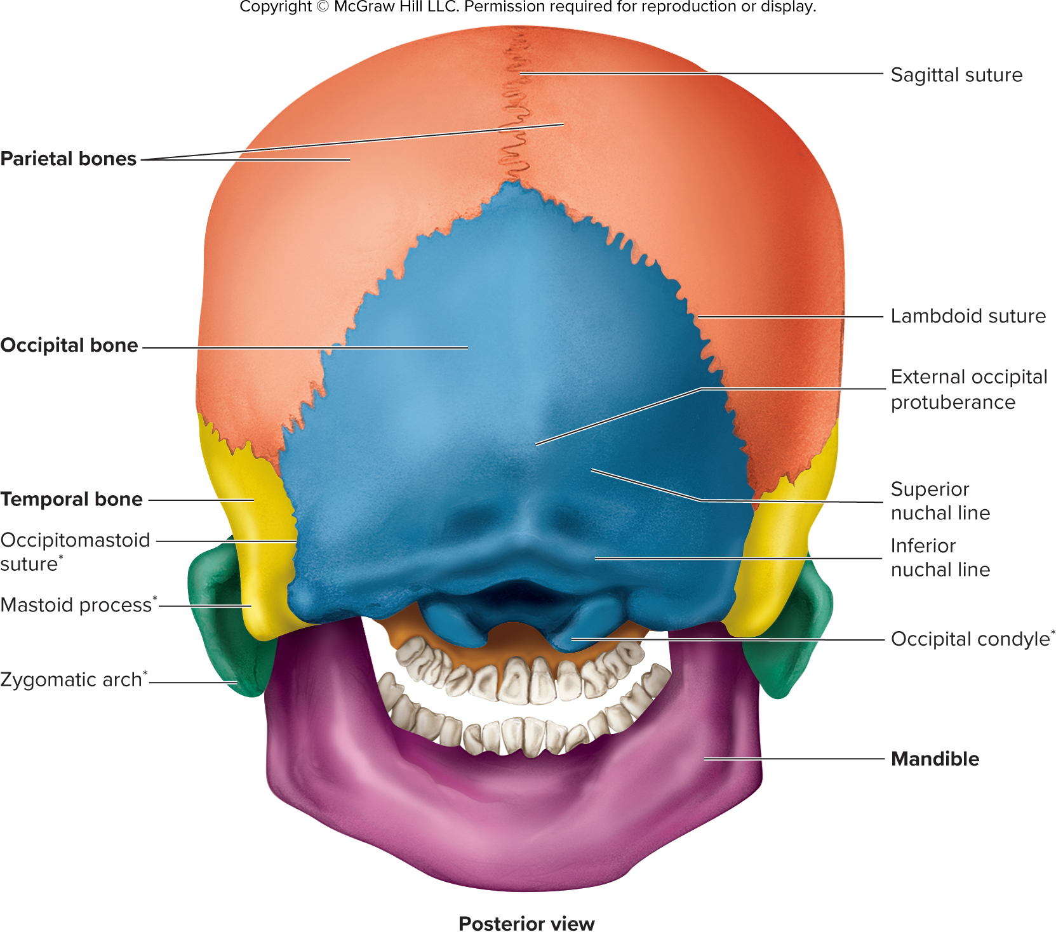
Figure 7.4

Slide 10
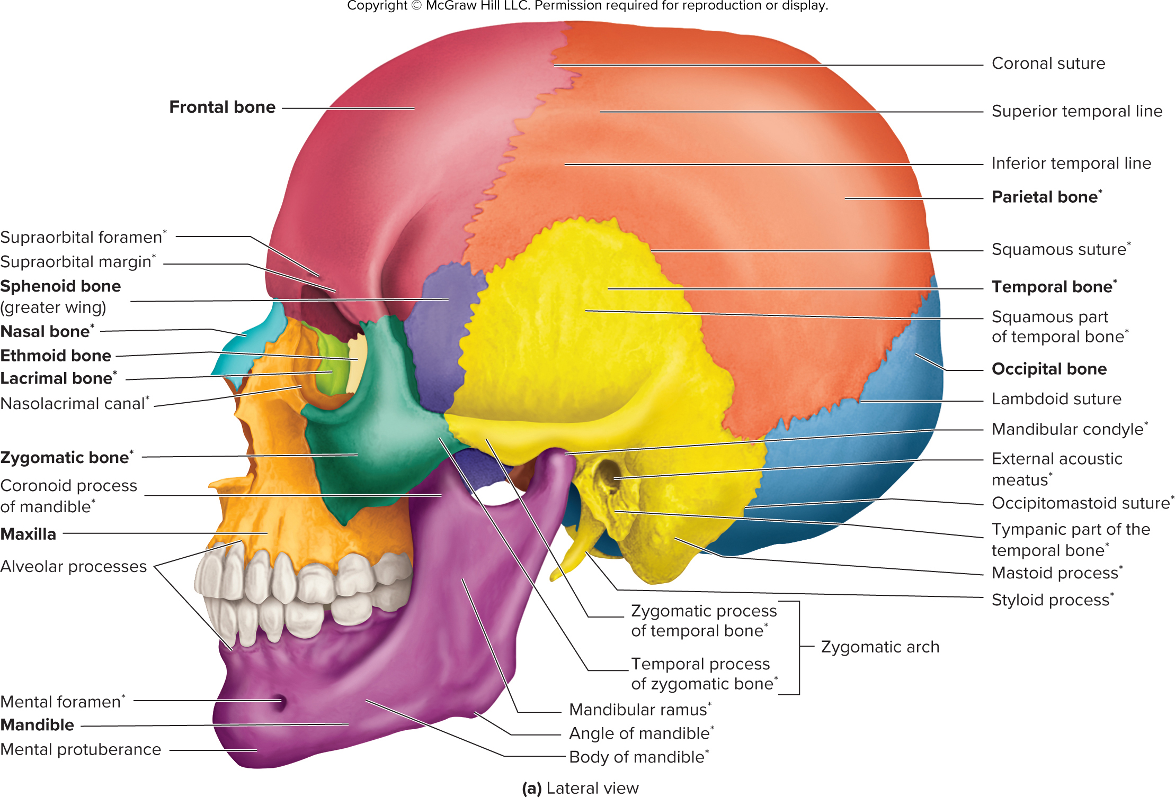
Figure 7.p1

Slide 11
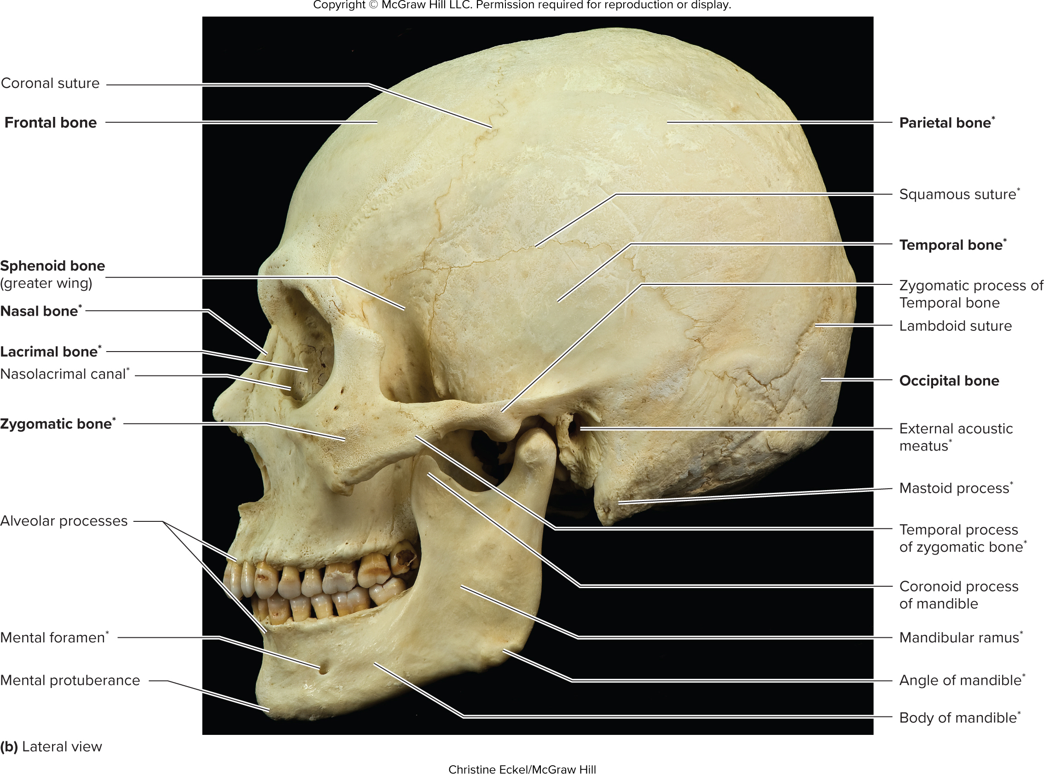
Figure 7.p2

Slide 12
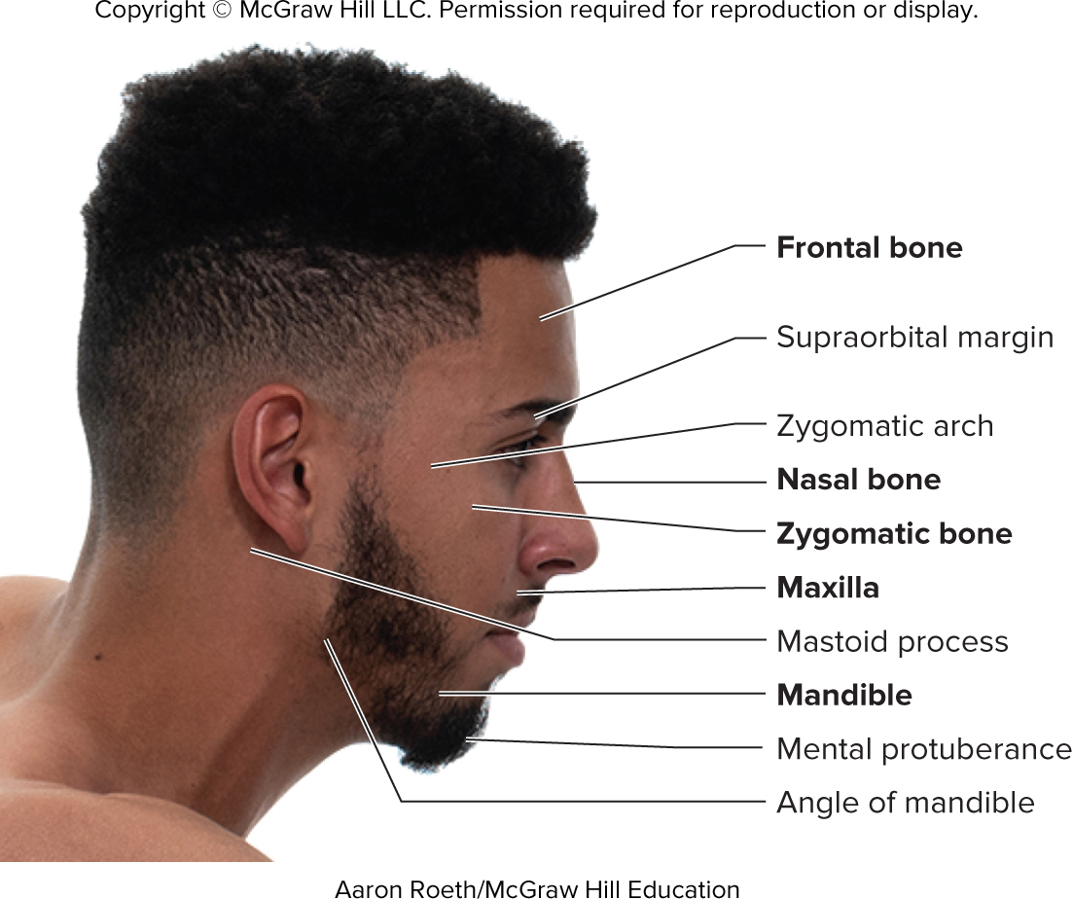
Figure 7.6

Slide 13
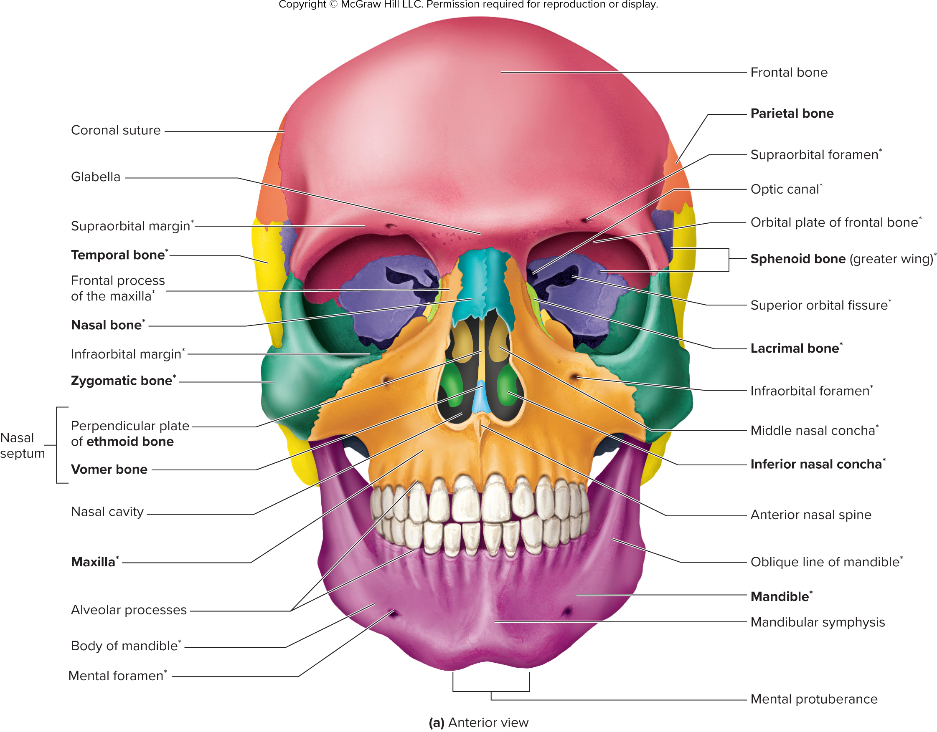
Figure 7.p1

Slide 14
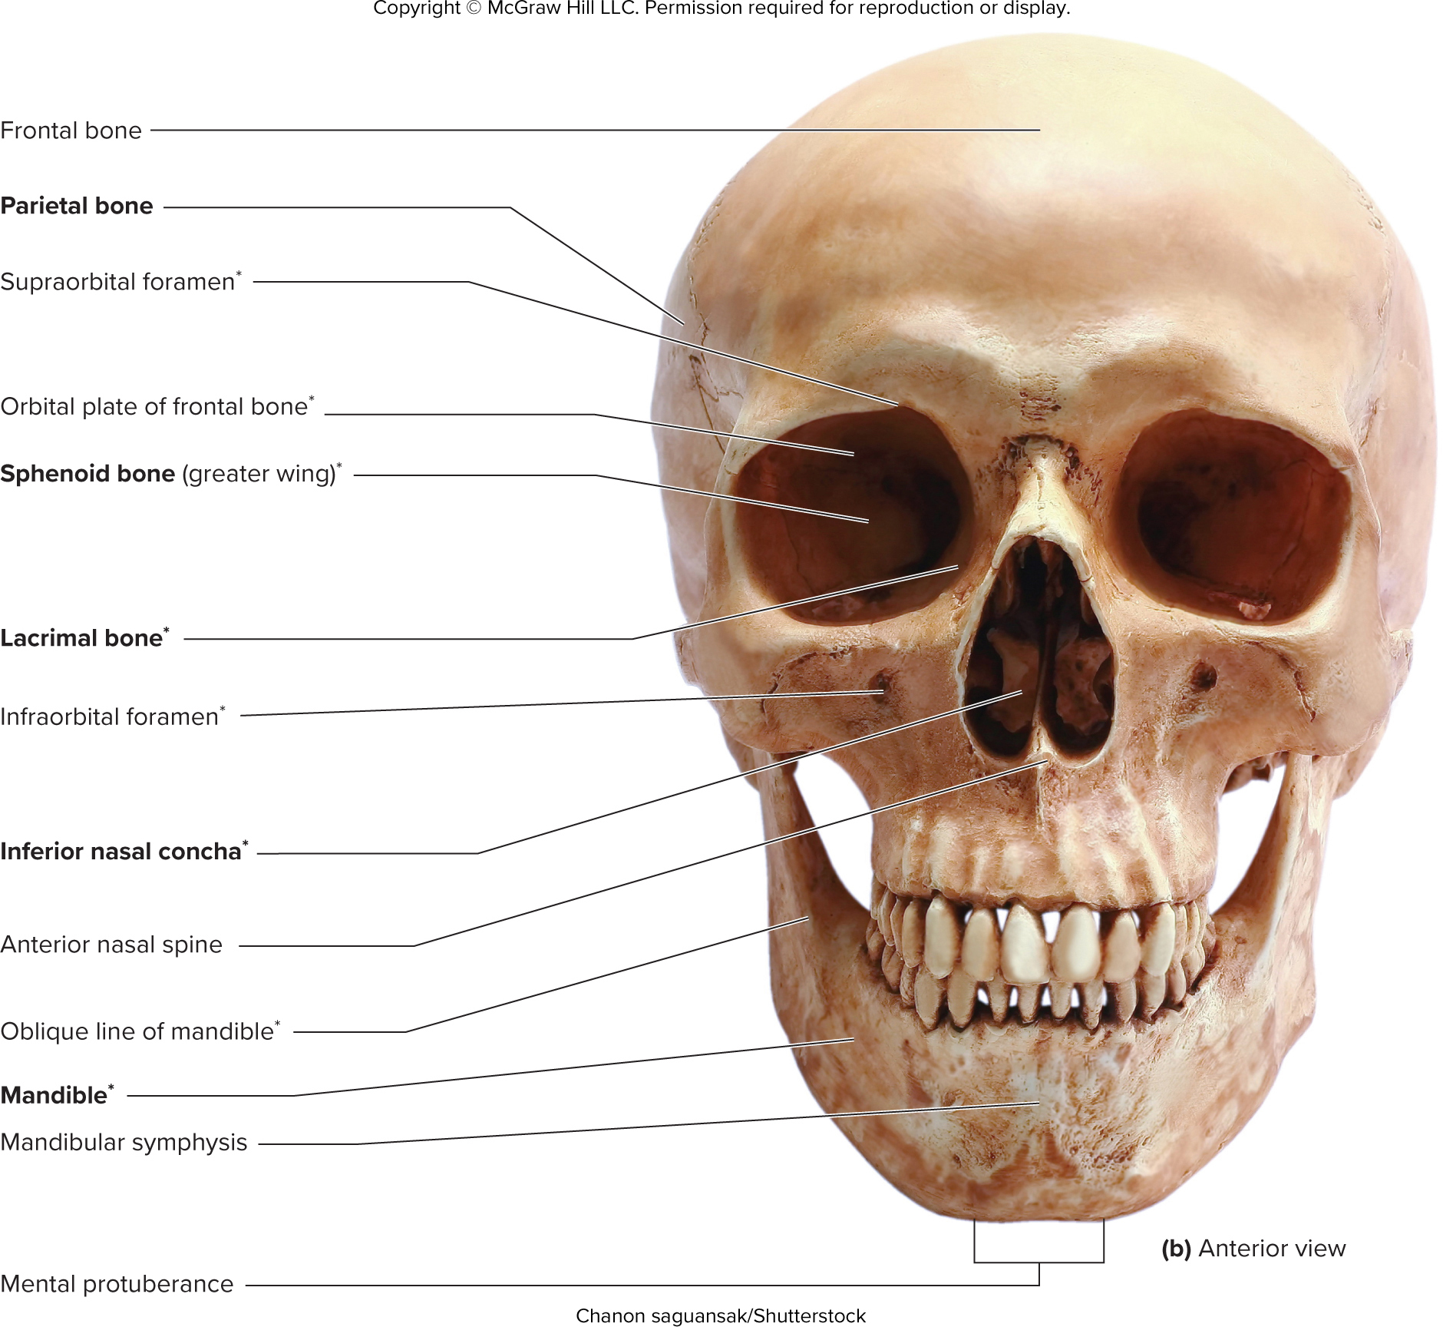
Figure 7.p2

Slide 15
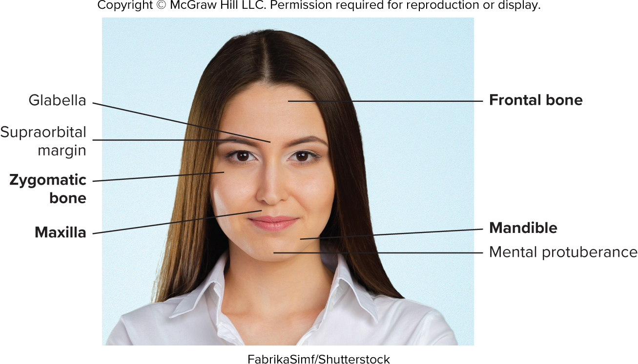
Figure 7.8

Slide 16
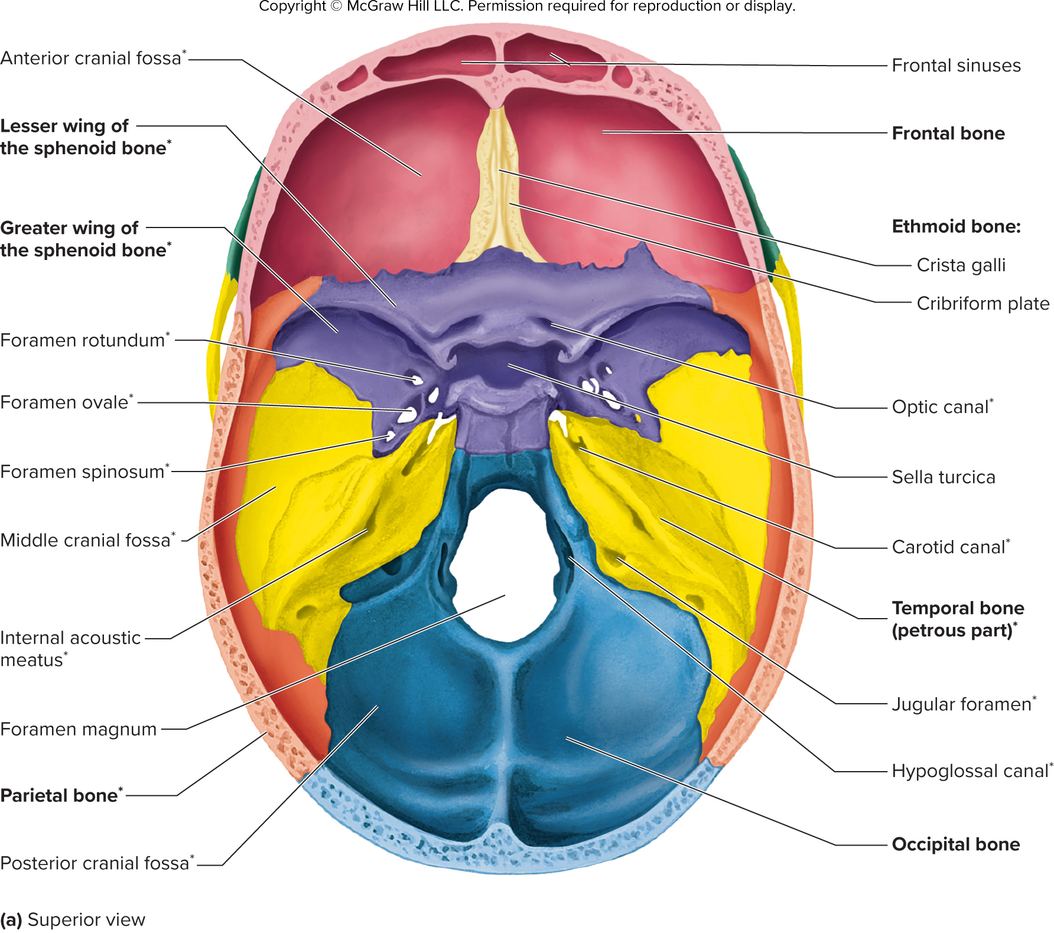
Figure 7.p1

Slide 17
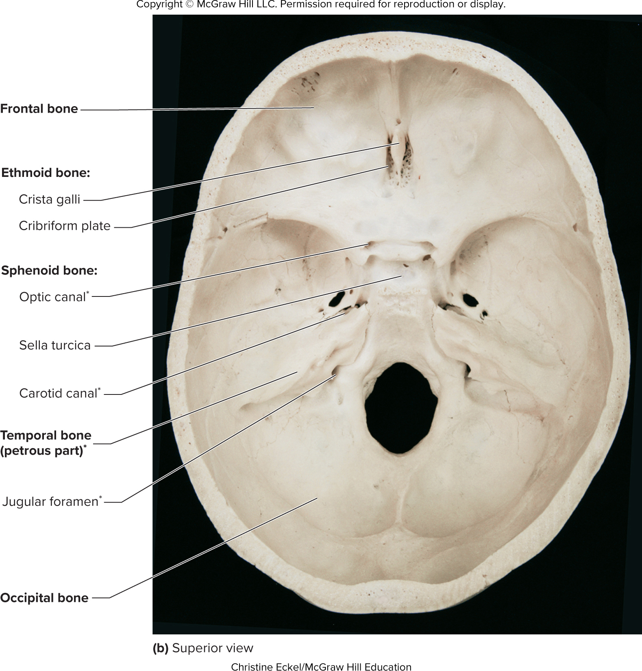
Figure 7.p2

Slide 18
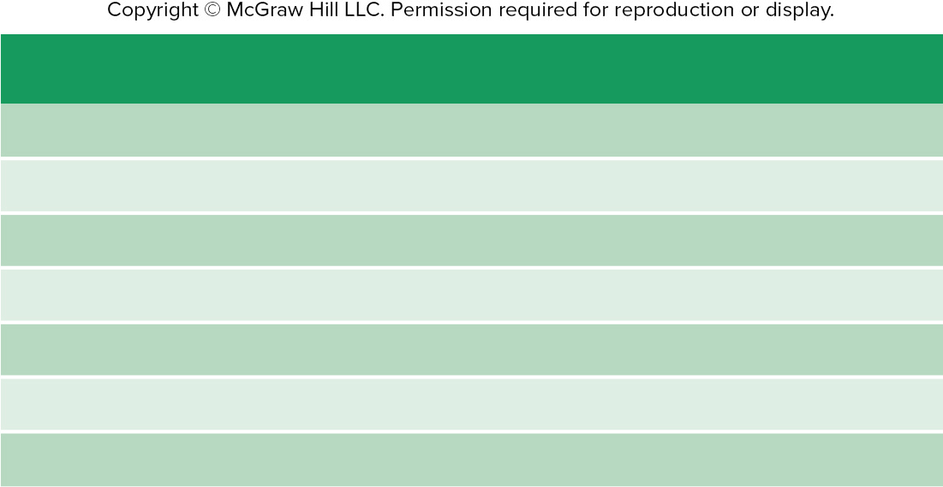
Table 7.4
TABLE 7.4
Bones Forming the Orbit
(see figures 7.7 and 7.11)
Bone
Part of Orbit
Frontal
Roof
Sphenoid
Roof and posterolateral wall
Zygomatic
Lateral wall
Maxilla
Floor
Lacrimal
Medial wall
Ethmoid
Medial wall
Palatine
Medial wall

Slide 19
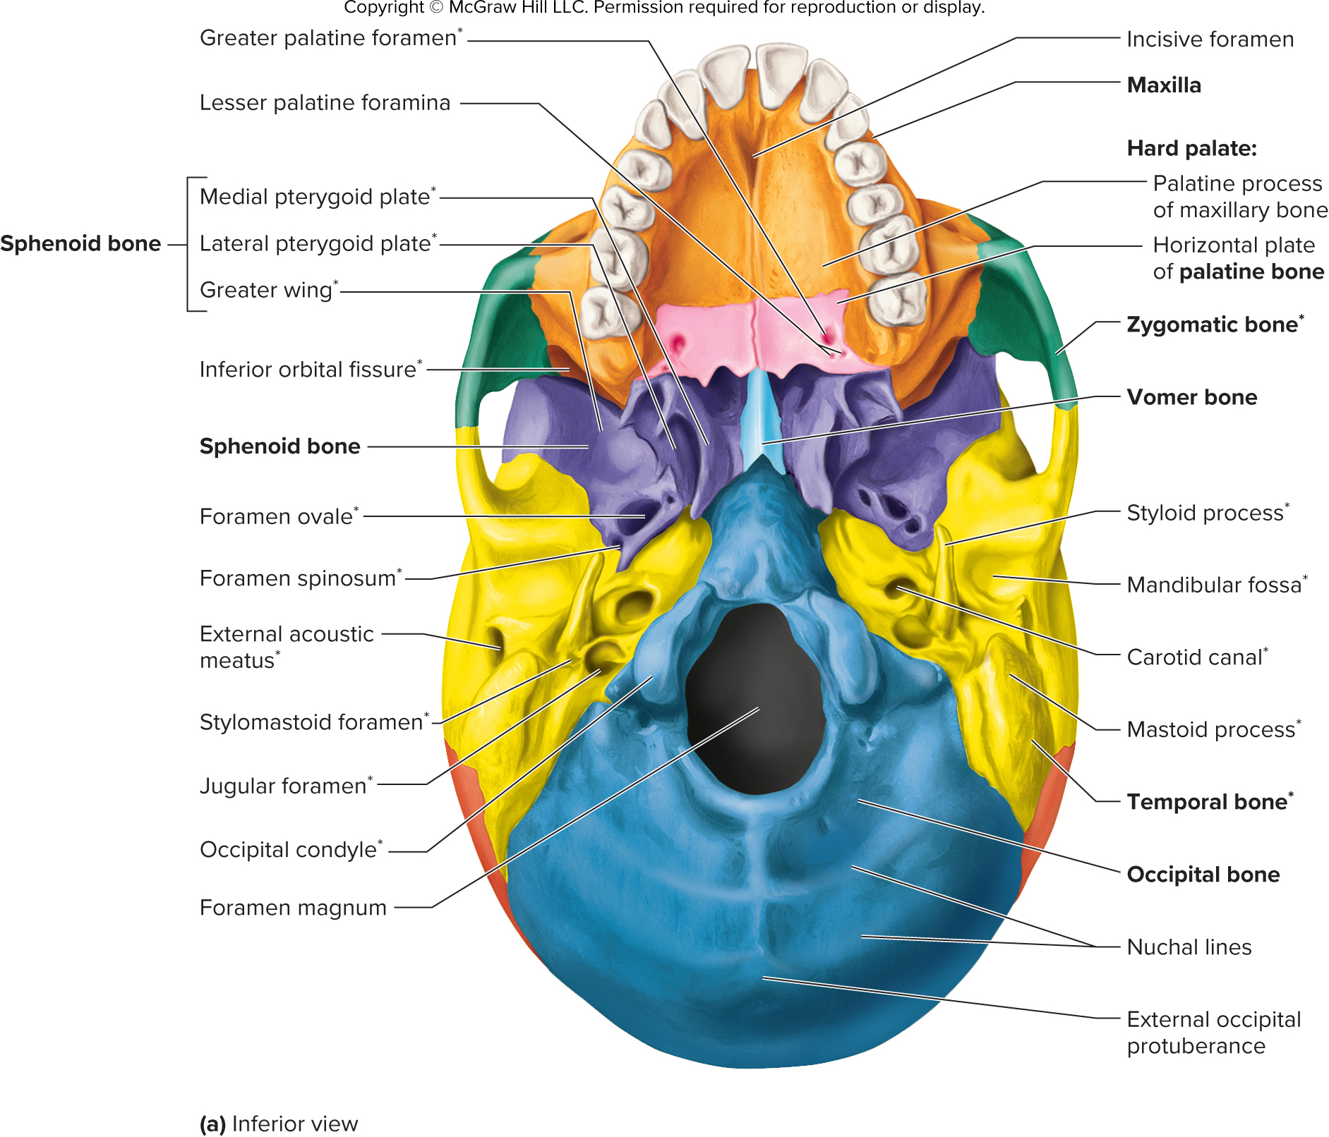
Figure 7.p1

Slide 20
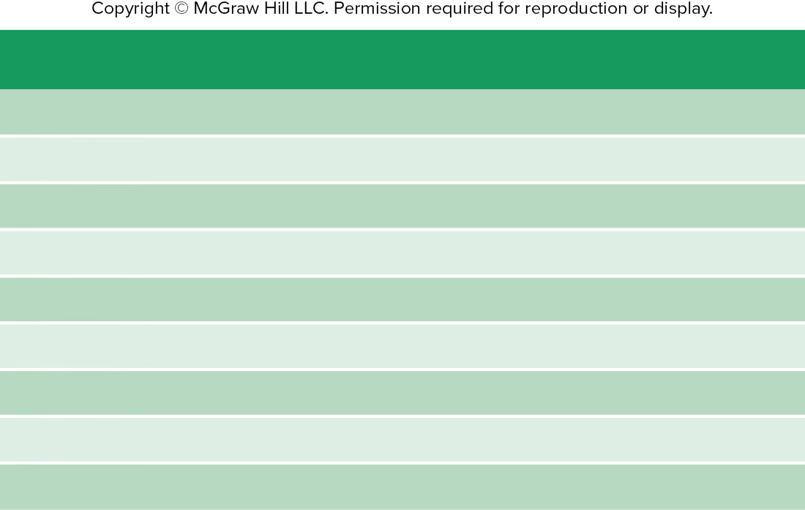
Table 7.5
TABLE 7.5
Bones Forming the Nasal Cavity
(see figures 7.7 and 7.12)
Bone
Part of Nasal Cavity
Frontal
Roof
Nasal
Roof
Sphenoid
Roof
Ethmoid
Roof, septum, lateral wall
Inferior nasal concha
Lateral wall
Lacrimal
Lateral wall
Maxilla
Floor
Palatine
Floor and lateral wall
Vomer
Septum

Slide 21
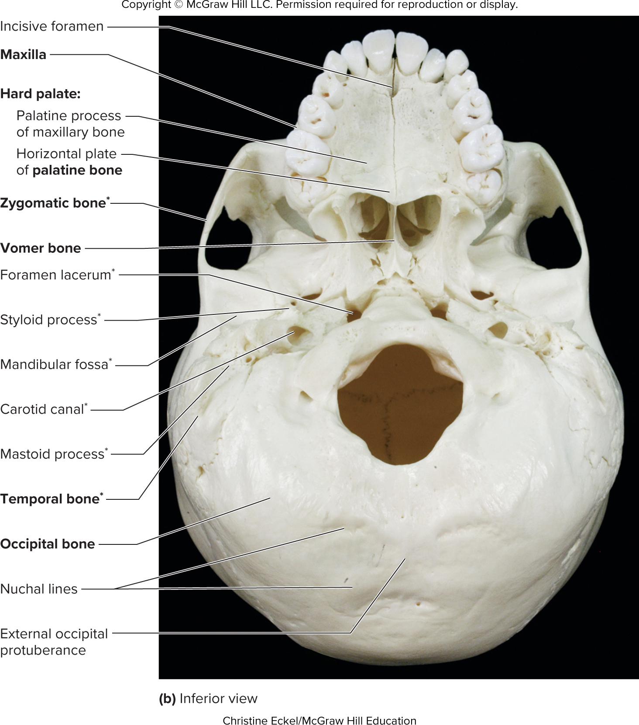
Figure 7.p2

Slide 22
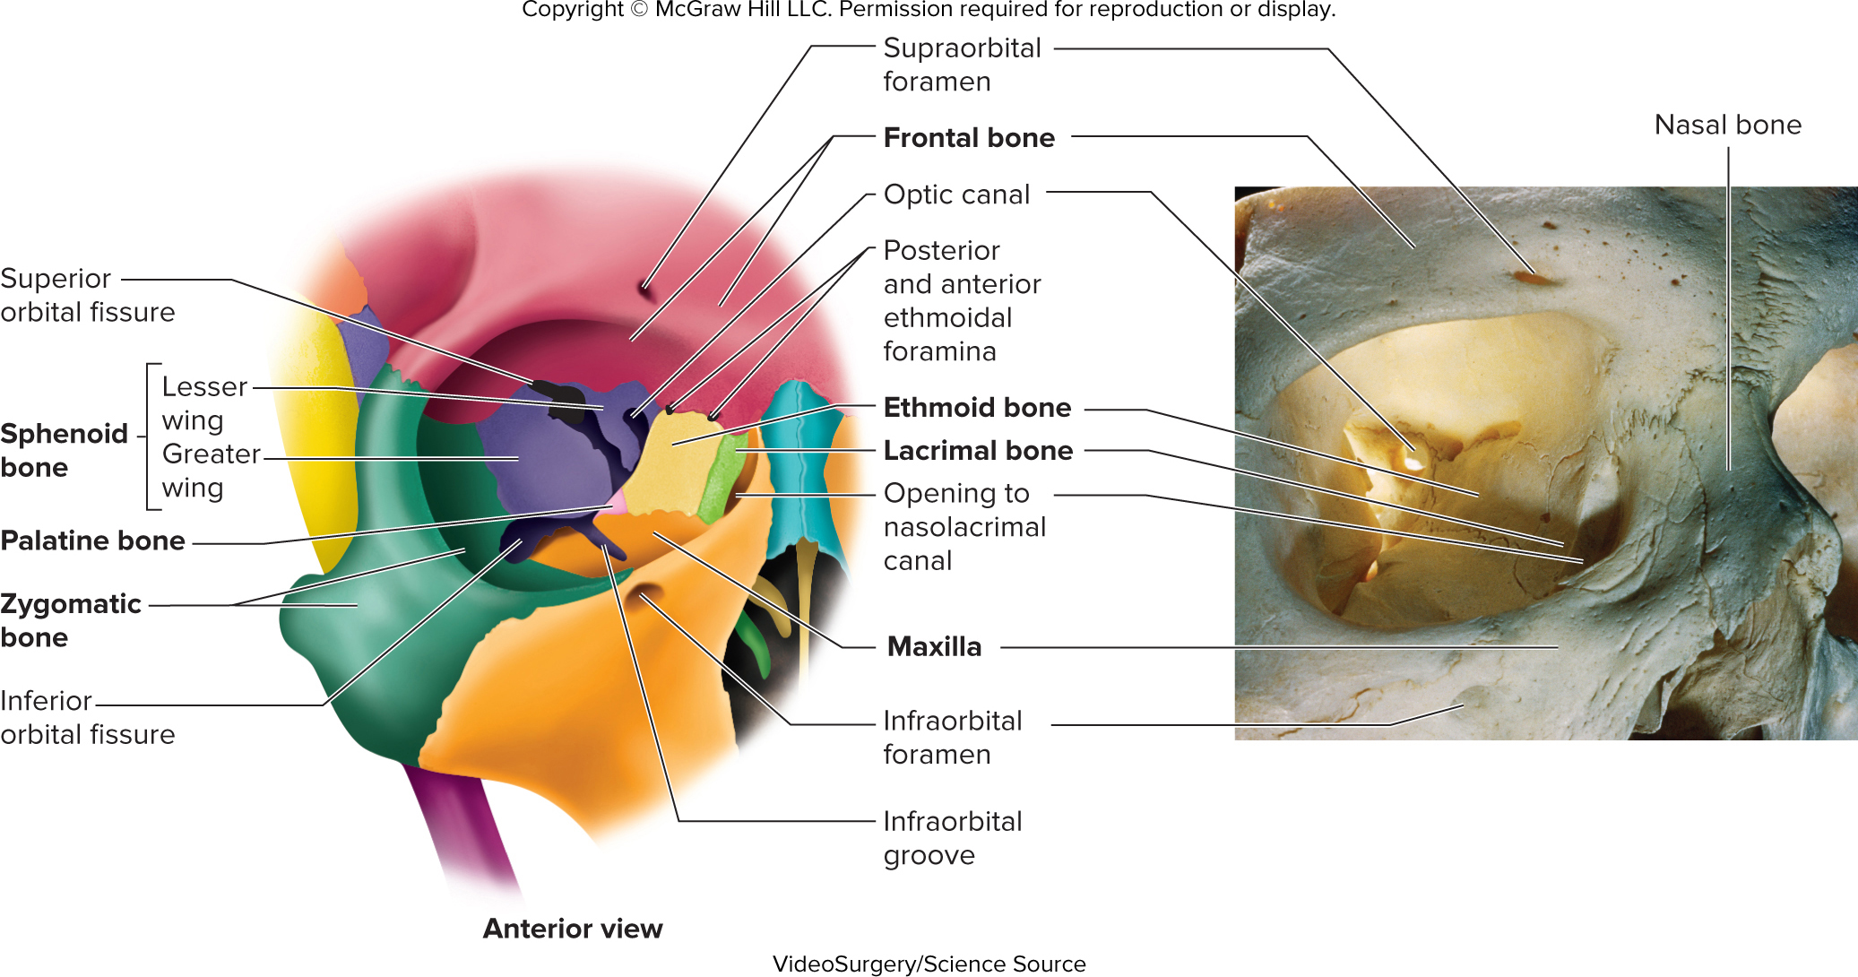
Figure 7.11

Slide 23
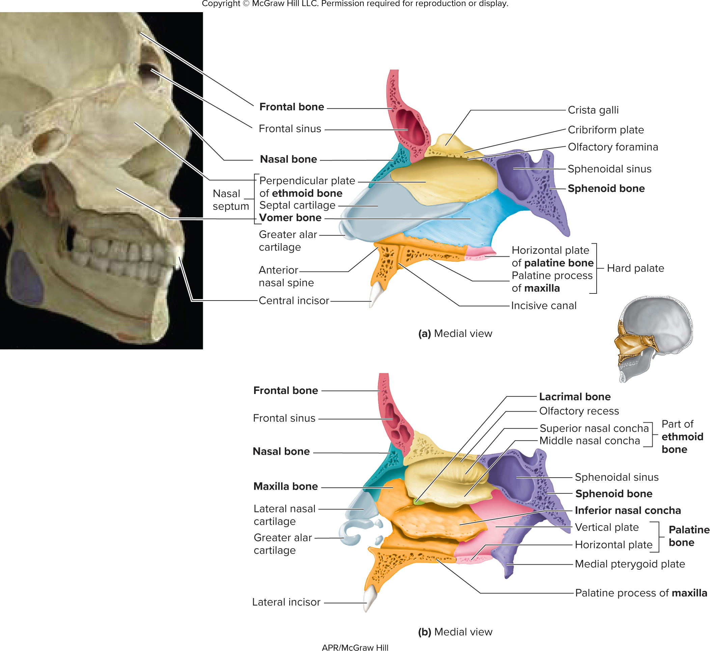
Figure 7.12

Slide 24
Table 7.6
TABLE 7.6
Skull Foramina, Fissures, and Canals (see figures 7.9 and 7.10)
Opening
Bones Containing the Opening
Structures Passing Through Openings
Supraorbital foramen or notch
Frontal
Supraorbital nerve and vessels
Carotid canal
Temporal
Carotid artery and carotid sympathetic
nerve plexus
External acoustic meatus
Temporal
Sound waves passing to the eardrum
Internal acoustic meatus
Temporal
Facial nerve and vestibulocochlear nerve
Stylomastoid foramen
Temporal
Facial nerve
Jugular foramen
Between temporal and occipital
Internal jugular vein, glossopharyngeal nerve, vagus nerve, and accessory nerve
Foramen magnum
Occipital
Spinal cord, accessory nerves, and vertebral arteries
Hypoglossal canal
Occipital
Hypoglossal nerve
Foramen lacerum
Between temporal, occipital, and sphenoid
Filled with cartilage in life
Foramen rotundum
Sphenoid
Maxillary division of trigeminal nerve
Foramen ovale
Sphenoid
Mandibular division of trigeminal nerve
Foramen spinosum
Sphenoid
Middle meningeal artery
Optic canal
Sphenoid
Optic nerve and ophthalmic artery
Pterygoid canal
Sphenoid
Sympathetic and parasympathetic nerves to the face
Superior orbital fissures
Sphenoid
Oculomotor nerve, trochlear nerve, ophthalmic division of trigeminal nerve,
abducens nerve, and ophthalmic veins
Inferior orbital fissures
Between sphenoid and maxilla
Infraorbital nerve and blood vessels and zygomatic nerve
Ethmoidal foramina, anterior and posterior
Between ethmoid and frontal
Anterior and posterior ethmoidal nerves
Olfactory foramina
Ethmoid
Olfactory nerves
Zygomaticofacial foramen
Zygomatic
Zygomaticofacial nerve
Zygomaticotemporal foramen
Zygomatic
Zygomaticotemporal nerve
Incisive foramen
Between maxillae
Incisive nerve
Infraorbital foramen
Maxilla
Infraorbital nerve
Sphenopalatine foramen
Between palatine and sphenoid
Nasopalatine nerve and sphenopalatine blood vessels
Palatine foramina, anterior and posterior
Palatine
Palatine nerves
Nasolacrimal canal
Between lacrimal and maxilla
Nasolacrimal (tear) duct
Mandibular foramen
Mandible
Inferior alveolar nerve to the mandibular teeth
Mental foramen
Mandible
Mental nerve

Slide 25
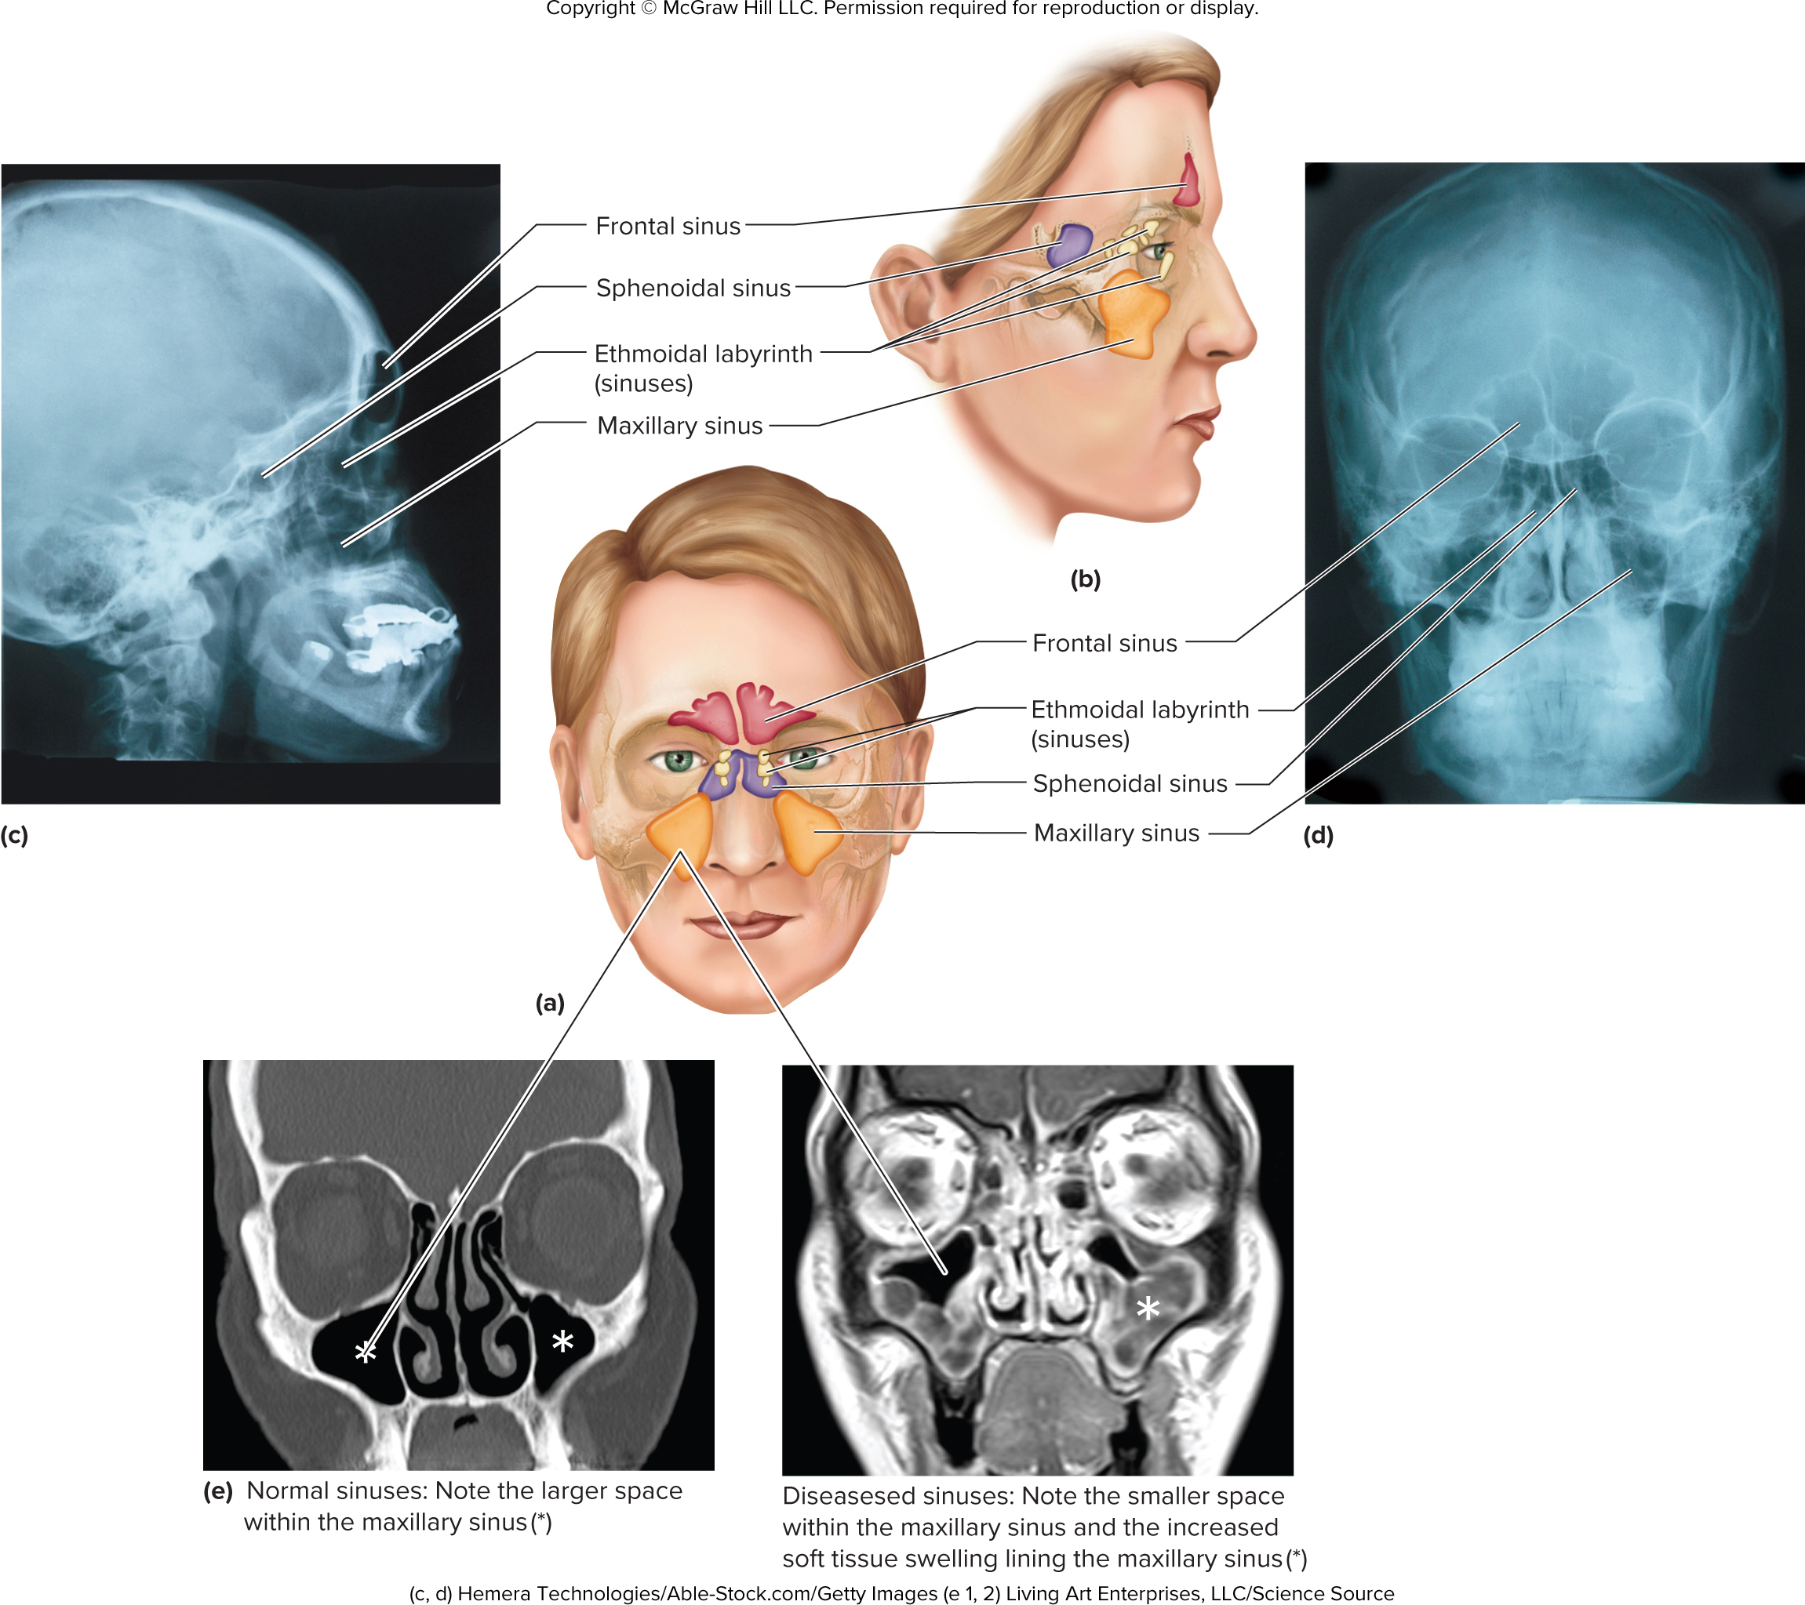
Figure 7.13a-e

Slide 26
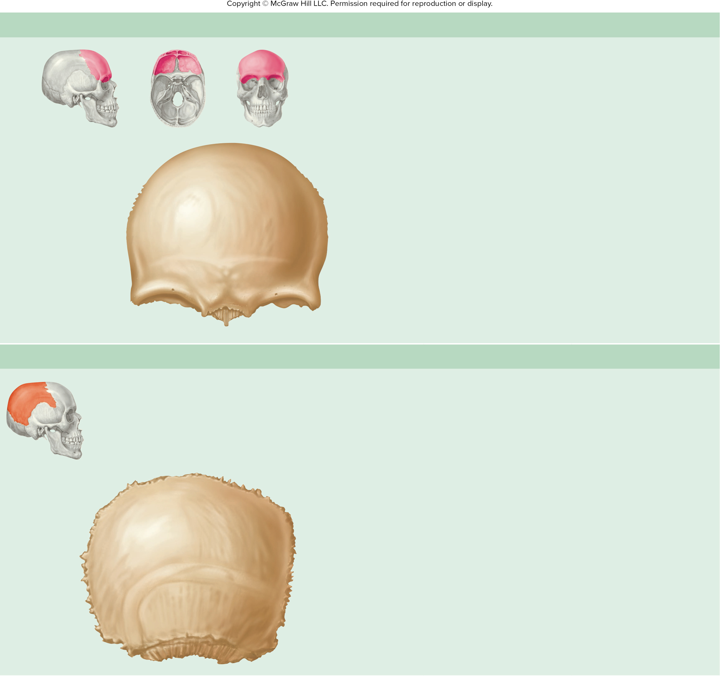
Table 7.7
TABLE 7.7
Cranial Bones of the Skull
(a) Frontal Bone—Anterior View
Landmark
Description
Glabella
Area between the supraorbital margins
Nasal spine
Superior part of the nasal bridge
Orbital plate
Roof of the orbit
Supraorbital foramen
Opening through which nerves and
vessels exit the skull to the skin of
the forehead
Supraorbital margin
Ridge forming the anterior superior
border of the orbit
Zygomatic process
Connects to the zygomatic bone; helps
form the lateral margin of the orbit
Special Features
Glabella
Forms the forehead and roof of the orbit
Supraorbital
foramen
Supraorbital
margin
Contains the frontal sinus
Orbital plate
Zygomatic
process
Nasal spine
(b) Parietal Bone (Right)—Lateral View
Landmark
Description
Parietal eminence
The widest part of the
head is from one parietal
eminence to the other.
Superior and inferior
temporal lines
Attachment point for
temporalis muscle
Special Features
Forms lateral wall of skull
Parietal
eminence
Superior
temporal line
Inferior temporal
line

Slide 27
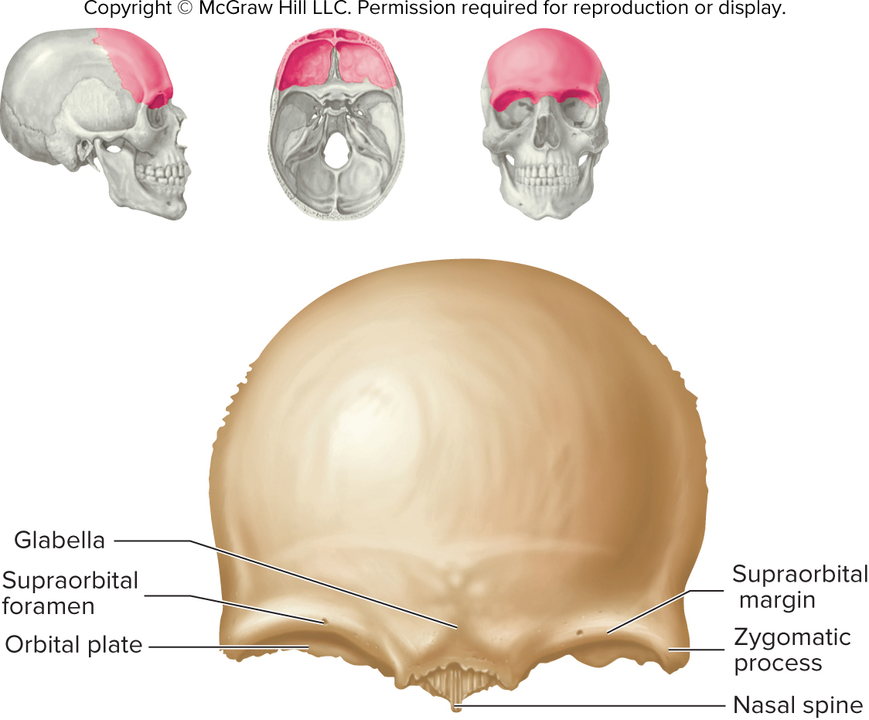
ta 7.01a

Slide 28
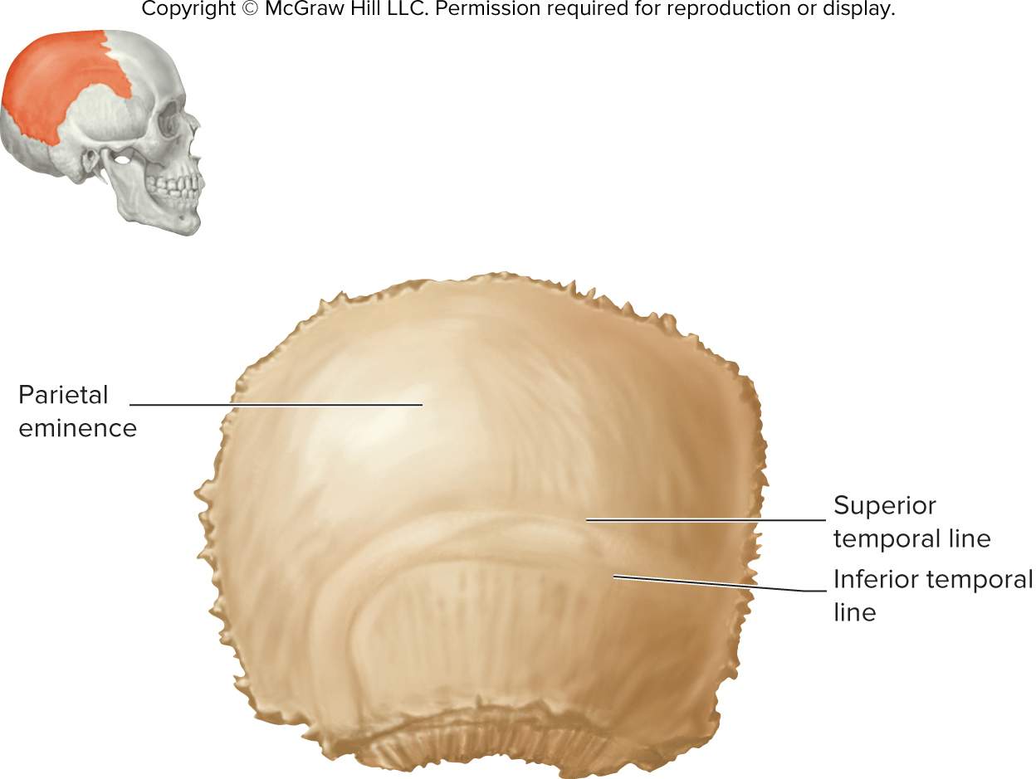
ta 7.01b

Slide 29
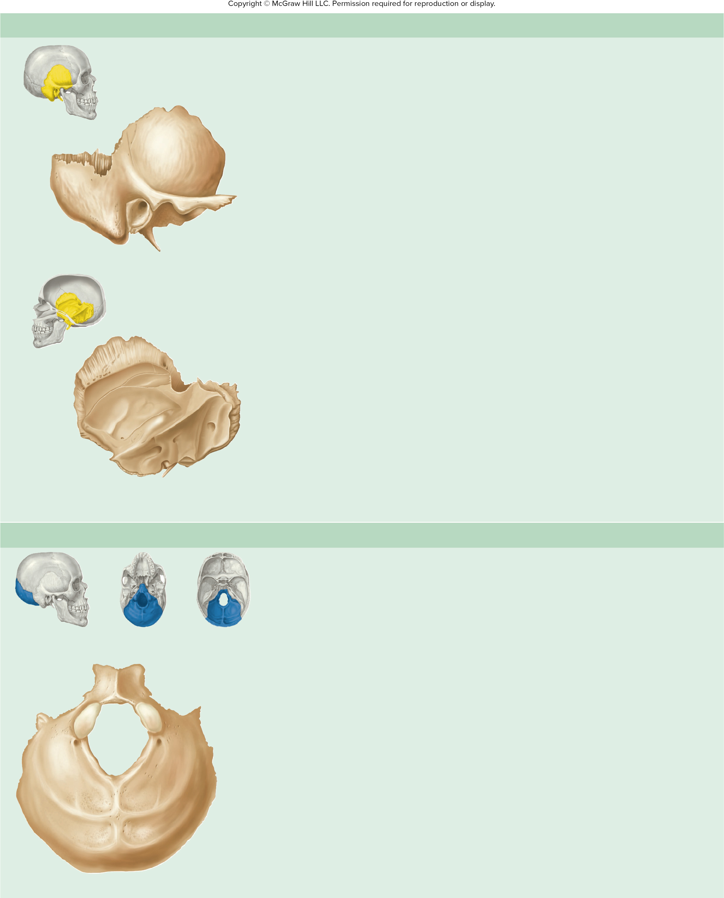
Table 7.7cont01
TABLE 7.7
Cranial Bones of the Skull—Continued
(c) Temporal Bone (Right)—Lateral and Medial Views
Landmark
Description
Carotid canal (shown in
figures 7.9 and 7.10)
Canal through which the internal carotid artery
enters the cranial cavity
External auditory canal
External canal of the ear; carries sound to the ear
Internal auditory canal
(shown in figure 7.9)
Opening through which the facial (cranial
nerve VII) and vestibulocochlear (cranial
nerve VIII) nerves enter the petrous part
of the temporal bone
Squamous
part
Zygomatic
process
Forms one side of jugu-
lar foramen (shown in
figures 7.9 and 7.10)
Foramen through which the internal jugular
vein exits the cranial cavity
Mastoid
process
Mandibular fossa
Mandibular fossa
Articulation point between the mandible
and skull
External acoustic
meatus
Styloid process
Mastoid process
Attachment point for muscles moving the
head and for a hyoid muscle
Lateral view
Middle cranial fossa
(shown in figure 7.9)
Depression in the floor of the cranial cavity
formed by the temporal lobes of the brain
Petrous part
(shown in figure 7.9)
Thick portion of the temporal bone
Squamous part
(shown in figure 7.9)
Flat, lateral portion of the temporal bone
Squamous
part
Styloid process
Attachment for muscles of the tongue, throat,
and hyoid bone
Petrous part
Stylomastoid foramen
(shown in figure 7.10)
Foramen through which the facial nerve
(cranial nerve VII) exits the skull
Internal acoustic
meatus
Zygomatic process
Helps form the bony bridge extending from
the cheek to just anterior to the ear; attach-
ment for a muscle that moves the mandible
Mastoid
process
Styloid process
Special Features
Medial view
Contains the middle and inner ear and the mastoid air cells
Place where the mandible articulates with the rest of the skull
(d) Occipital Bone—Inferior View
Landmark
Description
Condyle
Articulation point between the skull
and first vertebra
External occipital
protuberance
Attachment point for a strong ligament
(nuchal ligament) in the back of the
neck
Anterior
Foramen magnum
Opening around the point where the
brain and spinal cord connect
Condyle
Hypoglossal canal
(shown in figure 7.9)
Opening through which the hypoglos-
sal nerve (cranial nerve XII) passes
Foramen magnum
Inferior nuchal line
Attachment point for neck muscles
Posterior cranial fossa
(shown in figure 7.9)
Depression in the posterior of the
cranial cavity formed by the cerebellum
Inferior
nuchal line
Superior nuchal line
Attachment point for neck muscles
Superior
nuchal line
Special Features
External occipital
protuberance
Forms the base of the skull
Posterior

Slide 30
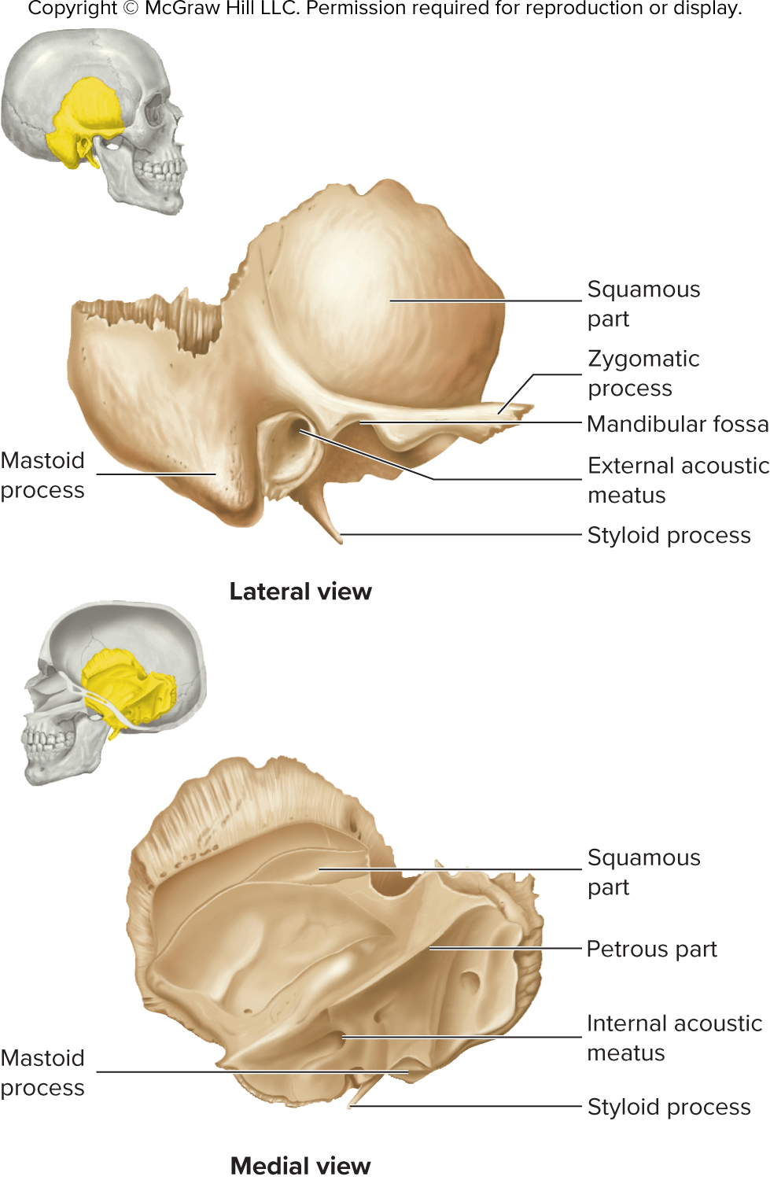
ta 7.01c

Slide 31
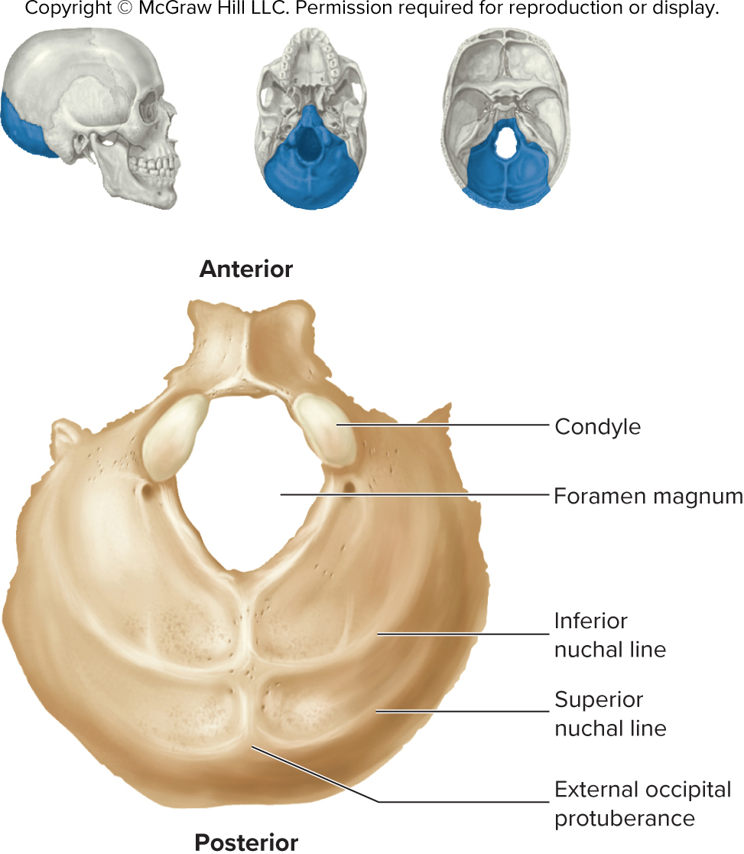
ta 7.01d

Slide 32
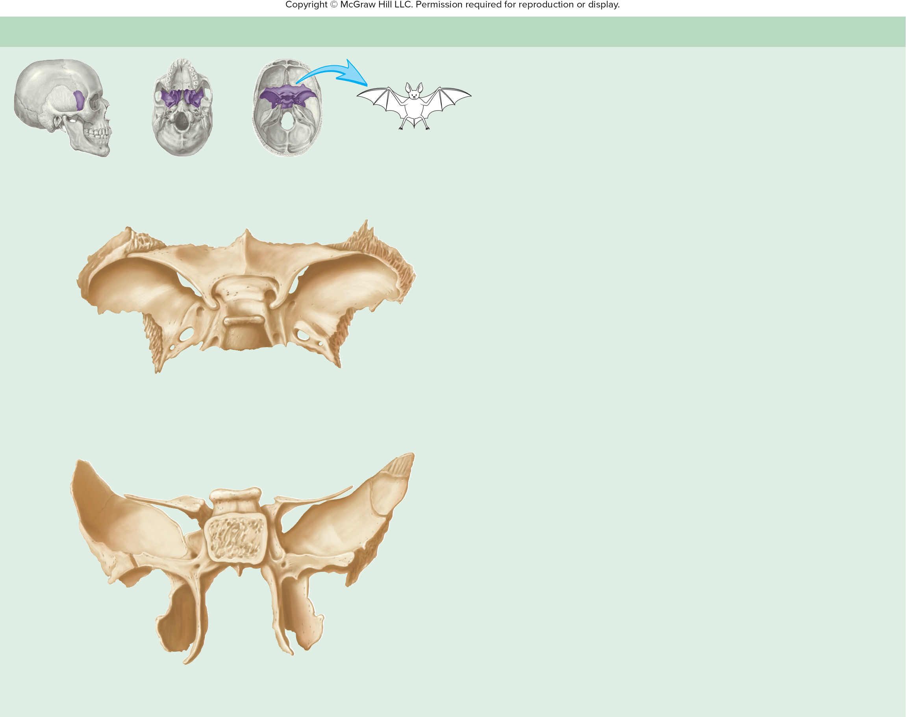
Table 7.7cont02
TABLE 7.7
Cranial Bones of the Skull—Continued
(e) Sphenoid Bone—Superior and Posterior Views
Landmark
Description
Body
Thickest part of the bone; articulates
with the occipital bone
The sphenoid bone is
somewhat shaped like a bat.
Foramen ovale
Opening through which a branch of
the trigeminal nerve (cranial nerve V)
exits the cranial cavity
Foramen rotundum
Opening through which a branch of
the trigeminal nerve (cranial nerve V)
exits the cranial cavity
Optic canal
Lesser
wing
Superior
orbital
fissure
Foramen spinosum
Opening through which a major artery
to the meninges (membranes around
the brain) enters the cranial cavity
Greater
wing
Sella
turcica
Greater wing
Forms the floor of the middle cranial
fossa; several foramina pass through
this wing
Foramen rotundum
Lateral pterygoid
plate
Attachment point for muscles of
mastication (chewing)
Foramen ovale
Groove of
carotid canal
Foramen spinosum
Superior view
Lesser wing
Superior border of the superior
orbital fissure
Medial pterygoid plate
Posterolateral walls of the nasal cavity
Optic canal
Opening through which the optic
nerve (cranial nerve II) passes from
the orbit to the cranial cavity
Lesser
wing
Superior
orbital
fissure
Pterygoid canal
Opening through which nerves and
vessels exit the cranial cavity
Greater
wing
Body
Pterygoid hamulus
Process around which the tendon
passes from a muscle to the soft
palate
Foramen rotundum
Lateral
pterygoid
plate
Sella turcica
Fossa containing the pituitary gland
Pterygoid canal
Superior orbital
fissure
Opening through which nerves and
vessels enter the orbit from the
cranial cavity
Pterygoid hamulus
Medial
pterygoid
plate
Posterior view
Special Feature
Contains the sphenoidal sinus

Slide 33
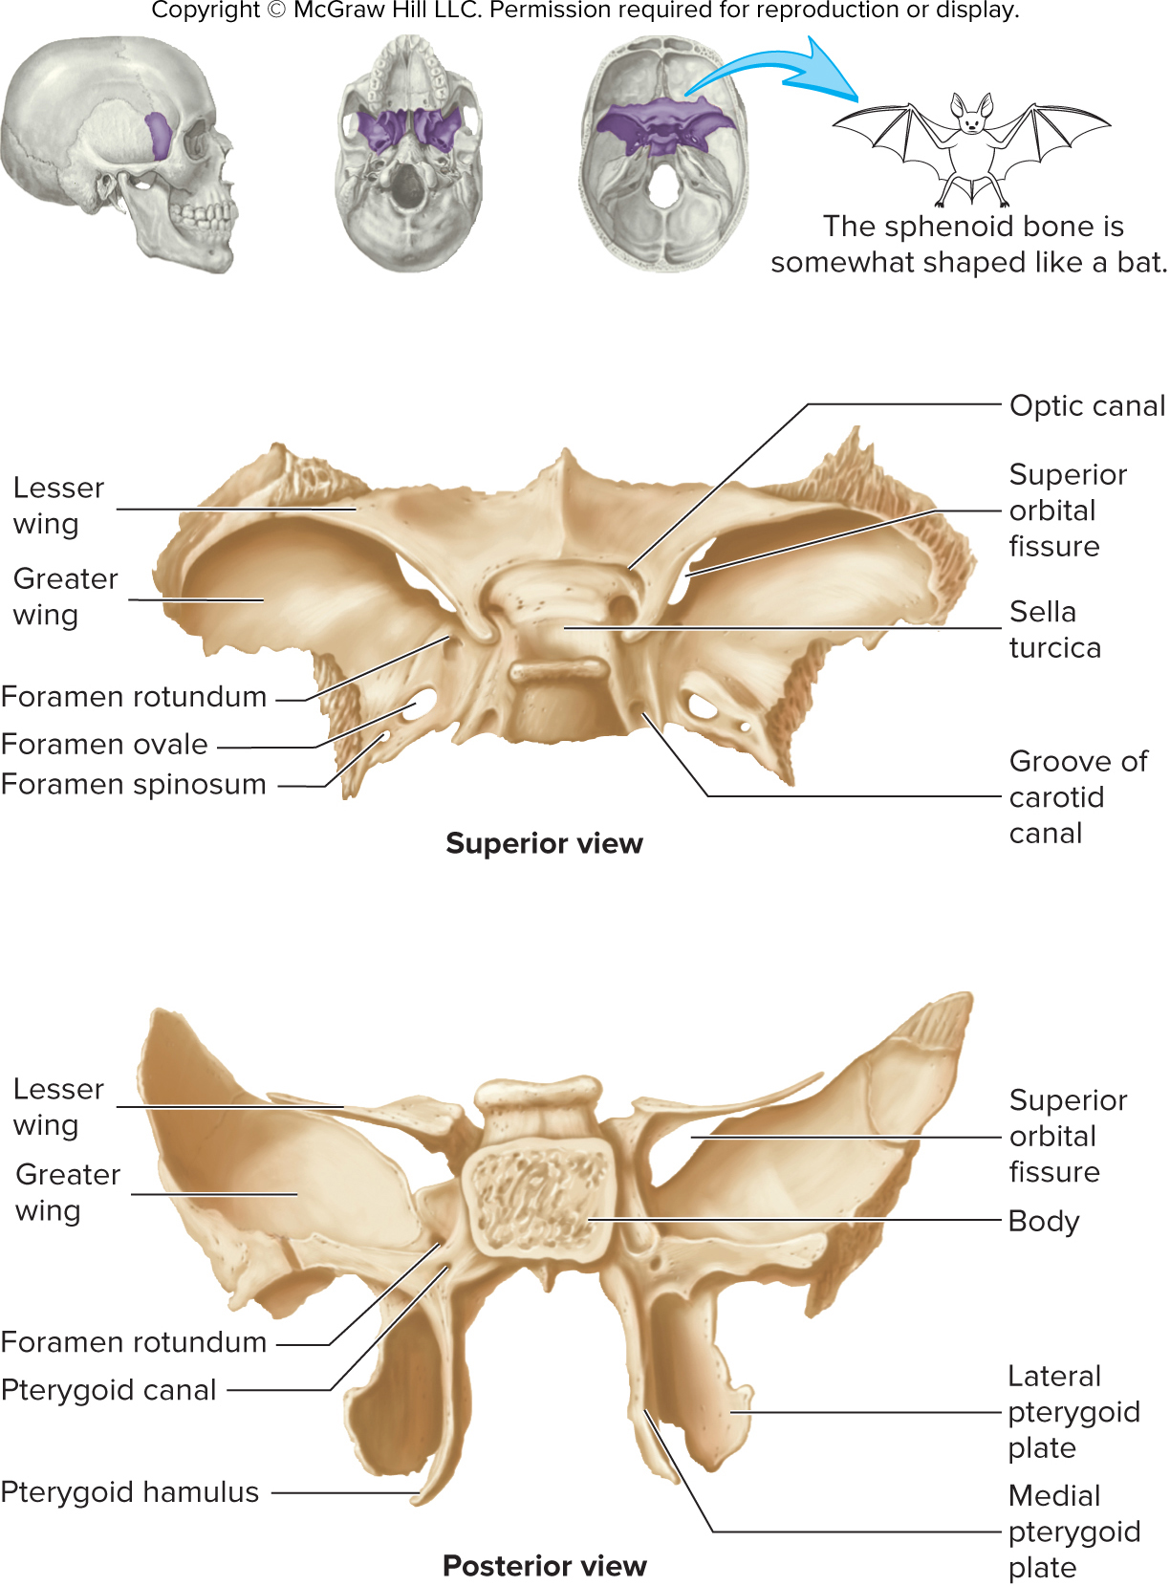
ta 7.01e

Slide 34
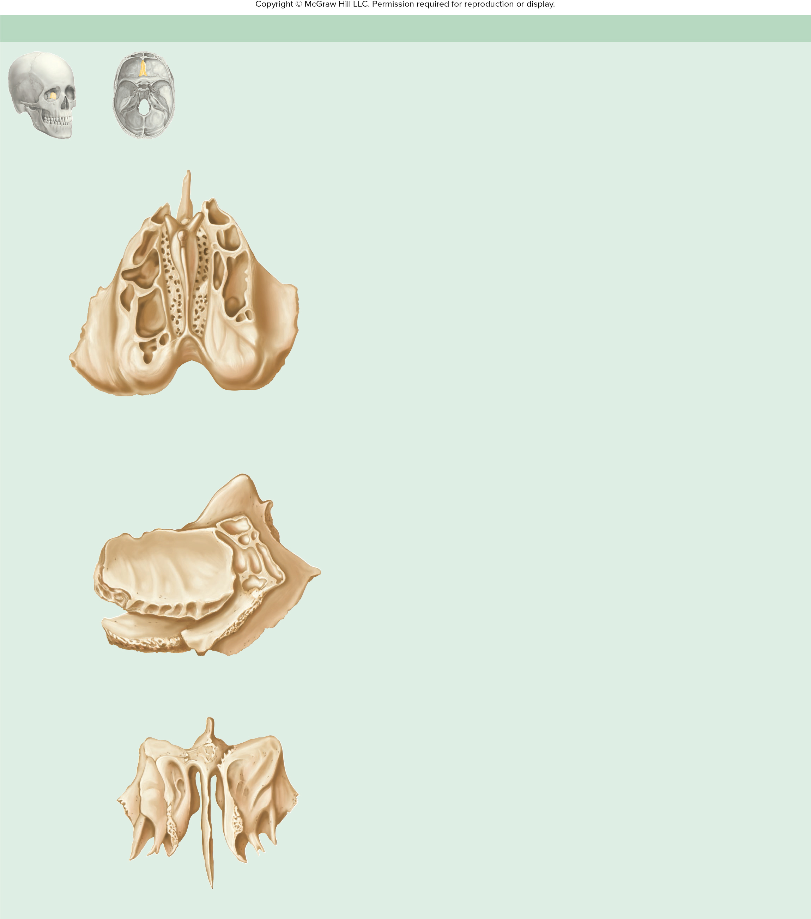
Table 7.7cont03
TABLE 7.7
Cranial Bones of the Skull—Continued
(f) Ethmoid Bone—Superior, Lateral, and Anterior Views
Landmark
Description
Cribriform plate
Contains numerous olfactory
foramina through which branches
of the olfactory nerve (cranial
nerve I) enter the cranial cavity
from the nasal cavity
Anterior
Crista galli
Attachment for meninges
(membranes around brain)
Perpendicular
plate
Ethmoidal foramina
(shown in figure 7.11)
Openings through which nerves
and vessels pass from the orbit
to the nasal cavity
Crista galli
Ethmoidal labyrinth
(sinuses)
Middle nasal concha
Ridge extending into the nasal
cavity; increases surface area,
helps warm and moisten air in the
cavity
Cribriform
plate
Orbital plate
Orbital plate
Forms the medial wall of the orbit
Perpendicular plate
Forms the superior portion of the
nasal septum
Superior nasal concha
Ridge extending into the nasal
cavity; increases surface area,
helps warm and moisten air in the
cavity
Posterior
Superior view
Special Feature
Crista galli
Forms part of the nasal septum and part of the lateral walls and
roof of the nasal cavity
Ethmoidal labyrinth
(sinuses)
Contains the ethmoidal labyrinth, or ethmoidal sinuses; the laby-
rinth is divided into anterior, middle, and posterior ethmoidal cells
Orbital
plate
Posterior
Anterior
Middle nasal
concha
Perpendicular
plate
Lateral view
Crista galli
Orbital plate
Ethmoidal labyrinth
(sinuses)
Superior
nasal concha
Perpendicular
plate
Middle
nasal concha
Anterior view

Slide 35
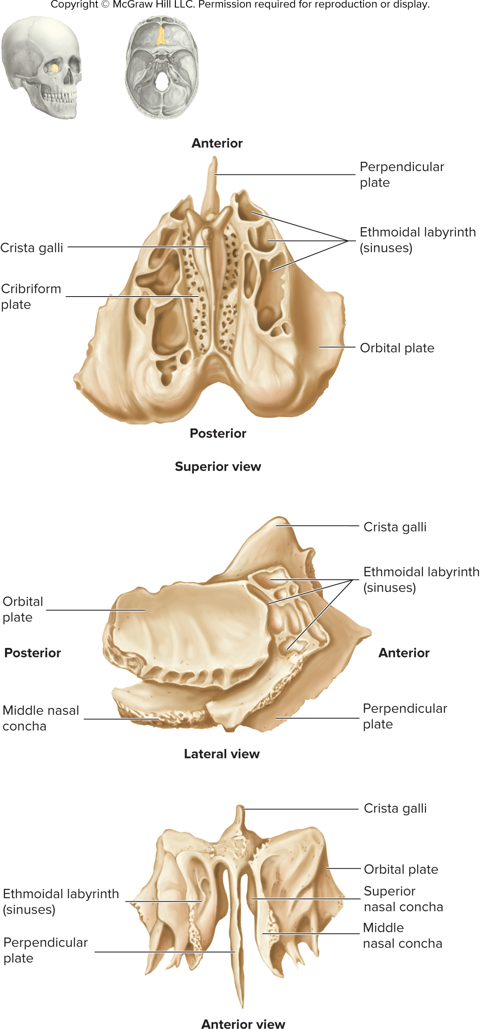
ta 7.01f

Slide 36
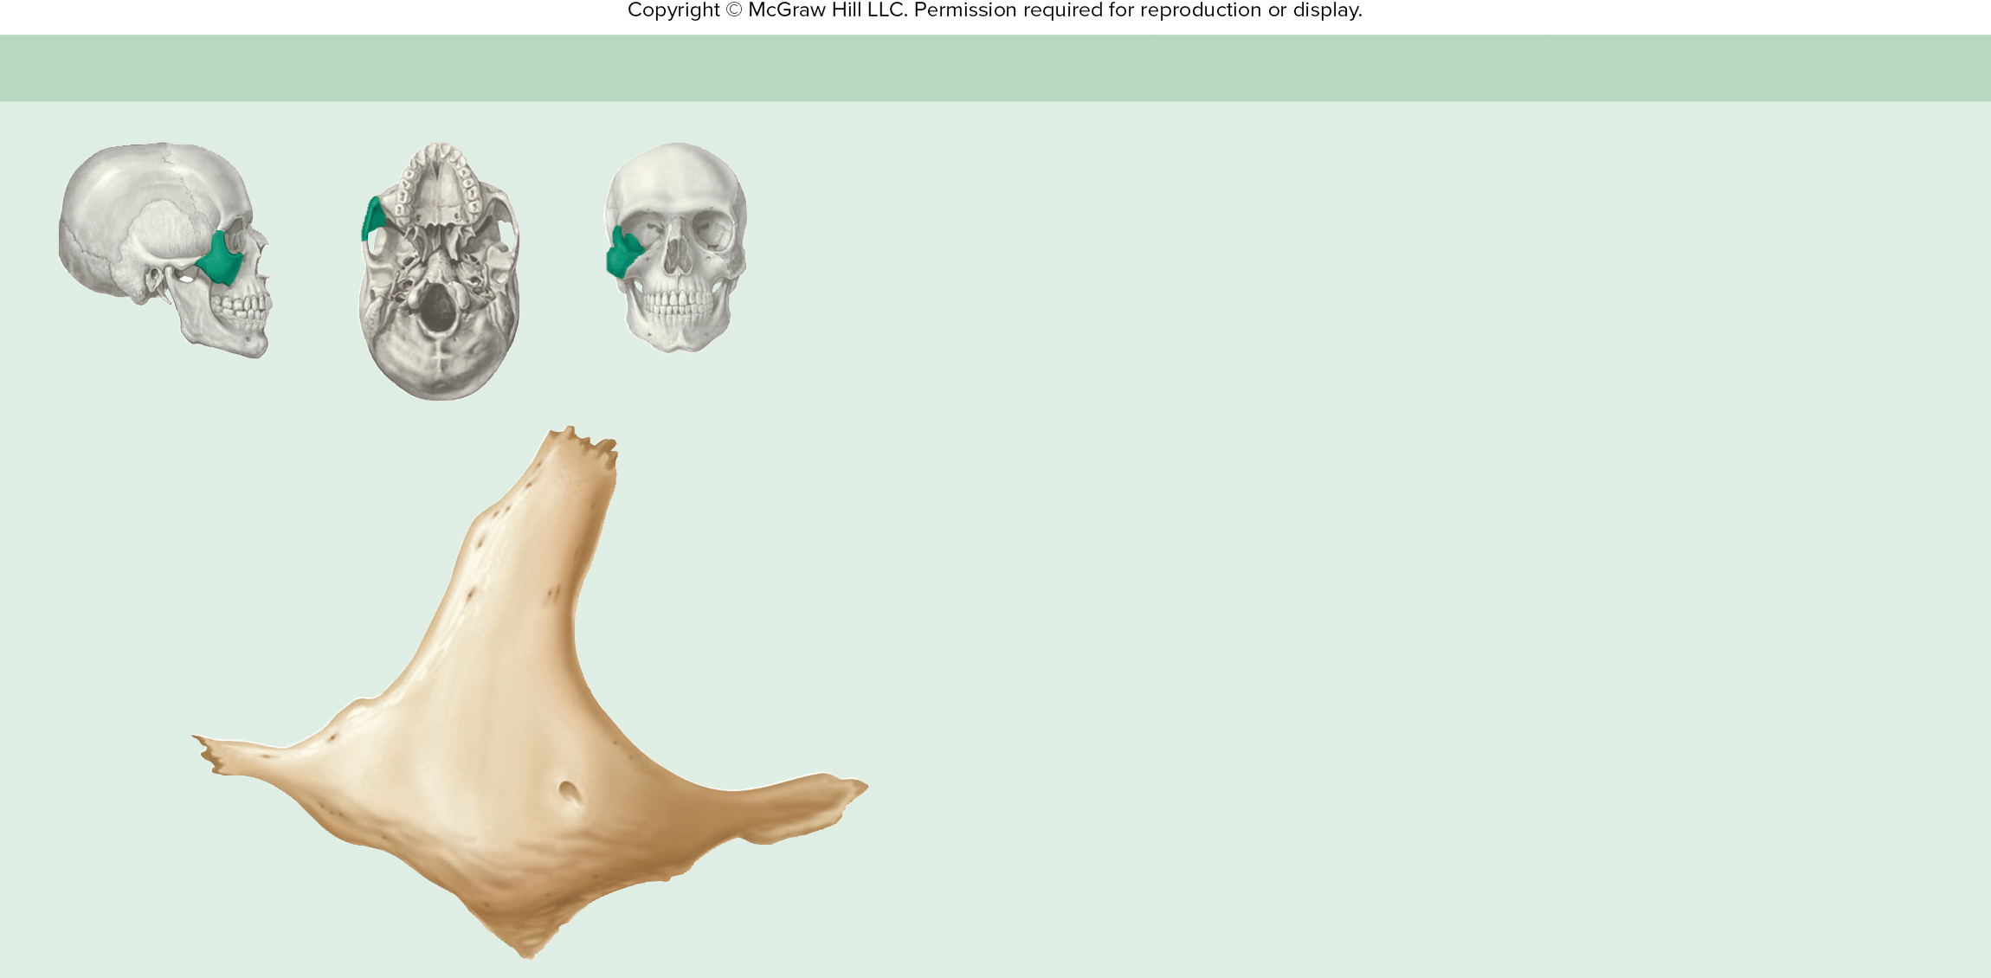
Table 7.8
TABLE 7.8
Facial Bones of the Skull
(a) Zygomatic Bone (Right)—Lateral View
Landmark
Description
Frontal process
Connection to the frontal
bone; helps form the lateral margin of the orbit
Infraorbital margin
Ridge forming the inferior border of the orbit
Temporal process
Helps form the bony bridge from the cheek to just ante-
rior to the ear
Frontal process
Zygomaticofacial foramen
Opening through which a nerve and vessels exit the
orbit to the face
Zygomaticofacial foramen
Special Features
Forms the prominence of the cheek
Temporal process
Forms the anterolateral wall of the orbit
Infraorbital margin
Maxillary process

Slide 37
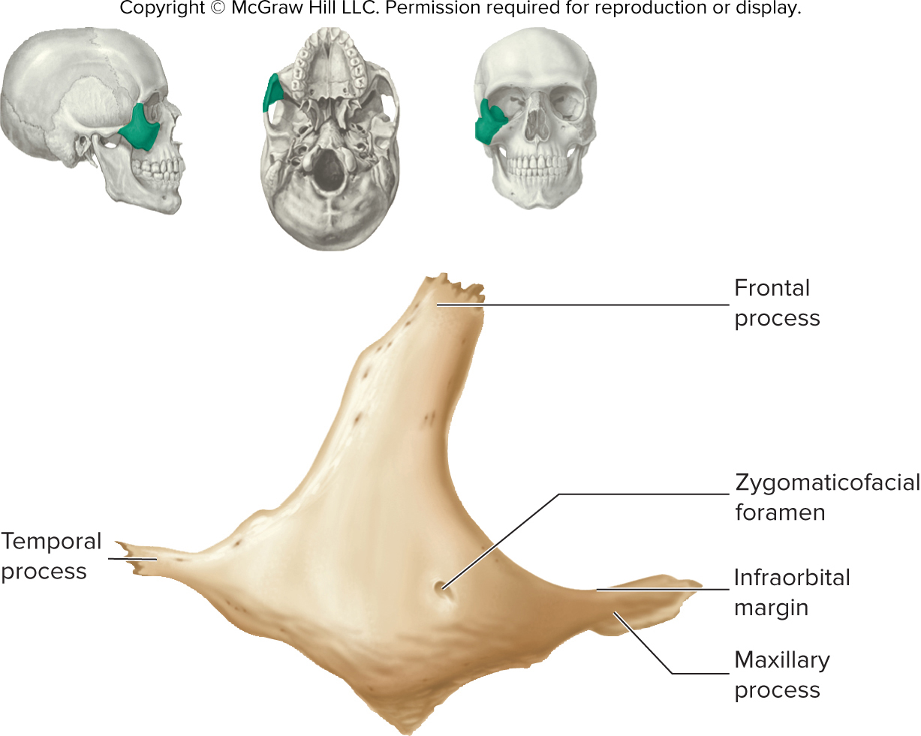
ta 7.02a

Slide 38
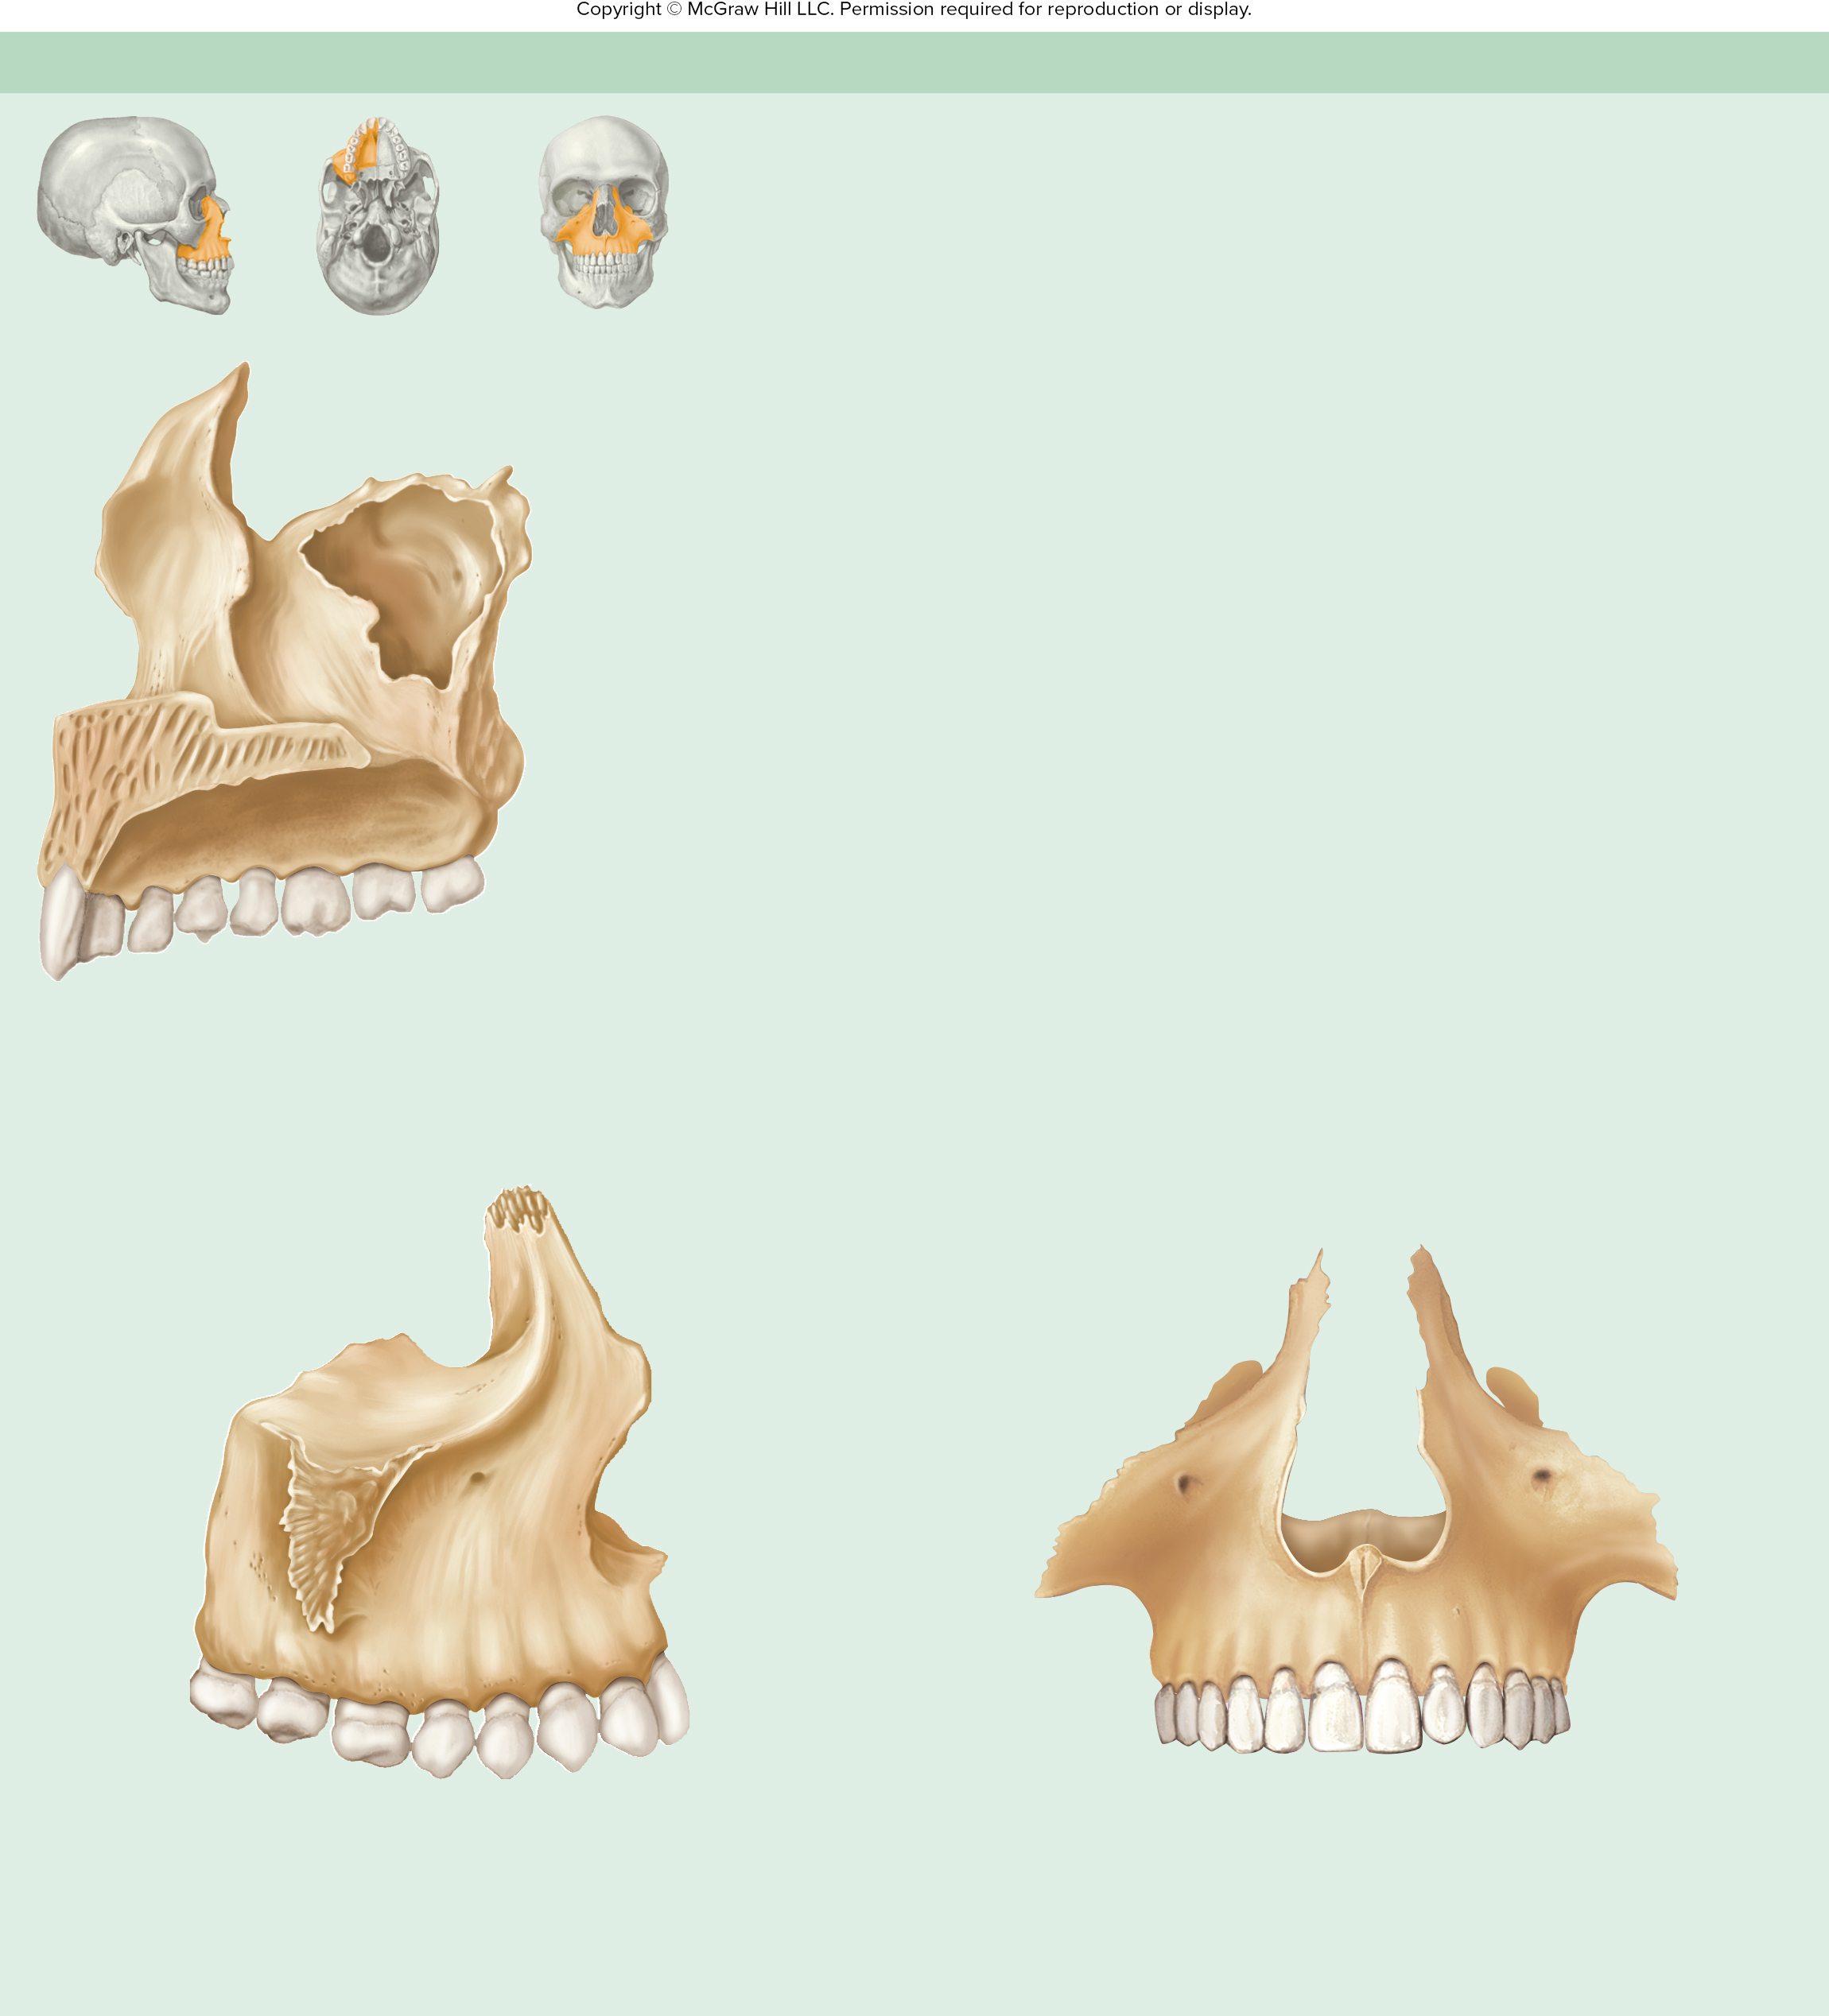
Table 7.8cont01
TABLE 7.8
Facial Bones of the Skull—Continued
(b) Maxilla (Right)—Anterior, Medial, and Lateral Views
Landmark
Description
Alveolar process
Ridge containing the teeth
Anterior nasal spine
Forms part of the nasal septum
Frontal process
Forms the sides of the nasal bridge
Incisive canal
Opening through which a nerve exits the nasal cavity to the roof of the oral cavity
Frontal process
Infraorbital foramen
Opening through which a nerve and vessels exit the orbit to the face
Maxillary tuberosity
Rounded projection posterior to the last max-
illary molar tooth
Maxillary sinus
Orbital surface
Forms the floor of the orbit
Palatine process
Forms the anterior two-thirds of the hard palate
Zygomatic process
Connection to the zygomatic bone; helps form the interior margin of the orbit
Palatine process
Special Features
Incisive canal
Contains the maxillary sinus and maxillary teeth
Alveolar process
Forms part of nasolacrimal canal
Molars
Premolars
Canine
Incisors
Medial view
Notch for
lacrimal bone
Frontal process
Orbital
surface
Infraorbital
foramen
Zygomatic
process
Anterior
nasal spine
Tuberosity
Alveolar
process
Incisors
Anterior view
Canine
Premolars
Lateral view
Molars

Slide 39
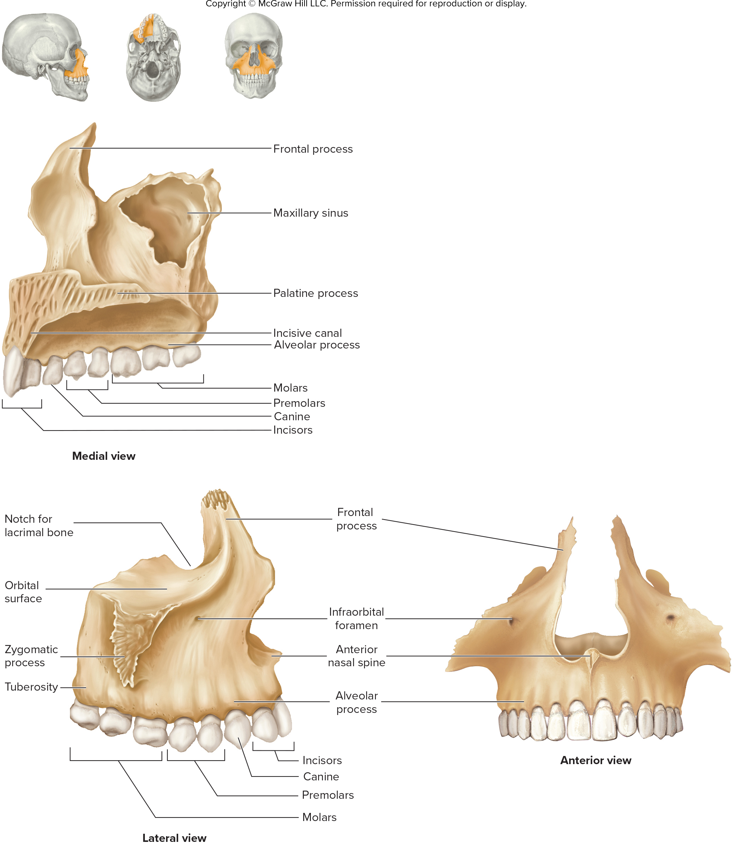
ta 7.02b

Slide 40
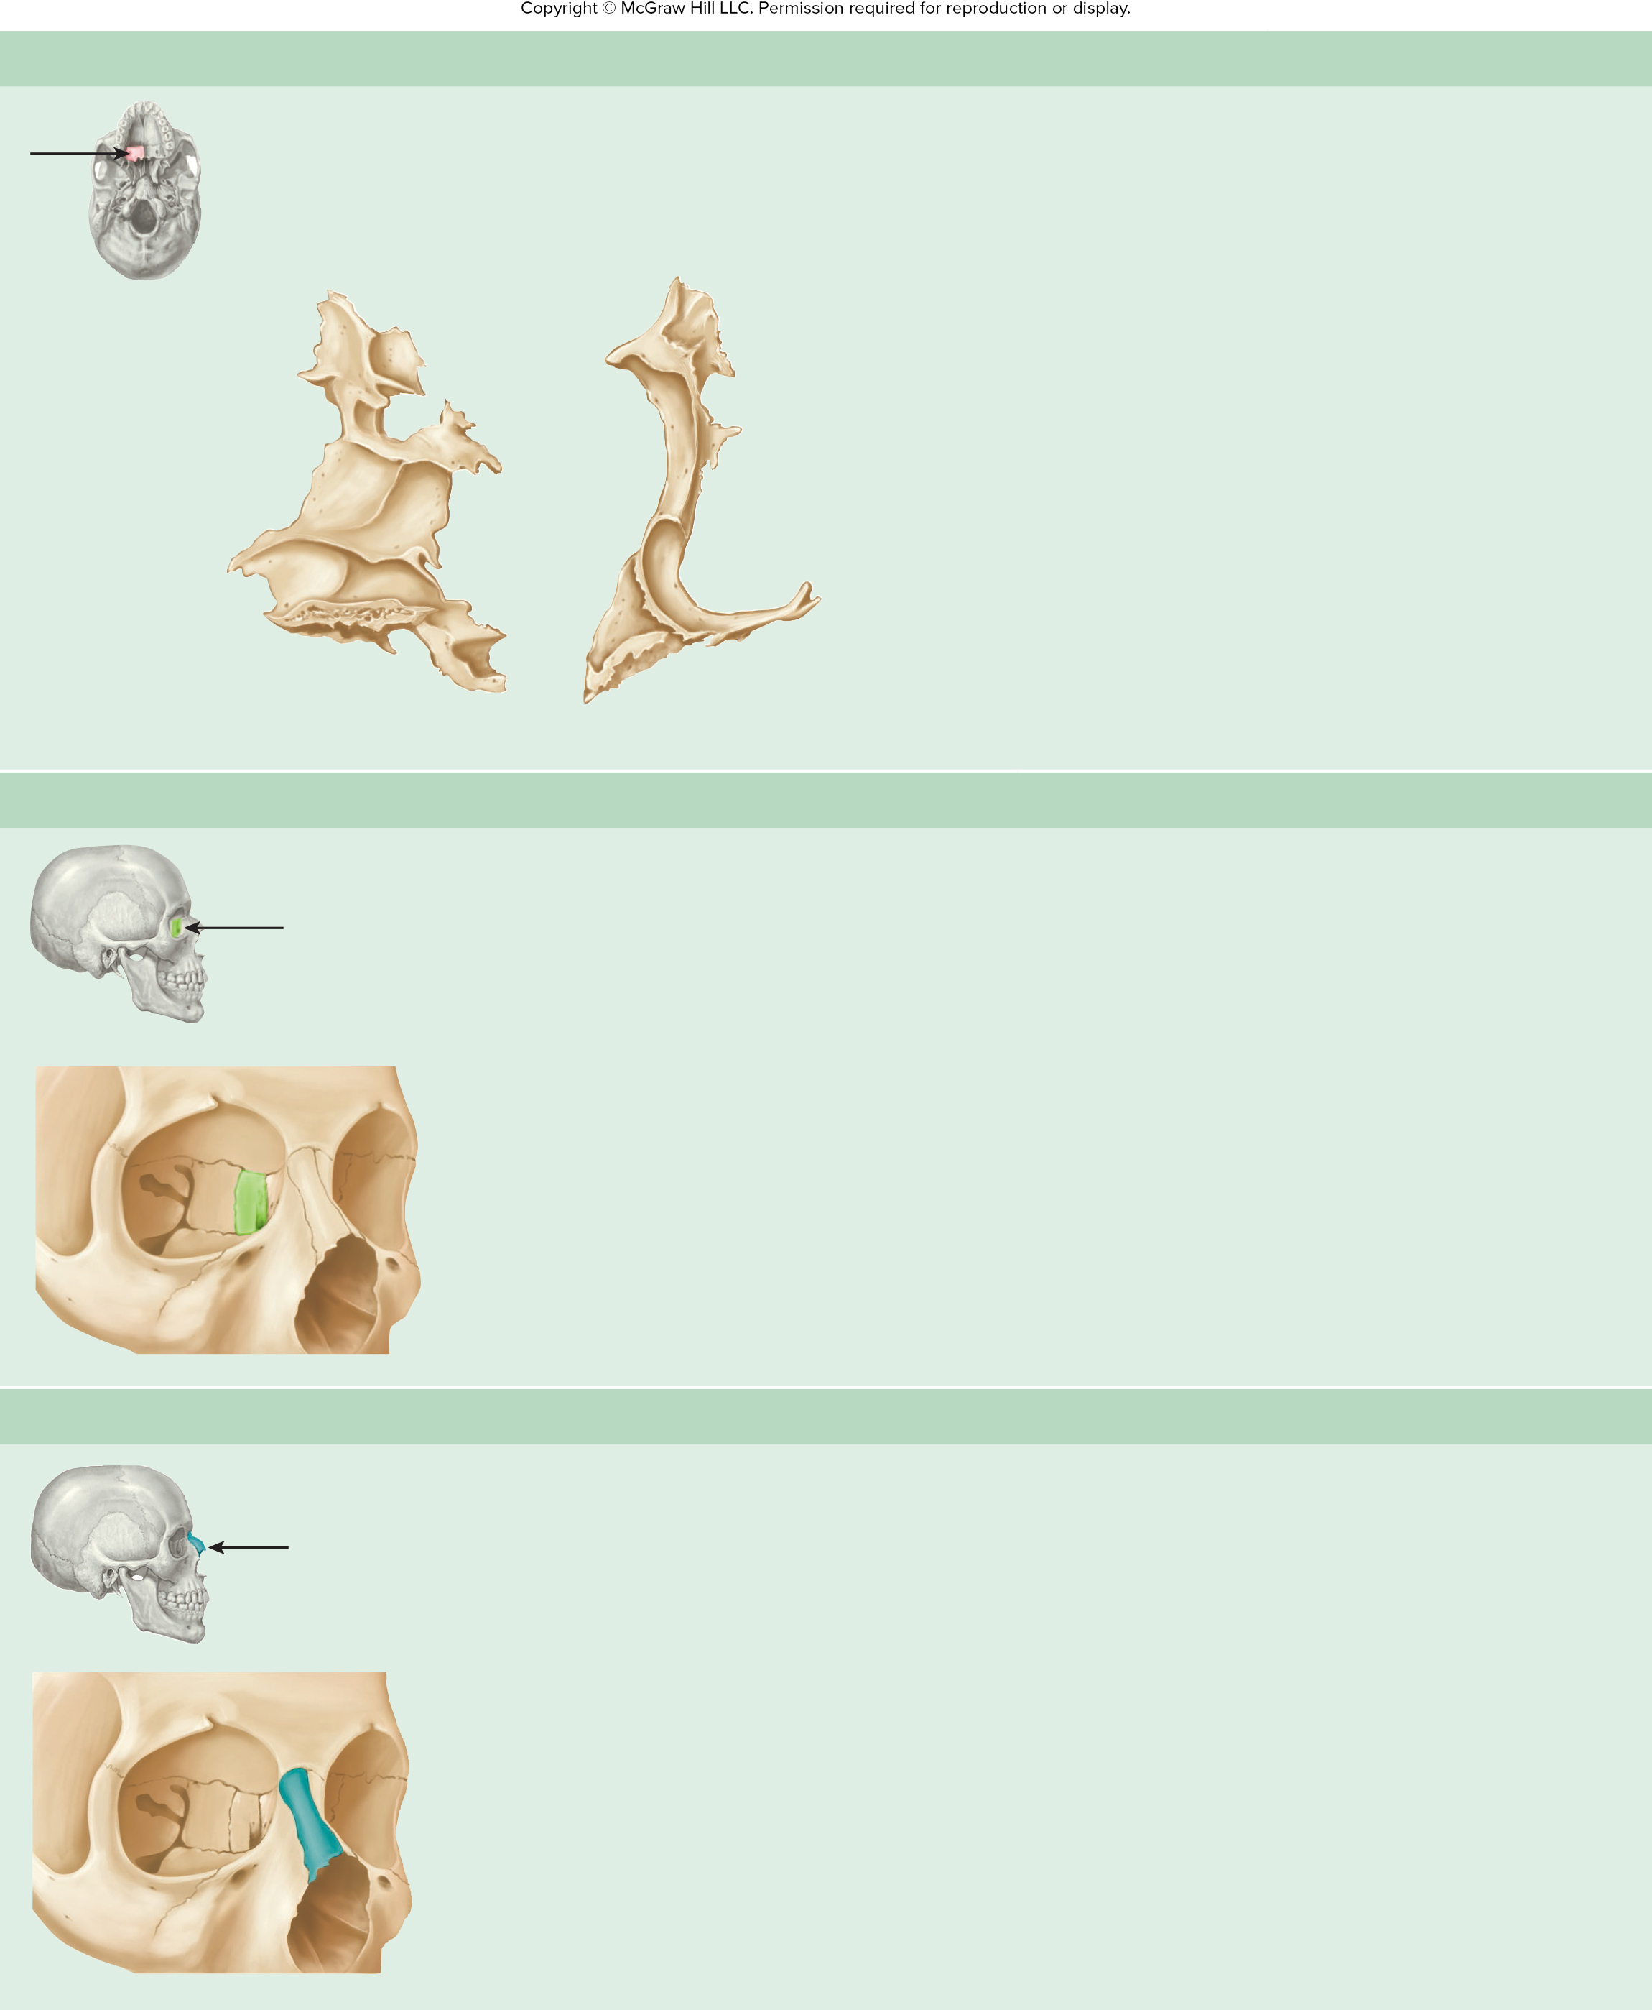
Table 7.8cont02
TABLE 7.8
Facial Bones of the Skull—Continued
(c) Palatine Bone (Right)—Medial and Anterior Views
Landmark
Description
Horizontal plate
Forms the posterior one-third of the hard palate
Vertical plate
Forms part of the lateral nasal wall
Special Feature
Helps form part of the hard palate and a small part of the wall of the orbit
Vertical plate
Vertical plate
Horizontal plate
Horizontal plate
Medial view
Anterior view
(d) Lacrimal Bone (Right)—Anterolateral View
Special Features
Forms a small portion of the orbital wall
Forms part of the nasolacrimal canal
Lacrimal bone
Nasolacrimal canal
(e) Nasal Bone (Right)—Anterolateral View
Special Feature
Forms the bridge of the nose
Nasal bone

Slide 41
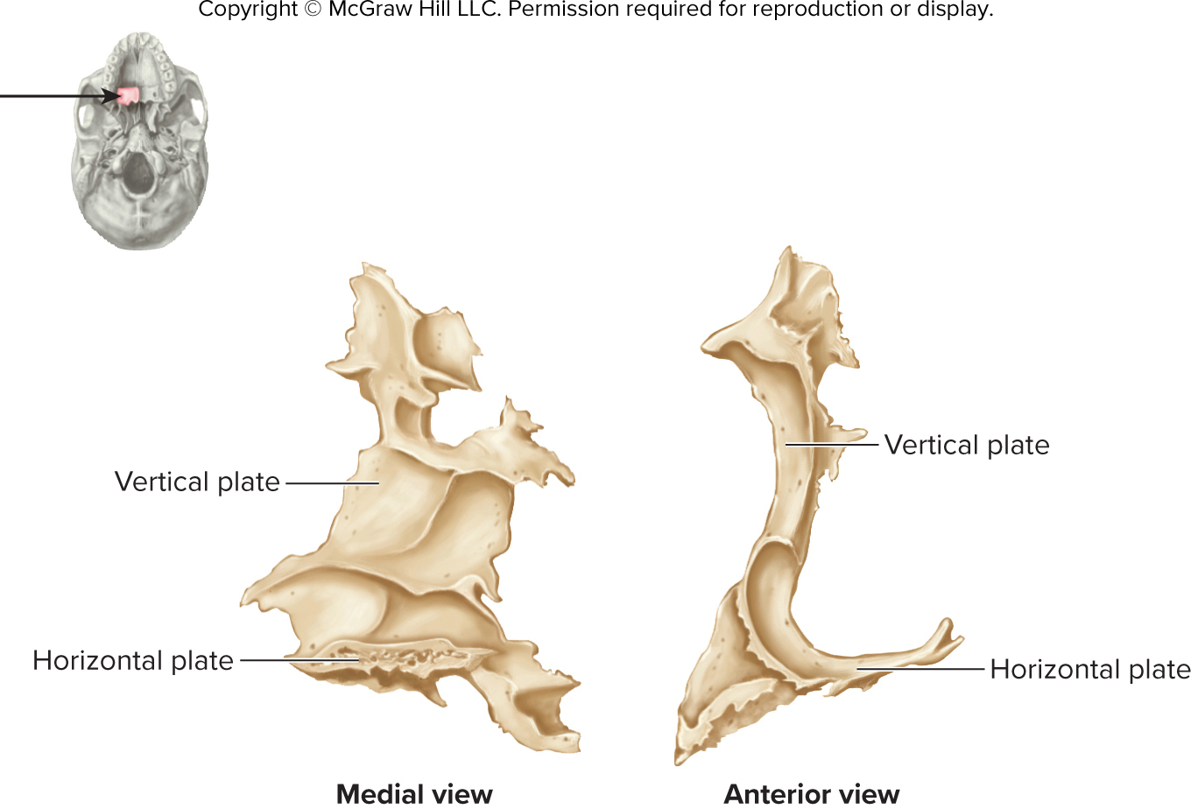
ta 7.02c

Slide 42
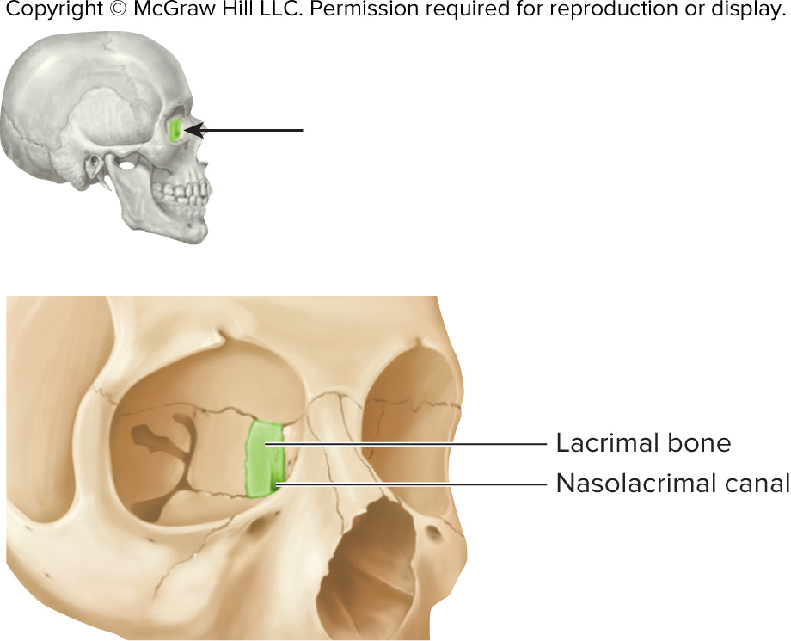
ta 7.02d

Slide 43
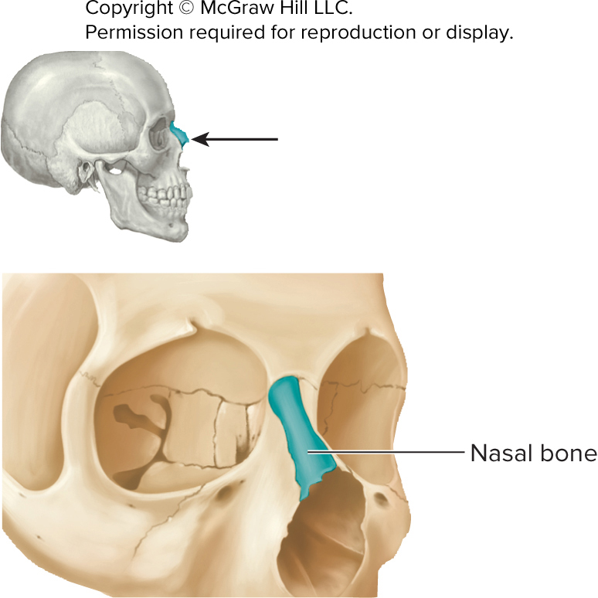
ta 7.02e

Slide 44
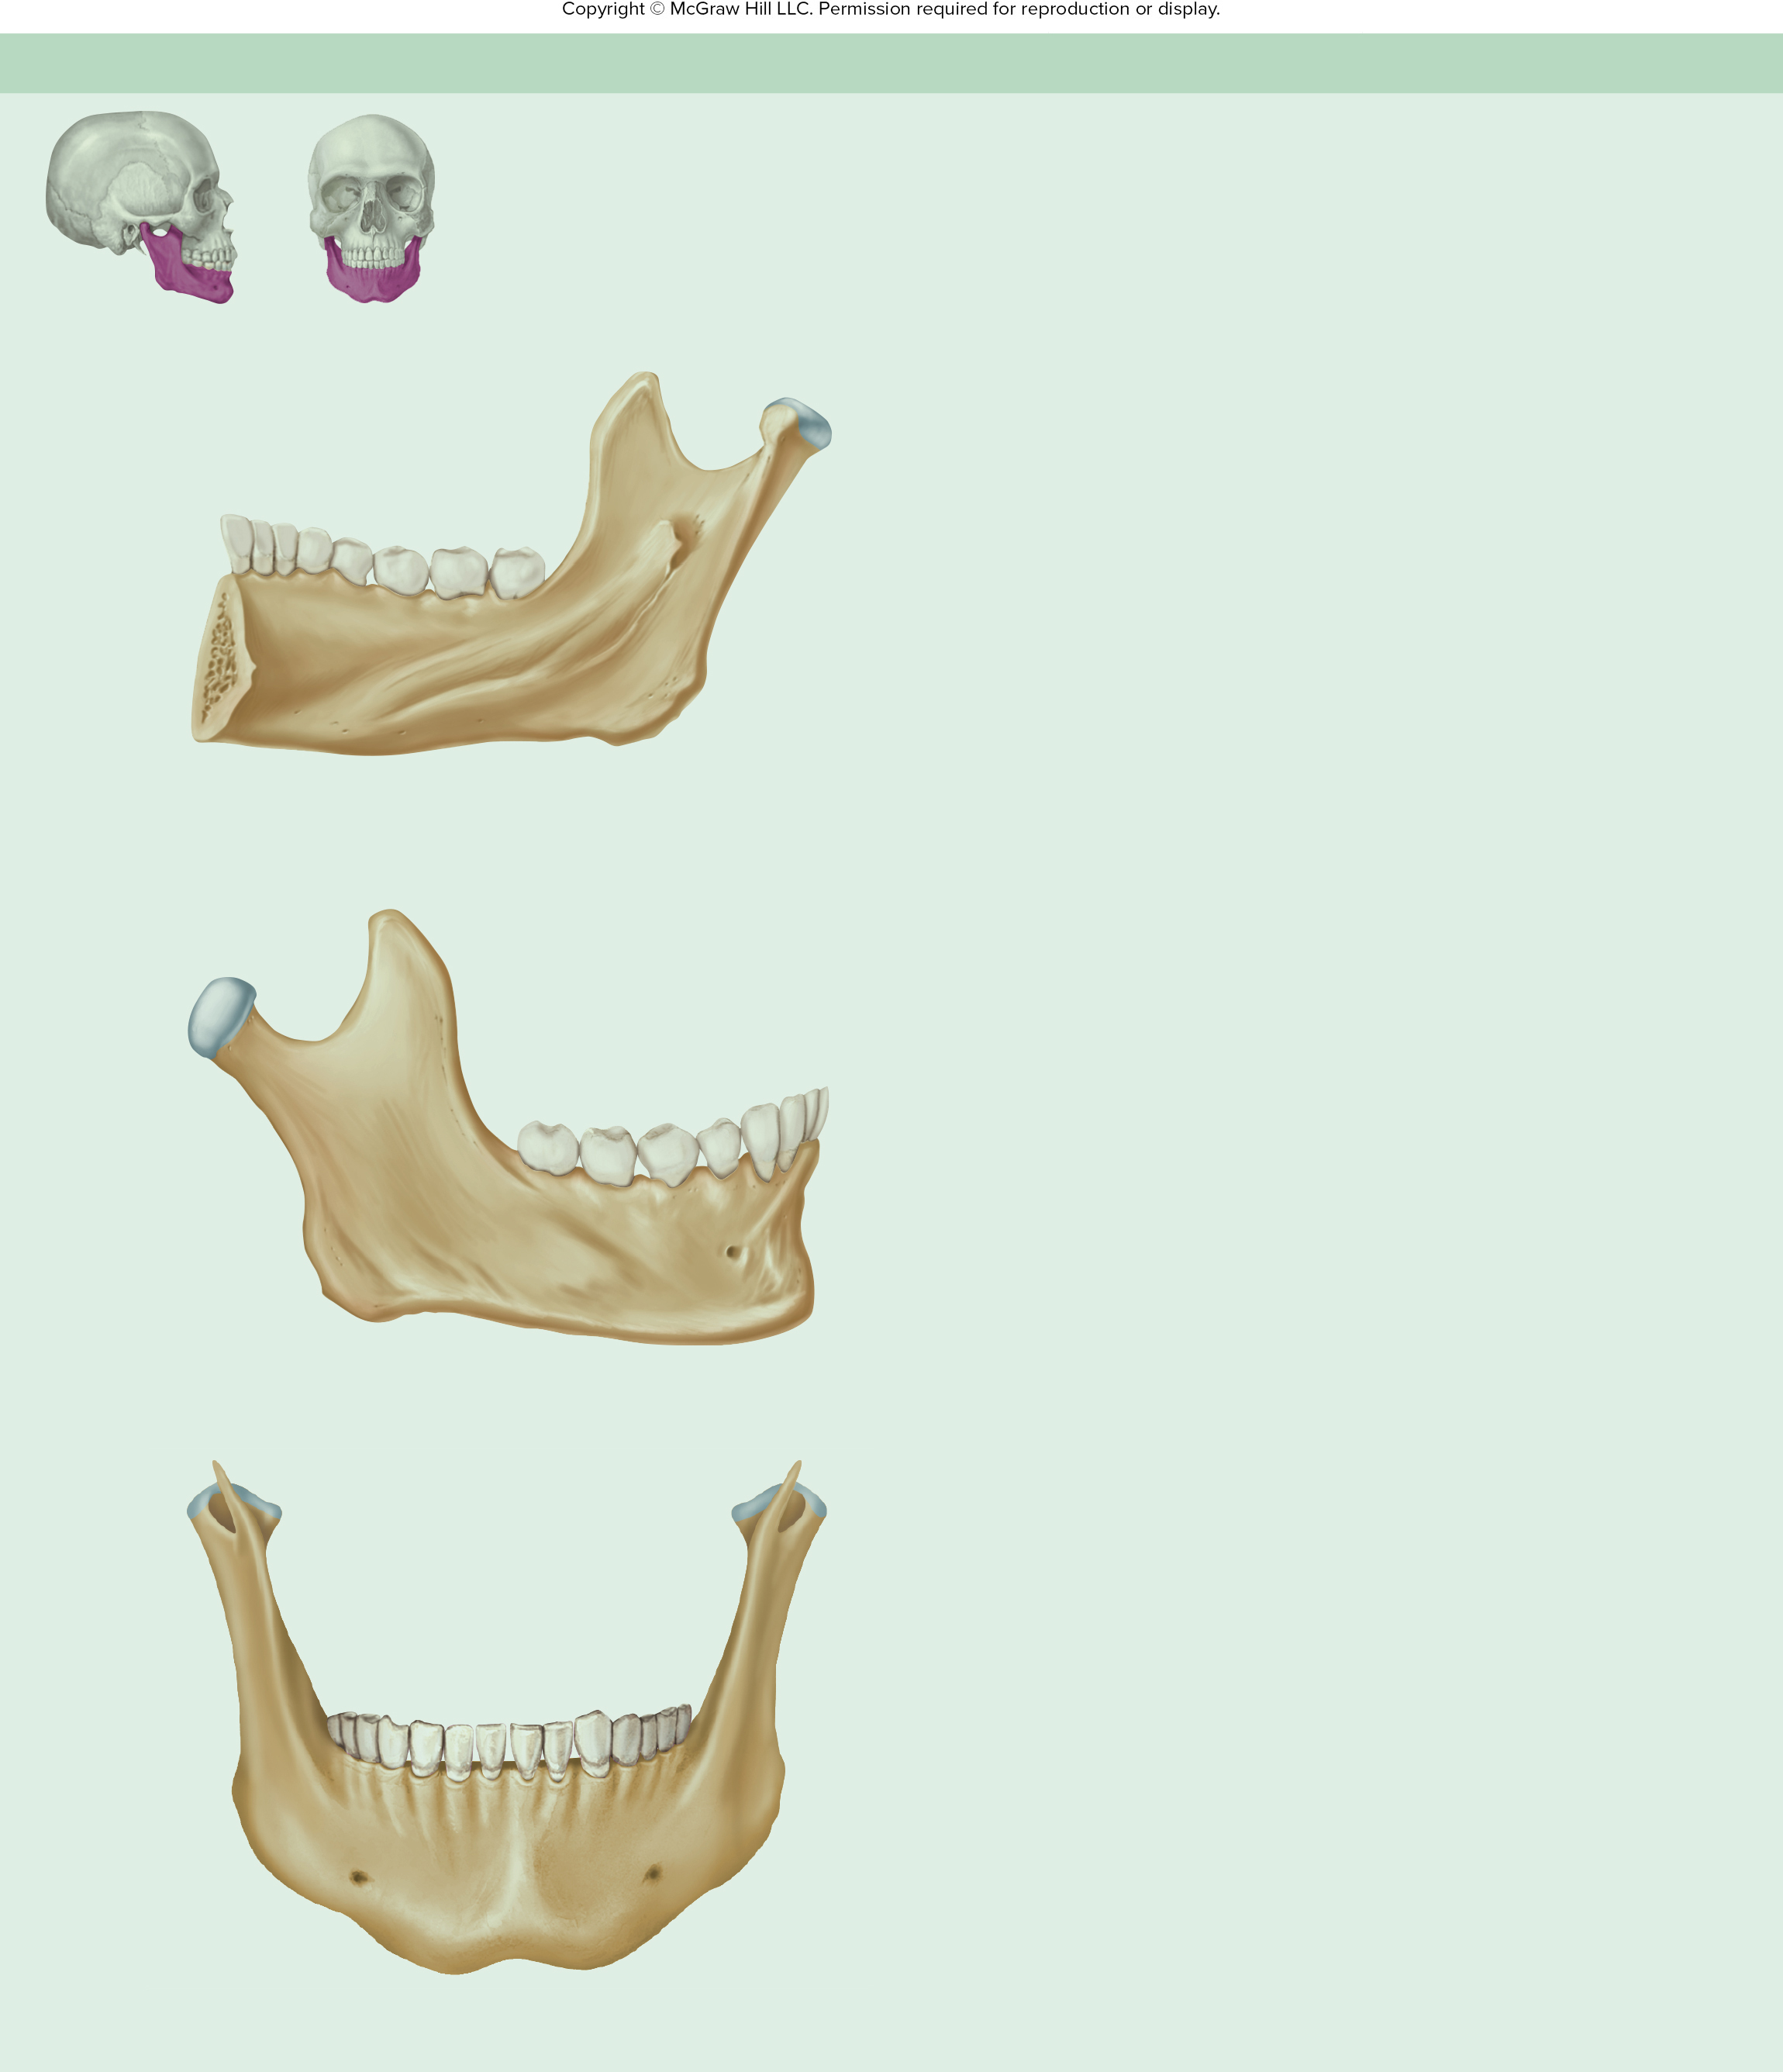
Table 7.8cont03
TABLE 7.8
Facial Bones of the Skull—Continued
(f) Mandible (Right Half)—Anterior, Medial, and Lateral Views
Landmark
Description
Coronoid process
Alveolar process
Ridge containing the teeth
Angle
Corner between the body
and ramus
Molars
Mandibular notch
Body
Major, horizontal portion of
the bone
Premolars
Mandibular
condyle (head)
Condylar process
Extension containing the
mandibular condyle
Canine
Condylar process
Coronoid process
Attachment for a muscle of mastication
Incisors
Ramus
Mandibular foramen
Mandibular condyle
Helps form the temporo-
mandibular joint (the point
of articulation between the mandible and the rest of
the skull)
Lingula
Alveolar
process
Mandibular foramen
Opening through which nerves and vessels to the mandibular teeth enter the bone
Mylohyoid line
Body
Medial view
Angle
Mandibular notch
Depression between the
condylar process and the
coronoid process
Mandibular notch
Coronoid process
Mental foramen
Opening through which a nerve and vessels exit the mandible
to the skin of the chin
Mandibular condyle
Molars
Condylar process
Premolars
Mylohyoid line
Attachment point of the
mylohyoid muscle
Canine
Oblique line
Ridge from the anterior edge
of the ramus onto the body of the mandible
Oblique line
Incisors
Ramus
Alveolar
process
Body
Ramus
Major, nearly vertical portion
of the bone
Angle
Mental foramen
Special Features
Lateral view
The only bone in the skull that is freely movable relative to the rest of the skull bones
Holds the lower teeth
Body
Mental foramen
Anterior view

Slide 45
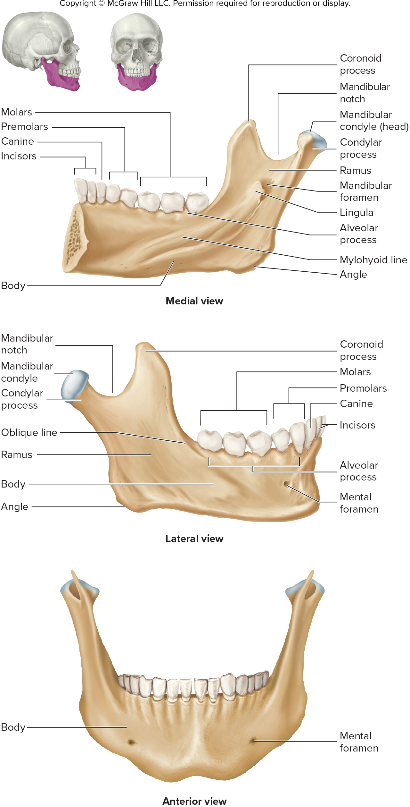
ta 7.02f

Slide 46
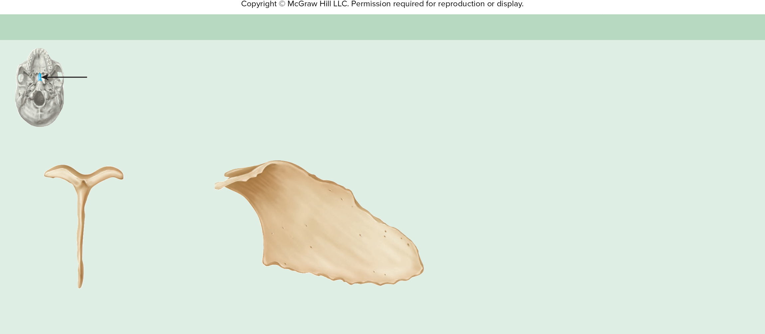
Table 7.8cont04
TABLE 7.8
Facial Bones of the Skull—Continued
(g) Vomer—Anterior and Lateral Views
Landmark
Description
Alae
Attachment points between the vomer and sphenoid
Vertical plate
Forms part of the nasal septum
Alae
Special Feature
Forms most of the posterior and inferior portions of the nasal septum
Alae
Vertical plate
Vertical plate
Anterior view
Lateral view

Slide 47
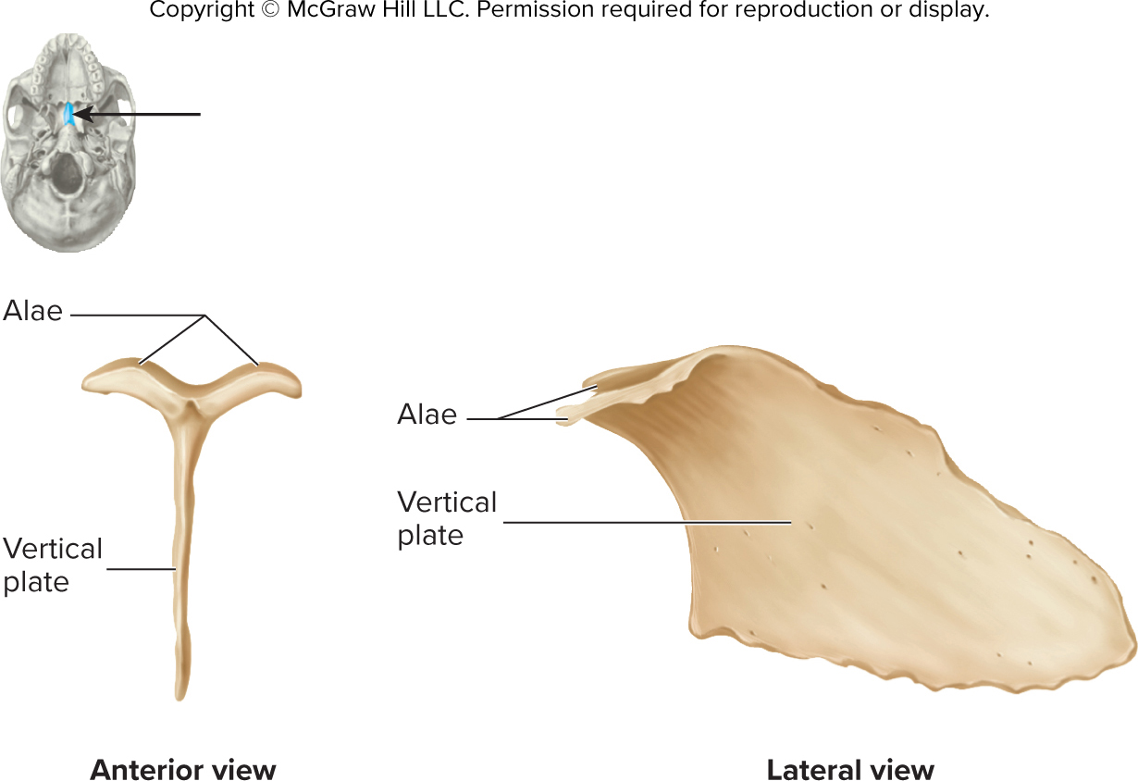
ta 7.02g

Slide 48
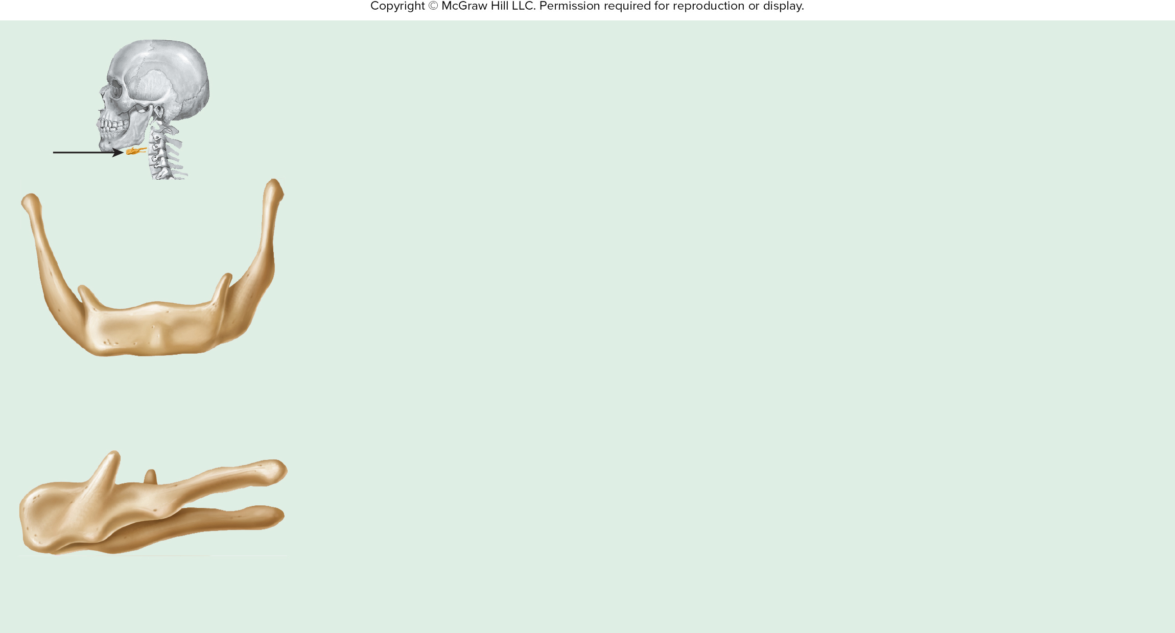
Table 7.9
TABLE 7.9
Hyoid Bone—Anterior and Lateral Views
Landmark
Description
Body
Major portion of the bone
Greater horn
Attachment point for muscles and ligaments
Lesser horn
Attachment point for muscles and ligaments
Special Features
Greater horn
The only bone in the body that does not articulate with another bone
Attached to the skull by muscles and ligaments
Lesser horn
Body
Anterior view
Lesser horn
Greater horn
Body
Lateral view
(from the left side)

Slide 49
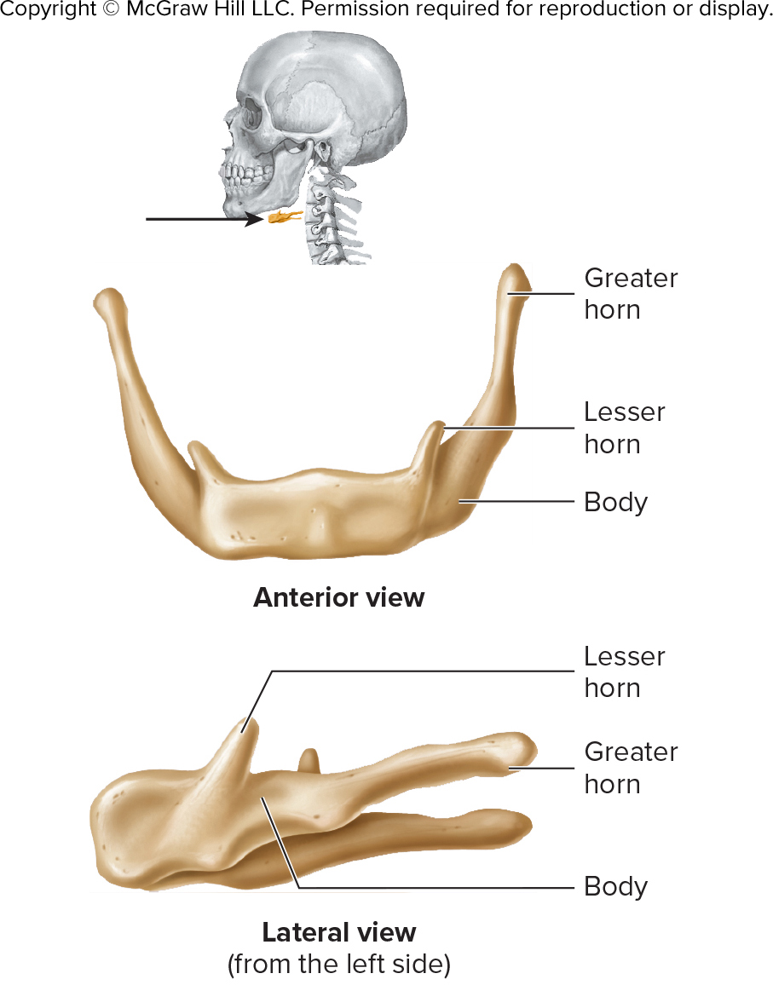
ta 7.03

Slide 50
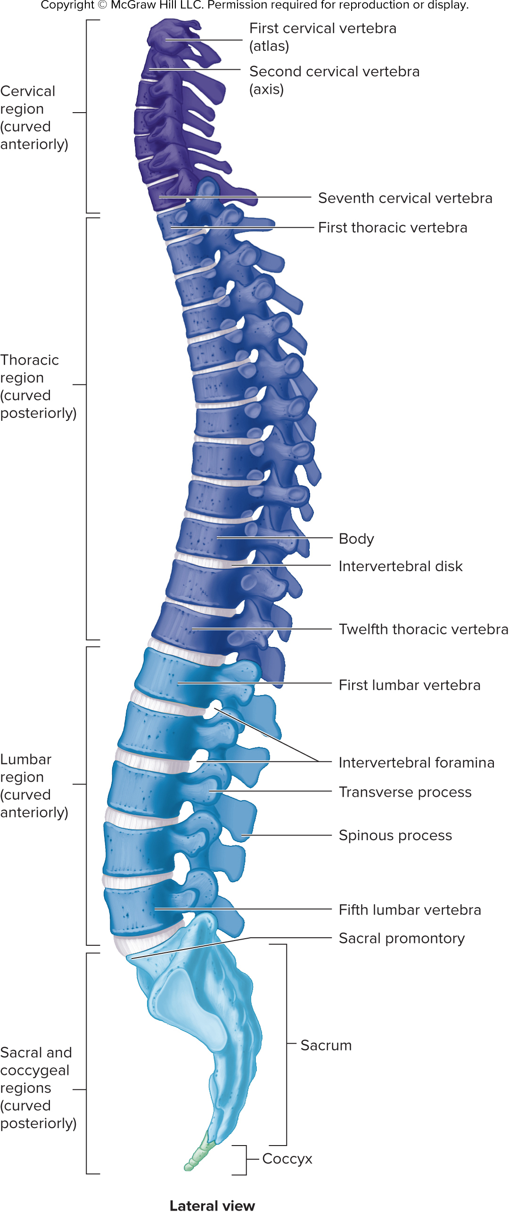
Figure 7.14

Slide 51
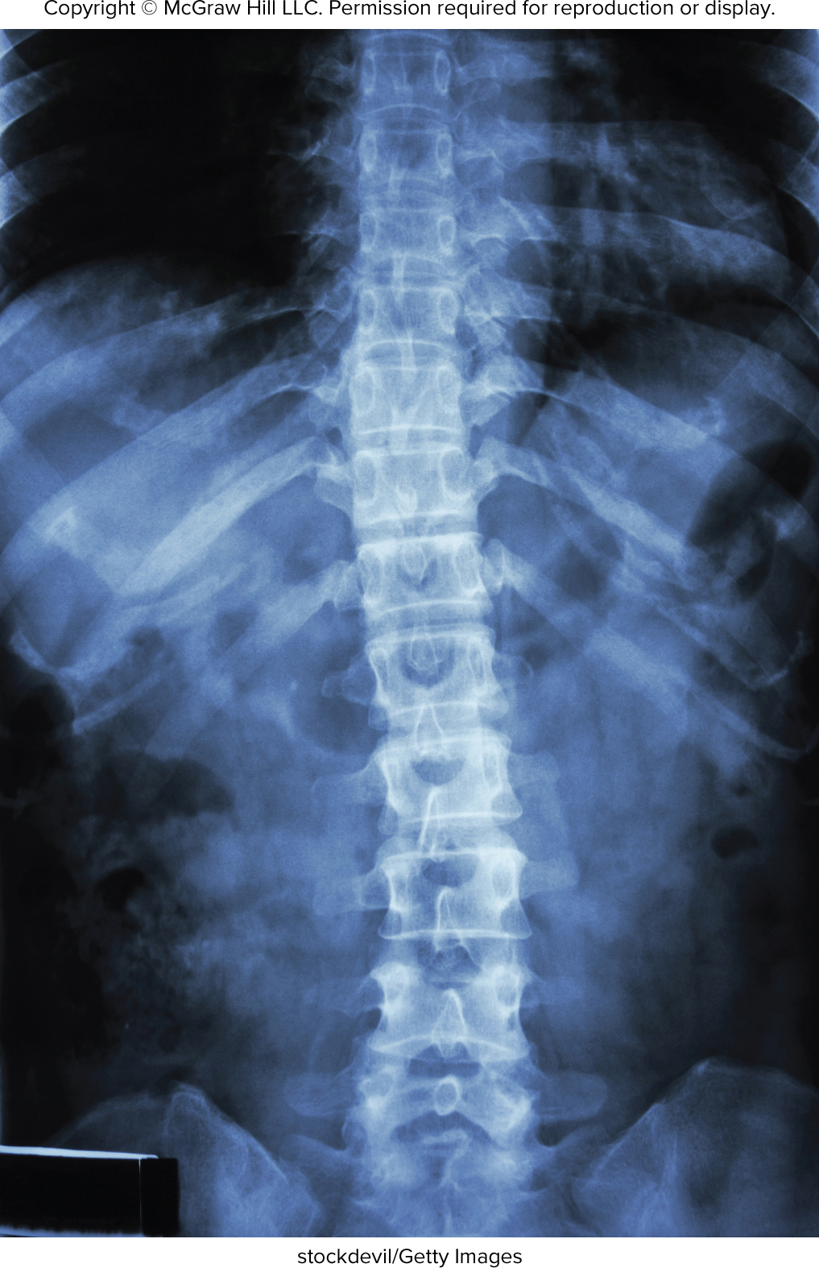
Figure 7.15

Slide 52
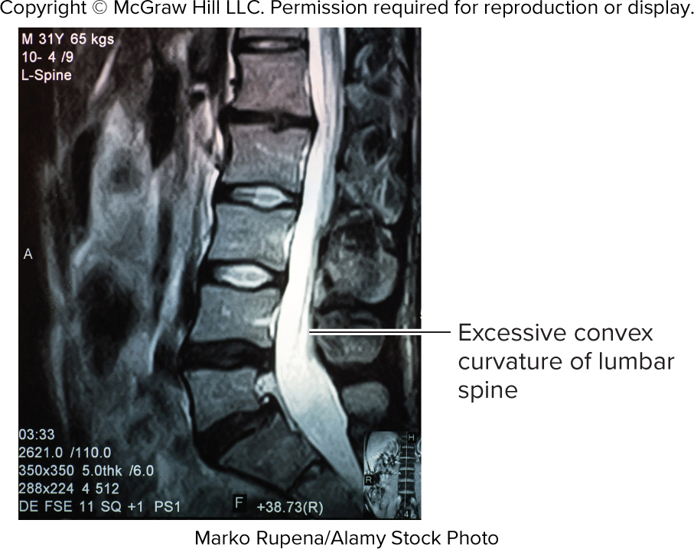
Figure 7.16

Slide 53
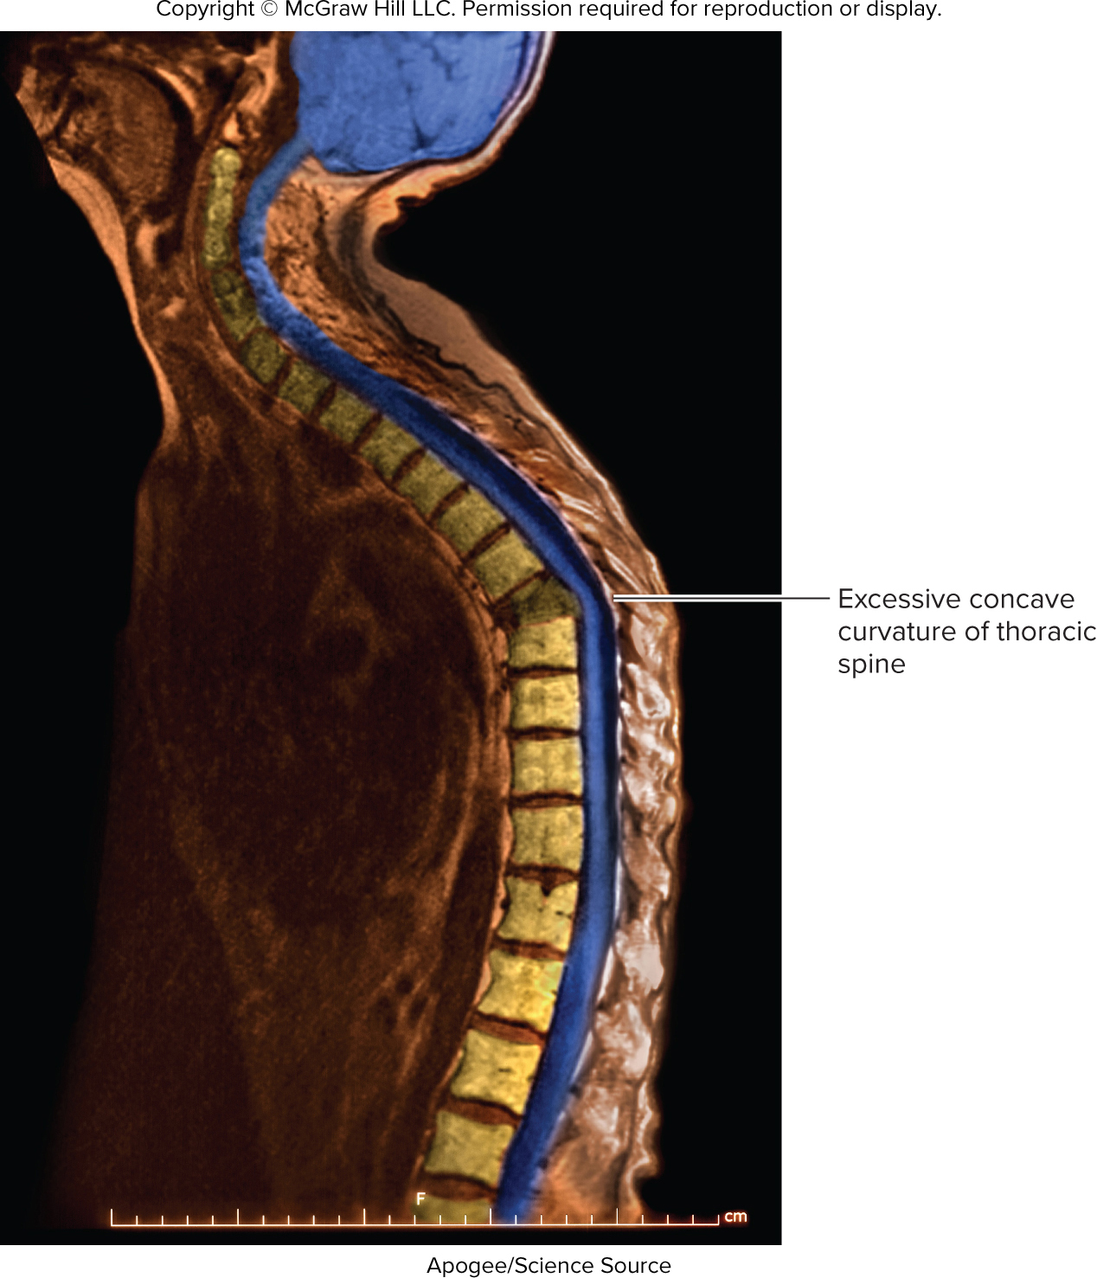
Figure 7.17

Slide 54
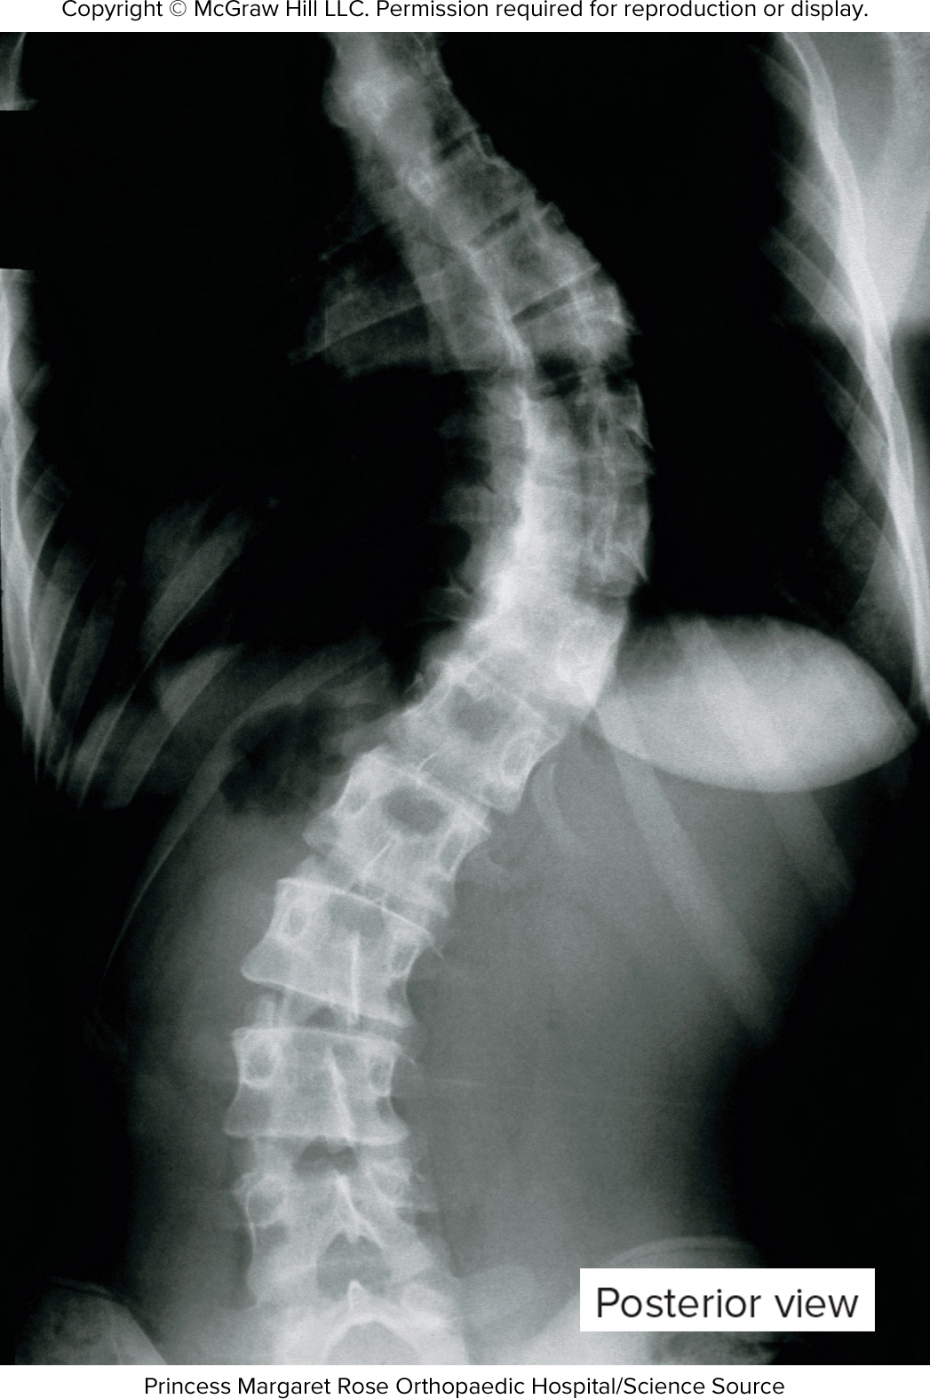
Figure 7.18

Slide 55
Table 7.10
TABLE 7.10
General Structure of a Vertebra
Feature
Description
Body
Disk-shaped; usually the largest part with flat surfaces directed superiorly and inferiorly; forms the anterior wall of the ver-
tebral foramen; intervertebral disks are located between the bodies
Vertebral foramen
Hole in each vertebra through which the spinal cord passes; adjacent vertebral foramina form the vertebral canal
Vertebral arch
Forms the lateral and posterior walls of the vertebral foramen; possesses several processes and articular surfaces
Pedicle
Foot of the arch with one on each side; forms the lateral walls of the vertebral foramen
Lamina
Posterior part of the arch; forms the posterior wall of the vertebral foramen
Transverse process
Process projecting laterally from the junction of the lamina and pedicle; a site of muscle attachment
Spinous process
Process projecting posteriorly at the point where the two laminae join; a site of muscle attachment; strengthens the verte-
bral column and allows for movement
Articular processes
Superior and inferior projections containing articular facets where vertebrae articulate with each other; strengthen the vertebral column and allow for movement
Intervertebral notches
Form intervertebral foramina between two adjacent vertebrae through which spinal nerves exit the vertebral canal
Articular facet
Posterior
Body
(cut)
Spinous process
Superior articular process
Lamina
Part of
vertebral
canal
Transverse process
Vertebral arch
Pedicle
Intervertebral
disk
Vertebral foramen
Body
Vertebral
foramina
Spinous
process
(cut)
Anterior
(a) Superior view
(b) Lateral view, sagittal section
Anterior
Posterior
Superior articular process
Anterior
Posterior
Transverse process
Inferior intervertebral notch of superior vertebra
Pedicle
Intervertebral
foramen
Inferior articular process of superior vertebra
Space for
intervertebral disk
Superior intervertebral
notch of inferior vertebra
Superior articular process of inferior vertebra
Spinous processes
Body
(c) General features, lateral view
(d) Intervertebral features, lateral view

Slide 56
ta 7.04

Slide 57
Figure 7.19

Slide 58
Figure 7.20

Slide 59
Figure 7.21

Slide 60
Figure 7.22

Slide 61
Table 7.11
TABLE 7.11
Comparison of Vertebral Regions
Feature
Cervical
Thoracic
Lumbar
Superior articular process
Superior articular facet
Superior articular process
Transverse process
Facets for rib articulation
Transverse process
Body
Body
Body
Transverse process
Transverse foramen
Inferior articular facet
Spinous process
Spinous process
Spinous process
Inferior articular facet
Body
Absent in C1, small in others
Medium-sized with articular facets for ribs
Large
Transverse process
Transverse foramen
Articular facets for ribs, except T11 and T12
Square
Spinous process
Absent in C1, bifid in others, except C7
Long, angled inferiorly
Square
Articular facets
Face superior/inferior
Face obliquely
Face medial/lateral

Slide 62
ta 7.05

Slide 63
Figure 7.23

Slide 64
Figure 7.24

Slide 65
Figure 7.25

Slide 66
Figure 7.26

Slide 67
Figure 7.27

Slide 68
Figure 7.28

Slide 69
Figure 7.29

Slide 70
Figure 7.30

Slide 71
Figure 7.31

Slide 72
Figure 7.32

Slide 73
Figure 7.33ab

Slide 74
Figure 7.33cd

Slide 75
Figure 7.34

Slide 76
Figure 7.35

Slide 77
Figure 7.36

Slide 78
Figure 7.37

Slide 79
Figure 7.38

Slide 80
Table 7.12
TABLE 7.12
Differences Between the Male Pelvis and the Female Pelvis (see figure 7.41)
Area
Description
General
In females, somewhat lighter in weight and wider
laterally but shorter superiorly to inferiorly and
less funnel-shaped; less obvious muscle attach-
ment points in females
Sacrum
Broader in females, with the inferior part directed more posteriorly; the sacral promontory does
not project as far anteriorly in females
Pelvic inlet
Heart-shaped in males; oval in females
Pelvic outlet
Broader and more shallow in females
Subpubic angle
Less than 90 degrees in males; 90 degrees or
more in females
Ilium
More shallow and flared laterally in females
Ischial spines
Farther apart in females
Ischial tuberosities
Turned laterally in females and medially in males

Slide 81
Figure 7.39

Slide 82
Figure 7.40

Slide 83
Figure 7.41

Slide 84
Figure 7.42

Slide 85
Figure 7.43

Slide 86
Figure 7.44

Slide 87
Figure 7.45

Slide 88
Figure 7.46

Slide 89
Figure 7.47

